Slide 1
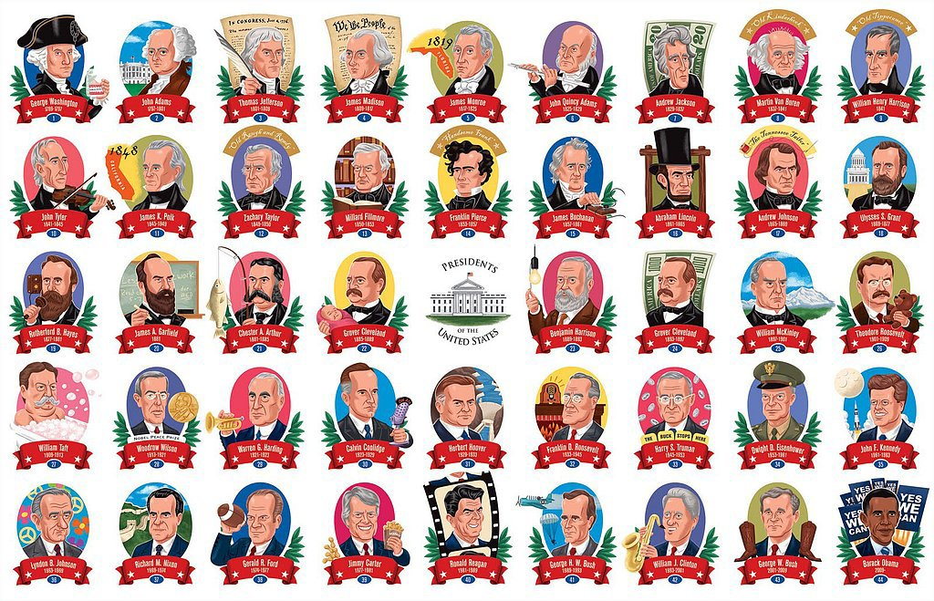
The President of the USA
The Executive Branch
Notes:
https://www.youtube.com/watch?v=oc3xTj3g9QQ

Slide 2
The Powers of the President
As the only person elected by all Americans, Presidents have enormous power. In particular, popular Presidents with a like-minded Congress, have used their support to increase their power.
After the 9/11 attacks, Bush extended the power of the Presidency by creating the Department of Homeland Security. In order to fight terrorism, Bush argued, it was necessary for the President to have greater powers of surveillance, arrest and detention. But with the passing of the Patriot Act (2001), some commentators argued that Presidential power had gone too far as this Act gave the Attorney General the power to arrest anyone the authorities suspected of terrorism even if the courts disagreed.
Note: In 2005, Congress refused to renew some parts of the Patriot Act although much of it remains in place today.

Slide 3
The Powers of the President
Article 11 of the US Constitution defines the powers of the US President. It states those powers the President can use without Congressional approval and those where he must seek Congressional approval.
1. Commander-in-Chief of the armed forces. Presidents have the responsibility for defending the USA (response to ISIS) including ordering troops overseas. However, only Congress can declare war e.g. in Iraq or Afghanistan. Treaties must also be approved by the Senate.
2. Power of appointment. The President appoints thousands of people to help run the country. These include members of the US Cabinet (e.g. Sec. of State John Kerry, etc.). However, nominations for overseas ambassadors and Supreme Court judges (Sonia Sotomayor ) must have the approval of the Senate.

Slide 4
The Powers of the President
3. Legislative Power
Every January the President speaks to Congress in the State of the Union Address. As well as reviewing the previous year, the President outlines spending plans and any proposals for legislation. Note: Presidents cannot introduce legislation, only members of Congress have this right. Congress also controls the budget.
4. Power of veto. Before legislation becomes law, Bills must be signed by the President. If, however, the President disagrees with a new law he can refuse to sign e.g. Bush vetoed Stem Cell Research Bill 2006, Child Health Bill 2007 and ban on water torture 2008.
Note: Congress has power to override the Presidential veto if a Bill is passed by two-thirds of the representatives of both Houses.

Slide 5
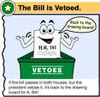
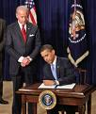
The Powers of the President
Powers of the President continued
Pocket veto. A ‘pocket veto’ or indirect veto is where a Bill remains unsigned by the President and there is insufficient time (i.e. less than 10 days before Congress adjourns) for Congress to reject the Presidential veto. Example: Obama returned a Bill unsigned to increase defence spending in 2009.
5. Executive Orders (EOs). The President can bypass Congress on certain occasions by issuing Executive Orders. EOs, in effect, allow the President to makes laws without Congressional approval. Under Bush, 262 Eos were issued. Obama has already issued a number of EOs including a review of the Guantanamo detainees and the ending unlawful interrogation techniques. Note: Congress can impeach or remove a President if they suspect any wrongdoing although use of this power this is very rare.

Slide 6
The Powers of the President Task
Find real-life examples of the following for Clinton, W. Bush, Obama and Trump:
Presidential Commander in Chief orders (Bush war on terror? Obama orders Osama dead?)
Presidential Appointments
Presidential Vetoes/Pocket Vetoes
Presidential Executive Orders
Try to include detail as you will use these examples in essays!

Slide 7
Impeachment Process
This is the process by which the Congress may remove the President or a Federal Judge for MISCONDUCT.
It is a long process that has been used sparingly (only ever 7 judges impeached successfully)

Slide 8
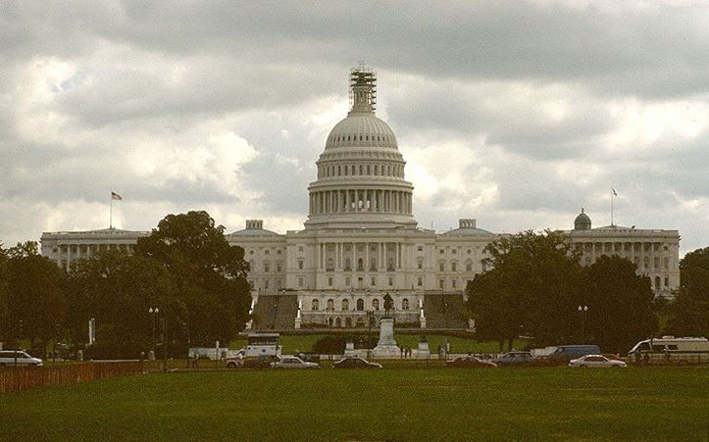
Impeachment Process
The House of Representatives pass a vote to begin impeachment hearings against a President or Judge for high crimes and misdemeanours
Senate must then try the President & vote on it.
The charge of high crimes and misdemeanours covers allegations of misconduct peculiar to officials, such as perjury of oath, abuse of authority, bribery, intimidation, misuse of assets, failure to supervise, dereliction of duty, unbecoming conduct, and refusal to obey a lawful order.
Notes:
Explain the term High Crimes and Misdemeanours. You may want to draw on the students British experience hear by asking them the ways in which a PM can be removed. It will be relevant later.

Slide 9
Only 3 Presidents have ever been in danger of being impeached.
Andrew Johnson 1868 - to do with leftover issues from the Civil War. Survived by 1 vote
Richard Nixon 1974 – Watergate scandal, process set in motion but resigned before the final vote.
The HoR voted to impeach Clinton in 1998 → Senate trial found him not guilty by 55-45 votes
Notes:
I would let students navigate through each of these. You will get a chance to discuss the cases with them during the accompanying exercises.

Slide 10
Richard M. Nixon was the only President not to survive the Impeachment process after being charged with “high crimes and misdemeanours”.
He had been involved in a cover-up of a break-in at the headquarters of the Democratic National Committee at Watergate. This unearthed a widespread dirty tricks campaign by Republicans against democrat opponents, much of which included illegal activities.
The Congress never had to complete the impeachment process as Nixon, realising that he would not survive, preferred to resign rather than prolong the humiliating process.
Click here to be taken to a BBC website on Nixon
Nixon's resignation
The Watergate Scandal

Slide 11
Like Andrew Johnson, Bill Clinton was subjected to charges that were more politically motivated than anything to do with ‘high crimes and misdemeanours’. Ironically, much of the finance for the case against him came from ex-members of the disgraced Nixon administration.
There was a trial on whether or not to impeach but Clinton was spared by a 55-45 vote.
It is a measure of the charge against him, that he won through in the midst of a Republican dominated Congress.
Click here to be taken to a BBC website on Clinton
Clinton's impeachment process

Slide 12
COMPARISON
Parliament can bring down the Executive much more easily in Britain than in the USA:
vote of no-confidence
change in party leader
Last happened to PM James Callaghan in 1979
Separation of Powers prevents this occurring in US government.
Notes:
Here you shall make the key point that the PM CAN be removed for political motives by the other branches of government.

Slide 13
US President -The most powerful person in the world?
After 2006 midterm election George Bush was referred to as…
…a lame duck!
President Johnson - ”the only power I’ve got is nuclear, and I’m not allowed to use that”
Barack Obama: a lame duck for last two years of his Presidency.
The men who invented the presidency did not wish to create a ruler.
Instead they hoped to create the conditions where leadership might from time to time flourish.
A ruler commands; a leader influences. A ruler wields power; a leader persuades others to follow their ideas

Slide 14
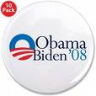
A joint ticket

Slide 15
Vice President John Nance Gardner
Garner once described the vice presidency as being:
"not worth a bucket of warm piss”
However, modern day Vice Presidents do have a much greater role than in the past

Slide 16
Key roles of the Vice President
Presiding officer of the senate
Has the power to break a tie vote (50-50) in the senate
Becomes President on the death, resignation or removal of the President
Becomes acting President if the President is declared, or declares, himself disabled

Slide 17
The President’s Cabinet
The Executive Power shall be vested in a President of the United States of America.

Slide 18
President v PM
US President | UK PM
Is elected by the people in a national election (E.g. Obama in 2008 and 2012) | Is elected by the party as its leader - no national election (leader of biggest party after a General Election usually becomes PM, e.g. David Cameron is leader of Conservatives, Conservatives won most seats in 2015 election, therefore David Cameron is PM)
Cannot choose election date (always in November every 4 years) | Usually able to choose election date (although must now be every 4 years)
Is subject to 2 term limit (two 4 year terms, e.g. Obama, Bush) | Is not subject to term limits (e.g. Tony Blair, 1997-2010)
Is not a member of the legislature (elected separately) | Is leader of the majority party in parliament
Role of chief executive and head of state combined in one person | Roles of chief executive and head of state are performed by different persons
Singular executive | Collective executive

Slide 19
Cabinet - UK v USA
USA | UK
Drawn from range of areas - cannot be serving members of legislature (Congress) | Drawn exclusively from legislature (Parliament)
May contain people from the ‘opposition’ (unusual though) | All belong to one political group (party or coalition)
Members have no political base | PM is ‘first among equals’
Members are not rivals of the President | Members are potential rivals of PM (e.g. Iain Duncan Smith resigned from UK Government Cabinet)
Not a common route to the presidency | Usual route to becoming PM
Tend to be policy specialists | Tend to be policy generalists

Slide 20
Relations with legislature
President relations with Congress | PM relations with parliament
President is not a member of congress | PM is a member of parliament (MP)
President’s party may be in minority in one or both chambers | PM is the leader of the majority in parliament
President has few sticks or carrots | PM has extensive stick or carrots
Congress has significant checks on president (see checks and balances) | Parliament has few checks on PM
President cannot dissolve the legislature | PM can dissolve the legislature
Low levels of party discipline (representatives may be more loyal to their constituents than they are to their party) | High levels of party discipline (representatives usually vote in line with party policy, all though not always)
President can be removed by Congress via impeachment if a crime has been committed | Parliament can remove the government by a no confidence vote

Slide 21
New Style Higher - 2015

