Slide 1
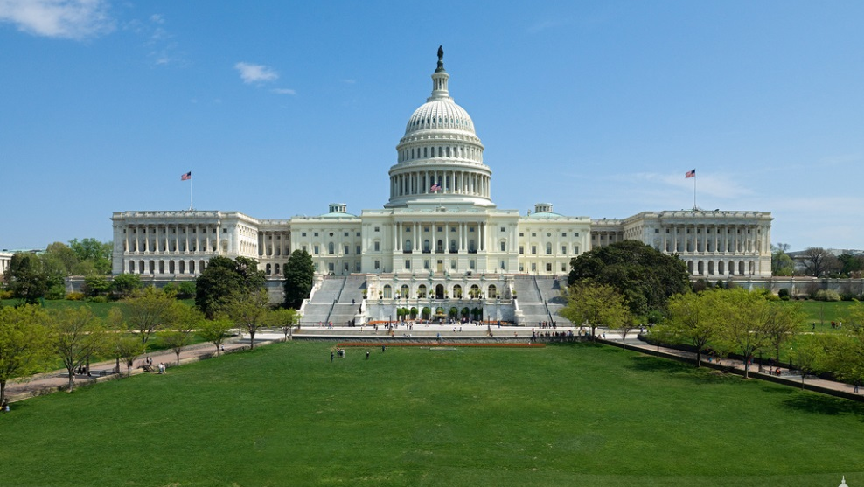
Scrutiny in the USA

Slide 2
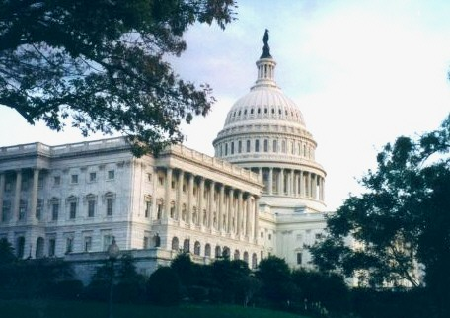
Government Scrutiny
Like the UK, most scrutiny of the executive is carried out by the legislative branch.
As well as its legislative role, one of the most important functions of Congress is to investigate and oversee the EXECUTIVE.
There are also other ‘outside’ factors which contribute to scrutinising the executive

Slide 3
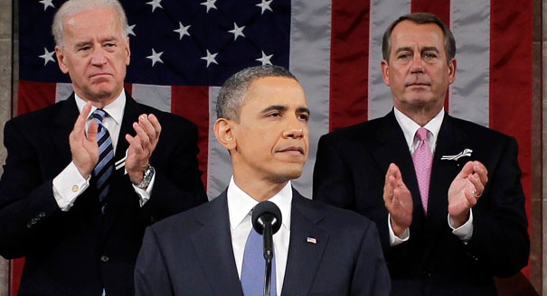
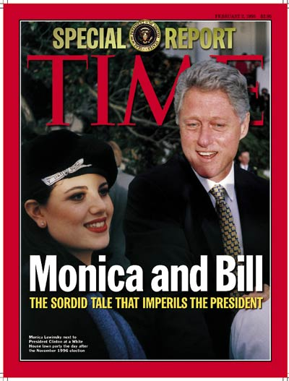
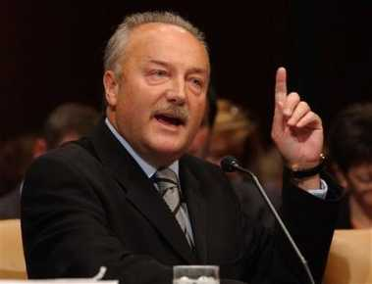
U.S. Congress
Congress can scrutinise the Executive & government through its Committees
Importantly, Congress also has the exclusive power of removal – of the President (impeachment), federal judges and other federal officers.

Slide 4
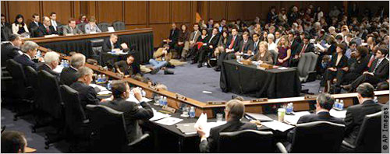
US Government Scrutiny
1 – Congressional Committees
Committees have a wide range of powers to call witnesses and see papers – Freedom of Information Act ensures the right to see official documents
Like the UK there are different types of committees in the USA, select committees and standing committees
Generally, a committee’s job is to investigate and oversee the executive
Committees tend to focus on a particular area i.e. Defence Spending committee
Crash Course - Committees

Slide 5
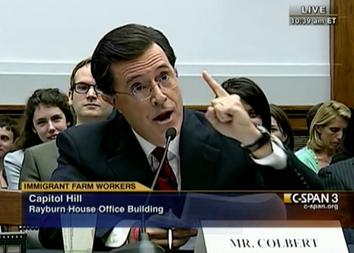
US Government Scrutiny
It could be argued that standing committees in the US have more power at the legislative process as they can ‘kill a bill’ .
For example, (Former) MP George Galloway was called before a senate committee over allegations of oil trading with Saddam Hussein
Comedian Stephen Colbert gave advice to a congressional committee after highlighting immigration on his TV show

Slide 6
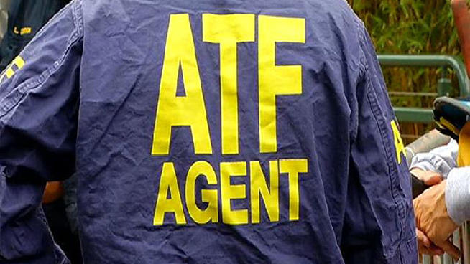
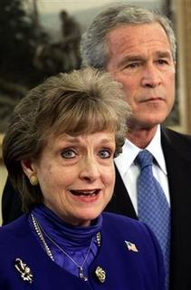
Government Scrutiny
2 – Senate approval
One important function of the executive is to be able to appoint Government members to help run the executive branch i.e. The President selects the US Defence Secretary
The President also has the power to select members of the SUPREME court if a position becomes available (as well as appoint the VP)
However, the SENATE can scrutinise any appointment as all appointees are subject to senate approval
The Senate therefore has the power to block presidential appointments or force the President to nominate someone else.
For example, Obama struggled to appoint a head to the ATF ( a federal agency) for over 6 years as his nominations were consistently blocked by the senate
President G. W. Bush had to back down from deciding to nominate Harriet Myers (head of Texas gaming commission) as a supreme court judge after outrage from Congress

Slide 7
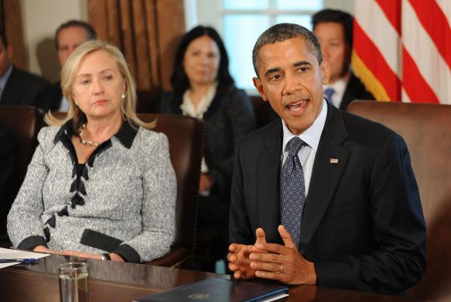
Government Scrutiny
3 – No ‘collective responsibility’
Unlike the UK, the US executive has no doctrine of ‘collective responsibility’
In the UK cabinet ministers are expected to ‘toe the party line’ and ‘stick together’ (most of the time)
In the USA scrutiny can come from within – as US cabinet ministers are responsible for their own dept, they can be much more frank with each other than the UK
For Example, the Obama administration stalled with differences relating to Israel
Former Defence Secretary Chuck Hagel was critical of Obama on Iraq and Syria
Republican state governors and members of Congress can/are openly critical of Donald Trump – for example over his pardoning of Sheriff Joe Apario
Republicans criticise Trump over pardon
GoP splintering

Slide 8
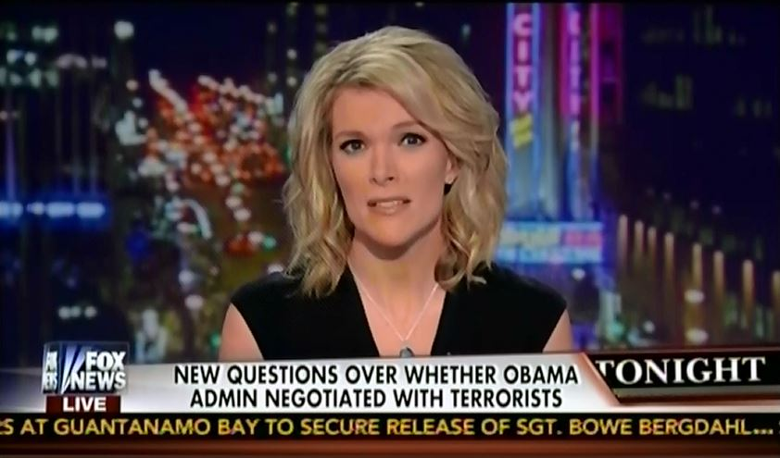
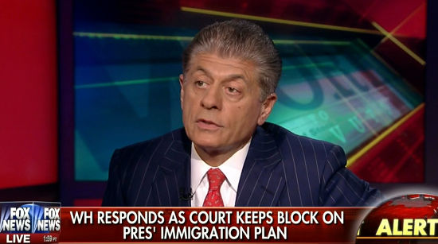
Government Scrutiny
4 – Publicity/Media
This relates to congress in that important congressional hearings can receive a lot of publicity
This in turn can lead to intense media scrutiny of the government over certain issues.
The network ‘c-span’ is dedicated to reporting on congressional and political matters
For example, FOX news was fiercely critical of President Obama, particularly over his healthcare plan and immigration reforms
https://www.youtube.com/watch?v=CwQZbQ54iOo

Slide 9
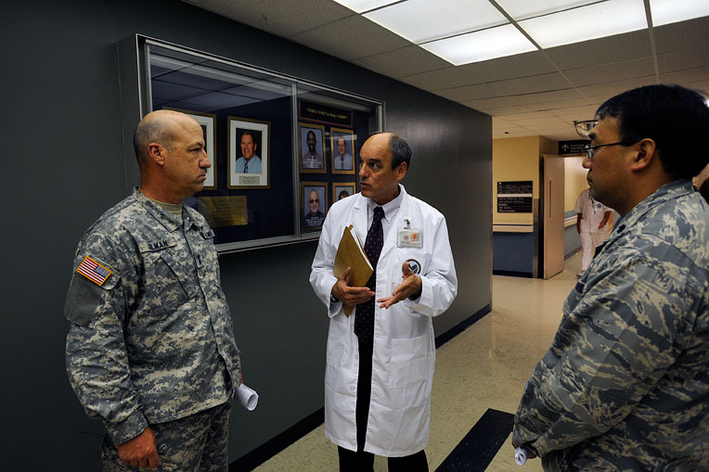
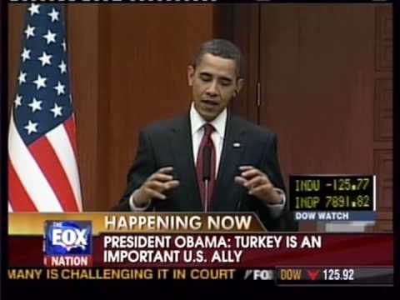
Government Scrutiny
4.5 - Public officials
In the UK, public officials and the civil service are ‘A- political’ meaning that they don’t and aren’t supposed to demonstrate any political allegiance
However, in the USA public officials are freer to express their views and demonstrate political opinion.
This allows more open criticism even from within
Unlike the UK civil service, USA officials will be members of a political party i.e. The dog catcher may be a Democrat whereas the governor of the water board may be a Republican.
For Example, many public officials have been openly critical about issues surrounding the US VA (dept of Veteran Affairs)
Obama was openly criticised by some officials over his comments regarding the Armenian Genocide

Slide 10
Task 1: Comparing Committees in UK and US
You will receive a hand-out comparing the Committee systems in the UK and US.
Learn the key differences between scrutiny in the UK and US.
In your opinion, which system is better? Explain your answer using examples.
Task 2: Comparing Scrutiny
Having looked at scrutiny of the executive in the UK and the USA draw up your own comparison table, like the one you were handed out for committees. Include: Questions, debates, Legislation process (UK) and Senate approval, Lack of collective responsibility, media/publicity and public officials (USA).

