Slide 1
5 sentence summary
Read the article linked on the blog about Brexit.
Create a 5 sentence summary of the article in your notes.
Be precise and factual in your summary

Slide 2
3. Scrutiny
What do you think this word means????
Notes:
Might be useful to get class to copy in a definition.

Slide 3
Scrutiny of Government
Andrew Heywood argues that the legislative and representative role of assemblies have declined in significance in recent years, while their roles as scrutinising bodies have grown.
Scrutiny of government can take place in the chamber of an assembly, but more importantly through committee systems, oversight of the appointment of government members and through questioning the executive.

Slide 4
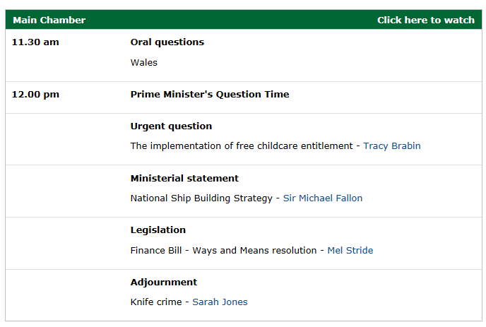
Scrutiny of UK Government
The Westminster Parliament examines and challenges the work of the government in both the HoCs and HoLs.
Both the House of Commons and the House of Lords use similar methods of scrutiny, although the procedures vary.
The principal methods are questioning government ministers, debating and the investigative work of committees.
The government can publicly respond to, explain and justify policies and decisions through these methods of scrutiny.

Slide 5
Questions
Questions to government ministers may be answered orally or in writing.
Ministers from each government department attend the Commons on a rota basis to answer oral questions.
The Prime Minister answers questions every Wednesday (PMQs/PMQT)
In the Lords, the House questions government ministers at the start of each day’s business, but there are no set days for government departments.

Slide 6
Debates
Debates in the Commons look at national and international issues and can be on any subject.
Votes are often taken to see whether a majority of Members either support or reject any discussed proposals.
In the Lords, one day a week is set aside for general debates and short debates take place on most days (lasting one and a half hours). There are no votes on such debates.

Slide 7
Legislation
The legislative process involves three stages in the Commons and Lords Chambers and a committee stage in each of the Houses.
There is plenty of opportunity for scrutiny, particularly within the committee stage.

Slide 8
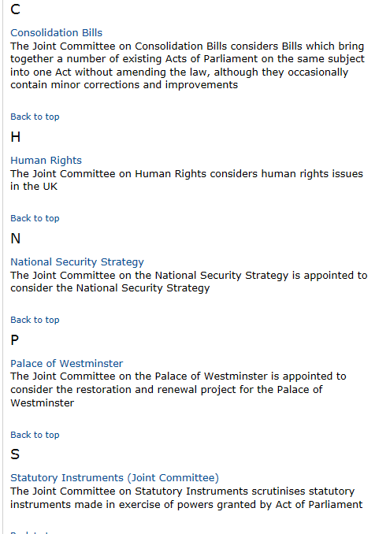
Committees
Committees of small groups of MPs and/or Lords look at specific policy issues or legislation in detail.
Different committees have different roles ranging from offering advice, to producing reports or altering legislation.
Both Houses have permanent and temporary committees.
MPs and Lords also work together in Joint Select Committees.
Select and General committees have become very important in Westminster.
They routinely call ministers, MPs and even civil servants before them to give evidence. They can also call members of the public/expert witnesses to give evidence.
For example, the Culture, Media and Sport Select Committee’ investigation into the phone-hacking scandal.

Slide 9
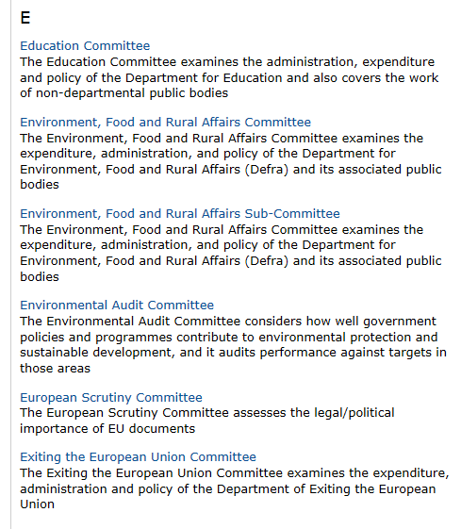
Select Committees
Select Committees are investigative committees set up by both the House of Commons and House of Lords.
They check and report on areas ranging from the work of government departments to economic affairs.
The results of these inquiries are public and many require a response from the government. For example, the enquiry into the near collapse of the Royal Bank of Scotland and HBOS, which the UK government bailed out.
John McFall MP questions HBOS and RBS bosses
Phone Hacking Inquiry highlights

Slide 10
Select Committees
The membership of select committees in the Commons reflects the party balance in the HoC as a whole, meaning that a majority of each committee will be MPs from the governing party or parties. From 2015-2017, for a typical 11-member committee, the composition might be four Conservative, one Liberal Democrat, four Labour and one SNP and one other opposition MP. Ministers, opposition “Shadow Cabinet” members and party whips do not normally serve on select committees.
Discussion Questions
Why do minister, opposition Shadow Cabinet members and party whips not serve on committees?
Committee membership usually reflects the party balance of the HoC – why might this be a positive?

Slide 11
Select Committees
Criticisms of Select Committees
Select Committees do not obstruct or change the bills going through parliament. Many people believe this makes them very ineffective as they cannot pre-empt problems with bills
The inbuilt government majority on the committees may limit their effectiveness as scrutinising bodies.
Examples of Select Committee Work:
In 2007 the Commons Treasury Select Committee questioned the Governor of the Bank of England over the collapse of Northern Rock.
The Culture, Media and Sport Committee took evidence from TalkTalk Chief Executive, Dido Harding, on cyber security and protection of personal data online following data leaks and hacks. (2012)
The Work and Pensions Select Committee questioned the Minister for Family Support, Housing and Child Maintenance on the impact of Universal Credit in June 2019.

Slide 12
Select Committees
https://www.youtube.com/watch?v=iLvNmMJmD0w
Watch the short documentary on Commons Select Committees and take detailed notes on: the make-up of committees; what they do and why they are important.
Homework: watch the short docu-series about Select Committees in the HoL and take further notes.
What are the differences?
https://www.youtube.com/watch?v=wpNbwyNk_5M&list=PLilBYVf0P9aZ2laTTD2GOaa1JzT-0F3KN&index=1

Slide 13
General Committees
The main role of General Committees is to consider proposed legislation in detail.
This committee system allows faster processing of Bills and is unique to the House of Commons; the Lords meet as a whole House in this function.
A Public or Private Bill Committee is appointed for each Bill that goes through Parliament.
Depending on its complexity, the consideration of a Bill can take a few minutes to a few months.
The Lords meet as a whole House in this function in the debating chamber or as a Grand Committee away from the chamber.
Each Public Bill Committee is named after the Bill it considers. For example, a committee considering a Bill titled the Climate Bill would be called the Climate Bill Committee.

Slide 14
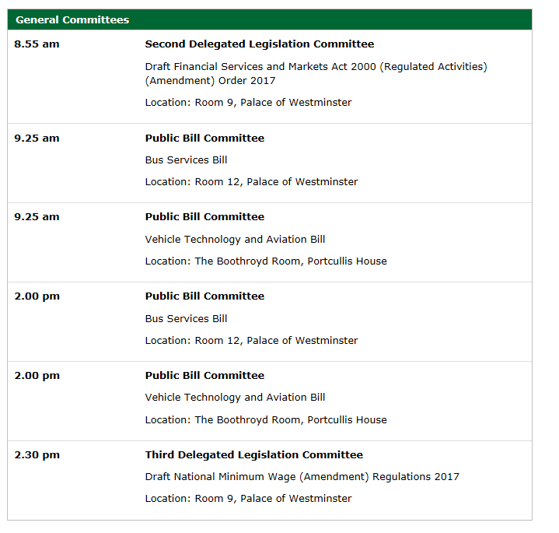
Tuesday March 14th 2017

Slide 15
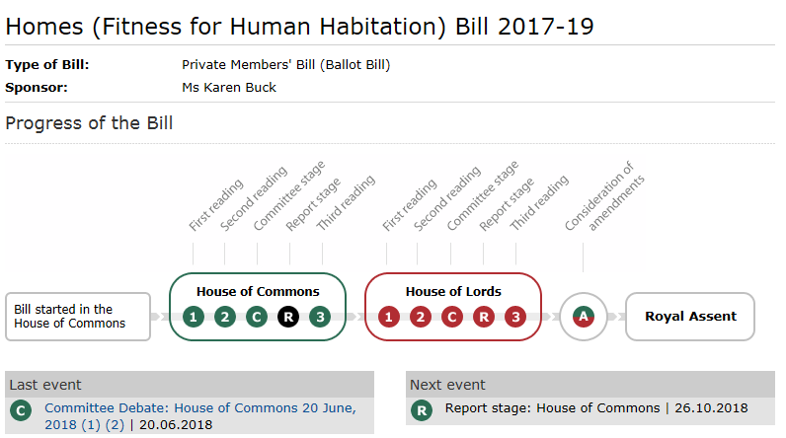

Slide 16
General Committees
Each committee is assigned a chairman and debate Bills as they would do in the Commons chamber, with broadly the same rules of debate applying.
Public Bill Committees have the power to take written and oral evidence from officials and experts outside of Parliament. This is intended to give Committee members more information upon which to make their decisions.
Public Bill Committees examine each Bill line by line. Once a committee has finished looking at (scrutinising) a Bill, it reports its conclusions and any amendments made to the Commons, where Members debate the Bill further.
The Bill is printed again with the amendments made by the Public Bill Committee; this is publicly available in printed and online formats.
The minimum number of Members in a committee is 16 and the maximum is about 50. The proportion of Members in a Public Bill Committee mirrors the political parties' strengths in the Commons, so there is always a government majority.

Slide 17
Joint Committees
Joint Committees are committees consisting of MPs and Lords. They have similar powers to Select Committees. Some are set up on a permanent basis, like the Joint Committee on Human Rights. Other appointments are for specific purposes, such as examining draft proposals for Bills on subjects ranging from gambling to stem cell research.
In Joint Committees, Members from both Houses meet and work as one committee, and appoint a single chairman who can be an MP or Lord. Joint Committees operate like Select Committees. They may conduct an on-going examination of a particular area (such as human rights) or of a specific matter, such as Draft Bills or House of Lords reform. Reports are available to the public in printed and online formats.
Two Joint Committees meet on a regular basis: Human Rights, which meets to consider human rights issues in the UK; and Statutory Instruments, which meets to scrutinise delegated legislation.

Slide 18
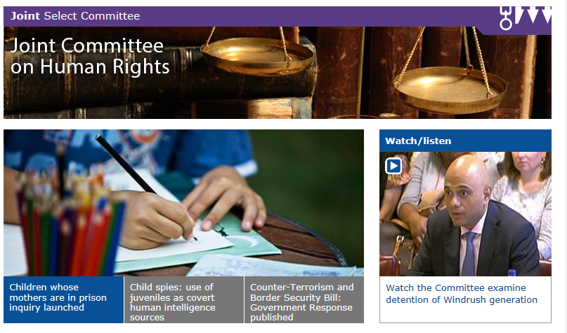

Slide 19
Questions
Describe, in detail, the functions and actions that the three different types of parliamentary committee can undertake.
Why are Select Committees considered so important in terms of scrutinising the UK Government? Provide examples.
What criticisms can be made of the committees systems in the UK Parliament?
In what other ways can the UK government be scrutinised?

