Slide 1
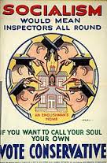
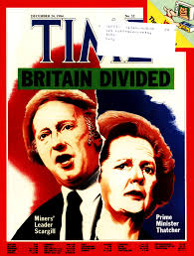
Political Theory Unit 3: Ideologies
Conservatism v Socialism

Slide 2
Unit Aims
The purpose of this section is to explain key political ideologies in relation to key political theorists.
There are two key political ideologies which will be studied.
Conservatism (New Right, Neoliberalism, Neoconservatism)
Socialism (Marxism, Social Democracy, Third Way)

Slide 3
conservatism
More conservative
Less conservative

Slide 4
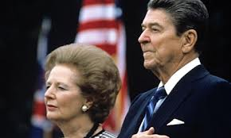
Conservatism what does that word mean to you?

Slide 5
Conservatism
Conservatism: An ideology characterised by support for tradition, duty, authority and property. (Heywood, 2002)
Note:
It is important at this stage to make a distinction between ‘big C’ Conservative and ‘small c’ conservative.
The former refers to the Conservative political party, whereas, the latter refers to the political ideology.

Slide 6
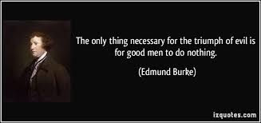
Key Influences
Conservatism first emerged in the late 18thC in response to economic and political changes brought about by the French Revolution.
Following the French Revolution a groundswell of liberalism, socialism and nationalism emerged posing a threat to the existing social order. Advocates of conservatism feared the rise of republicanism and the fall of monarchies in Europe.
Two of the most influential proponents of conservatism were Edmund Burke – British writer and MP (1729 – 97) and Joseph De Maistre (1753 – 1821).

Slide 7
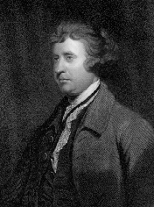
Key Influences
Conservatives blamed the bloodbath of the French Revolution on the Enlightenment idea that human beings could consciously create political society.
The major political conflicts in 20th century democracies have been between conservatives and socialists

Slide 8
What is conservatism?
Difficult to give an accurate definition and must be careful to associate it too much with the Conservatives of today, but there are a number of personal traits that a conservative is likely to have:
Conservatives tend to want less control over the individual, doesn’t like fixed political doctrines.
Like the status quo to be maintained rather than any radical change.
Although the nature of conservative thinking may change dependent on the time they usually want to maintain tradition, the present and they look to the past as a guide rather than fixed principles for the future.
Want the individual to work hard and flourish in terms of pursuing goals and achieving fulfilment.
Conservative also want good social order and security even if that is at the expense of freedom, rights and equality

Slide 9
So, Conservatism encompasses the following views:
Tradition (keeping things the way they’ve always been)
Human imperfection (humans will do bad things given the chance)
Authority (following rules)
Property (owning your own property is good)
Hierarchy (there are people below us and above us)

Slide 10
Key Features of Conservatism
Tradition
A central theme to conservative thought is ‘the desire to conserve’ traditions, customs and institutions that have endured over time.
The rationale behind this thought is that such traditions, customs and institutions have been tested over time and represent the accumulated ‘wisdom of the past’ and are worth preserving and retained for the benefit of future generations.
They also believe that tradition strengthens social integration through a common identity.
Edmund Burke ‘change is only necessary in order to conserve’.
Established traditions, customs and institutions arguably ensure stability and promote a shared sense of history and belonging.
Example - Monarchy & House of Lords – supported by many conservatives.

Slide 11
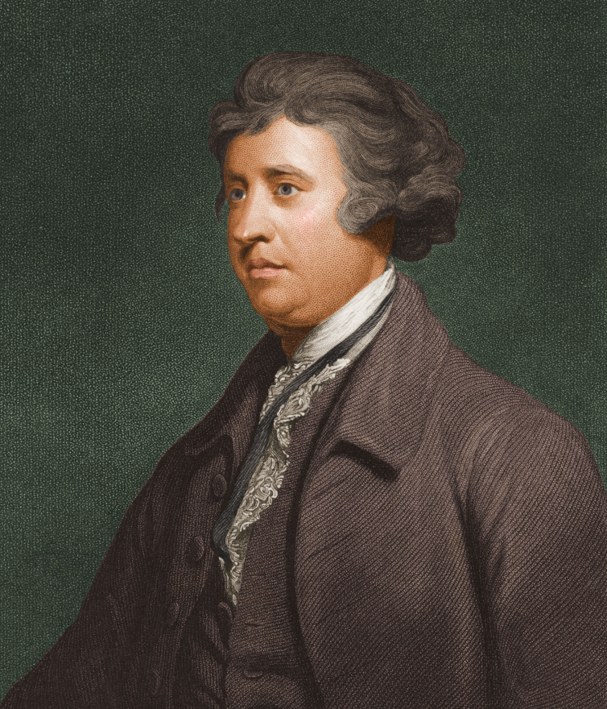
Theorist point!
Edmund Burke argued that deeply opposed the French Revolution on the grounds that wisdom is not about abstract principles but about experience, tradition and history
And
‘change is only necessary in order to conserve’.

Slide 12
Human Imperfection
Another core part of conservatism is the idea that humans are not perfect. Indeed, conservatives are actually quite pessimistic about the nature of human beings – humans are flawed.
Accordingly, conservatism believed that humans have the capacity for reason but are fundamentally security-seeking creatures, dependent and morally corruptible.
They view individuals to be inherently greedy, selfish and thirsty for power therefore human beings need a firm ‘moral compass’.
Proponents of conservatism view crime as an exemplification of this. Conservatives suggest criminality is a result of individual greed rather than the failings of society and that a strong system of law enforcement and punishment is required to combat it.
Example – conservatives may support harsher punishments, longer prison sentences. They are less in favour of rehabilitation of criminals

Slide 13
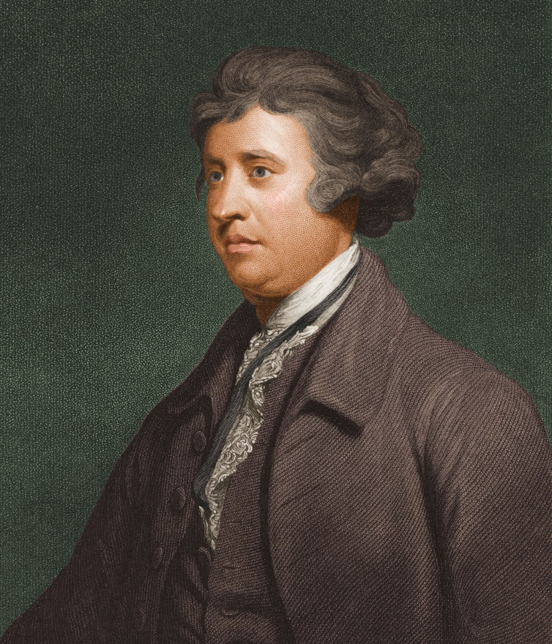
Theorist point!
Edmund Burke argued that human beings were intellectually imperfect especially when they are confronted with the complexity of social life
Do you agree with this statement?

Slide 14
Hierarchy
Linked to the idea of an organically developed society they view hierarchy within society as natural and inevitable as it reflects the different roles people have within society i.e. employer and worker or teacher and pupil.
Meritocracy: the holding of power based on merit. In the eyes of conservatism there exists ‘natural’ inequality (e.g. poverty) – very little society can do – down to individual
Conservatism suggests that individuals have an obligation to respect this hierarchy in order for society to function.
Example – conservatism would argue that young people should do as teachers and parents say without question out of duty
It also acknowledges that a person’s status in life is determined by chance and therefore suggests that the fortunate have a moral obligation to care for the less fortunate.

Slide 15
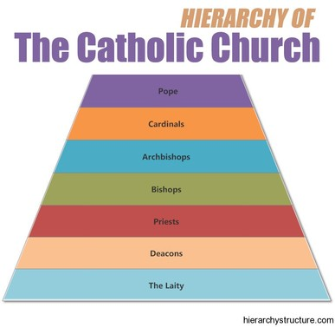

Slide 16
Authority
Allied to the natural hierarchy of society conservatives believe that authority should be top down in nature.
Conservatives believe that those with the higher social status will inevitably have the necessary experience or education to provide leadership and guidance to those on a lower social position i.e. a parent’s authority over their children.
Again conservatives view acceptance of authority as a necessary obligation to ensure the proper functioning of society.
Authority is embedded through a hierarchical series of social and political institutions: state, armed forces, legal system, education, religion, the family. (Link Hierarchy and Authority)
Example – conservatives would respect and uphold institutions such as the police, armed forces and courts

Slide 17
Property
Conservatives view the ownership of property as vital because it offers the individual security and independence, as well as, encouraging aspiration (desire to better oneself), respect for the property of others and an adherence to law and order.
Property guarantees social order, privilege and personal identity.
Example: Thatcher ‘Right to Buy’ programme of the 1980s – people could buy their council houses at reduced rates as this was seen important in ‘improving’ the working classes

Slide 18
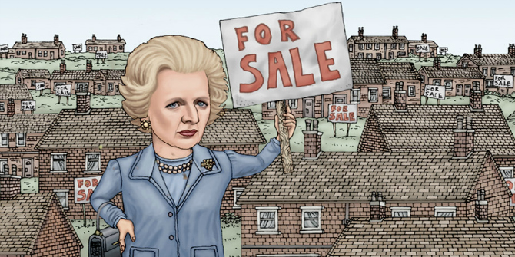
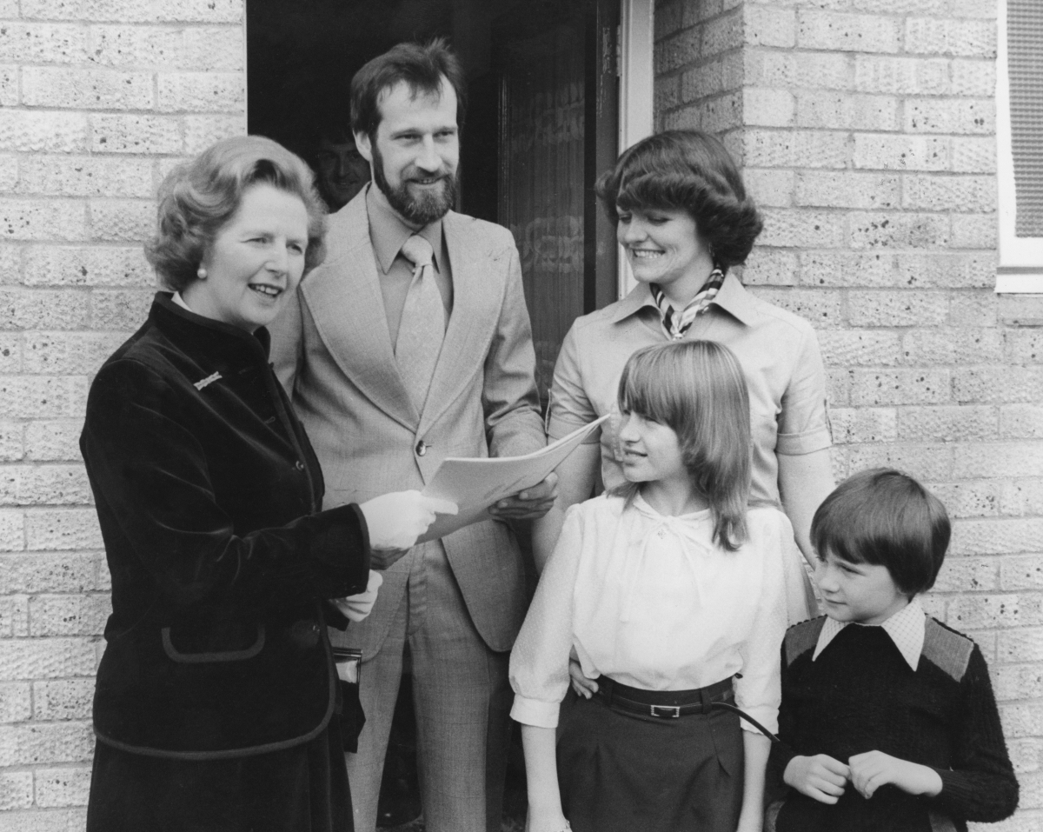

Slide 19
Try to find the missing words…
The ‘desire to conserve’ – no need for radical _______.
_________ for established customs and institutions (church/family/monarchy)
_________ in its view of human nature – humans are limited, dependent and need stability – individuals may be corrupt, selfish or greedy.
Need for strong system of _____ and _____
A belief in the importance of private ______

Slide 20
Summary: Conservatism is…
The ‘desire to conserve’ – no need for radical change.
Respect for established customs and institutions (church/family/monarchy)
The need for stability and security
Pessimistic in its view of human nature – humans are limited, dependent and need stability – individuals may be corrupt, selfish or greedy.
Need for strong system of law and order
The belief in a need for strong state, strong leadership and laws due to human imperfections.
A belief in the importance of private property

Slide 21
https://www.youtube.com/watch?v=khzQ8iOuwgI

Slide 22
Summarise Conservatism in 6 words!!

Slide 23
Conservatism in the Modern Context
We will now consider three prominent branches of conservatism to have emerged in the UK:
One Nation conservatism - Disraeli
Neoliberal conservatism - Thatcher
New Right (Neoconservatism) – David Cameron

Slide 24
Traditional ‘old fashioned’ Conservatism
Importance of patriotism and authority.
Opposes significant social and political changes.
Opposes Britain's closer connections with Europe (traditional Euro scepticism)
Racist tendencies
Supporters of social discipline and strong law and order – stress importance of punishment (favour of capital punishment).
Oppose constitutional reform (e.g. devolution)
Strong attachment to monarchy and House of Lords

Slide 25
‘One Nation’ conservatism
One Nation Conservatism is unity between the classes.
It promotes the idea that the privileged elite should care for the poor and less fortunate
It’s adoption in Britain was done more in fear of social revolution rather than of genuine care for the poor
During the late 19thC Conservative Prime Minister Benjamin Disraeli introduced a number of electoral reforms aimed at politically integrating poorer people in the UK stating that ‘reform from above’ was preferable to ‘revolution from below’.
Therefore, it is important to note that conservative social reforms are not done through some ideological desire for equality, but through a desire for a stable hierarchy.
Another example of conservative social reform can be seen in their cross party support for Labour’s creation of the Welfare State and the NHS following the Second World War.

Slide 26
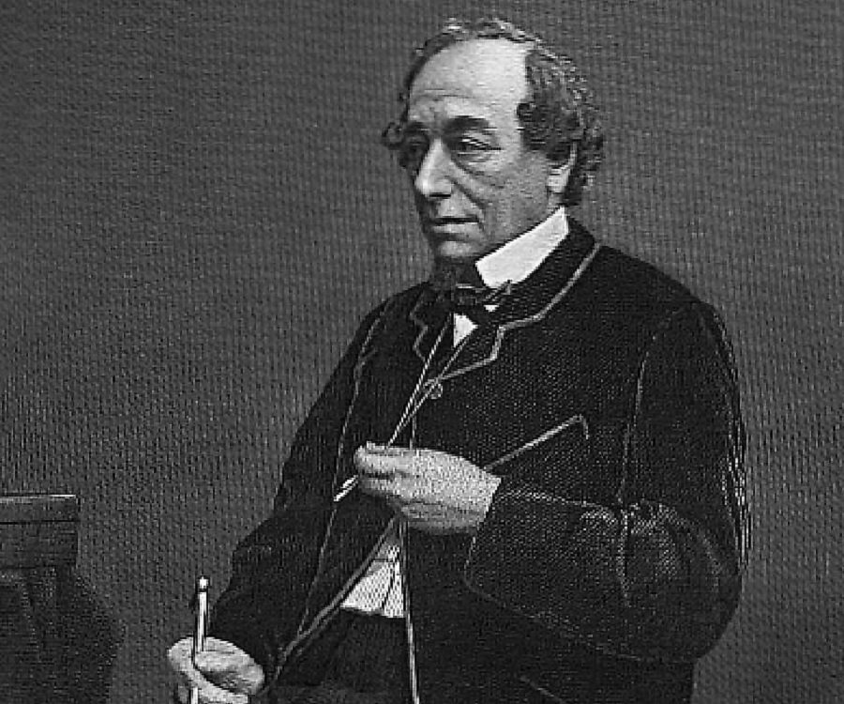
Disraeli 1871 Trade Union Act – legalised Trade Unions 1872 Secret Ballot Act – removed bribery and corruption from elections
1875 Public Health Act – clean running water, drainage systems etc.
These reforms benefited poorer Brits – an example of ‘One Nation Conservatism’
Provided more stability and reduced fear of revolution.
Notes:
https://www.youtube.com/watch?v=vOV7KeZANXw

Slide 27
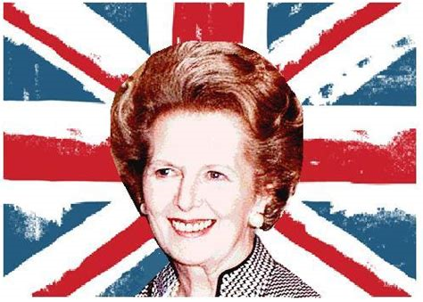
Neoliberalism

Slide 28
Neoliberalism
Classical liberalism (freedom) within a conservative framework.
Economic liberty – minimal Government intervention.
‘Laissez Faire’ economics (letting things take its own course without interference).
Support free market economics - state intervention is unnecessary.
Strong state is still required to maintain public order and ensure traditional values are upheld.
Welfare state undermines self-reliance – promotes idleness (laziness) – blaming individual for their situation.
Cut taxes and deregulate business.
Views are very ‘right wing’
Thatcher and her Government – perfect example

Slide 29
The ‘Iron Lady’
Prime Minister since 1979- 1990. Falkland's war victory in 1982 and the recovering economy led to her successful re-election.
Her support for the community charge (Poll tax) was her demise. She resigned as PM and party leader in Nov 1990 after Michael Heseltine challenged her leadership. She was then given peerage in the House of Lords.
https://www.youtube.com/watch?v=F0-ZZZPjE2g
Life and Legacy of the ‘Iron Lady’
(3:40)
https://www.youtube.com/watch?v=jUfIzRYvBT4
New York Times: What did Thatcherism do for Britain (3:06)

Slide 30
Margaret Thatcher was a major proponent of this individualist ideal, famously saying that ‘there is no such thing as society, only individuals and their families’.
As Prime Minister, Thatcher carried out a neoliberal legislative programme selling off state owned businesses such as British Telecom, British Airways and Rolls Royce; as well as, introducing new laws restricting trade unions and closing nationalised heavy industries, such as coal mines.
Thatcher believed state intervention bred a culture of dependence and inhibited the conservative traditions of individual responsibility and entrepreneurship.
She believed an unrestricted free-market would find a way to resolve issues such as unemployment and poverty without the need for government intervention.
However, Thatcher’s ‘right to buy’ scheme allowing people to buy their council houses at discounted rates is an indication that she still adhered to traditional conservative values such as the importance of owning property.

Slide 32
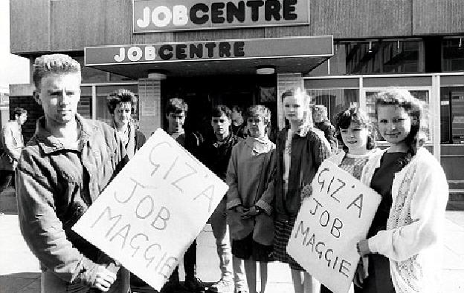
The ‘Yuppies’ of the 80s vs 3m unemployed
Notes:
Young Urban Professionals
Young Upwardly Mobile Porefssional

Slide 33
Neoconservatism
Neoconservatism (New Right) aims to reassert traditional 19thC conservatism with a primary focus on restoring hierarchal authority and a return to traditional societal values such as family, religion and nationalism in order to ensure stability.
Similar to neoliberalism the New Right advocate minimal government involvement in people’s lives and encourage individual responsibility and entrepreneurship.
In contrast, the New Right’s emphasis on restoring tradition puts it at odds with the multiculturalism that has developed as a result of neoliberal globalisation, as they view multicultural and multireligious societies as conflict ridden and unstable.
Inevitably, this leads advocates of the New Right to take a sceptical view of immigration or institutions such as the European Union.

Slide 34
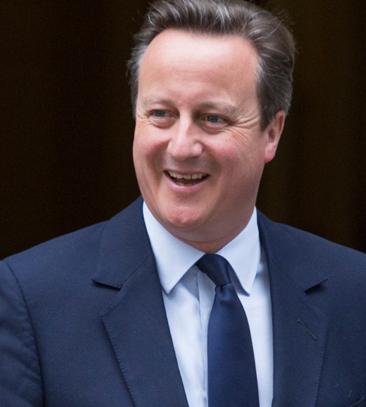
In Focus: David Cameron
Since becoming PM in 2010 David Cameron arguably pursued a New Right legislative agenda (albeit restricted by his coalition partners 2010-2015), reducing public spending, introducing welfare reform and allowing greater involvement of the free-market in the NHS and education.
Furthermore, his call for a ‘Big Society’ approach to social issues requiring charities and volunteers to take action rather than government fits neatly with the type of top down benevolence characteristic of traditional conservative values.
Cameron was troubled with the EU issue with many in his own party demanding Britain withdraws from treaties requiring social integration and specifically the ‘freedom of movement’ agreement that allows citizens of any EU member state to settle in the UK.

Slide 35
Organic Society
Conservatism rejects the idea that society is man-made but rather it forms organically as a result of shared experiences, traditions and values.
‘The total is greater than the sum of its parts’ - Conservatives believe in a more communitarian approach to development e.g. everyone plays a role to improve society
Accordingly, conservatives place a great deal of importance on traditional social institutions like organised religion and social structures like the nuclear family as these are considered to be the ‘fabric’ holding society together which allow it develop organically.
Example – David Cameron’s ‘Big Society’ of 2010 placed an emphasis on individual goodwill, volunteering and charity work to improve society as a whole

Slide 36
https://www.youtube.com/watch?v=YZDA0UpNrQA

Slide 37
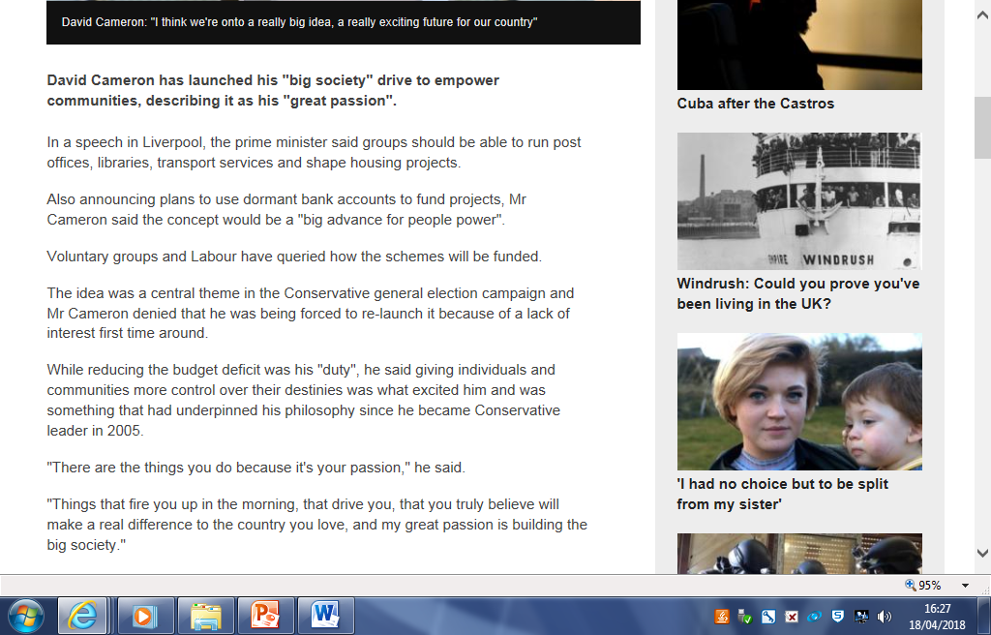

Slide 38
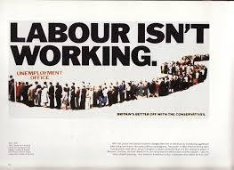
Success of UK Conservatives
Very successful at winning elections in the UK (in power for over two thirds of 20th Century)
Good at getting ideas across (gaining working class support in the 80s)
Still tends to defend a specific group, the middle classes.

Slide 39
Issues facing UK Conservatives
Blamed for recession in 1990s
Major issues with support in Scotland due to legacy of ‘Thatcherism’
Split over Europe (some want complete exit while others want economic union)
Linked to Political Sleaze (notions of privilege lead to corruption)
Centrality of tradition incompatible with modern multicultural society
Conservatives labelled the ‘nasty party’ due to their views on individual responsibility and market driven solutions to social problems.

Slide 40
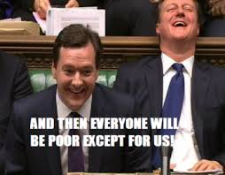

Slide 41
Starter
Give a definition of Conservatism
Explain One Nation Conservatism
Explain Neoliberal Conservatism
Explain New Right Conservatism

Slide 42
Key Features of Conservatism
Tradition
A central theme to conservative thought is ‘the desire to conserve’ traditions, customs and institutions that have endured over time.
The rationale behind this thought is that such traditions, customs and institutions have been tested over time and represent the accumulated ‘wisdom of the past’ and are worth preserving and retained for the benefit of future generations.
They also believe that tradition strengthens social integration through a common identity.
Edmund Burke ‘change is only necessary in order to conserve’.
Established traditions, customs and institutions arguably ensure stability and promote a shared sense of history and belonging.
Example - Monarchy & House of Lords – supported by many conservatives.

Slide 43
‘One Nation’ conservatism
One Nation Conservatism is unity between the classes.
It promotes the idea that the privileged elite should care for the poor and less fortunate
It’s adoption in Britain was done more in fear of social revolution rather than of genuine care for the poor
During the late 19thC Conservative Prime Minister Benjamin Disraeli introduced a number of electoral reforms aimed at politically integrating poorer people in the UK stating that ‘reform from above’ was preferable to ‘revolution from below’.
Therefore, it is important to note that conservative social reforms are not done through some ideological desire for equality, but through a desire for a stable hierarchy.
Another example of conservative social reform can be seen in their cross party support for Labour’s creation of the Welfare State and the NHS following the Second World War.

Slide 44
Neoliberalism
Classical liberalism (freedom) within a conservative framework.
Economic liberty – minimal Government intervention.
‘Laissez Faire’ economics (letting things take its own course without interference).
Support free market economics - state intervention is unnecessary.
Strong state is still required to maintain public order and ensure traditional values are upheld.
Welfare state undermines self-reliance – promotes idleness (laziness) – blaming individual for their situation.
Cut taxes and deregulate business.
Views are very ‘right wing’
Thatcher and her Government – perfect example

Slide 45
Neoconservatism
Neoconservatism (New Right) aims to reassert traditional 19thC conservatism with a primary focus on restoring hierarchal authority and a return to traditional societal values such as family, religion and nationalism in order to ensure stability.
Similar to neoliberalism the New Right advocate minimal government involvement in people’s lives and encourage individual responsibility and entrepreneurship.
In contrast, the New Right’s emphasis on restoring tradition puts it at odds with the multiculturalism that has developed as a result of neoliberal globalisation, as they view multicultural and multireligious societies as conflict ridden and unstable.
Inevitably, this leads advocates of the New Right to take a sceptical view of immigration or institutions such as the European Union.

Slide 46
Socialism

Slide 47
Socialism: The desire for an equal society
Socialism: An ideology characterised by the belief in community, cooperation, equality and common ownership. (Heywood, 2002)
Although early socialist ideas can be traced back to the Ancient Greek era, it only really began to take shape in the early 19thC in response to the rise of industrial capitalism.
Initially, used to articulate the views of artisans (skilled workers) socialism grew to represent the view of the majority of the working class who at the time were being routinely exploited by employers and excluded from politics by way of disenfranchisement (no vote).

Slide 48
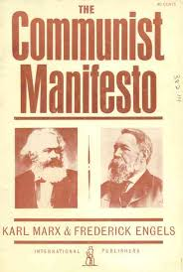
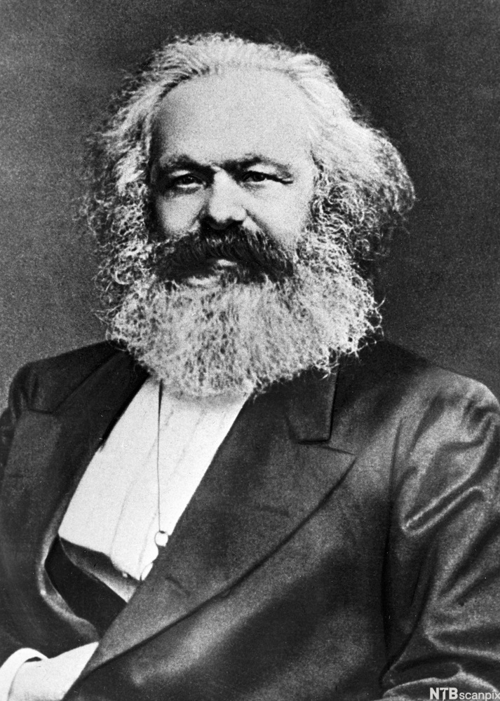
Key Influences
Without doubt the most influential representative of socialism is Karl Marx and his classic works Das Capital and the Communist Manifesto that he co-wrote with Friedrich Engels.

Slide 49
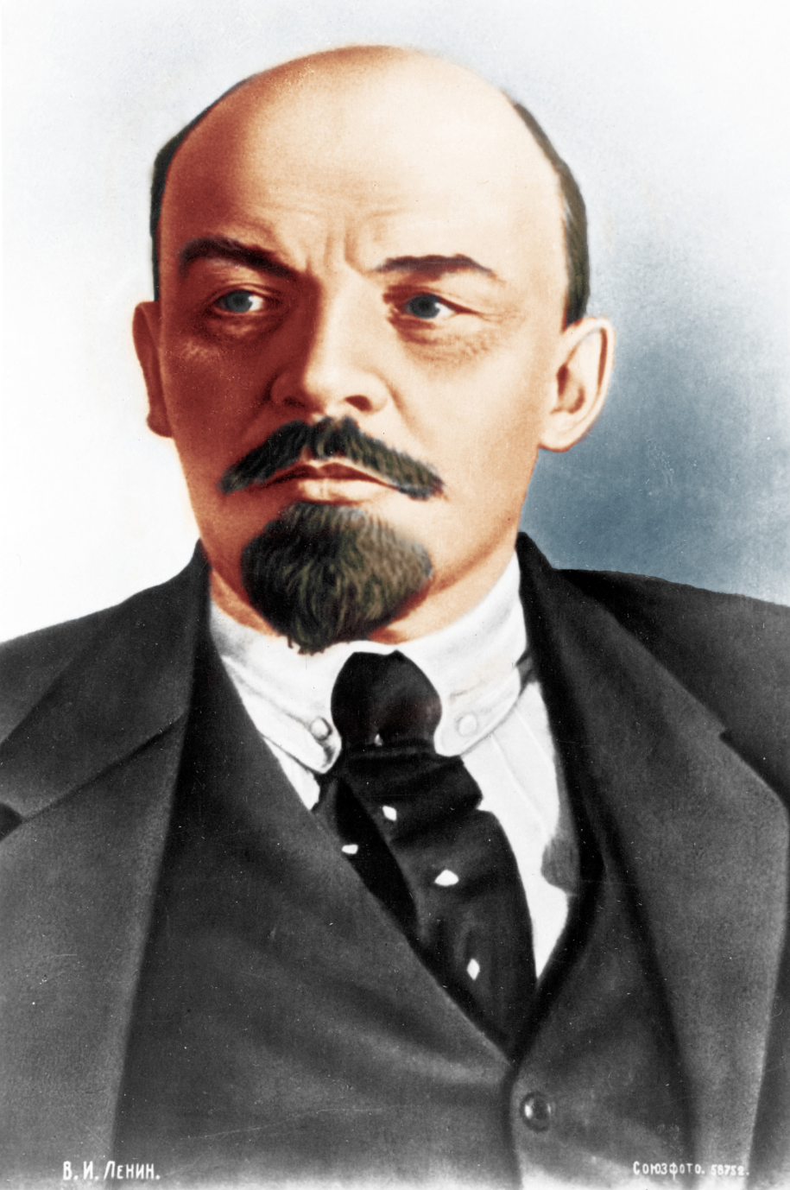
Vladimir Lenin is also seen as a key Socialist thinker
He led the Russian Revolution and established the USSR

Slide 50
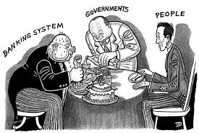
Key Tenets of Socialism
At the heart of socialism is the desire for a fair and equal society.
However, according to socialists this fairness and equality can only be achieved by putting some constraints on individual liberty – specifically, their ability to acquire property and wealth.
For many, socialism is utopian and idealistic in nature; to others, it is revolutionary.
However, all socialists believe there must be change in how wealth is owned and controlled to achieve an equal society.

Slide 51
Key Principles of Socialism
Co-operation – everyone working together for a greater society
Collectivism – the group takes priority over the needs of the individuals within the group
Equality – everyone should have equal access to opportunities
Class – the objective of Socialism is to eradicate social class
Common Ownership – society’s resources i.e. land, property should be owned by everyone

Slide 52
1 Co-operation
Socialism is based on a belief that human beings are social creatures and have a common humanity therefore believe that communities or groups working together can achieve more than individuals working themselves – community over individualism
According to the socialist view, individuals do not live or work in isolation but live in cooperation with one another
Socialists believe that individual identity is shaped by social interaction and that humans are a product of their environment (nurture over nature).
Socialism therefore views cooperative solutions as far preferable to wasteful competitiveness purely for profit
Example – Socialists would favour community cooperative initiatives where everyone pools their skills and resources for the common good over competitive businesses

Slide 53
2. Collectivism
Socialists believe that people are connected by way of a common humanity or ‘comradeship’. This is linked to the idea of a ‘fraternity’ or brotherhood
Cooperation & collectivism (pooling of resources) enables people to harness their collective energies and get more out
This belief encourages socialists to place collectivism over individualism, cooperation over competition and promotes unity and equality over division and inequality.
For Socialists, competition pits individuals against each other which can breed resentment and conflict.
For example – Socialists would argue that we should take a collective approach to welfare, and all contribute to ensure everyone is looked after i.e. with universal benefits. Socialists would disagree with individualist approaches to welfare i.e. private healthcare in the USA

Slide 54
3. Equality
Equality is a central pillar of socialism. Accordingly, they are less concerned with the equality of opportunity and more concerned about the equality of outcome – true equality.
Equality is meaningless unless it involves equal access to resources. Socialists believe that the government must ensure everyone receives the same quality of outcome i.e. quality of education
Therefore, socialists reject the liberal notion of equal opportunities as it ignores the inherent inequality built into the capitalist system
Socialists also rejects the acceptance of a ‘natural’ inequality (Conservatism) between individuals as a convenient distortion of the truth.
For example, private schools are open to all (equality of opportunity); however, not everyone has the means to send their children to private schools, thus, fees act as a barrier to equality (inequality of outcome). Socialists would fundamentally disagree with private schools.

Slide 55
Equality contd. - Need
Linked to equality, socialists believe that material benefits of society should be distributed on the basis of need rather than just simply merit.
Socialists would argue that those who have the least deserve the most help and those with the most resources should facilitate this
How they go about resolving this is largely dependent on the nature of socialism that is present; for example, social democrats try to tackle poverty through social welfare policies such as the minimum wage, state pensions, free health care, public education and benefits.
Example – Socialists would argue that the CEO of a company should not take home a huge salary and bonuses whilst the ordinary workers struggle to survive on their salary i.e.

Slide 57
Theorist point!
Karl Marx said ‘from each according to his ability, to each according to his need”.
This means that those with the most should contribute the most while those who need the most should receive the most help.

Slide 58
4. View on Human Nature
Socialists have a far more positive or optimistic view of human nature than conservatives
Socialists believe that human beings are inherently good but are often corrupted by society around them
Socialists agree with liberals that human nature can be improved, but reject the idea that humans are self interested and the conservative view that humans are naturally greedy
Socialists believe that human nature is able to be modified or improved in the correct conditions
Socialists believe that individuals are ‘corrupted’ or damaged by the historical and social conditions which they are born.
Example – Socialists would believe that key causes of crime are poverty, social exclusion or lack of education rather than a person just being flawed. Therefore they would support rehabilitation of criminals rather than harsh punishments

Slide 59
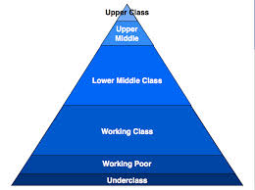
6. Social Class
Class is a key concept of socialism
Socialists would strongly disagree with the concept of one’s social class dictating their opportunities in life
On one hand Socialists use class to analyse the distribution of income and wealth in society.
On the other it views the working class as being the people who can force political and social change
Ultimately, the objective of socialism is to eradicate social class through the reduction of economic and social inequality in society

Slide 60
Theorist point!
Karl Marx argued that society was in a constant state of conflict between the classes
He argued that those at the bottom (workers) would eventually realise they were being exploited and revolt

Slide 61
Theorist point!
Vladimir Lenin argued that history was the story of class struggles and that the Capitalists were actively working against the proletariat (working class) and peasants.

Slide 62
Common Ownership
Another key aspect of socialist thinking is that wealth is not produced by individuals but by the work of groups and communities.
A Socialist would argue that although people like Richard Branson are celebrated as entrepreneurs in this country, the hard work was done by ordinary workers at Virgin.
Socialists view owning private property as creating the conditions for human inequality, that it promotes social division and selfishness.
They see private ownership as an injustice and unfair – workers work hard to make the CEO/ owner wealthy yet have little themselves
Therefore, socialists believe that society’s resources should be commonly owned and the ‘profits’ redistributed back into society.
Example – Socialists would be against the ‘Right to Buy’ programme in the 1980s as they would argue public housing belongs to society and should not be sold off to individuals. They would also support nationalisation of key industries i.e. transport, energy

Slide 63
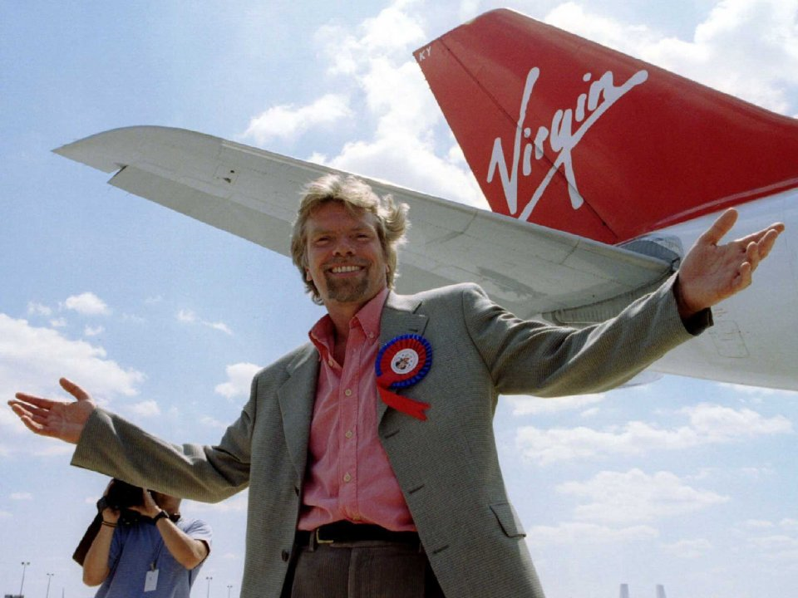

Slide 64
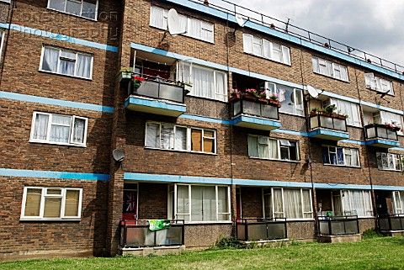
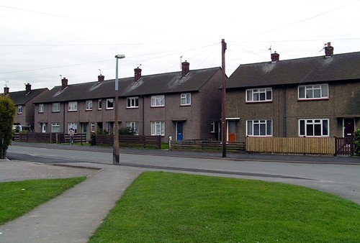
Many council houses built after WWII were sold off – leaving a shortage of public housing
Socialists would argue this was very negative - especially for the poorest people in the country

Slide 65
Are there any similarities between Socialism and Conservatism?
Actually, yes!
Conservatives and Socialists do agree to an extent on society and that every individual should contribute to the development of society
Conservatives would argue that society develops organically but that all citizens should contribute to ensure that society is more than just the sum of it’s parts. They also argue individuals are obligated to give to less fortunate if they can.
Example – David Cameron’s ‘Big Society’ Vision that people would all play a role in society – helping, volunteering etc.
Socialists also place emphasis on community and the idea that humans are social creatures and a community is stronger than individuals working together . They argue that the needs of the community are more important than the individual and everyone should contribute to society to make it better
However… Conservatives would argue that competition is important in terms of aspiration and self improvement but Socialists would argue that competition encourages greed and creates poverty

Slide 66
Possible Questions – Ideology
Analyse the key features of a political ideology that you have studied. In your answer you should refer to the work of at least one relevant theorist. (12)
To what extent are the key features of political ideologies different? You should refer to two political ideologies and make reference to the ideas of relevant theorists. (20)

Slide 67
Essay Plan – 12 marker on ONE ideology (you pick)
Short Intro – good practice
Pick 3 or 4 key features of your ideology i.e.
Conservatism – Tradition, Authority/ Hierarchy, Private Ownership, Human Nature
Socialism – Community/ Collectivism, Social Class, Equality, Human Nature
Discuss key features and give examples i.e. Thatcher’s Right to Buy, Private schools
Use theorists views! Conservatism (Edmund Burke) & Socialism (Marx/ Lenin)
Short conclusion – good practice

Slide 68
Essay Plan – 20 marker on the key features of political ideologies
Intro – establish the ideologies, bit of background, list the main areas of comparison, indicate argument – different or similar?
Pick 3 or 4 key areas of comparison i.e.
Human Nature, Ownership & Property, Hierarchy/ Social Class, Community
Discuss key differences and use examples to back up
Make sure you compare rather than just describing one then another – ‘Therefore it is clear that the Socialist and Conservative view of human nature is very different because…
Use theorists views! Conservatism (Edmund Burke) & Socialism (Marx/ Lenin)
Conclusion – recap main arguments made. Make final judgement – similar or different – evidence to back up!

Slide 69
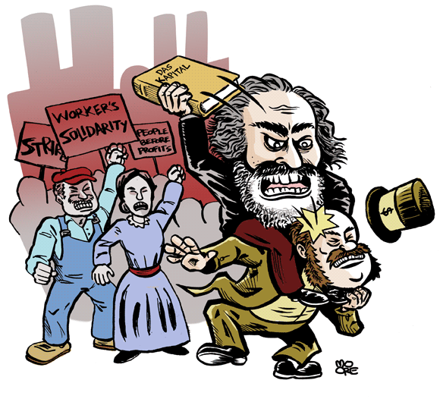
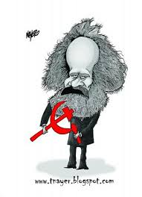
Marxism
When Marx set out his theory he was unhappy with what he perceived as the exploitation of the working class (proletariat) by the wealthy middle/upper class (bourgeoisies).
Marx envisaged a revolutionary classless society built upon the socialist principles of community, common ownership and equality.
Marxism is an outright rejection of capitalism which it views as the destroyer of societies.
According to Marx capitalism will inevitably lead to a proletariat uprising that will overthrow the bourgeoisie in order to install a communist social order.
Marx based his assertions on several core tenets:

Slide 70
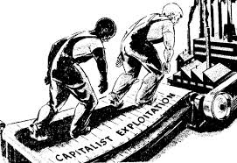
Alienation
Marx believed capitalist emphasis on the desires of the individual rather than the needs of the community would in effect separate a person from their humanity, thus, result in selfishness, greed and the exploitation of others.
Consequently, the continued exploitation of the proletariat would have the effect of diminishing their self-worth and ultimately their humanity, a person who does not value their own life has lost what makes them human.

Slide 71
Historical Materialism
According to Marx the history of mankind can be explained in terms of economic and class factors.
He argued that as all human beings require essential material goods to survive (food, water, shelter etc.) then whoever controls the production of these ‘base essentials’ will dominate and impose their will on those who are dependent on them.
In the modern context the ‘base essentials’ will include wealth, income and the means by which to produce goods and commodities (i.e. raw materials and factories).
Marx contended that those in control of the ‘economic base’ will impose their will through the creation of a ‘superstructure’ aimed at distracting the proletariat from reality.

Slide 72
Historical Materialism (2)
Marx argued that the history of mankind could be divided into four key areas that illustrated inherent economic and class division:
Tribal society (strong dominated the weak)
Slave owning society (slave owners dominated the slaves)
Feudalism (landowners who collect taxes from farmers)
Capitalism (industrial age with workers and factory owners)

Slide 73
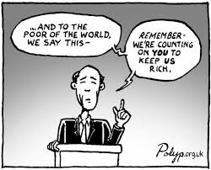
Exploitation
Marx contested that the relationship between the bourgeoisie and the proletariat is one of irreconcilable conflict.
He asserted that the capitalist desire for ‘profit’ made the systematic exploitation of the proletariat a necessity; furthermore, he predicted that as technology advanced the need for human capital (labour) would diminish.
Marxists hold the belief that capitalism is inherently unstable, as the proletariat cannot be permanently exploited.

Slide 74
Class Consciousness (Revolution)
Linked to the notion of exploitation Marx believed that the capitalist drive for more and more profit would eventually lead to the proletariat developing a ‘collective class consciousness’.
At this stage the working classes would have a collective realisation of their situation and see through the superstructure that kept them distracted and divided.
At this precise point society will be ripe for revolution and the proletariat will rise up to overthrow the bourgeoisie and assume control of the economic base (he suggested this would be a violent transition).

Slide 75
Communism
A final tenet of Marxism is the idea that following the proletariat revolution an interim ‘dictatorship’ would be required to manage the transition to socialism.
Marx argued this was essential in order to defeat the inevitable counter revolution of the disposed bourgeoisie; however, as class differences dissipated over time so would the need for a dictatorship.

Slide 76
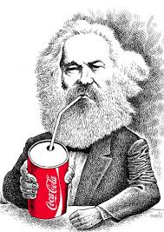
Criticisms of Marxism
It is too deterministic, suggesting that the economy determines too much of social and political change.
Marx underestimated the ability of capitalism to overcome obstacles. Falling profits were addressed by the use of new technology to improve efficiency and cut costs.
Rising standards of living created a market for goods and also ‘placated’ workers as they saw their lives improving.
Modern Capitalist societies are far more sophisticated than Marx predicted. There are not simply two social classes and there is more mobility across the classes, particularly through education than he ever expected.
The promotion of self-interest breaks down opposition to the system. For example, Thatcher encouraging working class people to buy their council houses and shares in big companies is a good illustration of this.

Slide 77
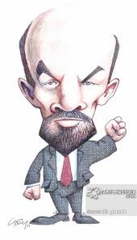
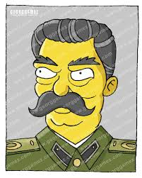
In Focus: Failure of Communism
Before we consider the failure of communism in Russia it is important to point out that there are a number of differences between Marx’s conception of communism and those adopted by Vladimir Lenin and Joseph Stalin.

Slide 78
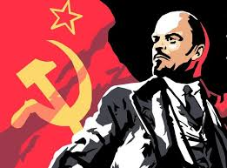
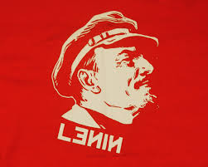
Leninism
Lenin was one of the leading political figures and revolutionary thinkers of the 20th century, who masterminded the Bolshevik take-over of power in Russia in 1917.
Although Lenin was influenced heavily by Marx he feared that the proletariat would never develop a ‘collective class consciousness’ and decided to help things along with the establishment of a revolutionary vanguard party.
Lenin’s ‘revolution’ resulted in three years of civil war and ended with the brutal murder of Tsar Nicholas II and his family.
Upon assuming control Lenin brutally oppressed any opposition to his leadership and displayed a notable disregard for his fellow countrymen who suffered as a result of war and famine.
When his efforts to transform the Russian economy to a socialist model stalled, he introduced the contradictory New Economic Policy, where a measure of private enterprise was again permitted!

Slide 79
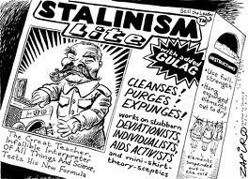
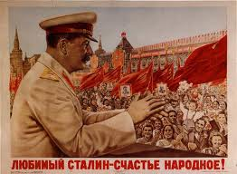
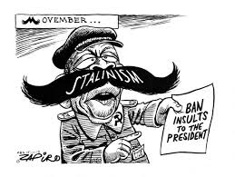
Stalinism
Josef Stalin emerged as the leader of the Soviet Union following the death of Lenin in 1924 and would become one of the world’s most notorious dictators.
His regime of terror caused the death and suffering of tens of millions of his own countrymen, but he also oversaw the war machine that played a key role in the defeat of Nazism.
He employed an extreme form of government which controlled the whole of society from top to bottom.
As part of his ‘five year plan’ Stalin’s collectivisation of agriculture cost millions of lives, while his programme of rapid industrialisation achieved huge increases in Soviet productivity and economic growth but at great cost.
As Stalin grew in power he became extremely paranoid and during the 1930s carried out purges within his party to expunge ‘enemies of the people’ – these purges resulted in mass executions and millions being exiled to slave labour camps (gulags).

Slide 80
Social Democracy
A brief history of the Labour Party
Social democracy is a type of socialism that advocates a peaceful, evolutionary transition of society from capitalism to socialism using established political processes.
Essentially, social democracy tries to balance the relationship between the state and the free market, and between the individual and the community.

Slide 81
Key Features of Social Democracy
A core feature of social democracy is the acknowledgement that free market capitalism is the only realistic means of creating wealth; however, this is allied to a commitment to distribute that wealth in accordance with need rather than merit.
The origins of democratic socialism lie in critiques of Marxism offered by people such as Eduard Bernstein (1850-1932) who rejected the notion that capitalism would inevitably collapse.
He argued by allying with middle class liberal parties socialists could move towards electoral domination due to the size of the working class vote (once the vote was achieved) and by this democratic method achieve socialism.
This revisionist approach led to the emergence of the Social Democrats in Germany and in Britain, from the Fabian and trade union movements to the Labour party.

Slide 82
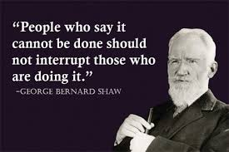
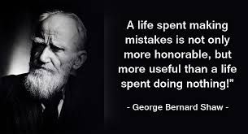
In focus: Fabian Society
The Fabian Society is Britain’s oldest political think tank. Founded in 1884, the Society has and continues to be at the forefront of developing political ideas and public policy on the left.
The 1880s saw an upsurge in socialist activity in Britain and the Fabian Society were at the heart of much of it.
The early Fabians’ commitment to non-violent political change was underlined by the role they played in the foundation of the Labour Party in 1900.
They rejected the Marxist view that change could only be achieved through violent upheaval, to use the power of local government and trade unionism to effect change.

Slide 83
Activity 1
The ultimate aim of Marxists and Social Democrats is to establish a socialist society.
Write a short paragraph explaining the main differences between Marxists and Social Democrats in bringing this change about.

Slide 84
Activity 2
Consider the following satirical cartoon:

Slide 85
Activity 2 Continued
From a Marxist perspective, create your own satirical cartoon mocking capitalism or conservatism.
You do not have to be artistic; it is the message that is important!!

Slide 86
Third Way
The ‘third way’ is a position that tries to reconcile aspects of different political ideologies (social democracy and neoliberalism) as a workable alternative to both free-market capitalism and socialism.
Proponents of the ‘third way’ argue that the cumbersome inefficient nature of socialism is incompatible with the market-based and knowledge-driven global economy that emerged in the 20thC.
Equally, they argue that unregulated free market capitalism creates a ‘free for all’ which undermines the moral foundations of society.
Therefore, the ‘third way’ argues for the establishment of a new social democracy that works collaboratively with the markets, avoiding the top down rigidity of socialism and harsh edge of neoliberalsim.
Accordingly, the third way is in favour of growth, entrepreneurship, enterprise and wealth creation but it is also in favour of greater social justice and it sees the state playing a major role in bringing this about.

Slide 87
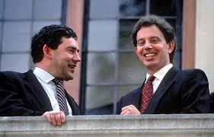
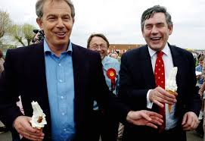
In Focus: New Labour
When Tony Blair took over leadership of the Labour Party in 1994 it was a party rebuilding itself.
For Tony Blair and Gordon Brown, their future vision of Labour had to involve forming a government over a period of years and argued that labour could achieve nothing unless it won power.
Accordingly, they rebranded to ‘New Labour’ and with it they shifted the party away from its traditional socialist ideals towards the ‘third way’ (the abolition of Clause 4 ‘nationalisation’ is evidence of this).
Blairites argued that New Labour was the vehicle for a ‘third way’ that tried to reconcile social democracy with the priorities and good aspects of capitalism.
Critics argued that Labour had lost its soul and that it blurred the divisions of the major parties; an issue that is often cited as a reason for voter apathy.
Marxists argued that the ‘third way’ is nothing more than neoliberalism with a ‘Christian face’ which softens some of the consequences of the free market on the people.
The rise and fall of Tony Blair

Slide 88
Success of UK Socialism
Creation of a Welfare State and National Health Service
Formed nine governments since 1945
Three consecutive New Labour majorities between 1997 and 2010
New Labour reduced child poverty by 900,000 from 3.4m to 2.5m
Is it possible to win elections on the left now? Will Corbyn take the UK Labour Party back to the left?

Slide 89
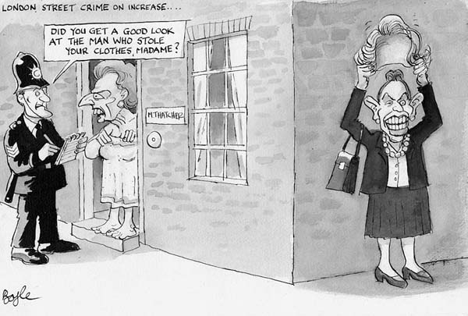
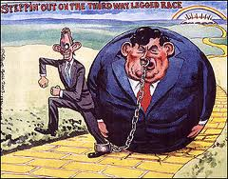
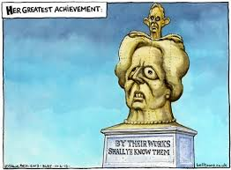
Issues Facing Socialism in the UK
Legacy over ‘winter of discontent’ and relationship with unions
Blamed for the 2007 financial collapse
New Labour accused of ‘losing its soul’ (crisis of Scottish Labour)
Tony Blair Iraq legacy
Borrow and spend economic model

Slide 90
posi

