Slide 1


Political Systems
Part 3 - Judiciary

Slide 2
What you will learn…
Success Criteria – I can…
To identify the judicial components of each system
To compare the political systems in the two countries
Answer essay questions comparing the UK and US political systems

Slide 3
The Judiciary
Comparing and contrasting the Judicial system in the UK and the USA

Slide 4
Key terms
Criminal law deals with crimes by an individual or group against the state, e.g. violent behaviour, serious fraud or burglary; such cases are normally brought by the state
Civil law is concerned with interrelationships between different individuals and groups, for example, matters such as wills or contracts; cases are generally brought by individuals rather than the state

Slide 5
Common law (sometimes called case law or judge-made law) is the term for the body of legal precedent resulting from the rulings of senior judges
Judicial review is the process by which judges review the actions of public officials or public bodies in order to determine whether or not they have acted in a manner that is lawful. Because of parliamentary sovereignty and supremacy of statute law, judicial review in the UK is generally seen as being less significant than in the USA, where the US Supreme Court can strike down regular statutes that are judged to have violated the US Constitution

Slide 6
What is the Judiciary?
In both administrations, the Judiciary is the system of courts which carry out the law.
The Supreme court of the USA is the final court of appeal in the USA.
In the UK, we also have a Supreme court but they are not the same!

Slide 7
Composition

Slide 8
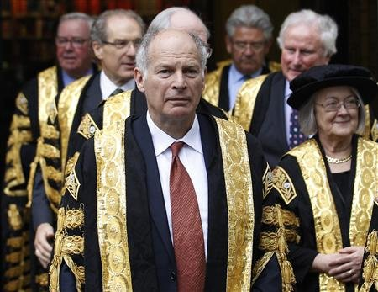
UK Supreme Court
Supreme Court Consists of 12 members.
Maximum who sit in judgement is 9.
Lesser cases will have 7 or 5.
All except one are male.
All have privately educated backgrounds (except Baroness Hale)
This has been a criticism of the Supreme Court – is it representative?
What is the UK Supreme Court?

Slide 9
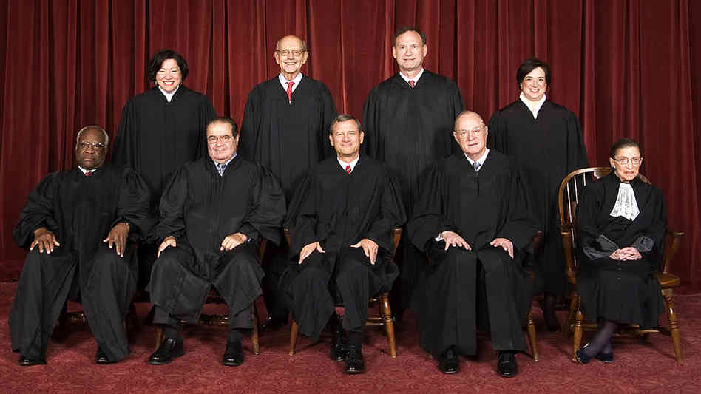
US Supreme Court
The US Supreme court have 9 members.
They all sit at the same time on EVERY case.
They are becoming increasingly diverse.

Slide 10
Some claim that the appointments to the UK supreme court necessarily make them conservative by nature.
Claims could be made that the US supreme court could give a more measured judgement.
There is more consistency in the US system as all justices are present in all judgements. In the UK, the outcome may depend on the luck of the draw!

Slide 11
Appointment

Slide 12
UK Supreme Court
The members of the UK supreme court are not appointed by Parliament.
They are selected from applications when a vacancy arises.
The Committee of Selection comprises members of the Judicial Appointments Commission for all of the UK nations and the President and deputy of the supreme court itself.

Slide 13
Before the creation of the UK supreme court in 2008, the Highest court in the UK was the House of Lords.
As members of the House of Lords are Political Appointments, the formation of the Supreme court was a bid to SEPERATE THE JUDICIAL FUNCTION of the UK Government.
The appointment of Judges now has NOTHING to do with either Parliament OR the Government!
They ARE NOT political appointments!
What is the UK Supreme Court?

Slide 14
USA Supreme Court
To Contrast, US Justices ARE political appointments!
When a vacancy arises, the President will nominate a prospective member.
This has to be approved by the senate.
How the justices INTERPRET the constitution can be based on their politics.
A President has to live with the appointments of his predecessors.

Slide 15

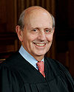
Republicans are more likely to appoint STRICT interpreters of the Constitution
Anthony Kennedy- Reagan
Democrats are more likely to appoint LOOSE interpreters of the Constitution
Stephen Breyer- Clinton

Slide 16
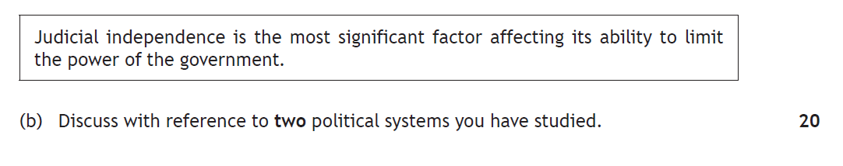
Higher Paper 2017

Slide 17
The roles of the Courts

Slide 18

Judicial Review
The USA has a long history of Judicial Review – in the UK, Judicial Review is far less common and typically weaker.
In the USA, Judicial Review is the process by which the Supreme Court declares that an act of Congress, the actions of the Executive or actions of state governments is unlawful.
This often has the effect of changing the law.
E.g. Roe vs. Wade,
(click image for video)

Slide 19
In the UK, Judicial Review is becoming a feature of the Supreme court.
In the UK, Judicial Review is the process by which Judges review the actions of public officials or public bodies in order to determine whether they have acted in a manner which is lawful.
The court can rule that some government actions may be illegal but they do not have the direct power to change the law themselves; this would have to carried out by the appropriate body following the ruling.
https://www.tutor2u.net/politics/blog/last-minute-judicial-review-examples-for-unit-2
Notes:
https://www.theguardian.com/education/2019/nov/20/oxfordshire-parents-win-right-to-prayer-free-school-assembly

Slide 20
REMEMBER…
The US supreme court can rule actions unconstitutional, changing the law.
This is as a result of the sovereign nature of the codified US constitution.
The UK supreme court cannot do this. Only Parliament can make a change to law.

Slide 21
The USA
As the Constitution of the USA is the supreme law of the country, how the judges interpret it is of huge importance.
E.g. The Death Penalty was reinstated in the USA because the Supreme Court ruled it did not constitute Cruel and Unusual punishment (banned by the constitution) and was therefore legal.

Slide 22
Task
Using the notes you have taken, copy and complete the table below and summarise the key differences between the UK and US judicial systems
UK | US

Slide 23
Documentary
https://www.youtube.com/watch?v=PZtYENfNa7k – The UK Supreme Court: the Highest Court in the Land

Slide 24
Judicial Independence
This is the concept that the courts are independent from the influence of Government.
Clearly, the new UK Supreme court can claim more independence from government DESPITE the clear separation of power in the USA.

Slide 25
Judicial Neutrality
Judicial neutrality is where judges operate impartially, i.e. without personal bias in their administration of justice and is an essential requirement of the Rule of Law.
A lack of judicial independence will threaten judicial neutrality, because if judges are subject to external control their impartiality will be compromised, but it does not guarantee it.
In the UK, judges are not appointed based on their politics but rather on their experience and suitability (they should be neutral, in theory).
In contrast, in the USA appointments to the Supreme Court are very much political – a Democrat President would likely appoint a liberal judge, a Republican President would likely appoint a conservative judge.

Slide 26
How is the independence of the judiciary maintained?
Judicial independence in the UK is based upon six main pillars:
The security of tenure enjoyed by judges
Guaranteed Salaries paid from the Consolidated Fund
The offence of contempt of court
A growing separation of powers.
An independent appointments system.
The training and experience of senior judges – only the best sit on the Supreme Court, usually following a distinguished career.

Slide 27
How is judicial neutrality guaranteed?
It is impossible to guarantee judicial neutrality absolutely, but:
  Judges are expected to maintain a relatively low public profile
  There are restrictions on their political activities
  They must provide legal justifications for their judgements
  They are highly trained and chosen from the ranks of highly experienced lawyers

Slide 28
Threats to judicial neutrality?
Most senior judges come from a relatively narrow social and educational background (rich, privately educated, male, white). Some argue, like John Griffiths, that this trend ensures they belong to an unrepresentative elite.
There has been an increased politicisation of the judiciary in recent years. See reading!

Slide 29
Has the UK judiciary become more politicised in recent years?

Slide 30
Yes...
Politicians have often broken with convention by publicly criticising rulings handed down by senior judges – EU Referendum cases.
Measures such as the Human Rights Act (1998) have drawn senior judges into the political arena by requiring them to rule on the ‘merit’ of individual pieces of statute law as opposed to their ‘application’
The Factortame Case (1990), showed that UK courts are able to ‘suspend’ Acts of Parliament where they are found to contradict EU law.

Slide 31
No...
The process by which senior judges are appointed in the UK has been made more transparent and less open to accusations of political interference
‘Politicisation’ is often associated with a loss of judicial independence, but the UK senior judiciary has in fact become more independent as a result of the Constitutional Reform Act (2005)
Increased conflict between judges and politicians is ‘good’ as it shows that the courts are challenging the government
Senior judges still benefit from security of tenure and guaranteed salaries, insulating them from political pressure

Slide 32
Task
Read the article on the UK Judiciary and then answer the following questions
What is Judicial Independence (Politics.co.uk, 2012)
What is the function of the judiciary in the UK?
Why is judicial independence important and in what ways is it guaranteed in the UK?
Why may some people argue that judicial independence in the UK is unstable?
Is the UK Supreme Court a neutral body? Explain your answer.

Slide 33
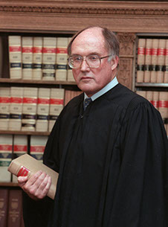
An independent judiciary is “one of the crown jewels of our system of government”.
- William Rehnquist, Chief Justice of the Supreme Court (1996)

Slide 34
How is the independence of the judiciary maintained? USA
Judicial independence was ensured in the Constitution in 3 main ways:
Federal Judges are appointed; this frees judges from having to run for election, raise money, and take a partisan stand on issues. Thus, once appointed they don’t have to please their constituents to try to gain re-election, and can simply do their job
Federal Judges serve a life term; lifetime term provides job security, and allows appointed judges to do what is right under the law, because they don’t have to fear that they will be fired if they make an unpopular decision.
Protection of Salary; judges cannot be punished with a reduction in salary. This security allows judges to decide each case strictly in terms of the legal issues in front of them, no matter how unpopular their decisions may be. Congress sets the salary of judges in the federal system. This salary can be raised but cannot be decreased once the judge has taken office.

Slide 35
Can the US Supreme Court be neutral and independent?
In order for America to be a democracy the judiciary, i.e. the Supreme Court, needs to be independent and a-political.
If not, then what is good for the people and for America may be ignored in favour of judgements that favour a particular political Party or viewpoint.
http://judiciallearningcenter.org/judicial-independence/

Slide 36
Can the US Supreme Court be neutral?
The Supreme Court can be viewed as a-political because, although Justices are nominated by the President, that nomination has to be ratified by the Senate.
As there is never any real guarantee that the party controlling the Senate will be the President’s Party, this can be seen as an assurance that the President will not be able to select a judge who will just rubber-stamp anything the President’s party wishes.
In this way, theoretically, the Supreme Court stays independent from political bias, although if the Senate is controlled by the president’s party, they may just sign off on whomever he wants to put in, knowing it would benefit their Party.

Slide 37
Can the US Supreme Court be neutral and independent?
However, despite the nominees having to be ratified, the power of appointment does belong to the President, and so he can choose nominees who share his political beliefs, and keep on choosing them until the Senate ratifies one, as the Senate cannot make such a choice. It is likely, that had President Obama had another term in office, he would have nominated someone else to the Supreme Court after the Senate refused to ratify Merrick Garland in 2016.
All nominees, in recent years at least, have been in some way connected to the president or his Party, if not necessarily their philosophy.
This negates the idea of judicial independence because a Justice would have been chosen because his political views coincide with the President’s, and any personal connection with the nominee could lead to the new Justice being swayed by the President’s political wishes, resulting in a politicised Supreme Court.

Slide 38
Can the US Supreme Court be neutral and independent?
Many would argue that the US Supreme Court cannot be entirely neutral until is entirely representative of the nation.
Read the Yolanda Young article from the blog then answer the following question:
To what extent is the US Supreme Court currently a representative and neutral body?

