Slide 1
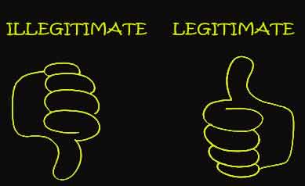
Legitimacy
Lesson starter:
Describe what legitimacy is, in your own words.
Give an example of a leader or group who lack legitimacy. Explain why they do.
Notes:
The sense of rightfulness; that a person or group are the rightful leader (s). Rightful power.
E.g. – Gordon Brown, Theresa May

Slide 2
We are learning to…
Success Criteria – I can…
Summarise the importance of legitimacy with relevant examples
Explain the consequences of a lack of legitimacy
Use my knowledge and examples in a 20 mark essay on Power, Authority and Legitimacy

Slide 3
Legitimacy: The Sense of Rightfulness
Legitimacy is usually defined as ‘rightfulness’.
If power is the ability to get other people to do what you want them to do, authority can be seen as having the right to do this.

Slide 4
Legitimacy
If governments are not legitimate then holding the state together will become difficult.
Weber defined legitimacy as being the right to rule. Therefore, as long as people were prepared to comply, a system of rule can be described as legitimate.
Weber’s definition was entirely separate from any moral or rational basis for legitimacy.
This is at odds with most political theorists who would argue that there are distinct differences between legitimate and illegitimate rule.

Slide 5
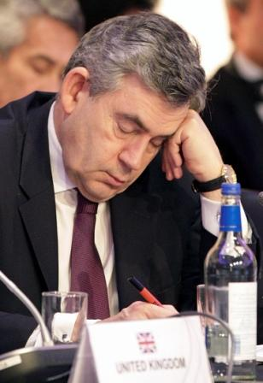

Lack of Legitimacy Example
Gordon Brown PM
Chancellor of the Exchequer from 1992 – 2007 under Blair
Popular chancellor, seen as staid
and reliable
10 May 2007, Tony Blair resigned
Brown won Labour nomination and became PM
Did not call a new election
Unpopular Prime Minister – blamed for economic problems
Resigned after 3 years
However, he had all the powers that Tony Blair (a strong PM) had as PM,
So if he has the power why not the Authority?
Brown’s unelected inheritance of Blair’s power was seen by many as illegitimate (he ran almost unopposed for labour leader), in that since there was no general election, Brown was not the ‘rightful’ PM.

Slide 6
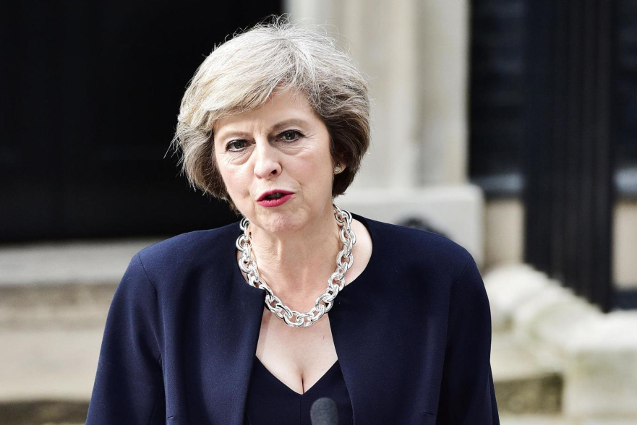
Lack of Legitimacy Example
Theresa May
British Prime Minister
Home Secretary 2010 – 2016 – a popular Home Secretary, seen as tough and ‘no nonsense’
David Cameron resigned post Brexit (2016), Theresa May won leadership election unchallenged (opposing candidate dropped out)
Lacked legitimacy as she hadn’t won an election
Called General Election in 2017 to gain a strong majority
Conservative majority lost – seats dropped from 330 to 317
Had to form alliance with right wing Northern Irish DUP
Hasn’t won an election, claims of ‘strong and stable’ ridiculed

Slide 7
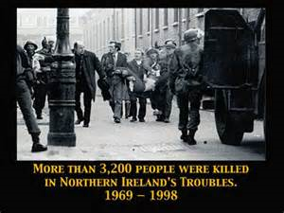
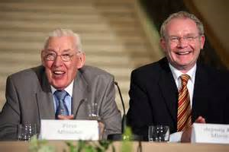
Government of Northern Ireland
Until relatively recently, a significant number of people (mainly Catholics) did not see the political system as legitimate
The government eventually sent in British troops and other means to maintain their power
AKA ‘The Troubles’ – ultimately civil war
The Nationalists (Catholics) felt discriminated against by the Unionist (Protestant) majority
The main attempts to resolve the Troubles have focused on trying to establish a government everyone sees as legitimate
The Good Friday Agreement 1998 introduced a power-sharing system between the Unionists and Nationalists (although this has recently been in crisis)
Notes:
https://www.youtube.com/watch?v=HzSTiOFndN4

Slide 8
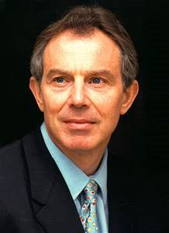
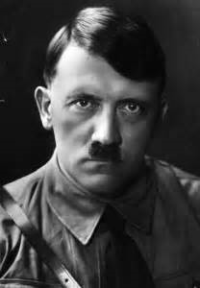
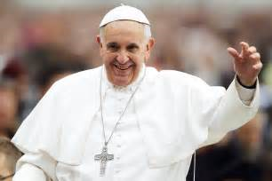
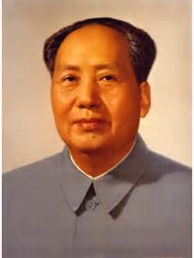
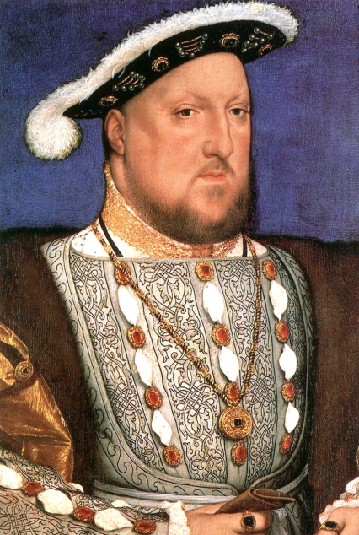
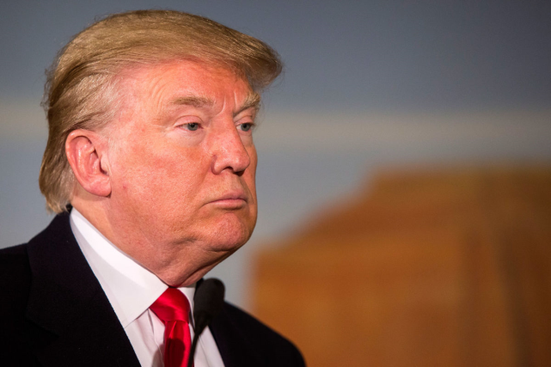
What gives a person or group legitimacy?

Slide 9
The Different Ways in which Legitimacy may be enabled
Communism – legitimacy came from having won a civil war or an uprising; the Victors in a struggle
Constitutionalism - The popular belief and acceptance that the actions of the government are legitimate because they abide by the law codified in the political constitution.
Democracy: The elected government abides by democratic principles in governing, and thus is legally accountable to its people
Fascism: Fascism based its political legitimacy upon the arguments of traditional authority; respectively, the German National Socialists and the Italian Fascists claimed they were legitimate because democracy was not
Monarchy – The ‘Divine Right’ of Kings – chosen by God

Slide 10
The impact of Lack of Legitimacy what happens when a leader or government loses or lacks legitimacy?
Political Unrest – for example Catalonia – The Spanish government’s violent reaction to the Catalonian’s ‘illegitimate’ referendum
Civil War/ Violence – for example The Troubles in Northern Ireland as the Catholic minority believed the government lacked legitimacy
Political Instability – for example Weimar Germany’s successive coalition governments and lack of majority governments led to 9 elections in 10 years 1918-28 and the eventual collapse of German Democracy
Power Vacuum/ Power Struggle– for example when Saddam Hussein was deposed/ died it led to conflict between the Sunni and Shi’ite Muslims in the country
These results are often interlinked

Slide 11
Legitimacy and the Electoral System
For a government to be legitimate, they must have the authority to act on behalf of the people.
A crucial part of our political process which produces legitimacy is the electoral system. It should be fair, free and competitive.
In Britain, in particular, the legitimacy of governments has been increasingly called into question because of the way in which the electoral system works.
Specifically, this has involved the increasing failure of the electoral system to produce proportional results, and governments, which reflect the will of the people.

Slide 12

Is the British political system legitimate?
The UK Government is elected using a system called First Past the Post
In groups, create a spider diagram on how this system works

Slide 13

Higher Politics Class Pet
Cat
Budgie
Iguana
Hamster

Slide 14
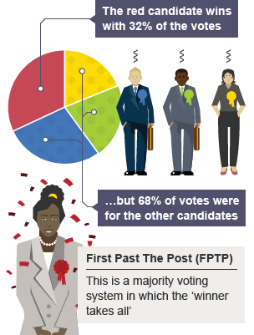
FPTP
Simple Voting System
‘Winner Takes All’
Easy to understand and simple
Easy to see who wins

Slide 15
Why do some people say governments elected through FPTP lack legitimacy?
The % of votes a party gets across the country does not relate to the % of seats they take in the House of Commons
Many votes are wasted or surplus – once someone has ‘won’ the other votes don’t matter
It means British governments have rarely achieved 50% or more of the popular vote
One party can actually form a government with fewer votes nationally than a competitor
Many critics of FPTP argue that it produces governments which lack legitimacy

Slide 16

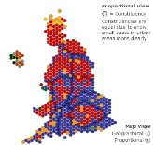
UK Electoral System
The 2015 General Election has been described as THE most disproportionate election result of all time.
The Conservatives were elected to run the country, on its own for five years, on the basis of 36.9% of the votes cast.
UKIP won almost 4 million votes but gained just 1 MP.
Had STV or a more proportional system had been in place, UKIP would have won 54 seats, the Liberal Democrats 26, instead of 8, and the Greens 3 instead of 1.

Slide 17
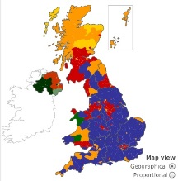
Legitimacy and the Electoral System
Nationally this means that governments in Britain are very rarely elected with more than 50% of the vote in a General Election.
In fact in the 20th century this has happened only twice, in 1900 and in 1931.
The system can also produce a situation where one party can win more seats than any other, but with fewer votes than another party.
This happened in February 1974 when the Conservatives polled 37.9% of the vote, with Labour second with 37.1%. However Labour had 301 MPs to the Conservatives 297, and, as such, formed the government.

Slide 18
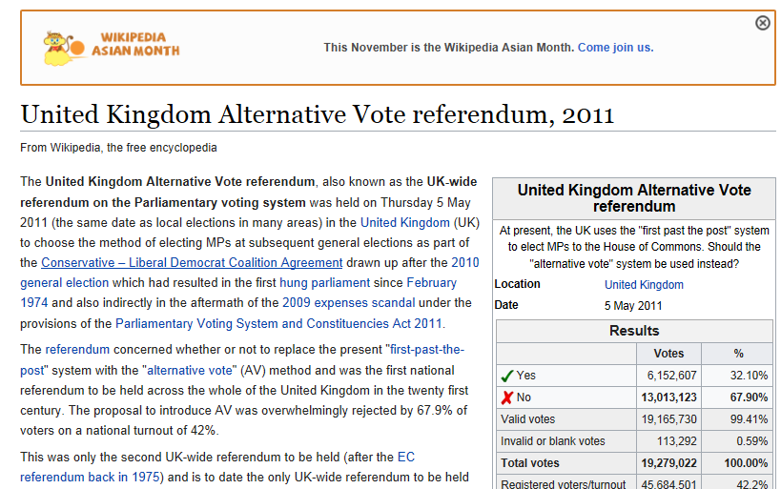
However…
In 2011, a referendum was held offering the British people the option to keep FPTP or move to the more proportional Alternative Vote (AV) system
Turnout was 42.2%
67.9% of those voted to keep FPTP
However is this a legitimate referendum?
Also – many people argue FPTP is simple, produces a clear winner quickly and is easily understood by people (especially old people)

Slide 19
Debate Topic
Britain should abandon FPTP in favour of a system which produces governments with legitimacy.
SUPPORT –
OPPOSE –

Slide 20

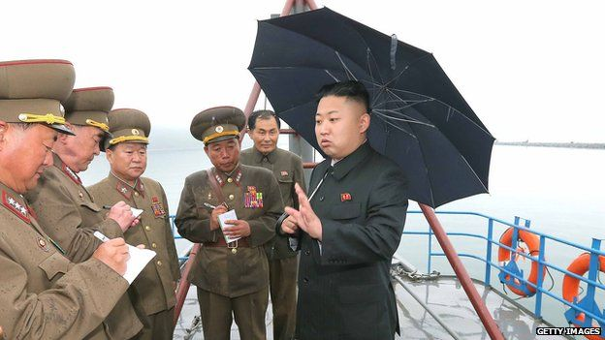
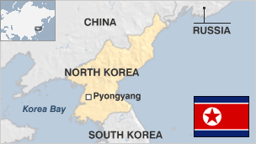
Legitimate Rule Example
North Korea
Kim Jong-un is the third supreme leader in the Kim dynasty, founded by his grandfather Kim il-Sung, the country's leader at the time of its establishment.
Kim Jong-un took over from his father Kim Jong-il.
Heavily criticised as no democratic elections are held
Leadership dependant upon the cult of personality, no free press and accused of sustained human rights abuses.

Slide 21
Legitimate Rule?
North Korea
This would suggest power without legitimacy.
In addition, North Koreans are legally expected to turn up to vote but they do not make a choice.
Ballot papers have already been filled out with pre-approved candidates. Usually have one candidate on the ballot paper.
Voting is compulsory for everyone over the age of 17. Failing to take advantage of the opportunity to show support for the government is tantamount to treason.
It is regarded as political offence as it means that, politically, someone is against the regime.
Therefore no such thing as democratically elections therefore the regime has power but lacks legitimacy.
Elections are just for show and used as propaganda by the regime to show that people are supporting the Kim regime.

