Slide 1
2017 Question
Our Question:
Analyse the relevance of Max Weber’s types of authority. 12

Slide 2
Intro – Good Practice & helpful for structure
Background & Factors you will discuss.
Authority can be described as ‘rightful’ power. (background) Max Weber described three types of Authority; Traditional, Charismatic and Legal Rational. (factors)

Slide 3
Para 1 – Traditional Authority
The first type of Authority is Traditional Authority.(topic sentence)
This can be described as… (K – description – how does it work? Mention monarchy, hereditary etc)
An example of this would be (K – example- British Royal Family)
It can be argued that (analysis – why good/ bad? Is it good for citizens, can it be abused etc., is it still relevant?) is it still relevant?)

Slide 4
Para 1 – Traditional Authority
The first type of Authority is Traditional Authority. (topic sentence)
This form of authoritative power comes from established customs passing power down on a hereditary basis; for example, the British Monarchy. This type of authority relies on the unquestioning acceptance of hereditary systems of power and privilege. This type of authority is often based on ideas of traditional and established values, ‘respect for elders’ and the idea that it is ‘right’ to accept the authority of certain people or groups as it has always been that way. (K - description) x 2
An example of this would be the British Monarchy. The British Royal family could be said to have traditional authority (although they have little real power) and people accept their rule due to the log-standing British tradition of having a monarchy. Their authority is passed on through descendants i.e. Prince Charles will become King after Queen Elizabeth.
(K - example) x 1
It can be argued that this type of power is unquestioned because it has always existed and therefore this traditional authority can be open to abuse by those who want absolute power – expecting citizens to follow their will because it is ‘right and just’ This type of authority is still relevant as many countries still have monarchies. However, it may be of less significance in Western Liberal Republics i.e. Germany, USA as they have no monarchy.
(analysis) x 2

Slide 5
Para 2 – Charismatic Authority
The second type of Authority is charismatic authority. (topic sentence)
This can be described as… (K – description – how does it work? Mention cult of personality)
An example of this would be (K – examples – Hitler, Stalin, Kim Dynasty)
It can be argued that (analysis – why good/ bad? Is it good for citizens, stable, sustainable etc.? Is it still relevant?)

Slide 6
Para 3 – Legal-Rational Authority
The third type of Authority is legal – rational authority. (topic sentence)
This can be described as… (K – description – how does it work? Mention elections, constitutions)
An example of this would be (K – example- Tony Blair)
It can be argued that (analysis – why good/ bad? Is it good for citizens, is it democratic, are citizens rights respected etc. is it still relevant?)

Slide 7
Conclusion – Good Practice & helpful for structure
Basic sum up.
In conclusion, Max Weber identified the three main types of Authority as Traditional, Charismatic and Legal- Rational. He argued that these types of authority had moved in a cycle through time; from traditional to charismatic to legal-rational, with the latter being the most relevant in today’s modern democracies.

Slide 8
Analyse the concept of power with reference to the ideas of Steven Lukes. (12) 2015 H Politics Paper

Slide 9
12 mark Responses Analyse… or Evaluate… or Compare
Component | Marks
Knowledge (K) & (KE) i.e. description, explanation, example | 8
Analysis & Evaluation (A) It can be argued that… It is clear that… However… | 4

Slide 10
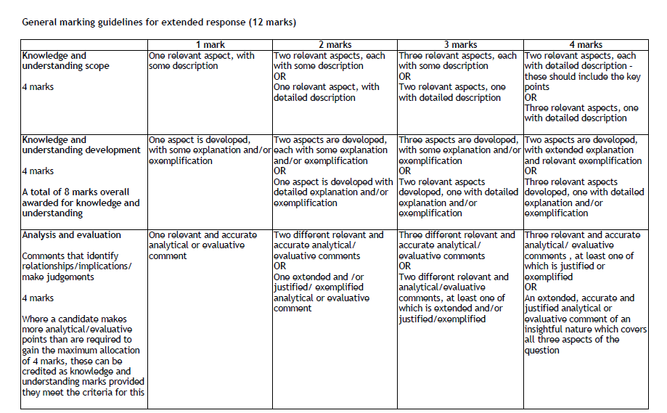

Slide 11
Analyse the concept of power with reference to the ideas of Steven Lukes. (12)
Power is the ability to get someone to do something, which they would not have done otherwise through the use of threats, sanctions, manipulation or rewards.
Lukes’ first face of power: the open face of power, where the decision-making process is considered to be relatively transparent.
Lukes’ second face of power: the secretive face of power, in which the political agenda is set behind closed doors.
Lukes’ third face of power: evident where power is the ability to manipulate the opinions of others in order to persuade them that what is being proposed is desirable.

Slide 12
Intro – Good Practice & helpful for structure
Background & Factors you will discuss.
It is often argued that all politics is about Power; who has it and how much power they have. (background) Steven Lukes’ theory of power consisted of ‘Three Faces of Power’; Decision Making, Agenda Setting and Shaping Desires. (factors)

Slide 13
How to Analyse
Links between different ideas…
This links with the view of…
Similarities and contradictions
This is similar to because…/ This goes against because…
Different views/interpretations
Some would argue that this means …
Possible consequences/implications
As a consequence of this…
It can be argued that…
The relative importance of components
Arguably this is relevant/ important because…

Slide 14
Analysis example
Therefore we could argue that the third face of power is used today by lots of politicians. It is quite different from the first face of power as the public may not know when they are being manipulate and it could lead to Governments making decisions that are not best for the country.

Slide 15
Para 1 – Decision Making
The first and most obvious face of power is the ‘open face’ of power or Decision Making. (topic sentence)
In a modern democracy like the UK, this would consist of the introduction of new laws through parliament. When the UK government proposes a law they produce a bill which will debated in the House of Commons, similarly in the USA a bill will pass through both the House of Representatives and the Senate. In a pluralist democracy, the bill is scrutinised by the media, pressure groups and committees before becoming a law. (K - description)
An example of this would be the Marriage of Same Sex Couples Act in 2013 which had several readings in Parliament, was voted on and scrutinised by committees and pressure groups before being passed as a law. (K - example)
It can be argued that this ‘open face’ of power is the most democratic and transparent as citizens can see the decision making process for themselves; therefore most citizens accept the decision due to the democratic nature of the process. (analysis)
It can also be argued that this type of power is the most commonly seen and relevant in Democratic countries such as the UK as the general public are aware of the passage of legislation through various stages and therefore accept it becoming law. (analysis)

Slide 16
Para 2 – Agenda Setting
The second and more ‘secretive’ face of power is… (topic sentence)
This can be described as…(K – description – how does it work?)
An example of this would be (K – example – Tories % Devolution or Thatcher & Poverty)
It can be argued that (analysis – why good/ bad? Is it Democratic, transparent etc?)

Slide 17
Para 3 – Shaping Desires
The third and most ‘insidious’ face of power is… (topic sentence)
This can be described as…(K – description – how does it work?)
An example of this would be (K – Blair & WMD)
It can be argued that (analysis – why good/ bad? Is it Democratic, transparent etc.?)

Slide 18
Conclusion – Good Practice & helpful for structure
Basic sum up.
In conclusion, Steven Lukes identified the three faces of Power as Decision Making, Agenda Setting and Thought Control. He argued that these faces are exercised by those in power and that the first face or ‘open face’ of power is largely positive whereas agenda setting and thought control can have a negative impact on citizens.

Slide 19
Conclusion – Good Practice & helpful for structure
Basic sum up.
In conclusion, Steven Lukes identified the three faces of Power as Decision Making, Agenda Setting and Thought Control. He argued that these faces are exercised by those in power and that the first face or ‘open face’ of power is largely positive whereas agenda setting and thought control can have a negative impact on citizens.

Slide 20
Past Paper P-A-L 20 markers

Slide 21
20 mark breakdown
Knowledge – up to 8 marks
Analysis – up to 6 marks
Structure – up to 2 marks
Conclusion – up to 4 marks
Where a candidate makes more analytical/evaluative points than are required to gain the maximum allocation of marks, these can be credited as knowledge and understanding marks
You MUST discuss power, authority and legitimacy in order to gain all 20 marks.
If you only speak about two of these concepts your marks are capped at 13.
You MUST complete 4 paragraphs in order to gain the analysis marks.
You may complete 5 paragraphs if you have time in the exam- which is unlikely!

Slide 22
What can I discuss?
Various definitions of power
Lukes’ three faces of power (decision-making, non-decision-making and shapingdesires)
definitions of authority
Weber’s three types of authority (traditional, charismatic, legal-rational)
definitions of the concept of legitimacy
identification of the links between power, authority and legitimacy

Slide 23
Intro
candidates should be credited highly for answers which define the central
issue in their introduction, and provide a clear structure so that their essay develops a line of argument.
So…
Central issue – structure - argument

Slide 24
Power and authority are often used interchangeably; however they are known to describe different aspects of how we are led. This essay will detail how in politics the distinction between Power and Authority comes down to the concept of legitimacy. This essay analyses the work of Sociologists Max Weber and Steven Lukes who have particular theories on power within a state. It can be argued that there are key differences between power and authority and this essay will show that it is legitimacy that creates a sense of rightful power.

Slide 25
Paragraph 1 – Definitions of Power
TS: It has been suggested that all politics is about power, who has it, what they do with it and how they get it.
K – Pick up knowledge marks here for discussion of different types of power – Power Politics, Absolute power. Describe what they are in detail.
K(ex) – Pick up additional K marks for providing detailed examples to go with your descriptions i.e. Hitler & Absolute Power
A – Pick up analysis marks for analysing these types of power – ‘It can be argued that this type of power is largely negative/ positive for citizens because…’

Slide 26
Mini Conclusions at end of paragraphs Good practice & can gain conclusion marks
Therefore, it can be argued that… (basically summarise the main content & arguments of that paragraph)
i.e. Therefore it can be argued that Lukes defined the three faces of power as Decision making, Non decision making and Shaping Desires and he argued that the first face was an open and visible face of power whereas the other two were more secretive and less visible to citizens, making them less transparent and democratic types of power.

Slide 27
Paragraph 2 – Lukes on Power
TS: Theorist Steven Lukes proposed that there were three ‘Faces’ of Power.
K – Pick up knowledge marks here for describing the three different types or ‘Faces of Power’ in detail
K(ex) – Pick up additional K marks for providing detailed examples to go with your descriptions i.e. Tony Blair WMD & Thought Control
A – Pick up analysis marks for analysing these types of power – ‘It can be argued that this type of power is largely negative/ positive for citizens because…’

Slide 28
Paragraph 3 – Authority
TS: It can be argued that authority is ‘rightful power’ where the group or person in power is seen as ‘legitimate’ due to this.
K – Pick up knowledge marks here for describing what authority is – how can you get it? What happens if you don’t have it?
K(ex) – Pick up additional K marks for providing detailed examples of people groups who have/ lack authority i.e. Gordon Brown as PM, Theresa May, N Ireland
A – Pick up analysis marks for analysing the importance of authority/ effects of losing it– ‘It can be argued that if a government lacks legitimacy…

Slide 29
Paragraph 4 – Weber on Authority
TS: Theorist Max Weber believed that it did not matter how one got authority as long as they had it. He believed there were three types of authority.
K – Pick up knowledge marks here for describing the Three types of authority – traditional, charismatic, legal-rational
K(ex) – Pick up additional K marks for providing detailed examples of people groups who have each type i.e. The British Monarchy, Hitler, Blair
A – Pick up analysis marks for analysing each type of authority ‘It can be argued that this type of authority is beneficial/ harmful for citizens because…

Slide 30
Paragraph 5 – Legitimacy
TS: Legitimacy, or the sense of Rightful power, is essential to maintain authority.
K – Pick up knowledge marks here for describing the definition of legitimacy and the ways of getting it i.e. elections, winning civil wars
K(ex) – Pick up additional K marks for providing detailed examples of people groups who have had or lacked legitimacy i.e. Blair’s New Labour in 1997, Northern Ireland’s government
A – Pick up analysis marks for analysing the effects of no legitimacy ‘It can be argued that if a government lacks legitimacy this can lead to… AND/OR
Analyse the legitimacy of the British electoral system FPTP

Slide 31
Conclusion – 4 marks
It should;
Directly address and evaluates the key issue in the question, providing example (s)
Provide a high level of sophistication as it develops a line of thought with supporting justifications

Slide 32
SQA Example 4 marks
In conclusion, it is clear that legitimacy provides the link between power and authority. For someone to have authority they must also possess legitimacy. For example, when Gordon Brown became PM he had all the formal powers of the prime minister but he did not have the same authority as other prime ministers as he had not been voted in by the people. He lacked the legitimacy, or the rightfulness to rule, as he did not have the consent of the people gained by being the winner of an election. As a result, critics claimed that he lacked authority — people did not accept that he had the right to rule without the consent of the voters and he was frequently challenged to call an election to gain the legitimacy he lacked. If power is the ability to get other people to do what you want them to do, authority can be seen as having the right to do this. The key to the difference between this is what creates the sense of rightfulness — i.e. legitimacy. In political systems where the rulers lack legitimacy (e.g. by holding elections), they are not seen as having the right to rule and have to rely on coercion to maintain their power. This could be exercised through threats or sanctions such as military force, or through manipulation such as control of the media.
This provides a very detailed conclusion which directly addresses and evaluates the
key issue in the question and provides a high level of sophistication as it develops a
line of thought with supporting justifications (4 marks).

