Slide 1

Democracy
What is democracy?
Is democracy a good or bad system? Why?

Slide 2
What you will learn…
Success Criteria – I can…
Define the concept of democracy
Describe the different types of democracy
Summarise Democracy’s key ideas in an essay

Slide 3
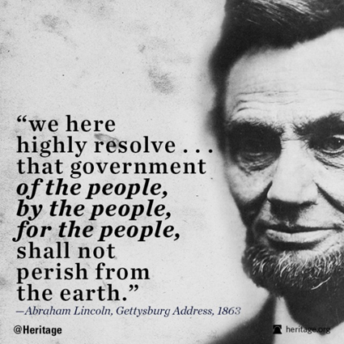
“government of the people, by the people, for the people”
(Abraham Lincoln 1863)

Slide 4
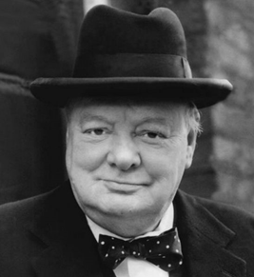
‘Democracy is the worst form of government, except all the other forms that have been tried from time to time”
WINSTON CHURCHILL, 1947

Slide 5


What is democracy?
https://www.youtube.com/watch?v=u6jgWxkbR7A

Slide 6
What is Democracy?
The origins of the term ‘democracy’ can be traced back to Ancient Greece and is derived from the Greek word ‘Kratos’, meaning power or rule. Democracy therefore means ‘rule by the demos’ (demos referring to ‘the people’).
The conversion of politicians and political thinkers to the cause of democracy has been one of the most dramatic events in political history.
Even in Ancient Greece (often thought of as the cradle of democratic idea) Democracy tended to be viewed in NEGATIVE terms i.e.
Thinkers such as PLATO and ARISTOTLE viewed democracy as a system of rule by the masses at the EXPENSE of wisdom and property.
Well into the 19th Century, the term ‘Democracy’ continued to have pejorative implications suggesting a system of ‘mob rule’.
Notes:
Make pupils aware that the Electoral Commission is an organisation which makes sure elections are carried out properly in the UK.

Slide 7
Two Key Types of Democracy
Direct Democracy – the people vote on every issue directly
Representative Democracy – the people elect representatives to vote on issues on their behalf

Slide 8

StJosephland
Direct Democracy
The leader asks every citizen (660) to vote on every decision
Citizens must come to vote on every issue
Citizens must be involved in every decision whether it is important to them or not
Citizens must vote many times a day
Representative Democracy
The leader asks every citizen (660) to elect year group leaders once a year
Leaders should come to vote on every issue
Citizens don’t need to be involved
Citizens can get on with their daily business

Slide 9
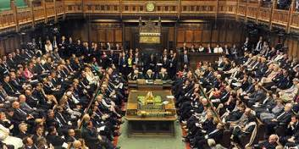
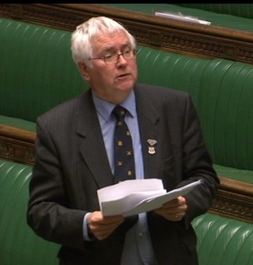
Democracy in the UK
REPRESENTATIVE DEMOCRACY
This means we ELECT officials to represent us and make decisions on our behalf.
We elect MPs to represent us in the British Parliament, Councillors to represent us in local authorities, MEPs to represent us in the European Parliament, and MSPs to represent us at Holyrood
In some Cities across the UK, Mayors are elected too!

Slide 10
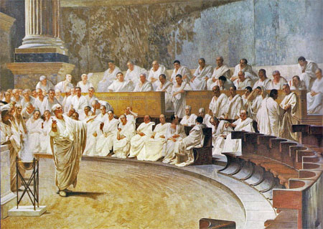
Direct Democracy
1. The Government by the people is often referred to as direct democracy: ‘a system where everyone is allowed to take part in law and decision-making’ (Cordell). Therefore, citizens make the decisions and are expected to participate fully in the political process.
For example:
Athens in ancient Greece about 500 BC, when all free men were entitled to attend forums to approve policies. However, women, children, slaves or those born outside Athens were excluded. Therefore, citizens were only Athens-born men, of a pure Athenian stock.
Notes:
Make pupils aware that the Electoral Commission is an organisation which makes sure elections are carried out properly in the UK.

Slide 11
Direct Democracy key features
Direct, constant and unhampered involvement of people in political life
No formal distinction between the people and the government, they are in practice one and the same. There are no professional politicians
It can be described as a system of self-government
Politics is constant: permanently consultative and active
Notes:
Make pupils aware that the Electoral Commission is an organisation which makes sure elections are carried out properly in the UK.

Slide 12

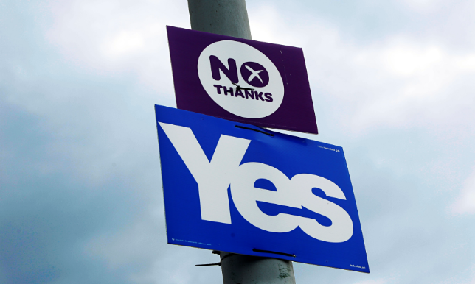
Direct Democracy
In a DIRECT democracy (such as the one which operated in Ancient Athens) citizens voted on every issue which concerns them.
This idea of direct democracy is often considered ‘unworkable’ in modern states and only really continues to exist in a few places, for example; township meetings in New England or the Cantons of Switzerland.
However, direct democracy does exist to an extent in the form of referenda (or propositions in the USA)
In 2011, UK voters had a referendum on whether to change the voting system to AV (Alternative Vote)
In 2014, Scottish voters had a referendum on whether Scotland should be an independent country
In 2016 UK voters had a referendum on whether the UK should remain part of the European Union.
Notes:
CANTONS-
https://www.youtube.com/watch?v=y5W45Va0cPE

Slide 13
Direct Democracy
Current Examples
Although Switzerland is not a true direct democracy, any law that is passed by the national legislative branch can be vetoed by the general public if put to a public vote.
Additionally, citizens can directly petition to change the Constitution through a direct vote on an amendment.
In some districts of Switzerland, they still have Landsgemeinde, or assemblies, where people assemble in open air on a certain day to decide and vote on the laws of their society.
This makes Switzerland the most prominent modern democracy to use elements of direct democracy.
Notes:
LANGS-GE-MINDE
CANTONS-
https://www.youtube.com/watch?v=y5W45Va0cPE

Slide 14
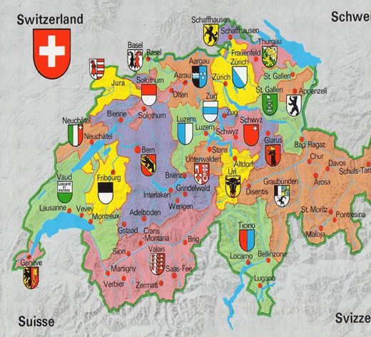

Slide 15
Direct Democracy
Who are the People?
The ‘people’ is now accepted as meaning almost all adult citizens, who can be viewed as one body with a common or collective interest. This is close to Rousseau’s ideas of a ‘general will’.
But divisions and disagreements exist in all communities, so ‘the people’ can also mean ‘the majority’.
Democracy can come close to being ‘majority rule’ reflecting the ‘tyranny of the majority’.
Notes:
Make pupils aware that the Electoral Commission is an organisation which makes sure elections are carried out properly in the UK.

Slide 16
Direct Democracy
Summary Box
Direct Democracy is based on the direct, unmediated and continuous participation of citizens in the tasks of government.
Direct Democracy therefore removes the distinction between government and the governed.
It is seen as a system of popular self-government and was achieved in Ancient Athens through a form of Mass Meeting.

Slide 17
Advantages and Disadvantages
Task
Consider the following questions:
What are the benefits of direct democracy?
What are the pitfalls?
You have 5 mins, on your own, to note down as many advantages and disadvantages as you can.
Now share with your partner, then share as a four.
Notes:
Make pupils aware that the Electoral Commission is an organisation which makes sure elections are carried out properly in the UK.

Slide 18
Advantages of Direct Democracy
(also known as ‘Features’)
You will be given a sheet with features of direct democracy as well as a list of political theorists who advocate for and against the two types for Direct or Representative democracy.
We will discuss these as a class.
This will help you with your essay.

Slide 19
Advantage of Direct Democracy 1:
Heightens Control
One benefit of direct democracy is that…
This means that…
An example of this is….
However…
Mini Conclusion
Therefore…

Slide 20
Advantage of Direct Democracy 2:
Politicises citizens
One benefit of direct democracy is that…
This means that…
For example….
However…
Mini Conclusion
Therefore…

Slide 21
Advantage of Direct Democracy 3:
Public don’t have to rely on self-serving politicians
One benefit of direct democracy is that…
This means that…
For example….
However…
Mini Conclusion
Therefore…

Slide 22
Advantage of Direct Democracy 4:
Legitimacy
One benefit of direct democracy is that…
This means that…
For example….
However…
Mini Conclusion
Therefore…

Slide 23
Problems with Direct Democracy
The most influential critic of direct democracy was the philosopher Plato.
Plato attacked the principle of political equality on the grounds that the mass of people possess neither the wisdom nor experience to rule wisely on their own behalf. Plato was essentially arguing that the ‘masses’ don’t know what is best for them.
The principle drawback of Athenian democracy was that it could operate only by excluding the mass of the population from political activity.
Notes:
Make pupils aware that the Electoral Commission is an organisation which makes sure elections are carried out properly in the UK.

Slide 24
Problems with Direct Democracy
Participation was restricted to Athenian-born males who were over 20 years old. Slaves (the majority of the population), women and foreigners had no political rights whatsoever.
Indeed, Athenian citizens were only able to devote so much of their lives to politics because slavery freed them of the need to engage in arduous labour. Women were also confined to the home.
Therefore, the Athenian Polis could be seen as the antithesis of the democratic ideal.
Notes:
Make pupils aware that the Electoral Commission is an organisation which makes sure elections are carried out properly in the UK.

Slide 25
What have you learned?
What is the difference between Direct and Representative Democracy?
What type of democracy do we have in the UK? How does it work?
Give an example of Direct Democracy in the UK in the last 10 years.
Why do some people say Direct Democracy is ‘unworkable’?

Slide 26
Direct Democracy Examples
In Ancient Athens, direct democracy was used. All male Athenian citizens would meet regularly and vote on issues which concerned them, including laws.
In small cantons of Switzerland, citizens have been allowed to take part in direct democracy
In New England in the USA, small townships use direct democracy to make decisions
In the UK, Referenda have been used in 2011, 2014, 2016 to decide on important issues such as Scottish Independence

Slide 27
Task
Take the sub-heading ‘Direct Democracy’ – Describe in detail what is meant by direct democracy, provide examples of current direct democracies
Write a K.A.C paragraph plan on each of the FOUR main advantages of Direct Democracy – Analyse EACH of the four arguments.
ESSAY:
Analyse the key features of direct democracy (12).
In your answer you should refer to the ideas of a relevant theorist
12 marks
Notes:
Make pupils aware that the Electoral Commission is an organisation which makes sure elections are carried out properly in the UK.

Slide 28

What are the most important reasons for Democracy?
Add reasons on why you think that this type of pressure group is powerful or not.
Most Important
Least Important

Slide 29
What are the most important reasons against Democracy?
Add reasons on why you think that this type of pressure group is powerful or not.
Most Important
Least Important

Slide 30
Representative Democracy
Starter:
Draw a spider diagram which outlines the four key features/ advantages of Direct Democracy.

Slide 31
Representative Democracy
Summary Box
Representative Democracy is a more limited and indirect form of democracy.
Participation in government is infrequent and brief, e.g. through voting in elections, the most important feature of representation.
In a representative democracy the ‘public’ do not exercise power themselves, they select (elect) those who will rule on their behalf.
This form of rule is only democratic because choosing a representative forms an effective link between the government and the governed.

Slide 32


Representative Democracy
In the UK and most democracies, we have representative democracy; we elect people to make decisions on our behalf.
In the UK we do not elect everyone who makes decisions – the USA elects a lot more than we do.
They Work for You
Notes:
Make pupils aware that the Electoral Commission is an organisation which makes sure elections are carried out properly in the UK.

Slide 33

Or do they?
Party whips
Outside interests
Themselves
Mark Harper MP, Government Chief Whip

Slide 34
Party whips
The Chief Whip is responsible for administering the whipping system that ensures that members of the party attend and vote in Parliament as the party leadership desires.
Whips are MPs or Lords appointed by each party in Parliament to help organise their party’s contribution to parliamentary business.
One of their responsibilities is making sure the maximum number of their party members vote, and vote the way their party wants.

Slide 35

Party whips
‘The Whip’ refers to a document sent out weekly to MPs detailing the forthcoming business of the House.
Items are underlined once, twice or three times to indicate their importance to the party leadership.
When a ‘three-line’ whip is issued, the leadership is letting MPs know that it expects them to turn up and vote on the matter under discussion!
An MP who ignores or disobeys the party whip will have his/her promotion chances diminished and ultimately runs the risk of being suspended from the parliamentary party and being de-selected as a future parliamentary candidate.

Slide 36
Outside interests?
MPs and members of the House of Lords are required to declare certain financial interests. These are recorded in the Register of Members' Financial Interests and the Register of Lords' Interests respectively.
In 2015 an investigation by the Daily Telegraph newspaper discovered that MPs declared earnings of more than £7.4 million from outside work and second jobs, with some making more than £1,600 per hour. Gordon Brown, the former prime minister, declared additional income of close to £1 million, followed by Geoffrey Cox, the Conservative MP, who declared earnings of £820,000 — 12 times the annual MP wage.
Do these ‘outside interests’ influence how MPs behave as MPs?
Cash for Access?

Slide 37
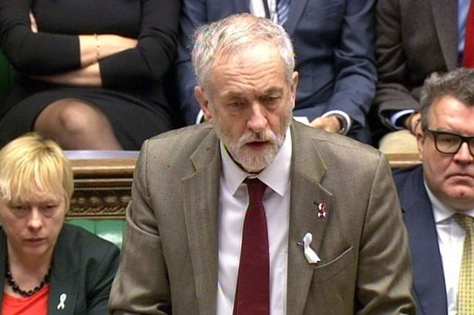
Themselves?
A conscience vote or free vote is a type of vote where MPs are allowed to vote according to their own personal conscience rather than according to an official line set down by the party Whip. Free votes have traditionally been allowed on ethical issues that are seen as a matter of conscience. In 2015 Labour leader Jeremy Corbyn granted Labour MPs a free vote on UK air strikes in Syria.

Slide 38
Representative Democracy Examples
In Britain, every 5 years a General Election takes place. The public elect representatives known as MPs to make decisions on their behalf in the UK Parliament.
In Scotland, every 5 years a Scottish Parliament Election takes place. The public elect representatives known as MSPs to make decisions on devolved matters in the Scottish Parliament, Holyrood.

Slide 39
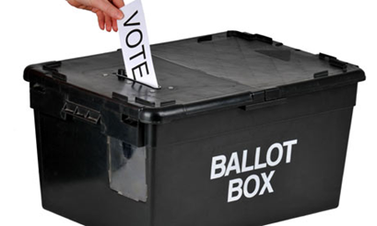
Advantages of Representative Democracy
(also known as ‘Features’)

Slide 40
Advantage of Representative Democracy 1:
It is Practicable (manageable)
One benefit of representative democracy is that…
This means that…
An example of this is….
However…
Mini Conclusion
Therefore…

Slide 41
Advantage of Representative Democracy 2:
It creates a Division of Labour
One benefit of representative democracy is that…
This means that…
An example of this is….
However…
Mini Conclusion
Therefore…

Slide 42
Advantage of Representative Democracy 3:
It uses Expertise & Experience
One benefit of representative democracy is that…
This means that…
An example of this is….
However…
Mini Conclusion
Therefore…

Slide 43
Advantage of Representative Democracy 4:
It provides Stability, Compromise & Accountability
One benefit of representative democracy is that…
This means that…
An example of this is….
However…
Mini Conclusion
Therefore…

Slide 44
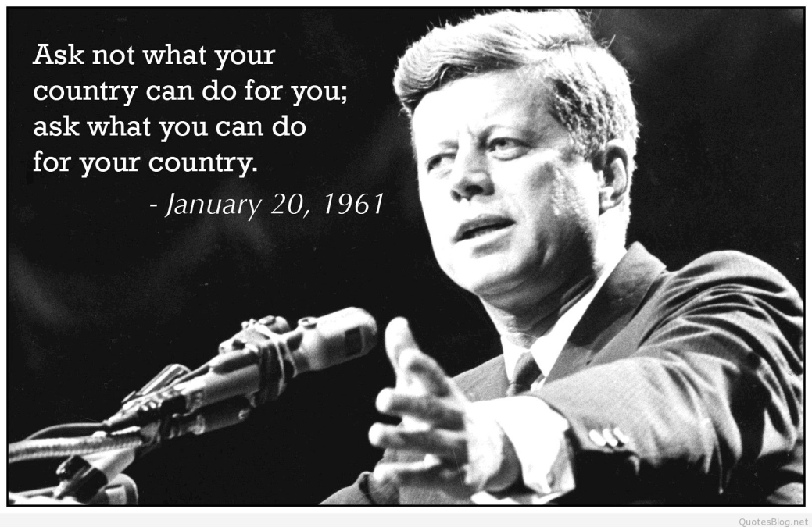


Lesson starter write down what these famous quotes mean in your own words

Slide 45
Democracy Theorists
For a 12 or 20 mark essay in the democracy topic, you are expected to refer to the ideas of political theorists
You should understand what these theorists have said about democracy, and the extent to which they support democracy

Slide 46
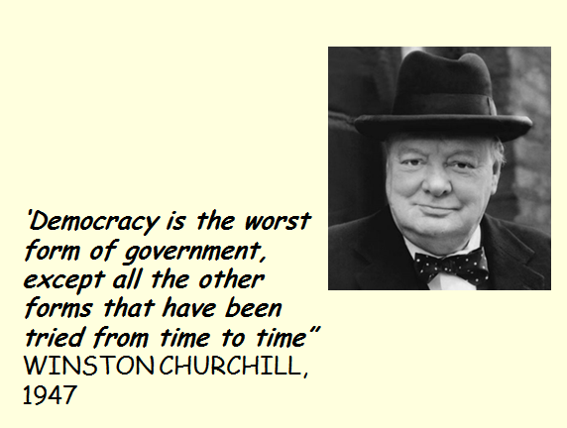

Churchill is saying democracy is far better than any other form of government

Slide 47
Task One – what do they mean?
Read through the Theorists’ views on democracy, highlighting Key Points
Then copy and Complete the table on the next slide, using your own words as much as possible to summarise their arguments/ thoughts on democracy

Slide 48
Theorist | Views on Democracy
Plato | Ancient Greek philosopher – said the State was a ship and we need experts to steer it Believed true democracy was dangerous as it put inexperienced people in control – ‘in a democracy fathers and sons change places’
Macchiavelli
Thomas Hobbes
John Locke
Jean Jacques Rousseau
John Stuart Mill

Slide 49
Theorist | Views on Democracy
Plato | Ancient Greek philosopher – said the State was a ship and we need experts to steer it Believed true democracy was dangerous as it put inexperienced people in control – ‘in a democracy fathers and sons change places’
Macchiavelli
Thomas Hobbes
John Locke
Jean Jacques Rousseau
John Stuart Mill

Slide 50
Task Two – For and Against
Cut out the summary box of each theorist
Decide which order you would place them in from the biggest supporter of democracy to the biggest opponent
Stick them into your notebook in order, making it clear where each theorist would be placed
Supports democracy
Opposes democracy

Slide 51
Theorists who support direct democracy
Theorists who support representative democracy
Jean Jacques Rousseau argued that elections were not good and that people were only ‘free’ when they participate directly and continuously in shaping their community
Alexis de Tocqueville argued that popular elections do not guarantee that wise and experienced people hold public office
Joseph Schumpeter considered representative democracy a credible solution to the problem of most people simply not having the time or expertise to be able to continuously engage in complex political debate.
Robert Dahl argued that competitive elections prevent any permanent elite emerging and ensure wide access to the political process
Plato said that experts were needed to ‘steer the ship’ and direct democracy was ‘sons leading fathers’

Slide 52
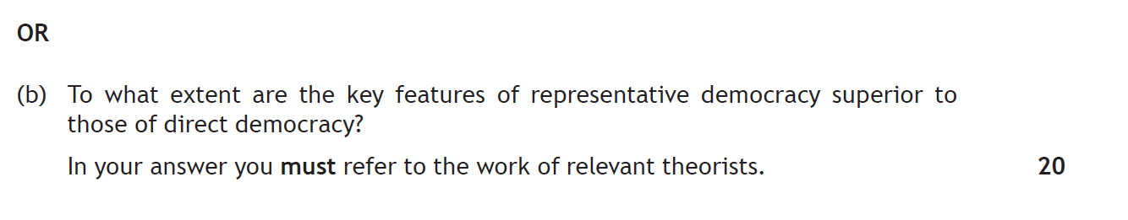
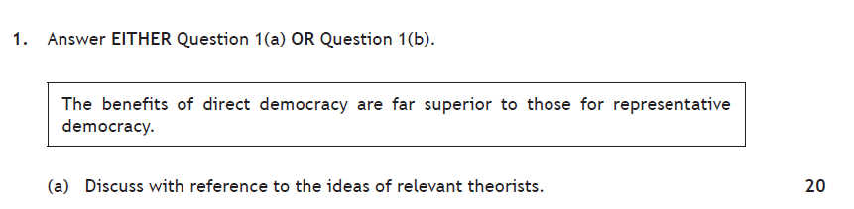
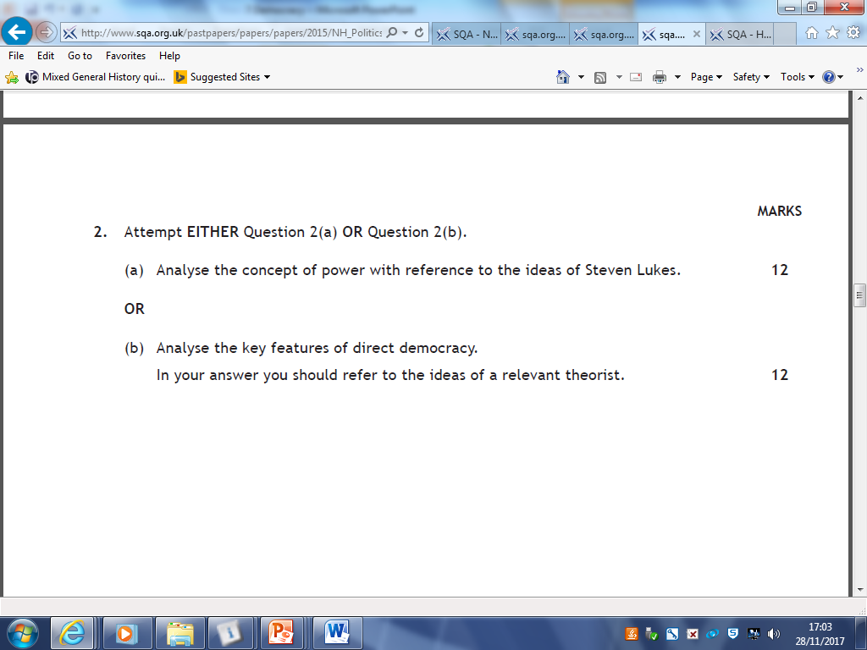
Direct & Representative Democracy in the exam
2018
2017 Comparison source question
2016
2015

Slide 53
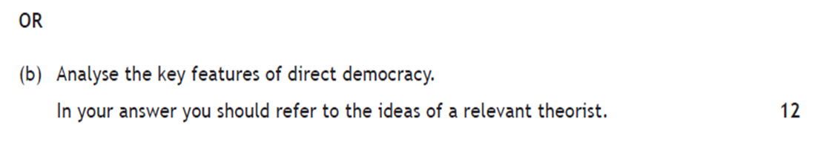
12 mark Question

Slide 54
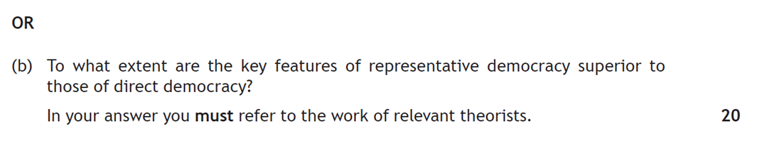
20 mark Question basically will ask if one system is superior to the other
The question will dictate which features you use to structure your paragraph!

Slide 55
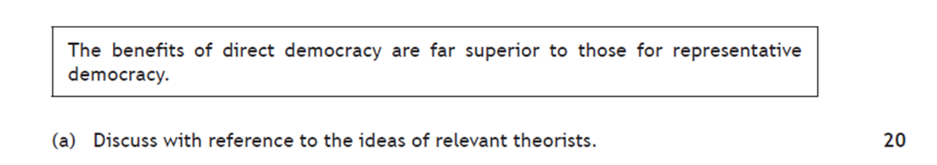
Mark Breakdown
Intro – 2
Knowledge – 8 (max 5 for only description or only examples)
Analysis – 6
Conclusion – 4 (separate or throughout)

Slide 56
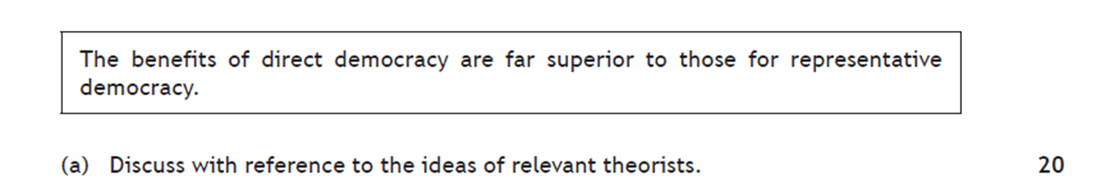
Intro
Background – what is democracy/ how does it work/ type of system/ describe direct & representative democracy
Factors - ^^ Political Theorists have identified a number of benefits of direct democracy such as… (list)
Argument – It can be argued that the benefits of direct democracy ARE/ ARE NOT far superior to those for representative because…(justify)

Slide 57
Essay guidance
This essay will focus on analysis of one type of democracy
This means your will discuss one feature of direct and counter it with a feature of representative
Therefore you must be clear before you begin your paragraphs, which you are arguing is best – as your mini conclusions should back this up
Your final conclusion will then look at the mini conclusions to make a final judgement

Slide 58
Paragraphs
DIRECT DEMOCRACY
Heightens control
Politicises citizens
Don’t have to rely on self-serving politicians
Ensures legitimacy
REPRESENTATIVE DEMOCRACY
Is more manageable/ practicable
Creates a Division of labour
Provides experience and expertise
Ensures accountability. Stability and compromise

Slide 59
Paragraphs
Paragraph Structure
Topic sentence ‘One key feature of direct democracy is…
Knowledge – Describe the feature in detail
Example – use an example that backs this up
Analyse – ‘Therefore it can be argued that direct democracy’…
Comparison – In contrast, it can be argued that Representative democracy (now repeat steps 2-4 for this feature
Mini conclusion – ‘Overall, it is clear that the direct/ representative democracy is superior because.. (provide Highly detailed evidence to support)
You must include a Theorist's view in at least two paragraphs!

Slide 60
Example Paragraph
One key feature of direct democracy is that it heightens control. This means that citizens are directly involved in decision making on matters which directly affect them and therefore those participating in this purest form of democracy are ultimately shaping their own destiny in regular participation in voting directly on matters which concern them. For example, in 2014 Scottish citizens were able to directly participate in deciding Scotland’s future when they participated in a referendum on whether Scotland should be an independent country, this was seen as too important a decision to be taken by representatives. Therefore it can be argued that direct democracy is advantageous because it allows citizens to have a direct say in matter which affect their daily lives. In contrast, It can be argued that Representative democracy is more manageable and practicable in a modern democracy like the UK where it is not seen as realistic to consult an electorate of 45 million citizens on every issue that concerns them. For example, in Ancient Athens it is estimated that only around 40,000 males participated in Direct Democracy due to the small scale of the city compared to present day so direct democracy was a more realistic possibility in Ancient Greece. Therefore it can be argued that representative democracy is far more manageable and feasible when presented with a large electorate and it is not realistic to ask citizens to vote regularly on every matter which concerns them. Theorist Joseph Schumpeter considered representative democracy a credible solution to the problem of most people simply not having the time or expertise to be able to continuously engage in complex political debate.
Overall, it is clear that representative democracy is superior because although direct democracy can give citizens more direct influence in decision making it is completely impractical to involve every citizen in a large modern state in every decision made which affects them. Direct democracy is unworkable and unmanageable in most modern states today due to the number of adults enfranchised. In the USA for example more than 146 million voters are registered and it is not feasible to involve every one in decision making directly, although it may be more workable in smaller areas such as New England townships.

Slide 61
Conclusion
1) In conclusion, it is clear that both Direct and Representative democracy offer advantages to citizens.
2) On the one hand… (summarise advantages of direct democracy here)
On the other hand… (summarise advantages of representative democracy here)
3) Overall, it is clear that the benefits of _____ democracy are far superior because….
This is also the case because…
Therefore it is clear that ______ democracy is superior.

