Slide 1
Stewarton Academy S5 Options Information
DETERMINATION FAIRNESS RESPECT RESPONSIBLE

Slide 2
S5 – Reasons to come back
Attainment in National Qualifications
Subject specific knowledge
1st year of a 2 year pathway
Attainment in vocational qualifications
Not sure what you want to do yet
Transferrable skills development
Post-school transition support
DETERMINATION FAIRNESS RESPECT RESPONSIBLE
Notes:
Open doors to competitive courses.
1st year of two year pathway
Next level of study in subject areas (N5 – Higher)
Study new subject areas
Schools college partnership courses (skills for work / foundation apprenticeships)
Schools DYW Projects – E Vallance (PTPS)

Slide 3

Routes and Pathways
further education
further training
higher education
Modern Apprenticeship
Graduate Level Apprenticeship
employment.
No Wrong Pathways
Notes:
There are a variety of routes and pathways to employment and we aim to support each of these through the curriculum at Stewarton Academy and through the our partnership courses.
In addition to curricular options pupils will have the chance to develop vocational skills, undertake flexible work experience, link in with employers and training providers.

Slide 4
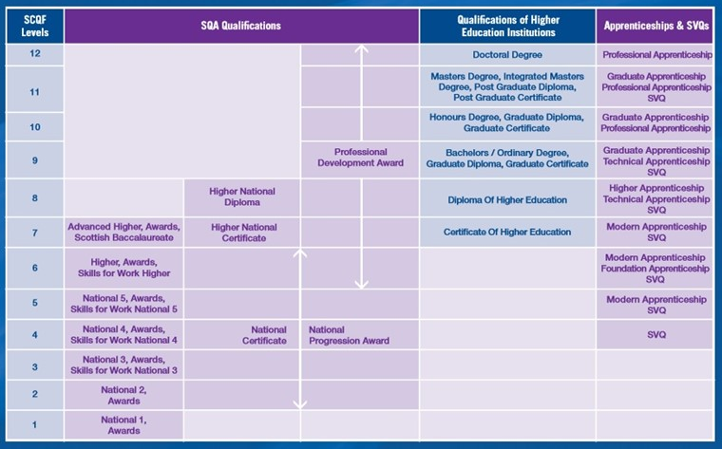
Scottish Credit and Qualifications Framework
This is the system across Scotland which makes sure all qualifications are rated against one framework, from National 1 all the way up to University level and it also includes apprenticeships.
Notes:
Equivalent level does not make them equal. It means they are at a comparable level in terms of knowledge, skills or competence required.
Over 11000 qualifications on this
Interestingly at L6, less than 10% of qualifications are SQA NQs, where as in school less than 10% of our L6 entries are with non SQA NQs (YSL, Enterprise, Ayrshire College certificates)

Slide 5
What do the levels mean?
SCQF level 3: These would usually be National 3, there is no exam at this level.
SCQF Level 4: These would usually be National 4, there is no exam at this level.
SCQF 5:
National 5 (Graded A-D) – for example English, History; these will usually have an external exam
National 5 (Graded Pass or Fail) – for example, Travel and Tourism; these will have no external exam
NPA Level 5 (Graded Pass or Fail) – For example Criminology; there is no external exam
Notes:
Equivalent level does not make them equal. It means they are at a comparable level in terms of knowledge, skills or competence required.
Over 11000 qualifications on this
Interestingly at L6, less than 10% of qualifications are SQA NQs, where as in school less than 10% of our L6 entries are with non SQA NQs (YSL, Enterprise, Ayrshire College certificates)

Slide 6
What do the levels mean?
SCQF Level 6:
Higher (Graded A-D) – for example Maths or Biology; these will usually have an external exam
L6 Creative Thinking – Interactive and immersive project based learning, worth 24 SCQF credits. There is no exam at the end.
SCQF Level 7:
Advanced Higher (Graded A-D) for example, English or Music; these will usually have an external exam.
YASS – (Graded Pass or Fail) – online courses run by the Open University
You should look very carefully at College and University entrance requirements as some courses only accept graded courses and some courses would rather have extra Highers as opposed to Advanced Highers.
Notes:
Equivalent level does not make them equal. It means they are at a comparable level in terms of knowledge, skills or competence required.
Over 11000 qualifications on this
Interestingly at L6, less than 10% of qualifications are SQA NQs, where as in school less than 10% of our L6 entries are with non SQA NQs (YSL, Enterprise, Ayrshire College certificates)

Slide 7
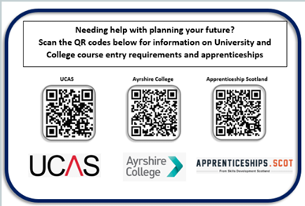
Preparing for Progression
It is really important at this point to consider where your future might b, so you can opt for the correct subjects you will need for your chosen pathway.
This is the time to start doing research. Don’t leave it too late, as you might end up not having the subjects or qualifications that you need.
Useful websites to look at are:
UCAS
Ayrshire college
Apprenticeships Scotland

Slide 8
OLD Vs NEW
Old:
Column Structure
Pick one from each column
Restricted Choice
Cannot always choose your best subjects
New
Free Choice
Pick any subjects that you have previously studied
Less Restricted Choice
Can pick your best subjects
With both systems classes can only run if there are enough pupils who pick that subject , and there are enough teachers available. WE will try our best to match your choices but this may not always be possible.
Notes:
Equivalent level does not make them equal. It means they are at a comparable level in terms of knowledge, skills or competence required.
Over 11000 qualifications on this
Interestingly at L6, less than 10% of qualifications are SQA NQs, where as in school less than 10% of our L6 entries are with non SQA NQs (YSL, Enterprise, Ayrshire College certificates)

Slide 9
School Leaving Age
Turning 16 by or on 30th September – you can leave at the Summer (end of S4)
Turning 16 between 1st October and end of Feb, official school leaving date is end of December
However, you can get an early release from school IF you get on to a full time college course
Applications for both school college partnership and full time courses open on January 19th 2026.

Slide 10
Key messages for S5 pupils
All pupils select 5 subjects. This maybe a combination of academic and vocational (part time college or school DYW course)
No drop policy, you have committed to return to school so you must complete your subjects.
Locked into SQA presentations at the start of September
Attendance and engagement in all classes
If you want to pursue a career in medicine, optometry, vet studies, law you must attain five strong Highers in S5 (Grade A)
DETERMINATION FAIRNESS RESPECT RESPONSIBLE
Notes:
The September date is important. Pupils will start engaging with these course at the change of TT in June, they then have the summer holidays where they receive their SQA certificates, they also have the option to change subjects prior to returning to school if their SQA qualifications went better of worse than they had hoped, any later than the Start of September will put them at a major disadvantage and negatively impact their attainment opportunities so that is why this date is set.
Dropping 1 subject or not completing 5 disadvantages you 20% against other pupils.

Slide 11
Key messages for S5 pupils
Courses in S5 are much more demanding.
Level 6 and higher have in some cases almost double the content of N5 courses.
Commit to the next year of serious studying and ensure you familiarise yourself with the entry requirements of courses you are interested in.
DETERMINATION FAIRNESS RESPECT RESPONSIBLE
Notes:
The September date is important. Pupils will start engaging with these course at the change of TT in June, they then have the summer holidays where they receive their SQA certificates, they also have the option to change subjects prior to returning to school if their SQA qualifications went better of worse than they had hoped, any later than the Start of September will put them at a major disadvantage and negatively impact their attainment opportunities so that is why this date is set.
Dropping 1 subject or not completing 5 disadvantages you 20% against other pupils.

Slide 12
What subjects should I pick for S5
In S5 you must maximise your attainment by picking as many subjects at Higher as you can
. This will give you the best chance of progression to your chosen pathway after school.
You should pick 5 subjects from those you are currently studying in S4. You should pick subjects according to:
The subjects listed as entry requirements for the course you are interested in
Those subjects you are predicted a good pass in
The subjects you enjoy
DETERMINATION FAIRNESS RESPECT RESPONSIBLE
Notes:
I spoke earlier on about my one need from pupils of giving 100% commitment to whichever reason that they are returning for S5.
I also want to highlight the wide range of supports available when pupils are selecting courses and exploring careers. Uni college entry requirement and even relevant skills and knowledge when applying for apprenticeships and jobs are linked to subject areas,

Slide 13
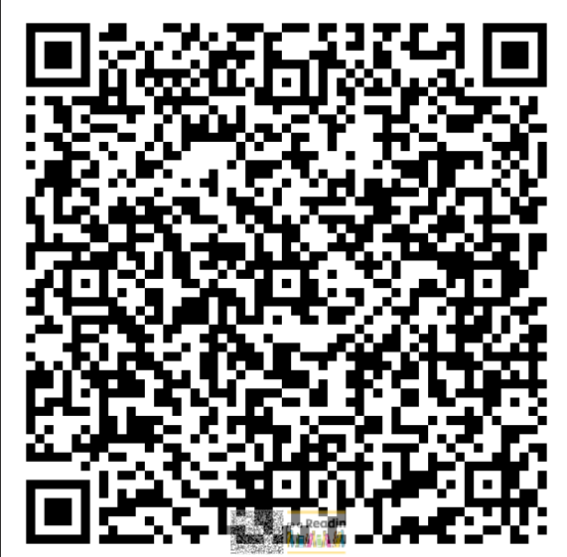
What subjects are available to pick for S5
English | French | Accounting
Maths | Spanish | Software Development
Applications of Maths | Music
Geography | Music Technology
History | Art and Design
Modern Studies | Creative Thinking
Travel and tourism | Admin and IT
Biology | Business Management
Chemistry | Design and Manufacture
Physics | Graphic Communication
PE | Barista
College Courses | Performing Engineering Operations *
Criminology | Events Planning

Slide 14
S5/6 Expectations
If you decide to remain at school for S5 and or S6:
Support for uniform policy, including blazer.
100% attendance where possible.
Focussed , committed to studies.
Complete all courses – no subjects dropped throughout year
Desire to demonstrate leadership via mentoring, prefect duties etc
Commitment to wider life of the school/school events
References – Work/College/UCAS.
DETERMINATION FAIRNESS RESPECT RESPONSIBLE
Notes:
I spoke earlier on about my one need from pupils of giving 100% commitment to whichever reason that they are returning for S5.
I also want to highlight the wide range of supports available when pupils are selecting courses and exploring careers. Uni college entry requirement and even relevant skills and knowledge when applying for apprenticeships and jobs are linked to subject areas,

Slide 15
S6 – What Subjects should I pick ?
In S6, you should supplement your attainment by picking a range of subjects that you need for what you require when you leave school. This is the last chance to achieve these in school.
Minimum of subjects
Those listed as entry requirements for College, University or needed for employment
Subjects you have previous experience of – studied in S4 but not S5
DETERMINATION FAIRNESS RESPECT RESPONSIBLE
Notes:
I spoke earlier on about my one need from pupils of giving 100% commitment to whichever reason that they are returning for S5.
I also want to highlight the wide range of supports available when pupils are selecting courses and exploring careers. Uni college entry requirement and even relevant skills and knowledge when applying for apprenticeships and jobs are linked to subject areas,

Slide 16
S6 – What other courses can I pick ?
YASS – SCQF Level 7
These are Open University Modules delivered online
Broadly at SCQF Level 7 (Adv Higher/First Year of University)
Self Directed online
Courses in areas such as Marketing, Business, Law, Science
SWEIC – SCQF 6 or 7
Virtual Learning Campus
Range of Higher and Advanced Highers including History, H Politics, etc.
College courses – Levels 5,6 or 7
DETERMINATION FAIRNESS RESPECT RESPONSIBLE
Notes:
I spoke earlier on about my one need from pupils of giving 100% commitment to whichever reason that they are returning for S5.
I also want to highlight the wide range of supports available when pupils are selecting courses and exploring careers. Uni college entry requirement and even relevant skills and knowledge when applying for apprenticeships and jobs are linked to subject areas,

Slide 17
Options timeline
Meeting with Pupil Support Teacher to discuss and choose options in January.
These choices should be as previously stated, in line with intended destinations and in courses where you have interest and previous study.
Take form home to discuss with parents/carers
Submit form online before deadline Friday February 13th 2026.

Slide 18


[[
BGE
Careers Adviser
Kirstin Reynolds
myworldofwork.co.uk

Slide 19

I work with pupils throughout their time at school through group learning sessions, drop-ins, and one-to-one career guidance appointments. My support is designed to help pupils understand and explore all their options and build their career management skills.
Notes:
Hi, I’m Kirstin Stewarton Academy’s careers adviser. I work with pupils throughout their time at school through group learning sessions, drop-ins, and one-to-one career guidance appointments. I meet with S4-S6 regularly and every pupil is offered a career guidance appointment 1-1 when they decide to leave school.
My support is designed to help pupils understand and explore all their options and build their career management skills. These are the key skills to help people make and take ongoing career decisions as the world of work and learning change. These are Self, Strengths, Horizons and Networks. As well as offering 1-1 and group support from myself in school, we also have a digital offer My World of Work.
Today I am going to look at Apprenticeships and a brief overview of college as I know we have Ashley here and I don’t want to steal her thunder!

Slide 20
Notes:
Key points:
Parity of esteem with qualifications, so instead of thinking you have to follow a specific route, which route is best for you. Is it based on how you like to learn, this is especially important for those thinking about their next steps.

Slide 21
Apprenticeship Overview
APPRENTICESHIP.SCOT
A job which lets people earn a wage, get workplace experience and work towards a qualification (SCQF level 5 through to SCQF level 12)
An alternative to college or university
Can take a year to four years to complete
There are over 100 Modern Apprenticeship frameworks and 15 Graduate Apprenticeship frameworks

Slide 22
Apprenticeship Overview
APPRENTICESHIP.SCOT
Apprenticeships immerse you in real-world tasks from day one. You learn best by doing, not just watching or reading.
Designed by employers - young people can be sure that their Apprenticeship is helping develop the skills and knowledge that employers are looking for.
Greater chance of gaining and sustaining employment – 92% of Apprentices stay in work after completing their qualification.

Slide 23
APPRENTICESHIP.SCOT
Accounting
Business Management & Business Analysis &Project Management
Civil Engineering
Construction and the Built Environment
Cyber Security
Data Science
Early Learning and Childcare
Engineering Design and Manufacture & Instrumentation, Measurement and Control
IT: Management for Business & Software Development
Operating Department Practice
Social Work
Notes:
These are the 15 options in terms of degrees available, but what the job looks like is completely dependent on the employer and the skills they need in their workforce. For example, there was a graduate apprenticeship in Software Development with the BBC and Glasgow University, and there was one with Morgan Stanley. Although both will candidates will finish with the same degree, the experiences they have will be dependent on the employer.

Slide 24
Careers Adviser Kirstin.Reynolds@sds.co.uk 01563 601 221
Notes:
Thank you, my contact information if anyone would like to take a note. My information is also available on the school website, and I have a stall if you would like to drop by later!

Slide 25

Senior Phase
School College Courses
Ayrshire College

Slide 26
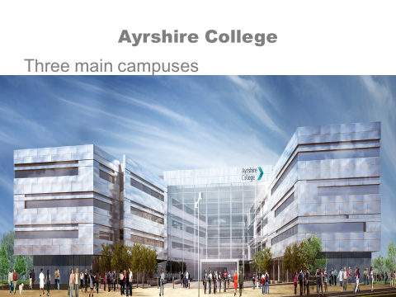
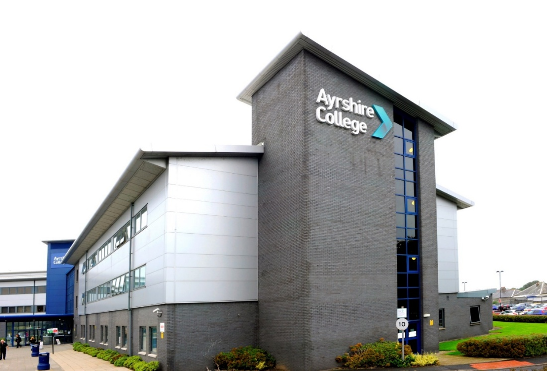
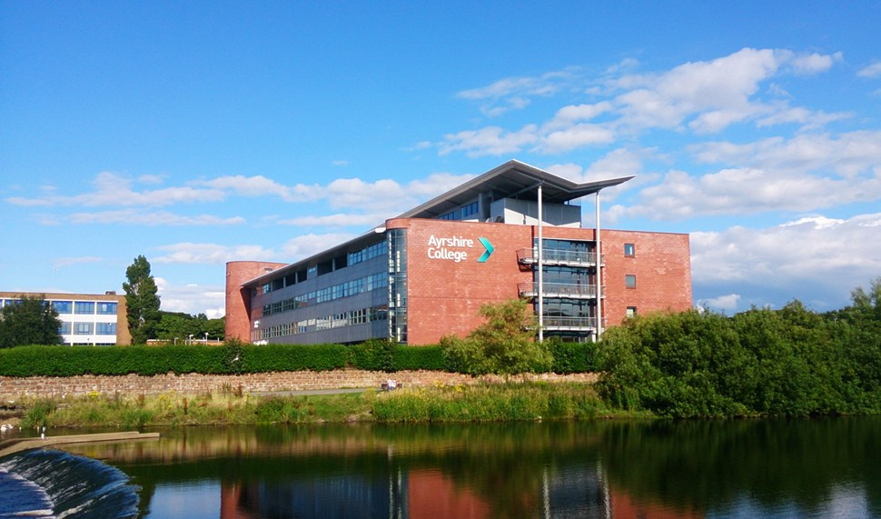

Slide 27
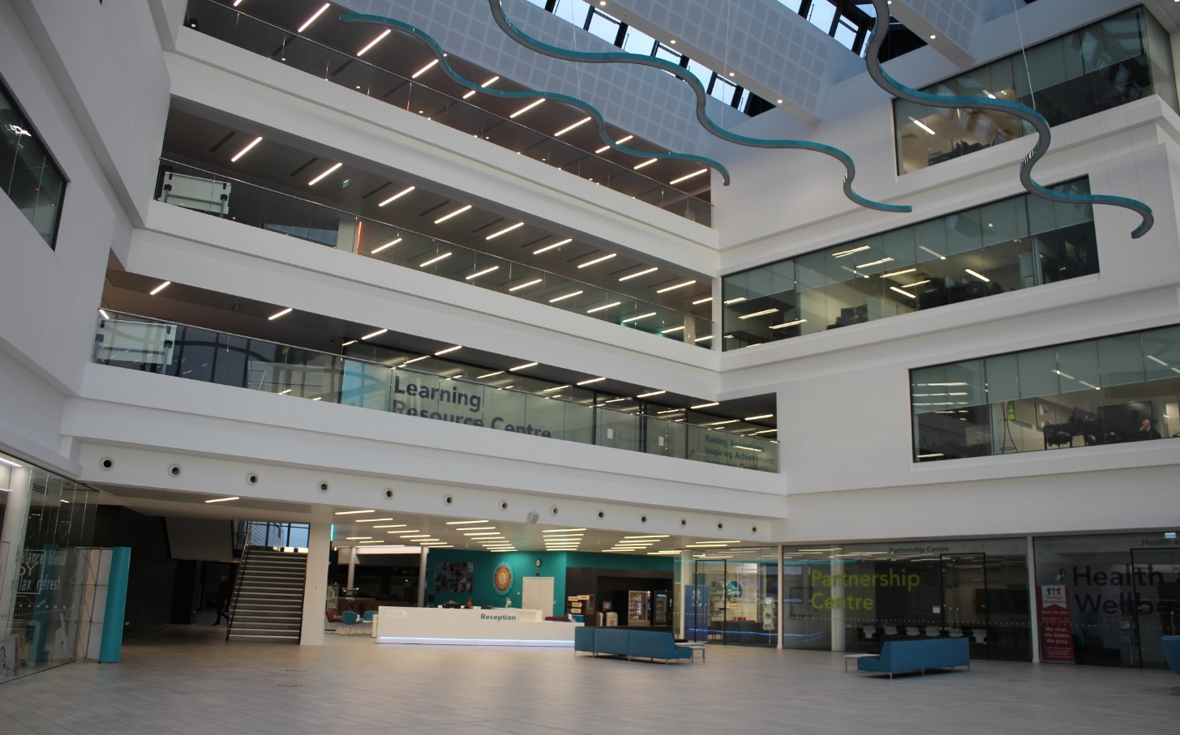
Kilmarnock Entrance Area

Slide 28

Role of School College Partnership
To provide a broad range and depth of subjects, qualifications, skills and experience to:
Get a job in a field you wish to work in
Achieve an apprenticeship
To progress to further / higher level of study
Develop existing skills to further your career

Slide 29

SCHOOL COLLEGE PARTNERSHIP
Courses start in June and finish at the end of April
2 afternoons per week (usually a Tuesday and Thursday 2:00 – 4:00 or 2:00 – 5:00
Attendance may be required during exam leave in May
Travel to and from college is organised through school

Slide 30
BENEFITS
Student card
Access to LRC and printing
Access to gym facilities (induction required)
Use of restaurants
Use of salons
Help with full-time college applications
Independent learning
Meet students from other schools with same interests
Expand social life
Adult environment
Use of technology and equipment not available in school
Raise awareness of progression opportunities
References

Slide 31

Courses 2026 - 27
Level 4
Steps to Work Award: Hair & Beauty
Skills for Work Early Education and Childcare
Introduction to the Construction Industry
Skills for Work: Uniformed Services
NPA Professional Cookery
Skills for Work: Automotive
NPA Software Development
SVQ Level 1 Performing Engineering Operations

Slide 32
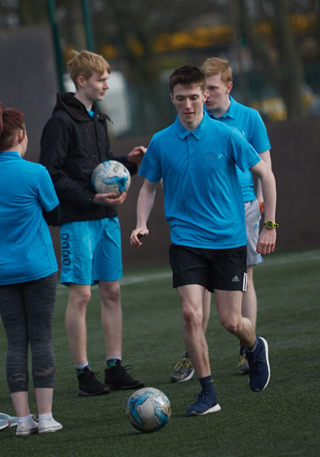
Courses 2026 - 27
Level 5
Skills for Work: Early Education & Childcare
Skills for Work: Renewable Energy – Kilwinning Campus and Ayr Campus
NPA Hospitality
NPA Digital Media with Film Making – Ayr Campus
SVQ 2 Performing Engineering Operations( infill to Full time)
Mental Health & Wellbeing Award
NPA Sport & Fitness (Football)

Slide 33
Courses 2026 - 27
Level 6
Art Portfolio & Print Making (including life drawing) - Ayr Campus
NPA Criminology - Kilwinning and Ayr Campus
NPA Psychology with Criminology
NPA Acting & Performance - Ayr Campus
NPA Children & Young People
NPA Software Development
NPA Sound Production - Ayr Campus
NPA Accounting – Ayr Campus

Slide 34
Courses 2026 - 27
Level 7 HNC (infill to Full time)
HNC Applied Sciences – Kilmarnock Campus
HNC Cyber Security – Kilwinning Campus
HNC Electrical Engineering - Kilwinning Campus
HNC Mechatronics - Kilwinning Campus
HNC Sports Coaching & Development – Kilmarnock Campus

Slide 35
WHAT IS AN HNC ( infill)?
A Full Time course which pupils can infill to as part of their school timetable
It is the same level of learning as an Advanced Higher
You will attend college two full days per week alongside your other school subjects
There is no end of year exam as assessments are ongoing throughout the year.
You will be required to complete a Graded Unit which is project based and is graded according to your knowledge and skills.
If completed successfully this will gain you entry to an HND College Course and possible University (depending on entry requirements.

Slide 36
Entry requirements
Level 4 – no formal qualifications
Level 5 – 4 or 5 National 4 qualifications
Level 6 – 4 or 5 National 5 qualifications
Level 7 – 1 or 2 Higher Qualifications

Slide 37
What's next?
Applications for School-College Courses are open from the 19th January 2026 and close on 25th March 2026.
You should discuss with your Guidance Teacher before making your application
Each course has a different selection process which you will be informed about after you make an application
An explanation of each selection process is explained on the website under the School-College Courses

Slide 38
Questions?
If you have any questions, please don’t hesitate to get in touch using the contact details below -
Ashley Husband
School College Partnership Officer (East Ayrshire)
Ayrshire College
Tel: 07526566296
Email: Ashley.husband@ayrshire.ac.uk

