Slide 1
S2 into S3 options
Curriculum for Excellence –Overview
Curriculum for Excellence identifies two key stages in secondary – the broad general education (BGE) and the Senior Phase. The BGE covers S1 – S3 and the Senior Phase from S4 - S6.
Instead of choosing two year courses at the end of S2 (Standard Grade/’O’ Grade) all pupils continue to experience a broad range of curricular areas until the end of third year, at which point they select the subjects they wish to study in fourth year.

Slide 2
S2 into S3 options
Stewarton Academy’s S3 Curriculum
Thirty three periods in total each week.
All pupils study Maths & English for four periods per week (8).
All pupils study core PE for two periods per week (2).
All pupils study core RE and PSE for one period per week each (2).
Pupils choose seven subjects, each for three periods per week (21).

Slide 3
S2 into S3 options
S2 into S3 Option Process
How your son/daughter will be supported
PSE classes and practice options exercise
Information evening –1st February 2024
Options booklet –available in PSE classes, on Teams and school website .
Opportunity to meet your son/daughter’s teachers at parents’ evening – Tuesday 6th February 2024.

Slide 4
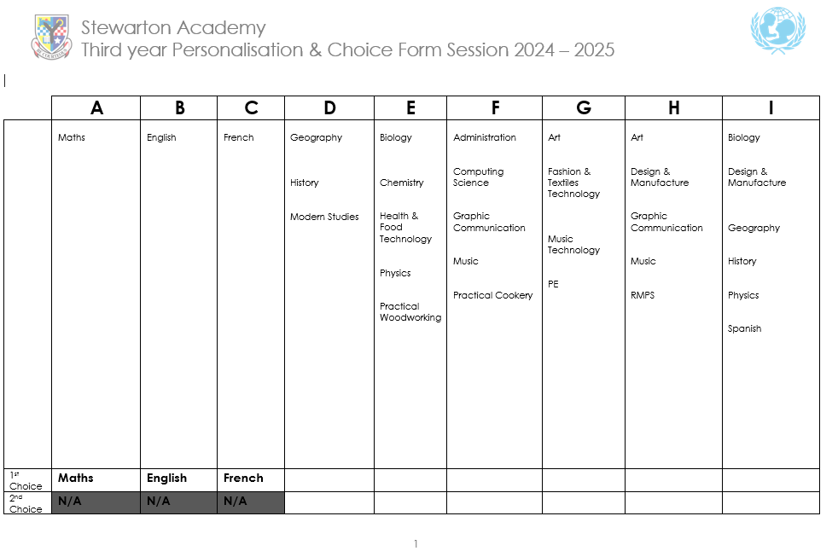
S2 into S3 options
S2 into S3 Option Process

Slide 5
S2 into S3 options
S2 into S3 Option Process
General Points
Pupils must select a first and second choice in each column.
Options should be completed on-line using Microsoft Forms. The link will go live on Friday 2nd February 2024.
Pupils must enter their name and house group (Boyd, Cunningham, Montgomery and Stewart).
The deadline is Friday 23rd February 2024.

Slide 6
S2 into S3 options
S2 into S3 Option Process
In More Detail – Modern Languages
All pupils have an entitlement to follow a modern foreign language until the end of the BGE.
Both French and Spanish can be selected. To do so Spanish must be selected in the final column.
Notes:
“One of the main changes to previous practice in modern language learning in primary schools is that children are entitled to learn a first additional language (L2) from Primary 1 onwards and to the end of the BGE, allowing for a 10 year language learning experience. Learners are also entitled to experience a second additional language (L3) from Primary 5 (at the latest) to Primary 7, and also at some point during the BGE in secondary school.”
https://education.gov.scot/resources/modern-languages-progression-framework/
11/04/2023

Slide 7
S2 into S3 options
S2 into S3 Option Process
In More Detail - Sciences
Suitability for multiple sciences will be discussed with relevant members of staff. Pupils need to give careful consideration to whether they need these subjects and likely progression in S4.
Science sections will be capped in a number of columns.
Three sciences – a pupil & parent/carer must indicate to the school they wish to follow this pathway and suitability and availability will be discussed with science staff.

Slide 8
S2 into S3 options
S2 into S3 Option Process
Second Choices
A relatively small number of young people may be asked to study their second choice. There a number of scenarios in which this can happen:
A subject has a very low uptake and therefore won’t run.
A subject is oversubscribed.
A young person has made a choice that subject teachers have concerns is not appropriate.

Slide 9
S2 into S3 options
S2 into S3 Option Process
Second Choices
A young person won’t continue with that subject in S4.
Effort, behaviour and attendance both in the subject a young person has selected and globally.

Slide 10
S2 into S3 options
S2 into S3 Option Process
Would you like to know more?
Please do not hesitate to contact the school – pupil support teacher, class teacher or year head if you would like more information.
House | Pupil Support Teacher
Boyd | Mr. McCormack
Cunningham | Mr. Reid
Montgomery | Mrs. Beattie
Stewart | Mr. Morgan

Slide 11
S2 into S3 options
S2 into S3 Option Process

