Slide 1
Stewarton Academy Feb 2023
S4 Information Evening: Career Management Skills and
Future career paths
Sarah Gifford
Careers Adviser
Notes:
Introduce self and session S4 options and routes and pathways beyond school

Slide 2
Career Management Skills, future career planning and Labour Market Information - Ayrshire
Option Choices & Career Pathways – Planning for the future
Resources
Local LMI & a growth sector example
Key skills sought by employers & the changing nature of work

Slide 3
Routes & Pathways
Take Nat 5s
& Highers &
plan for
University
Apply for a Modern
Apprenticeship/ Training or a Foundation Apprenticeship
Apply to Further Education (College)
Entrepreneurship/
Start your own business
Seek employment/
work experience/ volunteering
Notes:
Challenge group we are here today to find out.......are they ready for this next step??.....
Have they prepared, have a plan......know their options …….that’s what today is about.....supporting this next step.
To support this next decision stage pupils, need to know there are lots of option choices and routes and pathways beyond from S4 and are interchangeable and flexible throughout an individuals career journey
Highlight that there are lots of opportunities ...........and there are lots of routes and pathways to those opportunities and that these are interchangeable and flexible throughout an individuals career journey e.g.; a foundation apprenticeship can open up opportunities to further /higher education routes or more advanced apprenticeships. Or completing a national certificate course can progress to HNC/HND and on to university
Expand on every decision is a career decision – its so important to get it right
From the smallest decision you make eg; getting out of bed in the morning to doing your homework or getting involved in hobbies and interests all have an impact on your future career journey
Introduce each options and expand
Return to School
Foundation Apprenticeship
Advanced Highers
Highers
Nat 5s
Nat 4s
How will their qualifications help them when deciding to move onto uni/college
Further Education
Can study a number of different courses
Gain further qualifications
Build a pathway of qualification for entry to next level
Entrepreneurship
Can develop your interest in to a job
Exciting to grow your own business
You’re your own Boss you can decide when, where and how you work
Modern Apprenticeship/Training
Gain nationally recognised qualifications
Get valuable work experience
Receive a national level wage
Seek Employment
Permanent job
Work for a company
Receive a wage

Slide 4
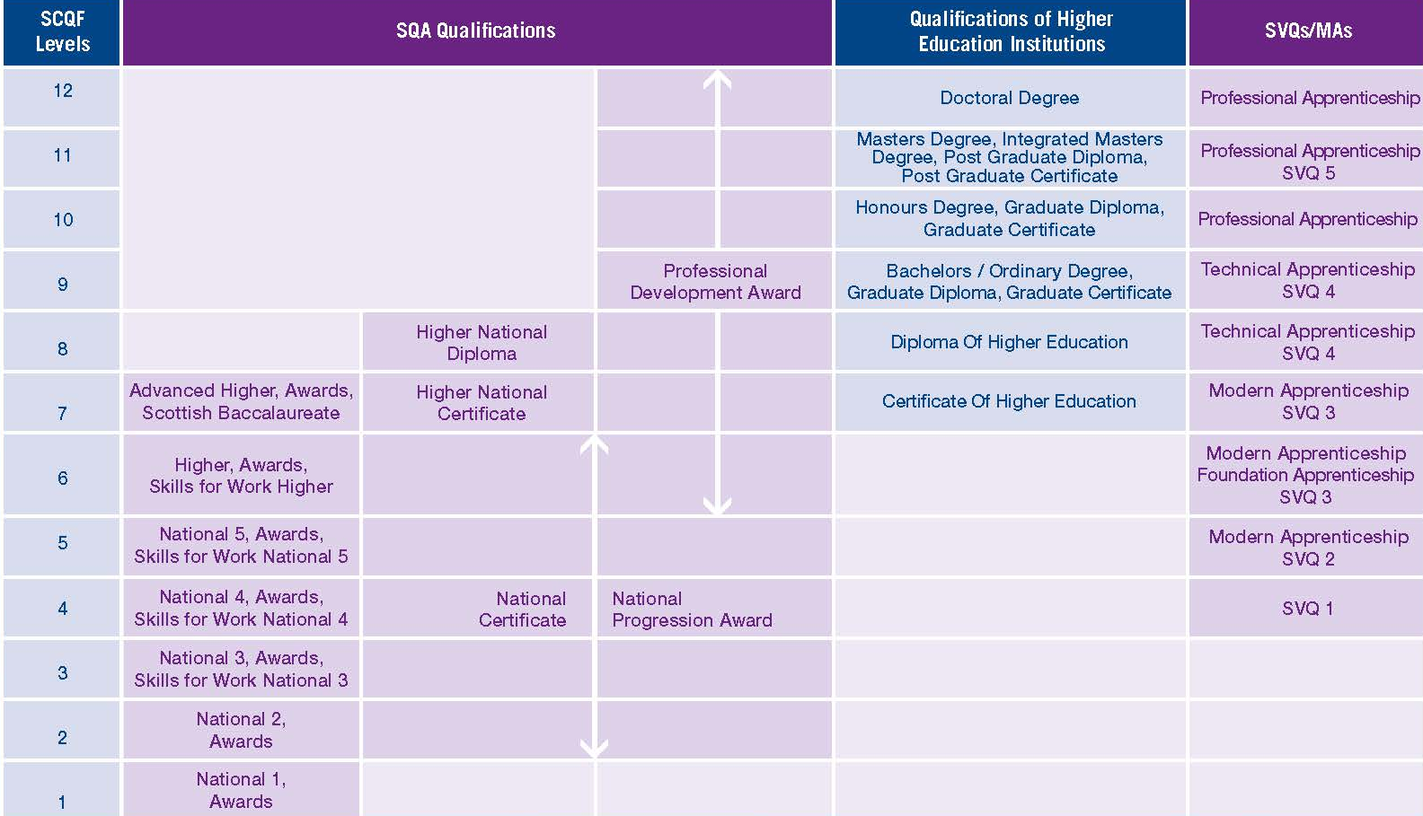
What are your qualifications options?
Notes:
Use this slide to introduce the value of qualifications and different ways to get qualifications.
You may also want to highlight the need for life-long learning.
What’s it worth, based on SCQF Framework to show the value of qualifications.
Point out value of current National school subjects vs. college vs. university and how apprenticeships at various levels can equate to Highers and above qualifications….
Dependent on IT access, login to www.apprenticeship.scot to look at levels of current roles e.g. SVQ 2/3 Business Admin and map on the framework image for discussion
Good Time to reinforce about the variety of new college, MA and FA routes to work which may be available within their school.
Use of LMI resources on Connect to enhance this information.

Slide 5
Qualifications required for:
University = 4-5 Highers usually at Grade A or B, specific subjects required for some courses
FE College (Ayrshire College, City of Glasgow, Glasgow Clyde) usual requirements: 1-2 Highers for HNC, Nat 5s for Level 6/ NC, Nat 4s for Level 5, etc.
(Note: College HNC/HND can be a good route to University for some subjects)
Modern Apprenticeships & other training: usually Nat 5s, sometimes Nat 4s; Maths and English most important.

Slide 6
Option choices: important ‘Do’s and Don’ts’…
Do:
Consider future career areas of interest – choose subjects relevant for your career
Talk to people –subject teachers, Guidance teachers, parents, older siblings, Careers Adviser
Don’t:
Choose a subject without taking time to do research – some careers and University courses require specific subjects at Higher level.

Slide 7
The Careers website: myworldofwork.co.uk

Slide 8
My World of Work ‘Option Choices tool’

Slide 9
A useful source of information: Planit Plus
‘Planit Plus’ website for detailed Career/ Job profiles, University & College courses and entry requirements:
https://www.planitplus.net/

Slide 10
Use PlanitPlus ‘Related courses by Level’ tab in each Job Profile:

Slide 11
School College Partnership courses
Apply on Ayrshire College website: https://www1.ayrshire.ac.uk/schools/school-college-courses-apply/
Part-time College courses - part of curriculum (at College or in School)
2 afternoons a week in S4, S5 or S6
Course Options include
Computing – Software Development
Construction Skills (Trades)
Early Education & Childcare
Engineering (PEO)
Hair & Beauty
Health & Social Care (Mental Health & Wellbeing)
Professional Cookery
Automotive Skills

Slide 12
Apprenticeships: work, earn & learn www.apprenticeships.scot

Slide 13
What are Foundation Apprenticeships?
1-2 years in S5 and/or S6 (1 day/2 pms a week in College Centre)
*Apply in S4 for 2-year courses*
Equivalent to Level 6 (Higher)
Popular Subjects: Engineering, Early Years & Childcare
Includes practical work and regular work placement
Good preparation for College HNC study or a Modern Apprenticeship
Accepted by most Universities, but not all, and not for all courses

Slide 14
What are Modern Apprenticeships?
From age 16 - undertaken after leaving school
Usually need Nat 5s – though not always
Employed from day 1 and earning a wage.
Training on the job or at College through ‘day’ or ‘block’ release.

Slide 15
What are Graduate Apprenticeships?
Study towards an Honours Degree while working and earning
Start from Level 8 (usually need Level 7/ Advanced Higher or HNC first)
Builds relevant skills and knowledge that Scottish Industries are seeking
Popular frameworks:
Business Management & Financial Services
Engineering: Civil and Design
Management for Business, Software Development
Cyber Security

Slide 16
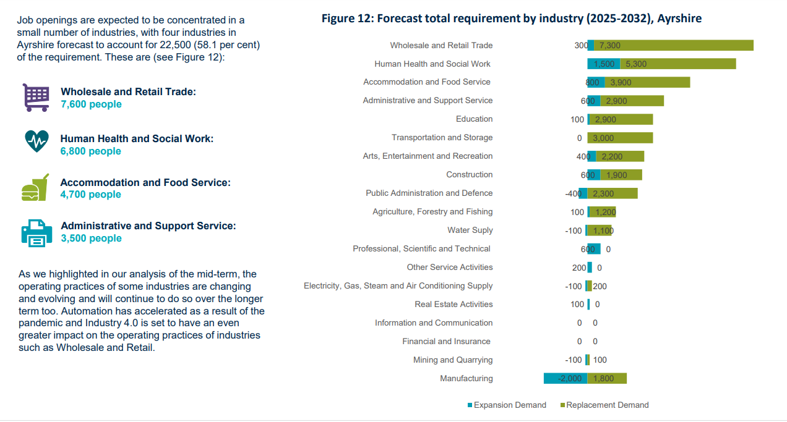
Employment by Industry (2022-2025) Ayrshire

Slide 17
Forecast Employment by Industry (2025-2032) Ayrshire

Slide 18
A growth sector – Green Careers https://www.myworldofwork.co.uk/green-careers

Slide 19
Explore Green Jobs https://www.myworldofwork.co.uk/green-careers

Slide 20
Working in a Green Career https://www.myworldofwork.co.uk/green-careers

Slide 21
Top skills employers want (‘Meta Skills’)
good verbal & written communication
teamwork
complex problem-solving
analysing & investigating
initiative/self-motivation/drive
commercial awareness
planning & organising
flexibility
time management.
Notes:
Content of degree will develop a number of these skills e.g.; communication skills, analysing, problem solving
Other experiences gained while studying for your degree p/t work, voluntary work, etc.

Slide 22
The nature of work is changing
https://www.skillsdevelopmentscotland.co.uk/is-the-future-now/the-world-of-work-is-changing/

