Slide 1
Lockerbie Manor
2nd - 5th May 2023

Slide 2
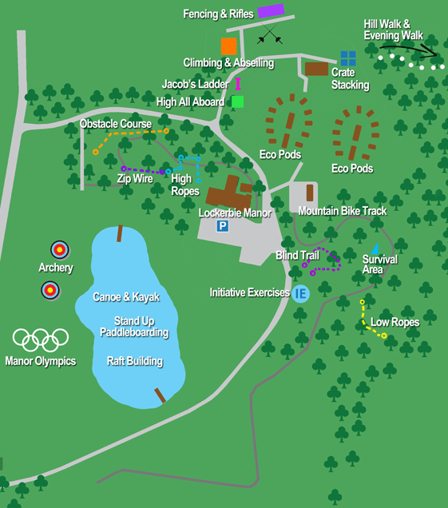
Lockerbie Manor Map
z

Slide 3
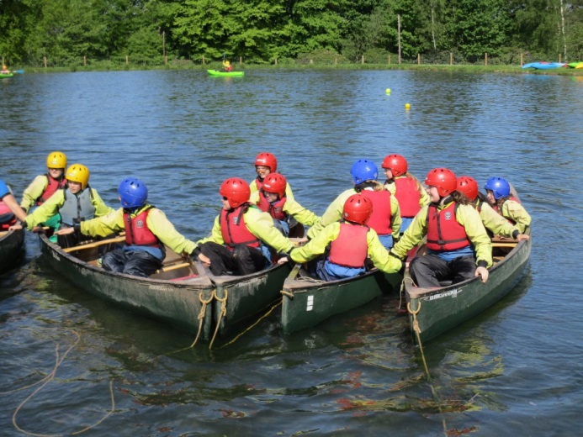
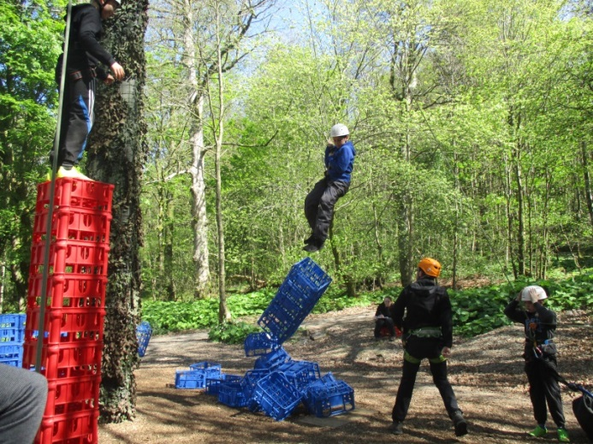
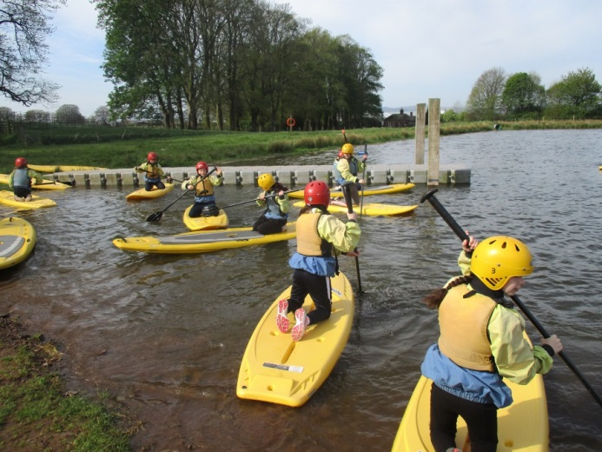
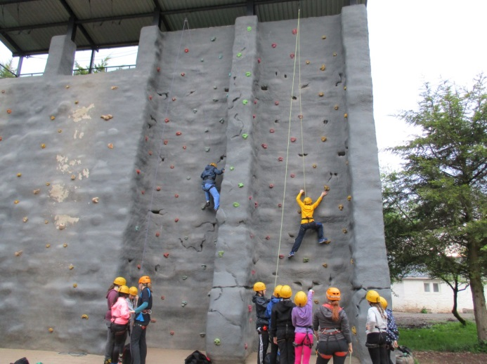
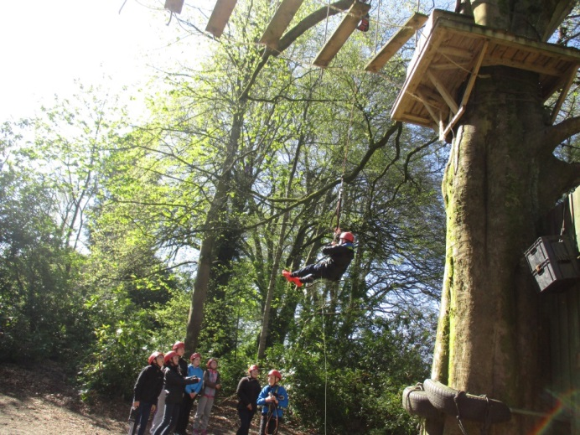
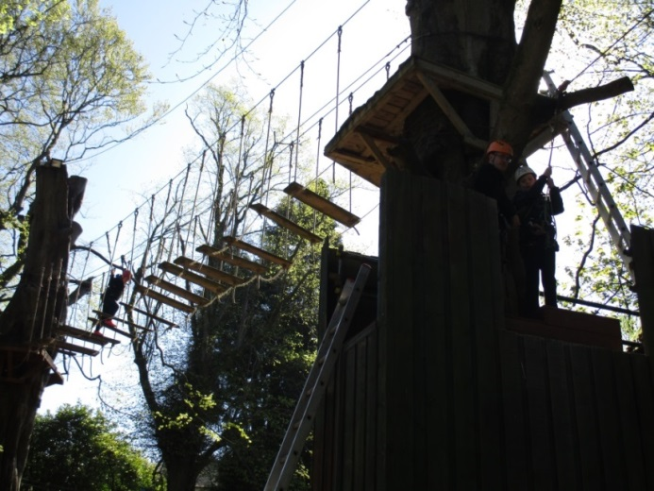
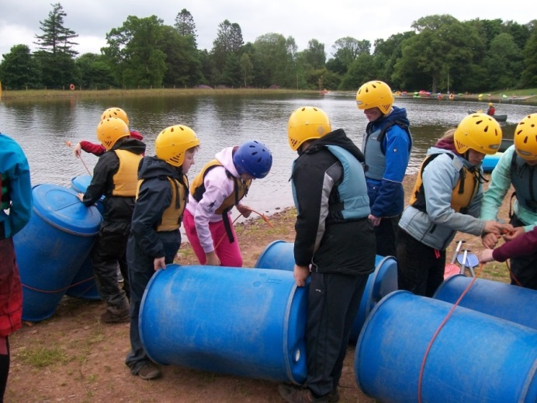
Activities:
Archery
Blind Trial
Bike Skills
Climbing
Crate Stacking
Paddle Boarding
High Ropes
Obstacle Course
Orienteering
Scavenger Skills
Team Games
Zip Wire

Slide 4
Student Code of Conduct
In school:
- Follow the Core Values (Ready, Respectful and Safe)
Adhere to the Class Charter (Work hard, be respectful and listen to adults)
- Staff and children have agreed a system of rewards and sanctions (see next slide).
Lockerbie Manor Code of Conduct:
Listen to instructors
Arrive at assembly point on time and correctly dressed for the activity
Keep the site tidy
No drinks in the dormitories
Do not go into other people’s dormitories
Keep dormitories tidy and ready for inspection each morning at 8:50am
Make no noise that can be heard outside the dormitory after lights out
Enter building through the boot room and take outside footwear off before entering

Slide 5
P7 Ladder
A shining example! Have the chance to do special P7 jobs around the school.
Making good choices! First dibs on Choosing Time activities
z
Everyone starts here on a Monday
Disruption of learning
Failure to respond to a teacher’s instructions
Disrespectful
Loss of Choosing Time.
5 times here in a Term means no end of term treat
Continuous and repeated incidents from above list
Violence, threats, bullying behaviour
Phone-call home
3 times here means no Lockerbie.

Slide 6
Care and Wellbeing
Medical and Dietary details
All medication should have a prescribed pharmacist label and be handed into the office, with completed forms on or before the day of departure.
Pupils are not allowed to carry medication.

Slide 7
Meals and Accommodation
Meals
Lockerbie Manor provides three meals everyday for guests. There is a wide range of options served in the communal dining area.
Please let the office know of any specific religious or dietary requirements.
Accommodation
Dormitories are furnished with bunk beds. Students are required to bring a freshly laundered sleeping bag and pillow with pillowcase.
All rooms are en-suite.

Slide 8
Packing List
z
Old clothing for activities:
Long-sleeved shirts/jumpers
Trousers/jogging bottoms
T-shirts
Closed-toe shoes are essential.
Clothing and shoes will get wet/muddy.
Please bring spares!
Please restrict to one case.
Sleeping bag and pillow
A drinks bottle
Torch
Rucksack
Toiletries (no aerosols)
Old clothing
Waterproof clothing
Large plastic bag for dirty clothes
Bath towels x 2
Hat and gloves (weather dependent)
Sun-cream/hat (weather dependent)
Pyjamas and slippers
NO:
Glass containers
Aerosols
Jewellery
Digital items including mobile phones, watches and Kindles.

Slide 9
Twitter
Follow the school Twitter account for regular updates and photos every day!
z
@StAndrewsPS1

Slide 10
Payment details
£320 Total
 | Amount | Due Date
Deposit | £50 | Friday 27th September
Deposit | £50 | Friday 25th November
Final balance | £220 | Friday 10th February
If, for any reason, a cancellation occurs, the following cancellation charges are:
Date | Amount
70 days or more (before 21st Feb) | Deposits paid
69-14 days (22nd Feb - 18th April) | £240
13 days or less (After 18th April) | £320

