Slide 1
Addition Strategies

Slide 2
Addition Strategy
Add Up In Chunks
Keep the first number whole, add the second number in friendly chunks
23 + 12
+10 +2
23
33
35

Slide 3
Addition Strategy
Add Up In Chunks
Keep the first number whole, add the second number in friendly chunks
209 + 124
+100 +20 +1 +3
209
309
329
330
333

Slide 4
Addition Strategy
Place Value
Partition the numbers and add by the place value
21 + 14
20 1 10 4
20 + 10 = 30
1 + 4 = 5
30 + 5 = 35

Slide 5
Addition Strategy
Place Value
Partition the numbers and add by the place value
124 + 235
100 + 200 = 300
20 + 30 = 50
4 + 5 = 9
300 + 50 + 9 = 359

Slide 6
Addition Strategy
Compensation
Make friendly numbers by removing from one number
and adding the same amount to the other number
17 + 19
-1 +1
16 + 20 = 36

Slide 7
Addition Strategy
Compensation
Make friendly numbers by removing from one number
and adding the same amount to the other number
135 + 118
-2 +2
133 + 120 = 253

Slide 8
Addition Strategy
Making a Ten/Bridging Through Ten
Make a ten by partitioning a number
18 + 6
10 + (8 + 2) = 20
20 + 4 = 24
2 4

Slide 9
Addition Strategy
Making a Ten/Bridging Through Ten
Make a ten by partitioning a number
137 + 118
130 + 110 + (7 + 3) + 5
240 + (7 + 3) + 5
250 + 5 = 255
3 5

Slide 10
Addition Strategy
Near Doubles
Knowing Doubles helps with Near Doubles
25 + 26
25 + 26 = 25 + (25 + 1)
50 + 1 = 51
25
25
1

Slide 11
Addition Strategy
Near Doubles
Knowing Doubles helps with Near Doubles
340 + 330
340 + 330 = 340 + (340 - 10)
680 – 10 = 670

Slide 12
Subtraction Strategies

Slide 13
Subtraction Strategy
Removal
Partition to remove the number within the subtraction.
22 – 8 = 14
-6 -2
14
20
22

Slide 14
Subtraction Strategy
Removal
Partition to remove the number within the subtraction.
132 – 47 = 14
-15
-32
85
100
132

Slide 15
Subtraction Strategy
Add Up
Partition to add from the lowest number to the highest number
50 – 39
+1
+10
1 + 10 = 11
39
40
50

Slide 16
Subtraction Strategy
Add Up
Partition to add from the lowest number to the highest number
123 – 68
+2
+30
+23
2 + 30 + 23 = 55
68
70
100
123

Slide 17
Subtraction Strategy
Place Value Subtraction and Negative Numbers
Partition and subtract using place value
75 – 38
70 – 30 = 40
5 – 8 = -3
40 – 3 = 37

Slide 18
Subtraction Strategy
Place Value Subtraction and Negative Numbers
Partition and subtract using place value
243 – 169
200 – 100 = 100
40 – 60 = -20
3 – 9 = -6
100 – 20 – 6 = 74

Slide 19
Subtraction Strategy
Keeping a Constant Difference
Adjust both numbers in the same way to create a friendly number
to keep the difference constant.
53 – 29 = 54 – 30 = 24
29
30
53
54

Slide 20
Subtraction Strategy
Adjust One Number to Create an Easier Problem
Adjust one number to make a friendly number
43 – 29
+1
43 – 30 = 13
13 + 1 = 14

Slide 21
Multiplication Strategies

Slide 22
Multiplication Strategy
Repeated Addition
Repeat the addition of one factor by the number of times the other factor
4 x 9
+9
+9
+9
+9
0
9
18
27
36

Slide 23
Multiplication Strategy
Making Friendly Numbers
Partition to use a friendly number to solve a more challenging problem
3 x 37
(3 x 40)
-
(3 x 3)
3 x 40 = 120
3 x 3 = 9
120 - 9 = 111

Slide 24
6
Multiplication Strategy
Partial Products
Partition one factor using place value and use distributive property to multiply
6 x 325
6 x (300 + 20 + 5)
1800 + 120 + 30 = 1950
300
20
5
6
1800
120
30

Slide 25
6
Multiplication Strategy
Breaking Factors into Smaller Factors
Break a factor into smaller factors and apply the associative property
8 x 25
So… 2 x 4 x 25 =
2 x 100 = 200

Slide 26
6
Multiplication Strategy
Doubling and Halving
Double one factor and halve the other to simplify a problem
4 x 125
4
= 2 x 250
125
= 1 x 500
2
= 500
250
1
500

Slide 27
Division Strategies

Slide 28

Division Strategy
Repeated Subtraction
Repeat the subtraction of the divisor until the difference is less than the divisor
12 $÷$ 4
-4
-4
-4
3
0
4
8
12

Slide 29

Division Strategy
Repeated Subtraction
Repeat the subtraction of the divisor until the difference is less than the divisor
129 $÷$ 40
-40
-40
-40
3 R9
9
49
89
129

Slide 30
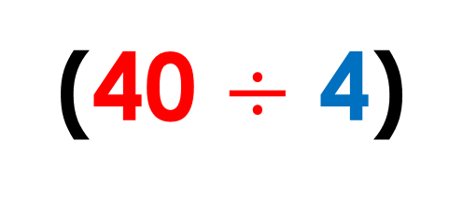

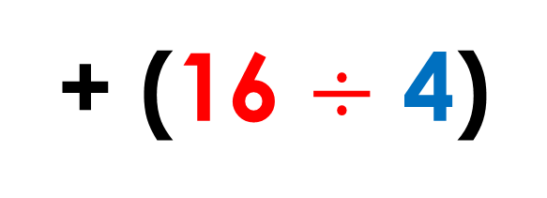
6
Division Strategy
Partial Quotients
Partition the dividend into parts easily divisible by the divisor
56 $÷$4
4
56
Think…
(40 $÷$ 4)
+ (16 $÷$ 4)
4
40
16
10
+
4
=
14

Slide 31

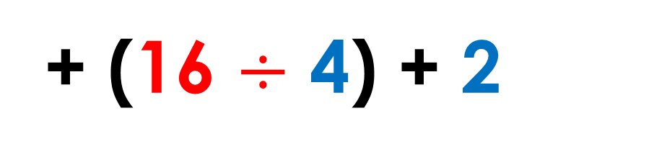
6
Division Strategy
Partial Quotients
Partition the dividend into parts easily divisible by the divisor
58 $÷$4
4
58
Think…
(40 $÷$ 4)
+ (16 $÷$ 4) + 2
4
40
16
2
10
+
4
=
14 R2

Slide 32
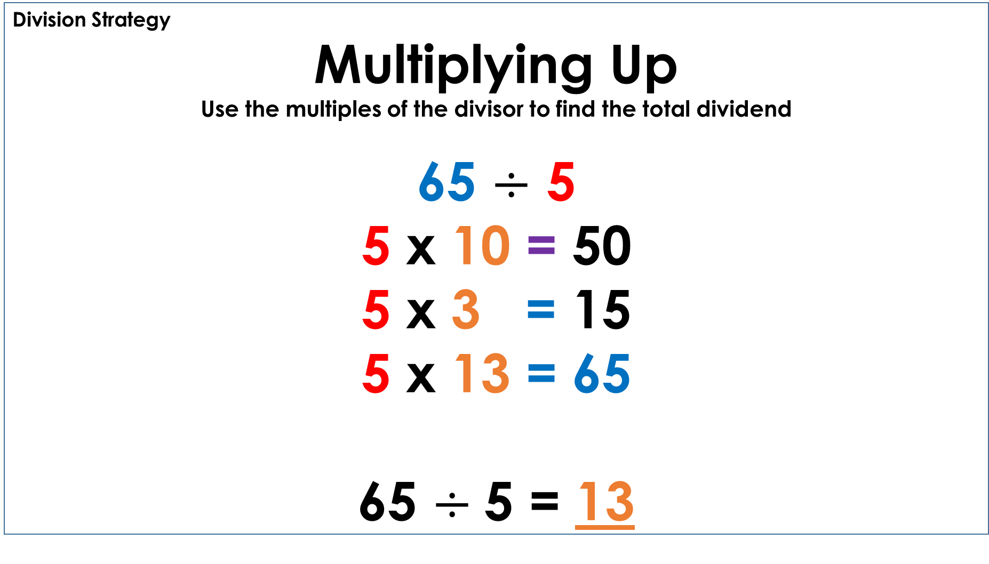
6
Division Strategy
Multiplying Up
Use the multiples of the divisor to find the total dividend
65 $÷$ 5
5 x 10 = 50
5 x 3 = 15
5 x 13 = 65
65 $÷$5 = 13

Slide 33
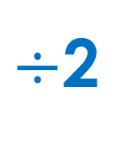

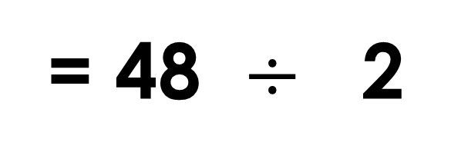
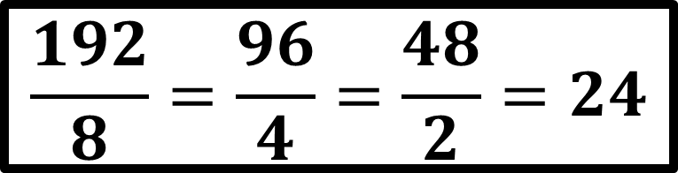

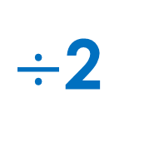
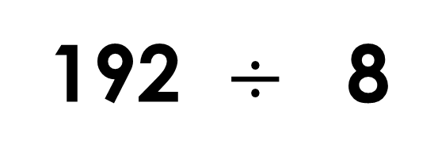
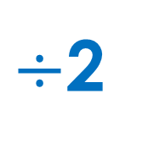
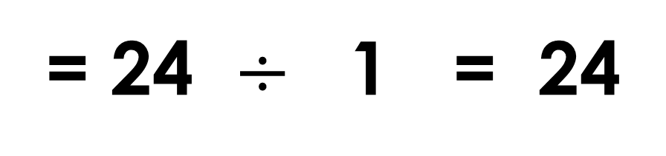
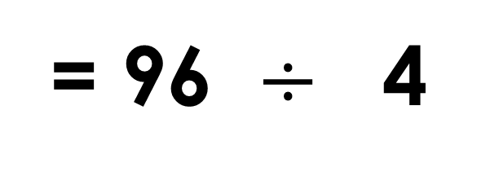

6
Division Strategy
Proportional Reasoning
Divide the dividend and the divisor by the same amount to simplify the problem
192 $÷$ 8
$÷$2
$÷$2
$$\frac{192}{8}=\frac{96}{4}=\frac{48}{2}=24$$
= 96 $÷$ 4
$÷$2
$÷$2
= 48 $÷$ 2
$÷$2
$÷$2
= 24 $÷$ 1 = 24

