Slide 1
Consonant Vowel Consonant
Words

Slide 2
van

Slide 3
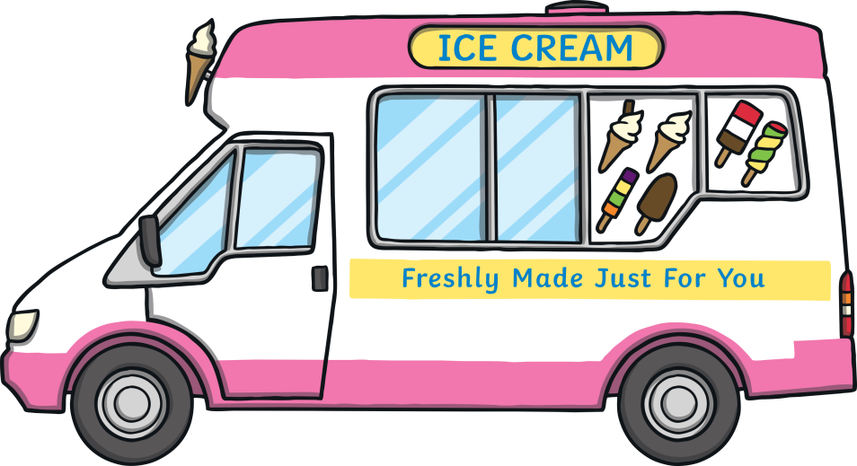
van

Slide 4
map

Slide 5
map

Slide 6
bag

Slide 7
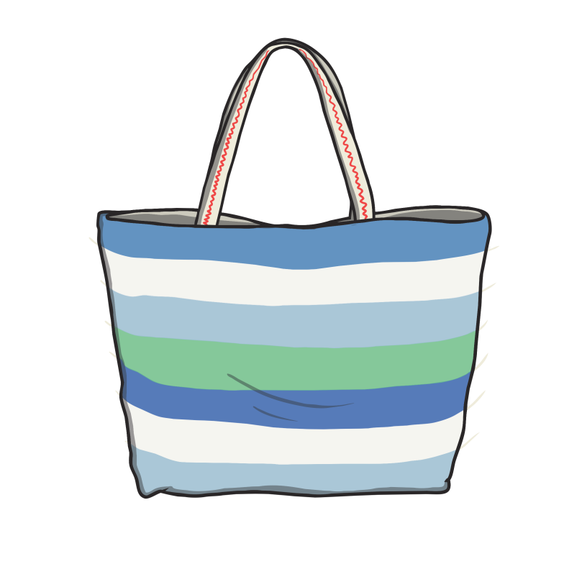
bag

Slide 8
pan

Slide 9
pan

Slide 10
hat

Slide 11
hat

Slide 12
tap

Slide 13
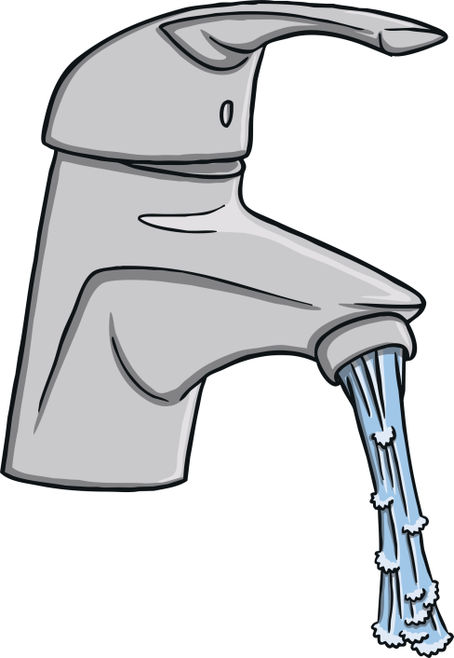
tap

Slide 14
cat

Slide 15
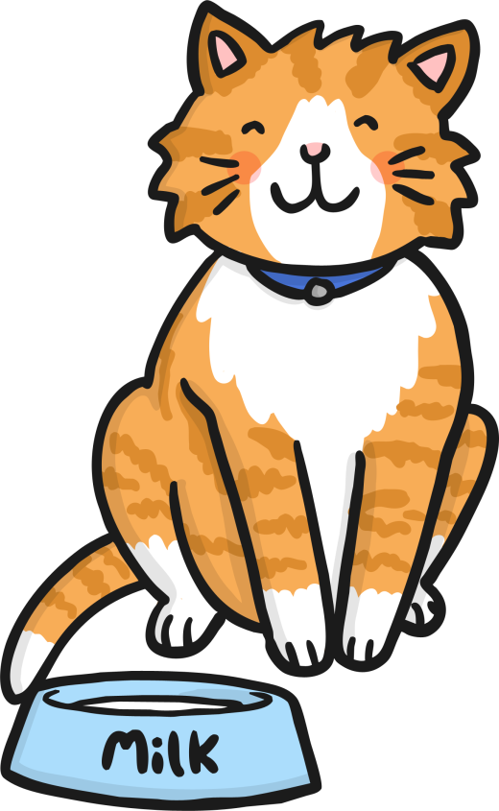
cat

Slide 16
bat

Slide 17
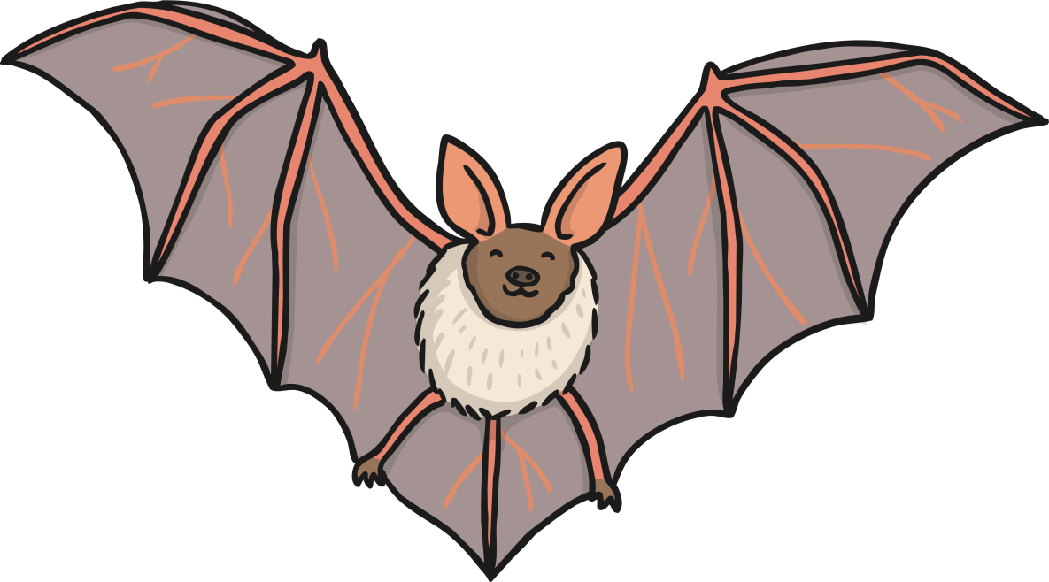
bat

Slide 18
jam

Slide 19
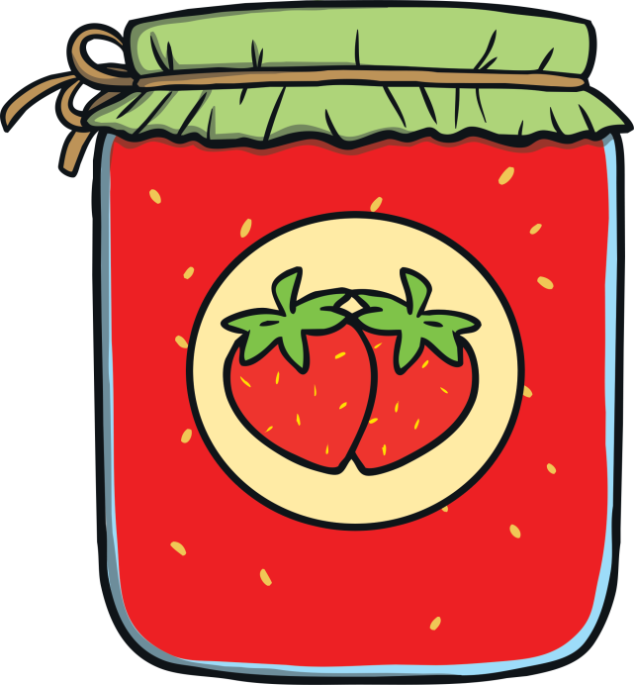
jam

Slide 20
mat

Slide 21
mat

Slide 22
man

Slide 23
man

Slide 24
cap

Slide 25
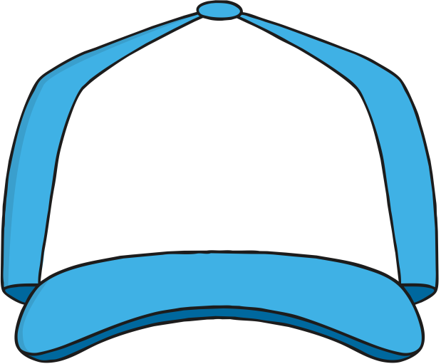
cap

Slide 26
Well done! If you got any wrong, practise those ones again.

