Slide 2
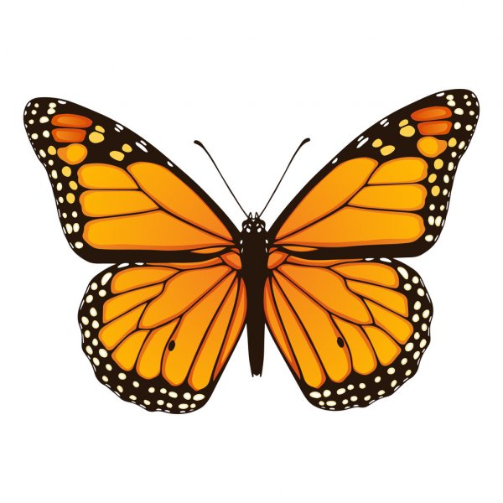
Syllables
Learning Intention: I am learning what a syllable is.
Clap or use your fingers/robot voice/drum to work out how many Syllables each word has.

Slide 3
What is a syllable?
Syllables are chunks or beats of sound in a word.
ap
ple

Slide 4
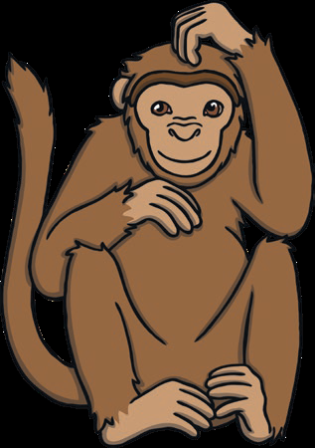
Monkey

Slide 5
Mon-key
2

Slide 6
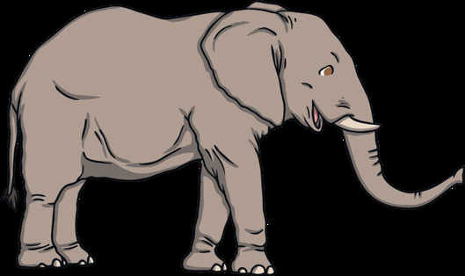
Elephant

Slide 7
El-e-phant
3

Slide 8
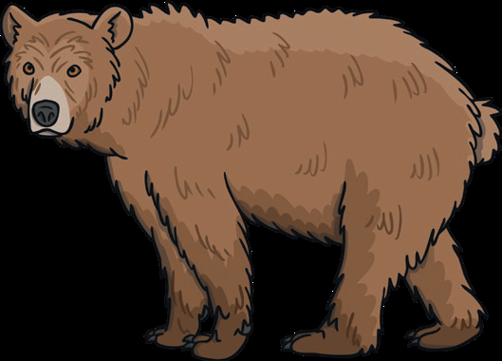
Bear

Slide 9
Bear
1

Slide 10
Tiger

Slide 11
Ti-ger
2

Slide 12
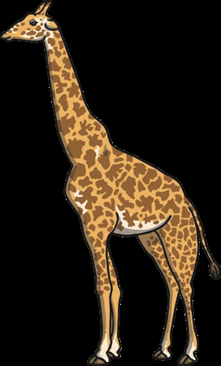
Giraffe

Slide 13
Gi-raffe
2

Slide 14
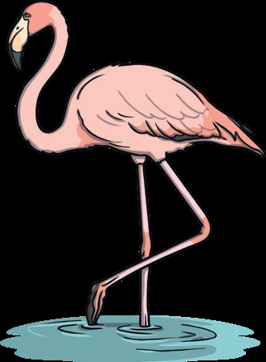
Flamingo

Slide 15
Fla-min-go
3

Slide 16
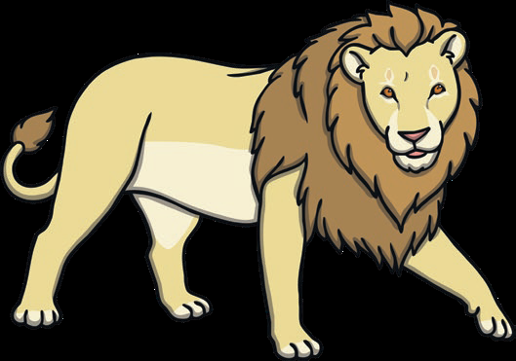
Lion

Slide 17
Li-on
2

Slide 18
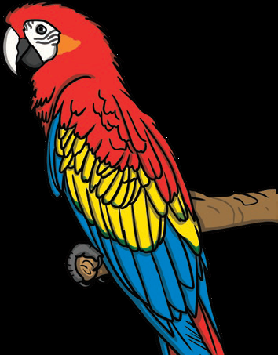
Parrot

Slide 19
Pa-rrot
2

Slide 20
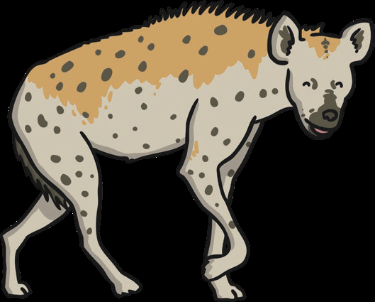
Hyena

Slide 21
Hy-e-na
3

Slide 22
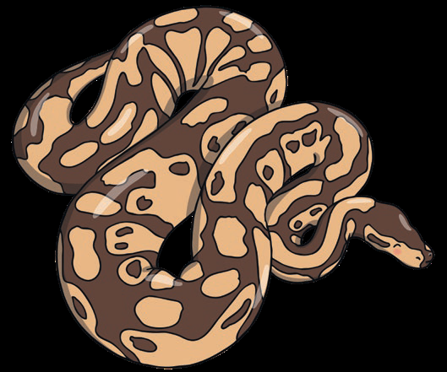
Snake

Slide 23
Snake
1

Slide 24
Cheetah

Slide 25
Chee-tah
2

Slide 26
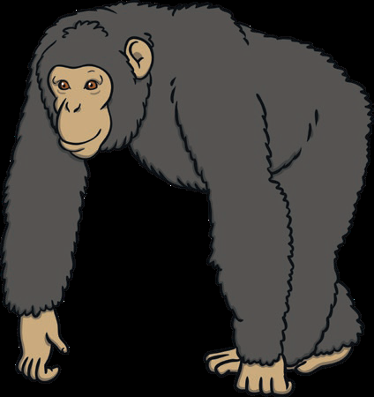
Chimpanzee

Slide 27
Chim-pan-zee
3

Slide 28
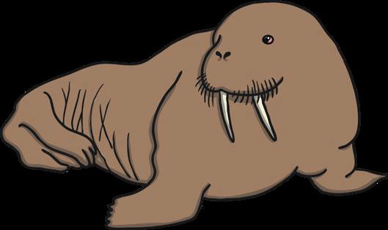
Walrus

Slide 29
Wal-rus
2

Slide 30
Leopard

Slide 31
Leo-pard
2

Slide 32
Well Done!

