Slide 1
Unicef/choufany
Notes:
On 1 September 2020, Kevin, 8 years old, left, with his mother Nadida Kayyal Bakli and brother at the UNICEF's children friendly space (CFS) at the Karantina public garden in Beirut, Lebanon.
Unicef/Choufany

Slide 2
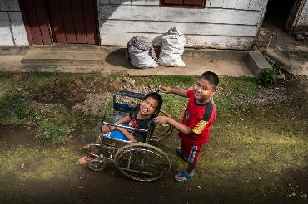
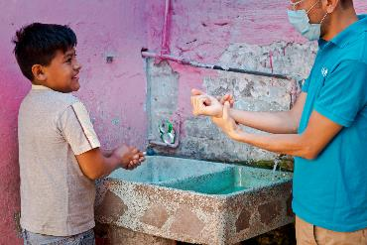
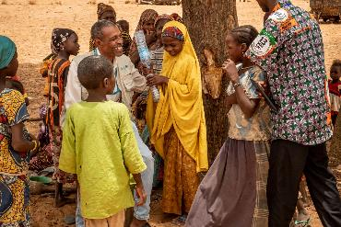
Guess the article
These pictures provide a clue to this week’s article.
Can you guess how they are linked together? Which article of the Convention do these pictures relate to?
Write down your thoughts or discuss with someone in your home.
Unicef/Ijazah
Unicef/Armando
Unicef/Gilbertson
Notes:
From left to right:
Unicef/Ijazah - Syaiful (left), 12, a child with a physical impairment, and his best friend Kevin Saputra (right), 9, a child with a visual impairment, play outside near Syaiful's house in Banyumas, Central Java, Indonesia. Syaiful cannot freely move his lower body or his right hand.
Unicef/Armando - A Unicef member of staff demonstrated good handwashing practice with a child in Mexico.
Unicef/Gilbertson - Ramatou (yellow veil), 12, an unaccompanied minor is returned to her father Bahari Inoussa (not pictured) and brothers and sisters in a tiny village in Niger. Moussa, a child protection officer from UNICEF sits with her, and a social worker is on the right.

Slide 3
Introducing… Article 3
Gerry introduces Article 3 - Best interests of the child
Article 3 – Best interests of the child
The best interests of the child must be a top priority in all decisions and actions that affect children.
Watch Gerry on YouTube

Slide 4
Make sure you write down the answers to all of your activities and post them on your blog or email them to your teacher ☺

Slide 5
Exploring Article 3
There are many adults involved in making decisions that affect your life.
Give yourself one minute to think of as many types of adults as you can.
Write these down on paper or on a blog post.
Then compare with the ideas on the next slide.

Slide 6
How Did you get on? Did your thoughts include any of these?
Parents or carers
Other family members
Teachers
Healthcare workers
Social workers
Sports coaches
Youth workers
Police officers
Members of the government
Courts officials – judges, lawyers
They should all put your best interests first when they make a decision that affects you, considering every part of your life, including your safety, your education, your views and your relationships with people in your family.

Slide 7
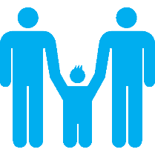
Activity Time
This 9-year-old boy has written to an advice page. Working on your own or with a friend, can you write a reply to him?
“OK, so when I was five, I got scared at the dentist’s and bit her when she was looking at my teeth. She was hurting me, and I don’t want to go again. For ages, my mum hasn’t made me go, but now she says I must because she’s worried my teeth are rotting. I said I’d run away if she made me go. I don’t get why she would make me do it when I don’t want to. What should I do?”
Primary

Slide 8
Activity Time
Whole school activity.
P4- 7 activity
Create a special badge, certificate or card to give to an adult you know who always think about what is best for you or for other children, to say well done or thank you?
Some decisions adults make affect one child, or a few children. Some decisions affect a lot of children. Can you think of any examples of a decision that affects one child, a few children, and many children?
Primary

Slide 9
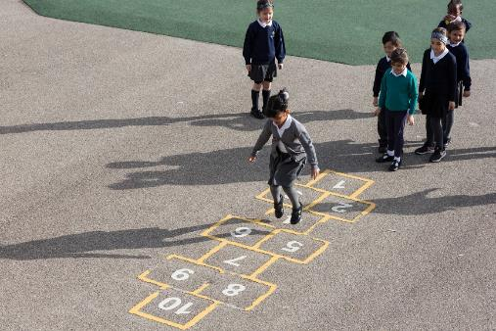
Reflection
Find somewhere quiet and give yourself some space to think:
Who are the adults you trust to make decisions in your best interests?
Think about how they involve you in the decision.
Can you think of decisions made or instructions given to you by adults which you don’t like but you know they are right?
Uncief/Dawe

Slide 10
Thank you

