Slide 1
Unicef/Kolari
Notes:
Portrait of Sarika, 16 from India.
Unicef/Kolari

Slide 2
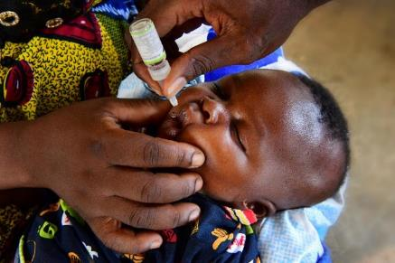

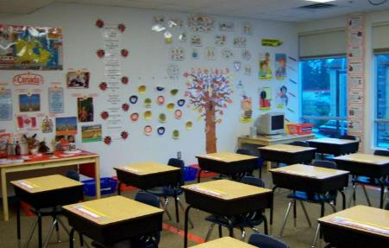
Guess the articles
These pictures provide a clue to this week’s articles.
Can you guess how they are linked together? Which articles of the Convention do these pictures relate to?
Write down your thoughts or discuss with someone in your home.
Unicef/Faso
WikiCommons
WikiCommons
Notes:
From left to right:
1. Mumbai, India, December 2018: Members of the transgender community in India and allies protesting against the regressive provisions of the Transgender (Protection of Rights) Bill. Wikicommons
2. Recently married couples leaving the City Hall in Seattle are greeted by well-wishers on the first day of same-sex marriage in Washington state after enactment of Washington Referendum 74 Dennis Bratland/Wikicommons
3. Baltimore, US, July 2016: An image from a Black Lives Matter march through downtown Baltimore City. John Lucia/Wikicommons – licence: https://creativecommons.org/licenses/by/2.0/deed.en

Slide 3
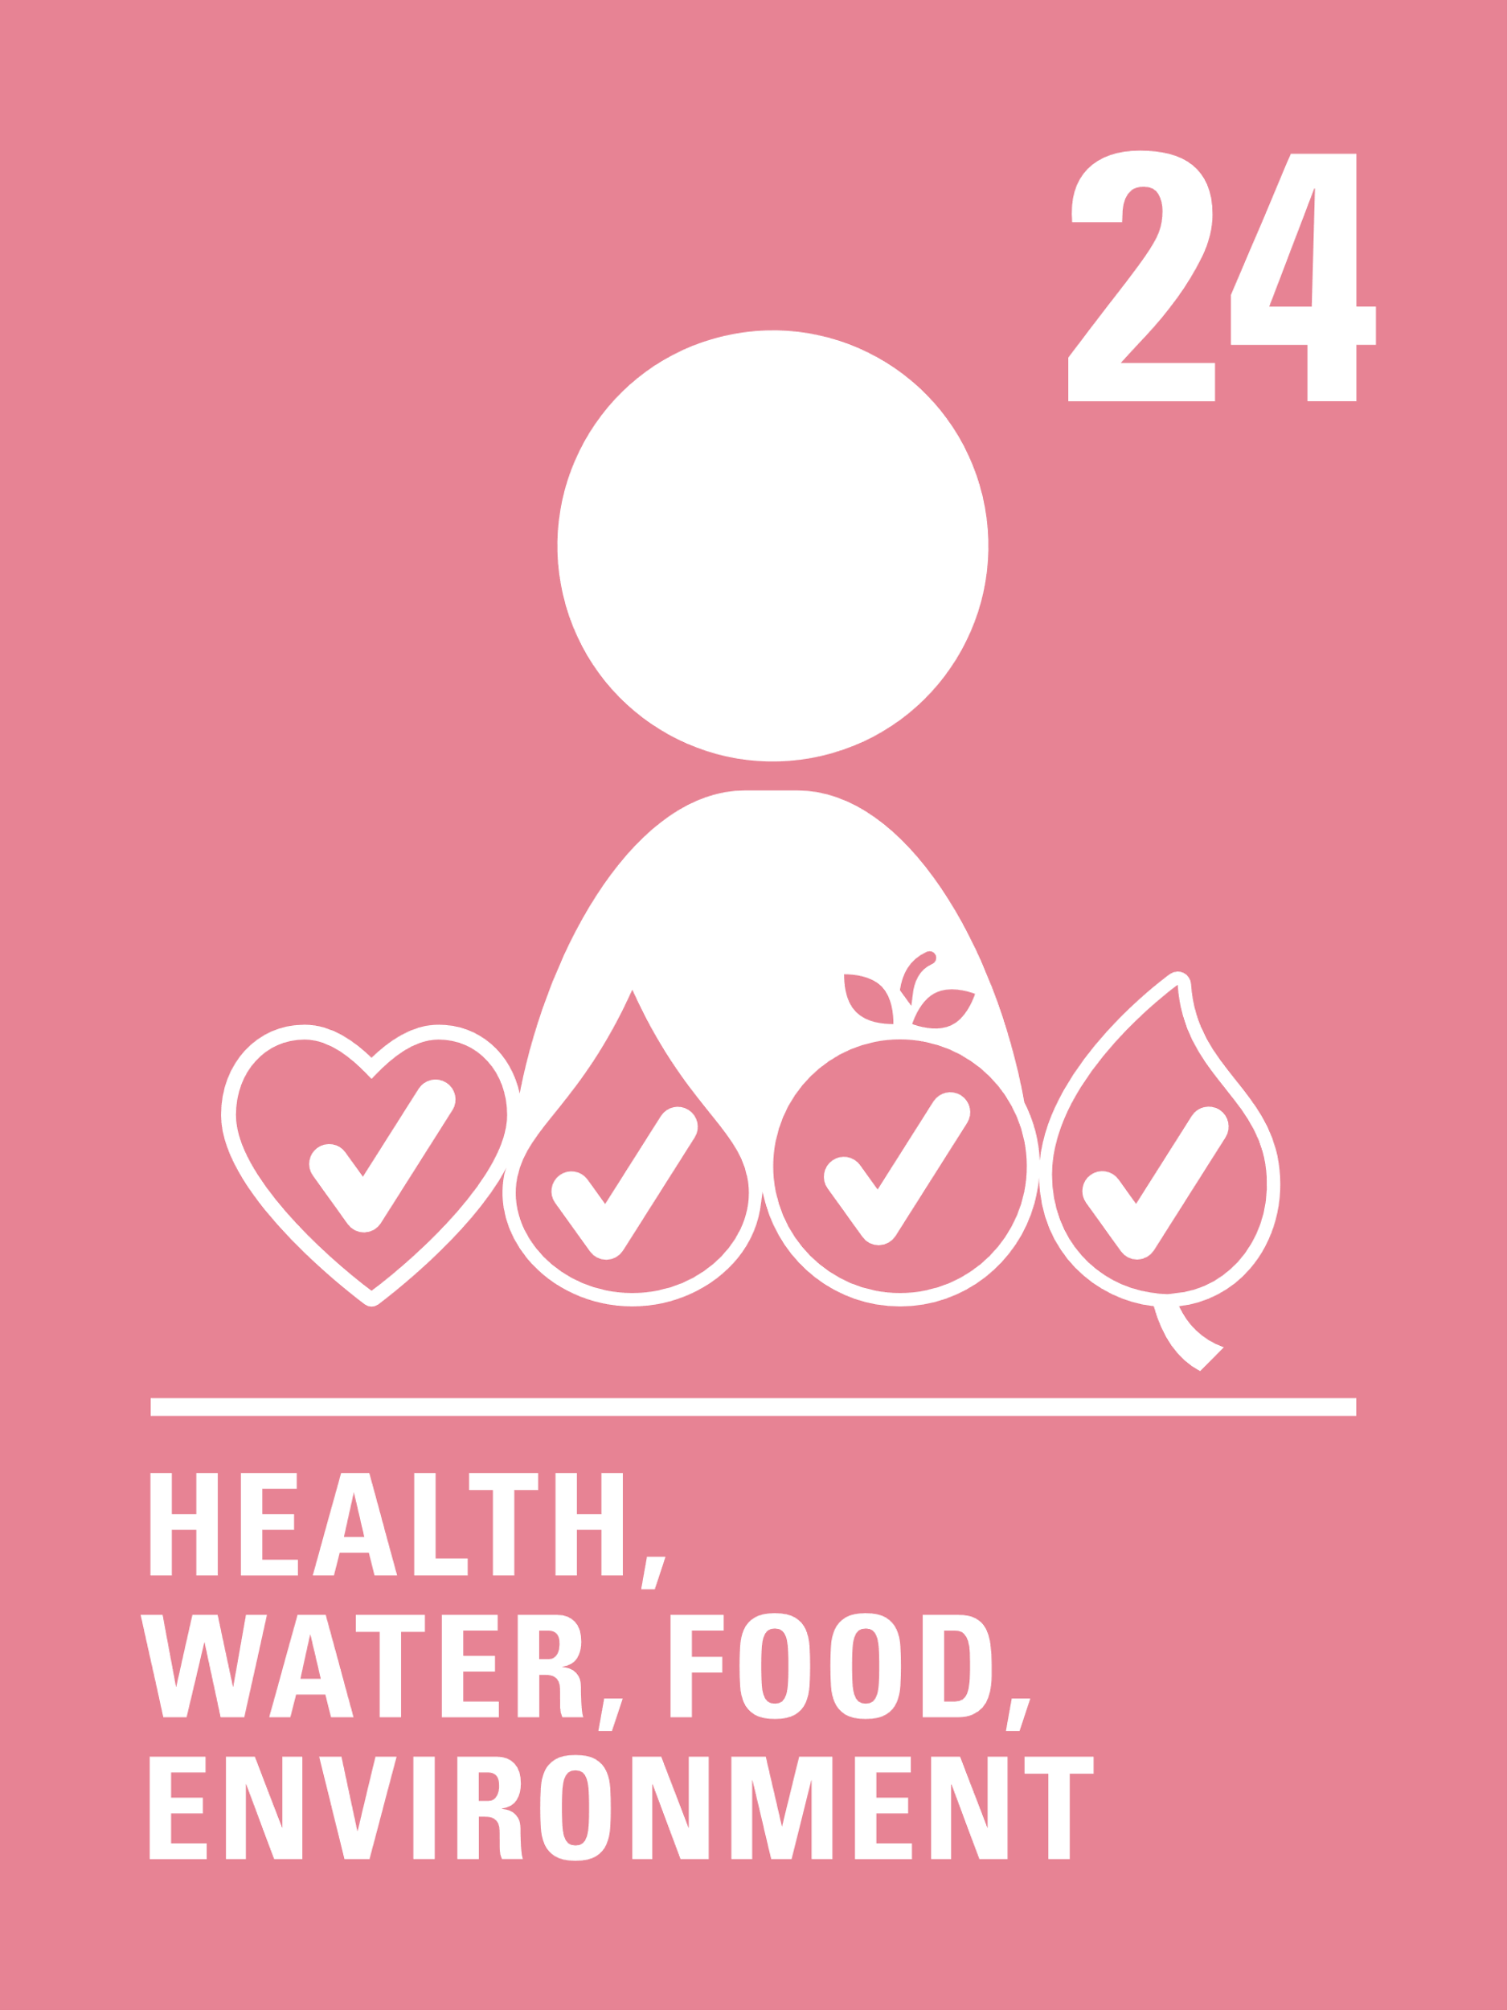

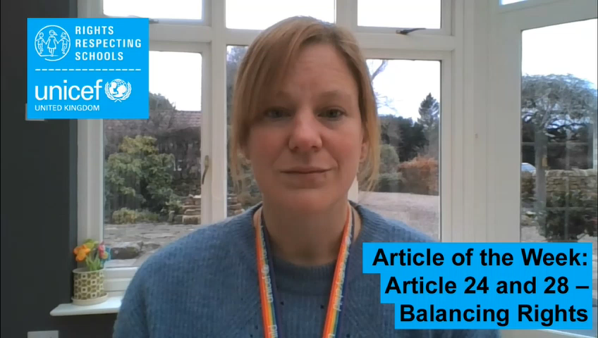
Introducing…
Article 24 & 28
Kathy introduces Article 24 & 28
Article 24 – Health care ensures that every child has the right to the best possible health
Governments must provide good quality health care, clean water, nutritious food, and a clean environment and education on health and well-being so that children can stay healthy. Richer countries must help poorer countries achieve this.
Article 28 - Every child has the right to an education
Primary education must be free and different forms of secondary education must be available to every child. Discipline in schools must respect children’s dignity and their rights. Richer countries must help poorer countries achieve this
Watch Kathy on YouTube

Slide 4
Exploring Article 24 & 28
How many ways can you think of to link education and health?
Note down your thoughts and compare with the next slide.

Slide 5
How many of these did you get?
In school we learn about health
Being active helps our learning and our health
Healthy eating helps our learning
Learning from home is helping to protect health
Teachers make sure we learn about wellbeing, feelings and mental health
Lessons like PSHE are all about making healthy choices
Schools sometimes support health and dental checks and vaccinations
Doctors and scientists learn all the time to help with new diseases
The rights to be healthy and to learn help with all our other rights
Time for exercise and physical education supports good health.
What else did you think of?

Slide 6
Activity Time
How do parents or carers teach their toddler or very young child about being healthy? Do you remember learning things such as how to clean your teeth? Discuss this at home. Imagine you had to teach a younger brother or sister ONE MESSAGE about being more healthy – what would you say or do? Try it out on a family member or with a friend safely on line.
Draw or list people who can help you stay healthy and to learn. What are their jobs? How can you thank the people in your family who help you?
All these activities are related to…
Think about how you learn about health in school. Your school will talk to you about wellbeing. What does health and wellbeing mean to you? Why are they important? Create an information leaflet or poster to share your ideas.
How is your teacher supporting your learning right now? List all the different ways that you learn and talk to a friend or family member and see if you can come up with more ideas.
You don’t need to do every single activity
but if you have time you can do more than one.
Primary

Slide 7
Activity time
What does your right to education mean to you? What are the many different things you can do to be a great learner? Write an article or create a short video about this and safely share with your friends and family on social media.
These activities will help you
understand how...
…can relate to your life.
You don’t need to do every activity, just do as many as you can.
Duty bearers often have to make hard decisions that involve balancing rights particularly when it comes to our health. Draw a balance scale to show, at this current time, how on one side you are accessing your right to an education and on the other side show how you are accessing your right to being healthy. With family or friends discuss other examples of situation where rights have to be balanced.
Most children and young people are learning at home to protect everyone from coronavirus. What are the other rules and restrictions helping everyone to stay protected and how do they help? Think about your community, or find some examples in the news to show how people have supported others at this time. How can you share these with your class? Are there ways that you could help locally?
Secondary

Slide 8
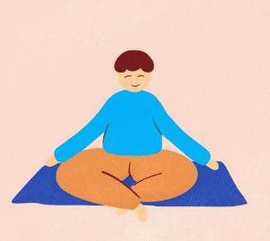

reflection
Find somewhere peaceful and quiet. Relax and let your mind be still. Focus on the sounds of your breath.
Inhale for 4 seconds, hold your breath for 7 seconds, and exhale forcefully making a WHOOSH sound for 8 seconds. Repeat 4 times or until your mind relaxes.
Now lets consider…
…how important it is for everyone’s health and for all children’s education to get the world protected from Covid-19.
Spend a couple of moments thinking about this and then write down your thoughts and if you want, share this back with your teacher, friends or family.
Take a moment to breath…
Press play below to do a breathing exercise and reflect on this week’s topic.
Uncief/UN0376033

