Slide 2
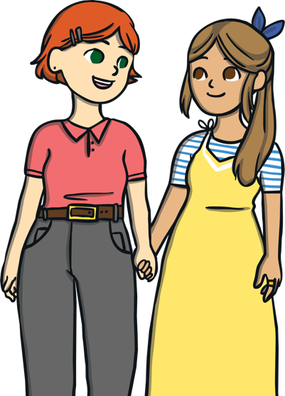
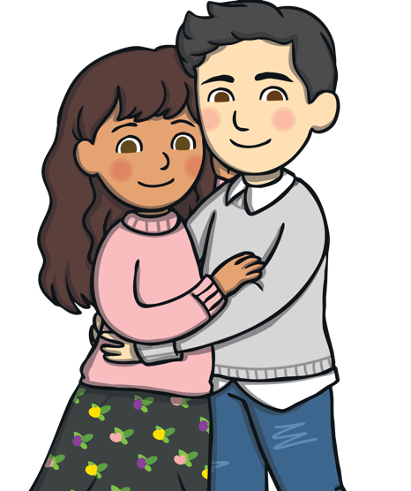
Valentine’s Day
Valentine’s Day is celebrated on February 14. It is a day when people show their love for one another by giving and receiving cards and gifts.

Slide 3
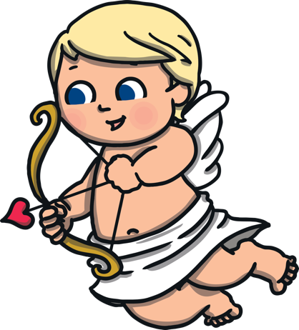
Cupid’s Bow
Cupid, the Roman god of love and affection, is said to help people find love on Valentine’s Day. He is portrayed as a winged cherub with a bow and arrow.

Slide 4
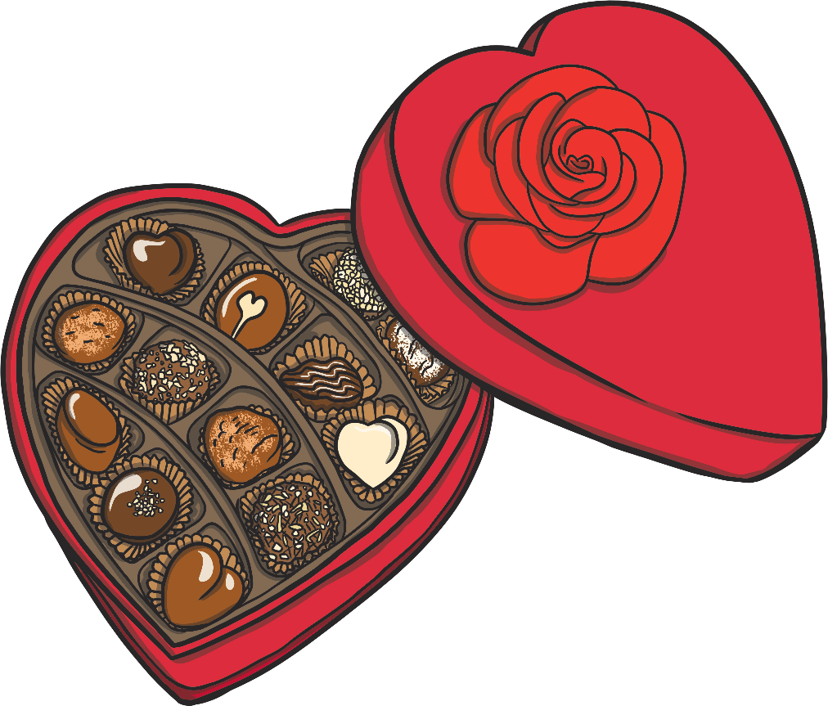
Gifts
Friends and loved ones give each other delicious candy on Valentine’s Day.

Slide 5
Gifts
They might also give each other flowers – red roses are a popular gift.

Slide 6
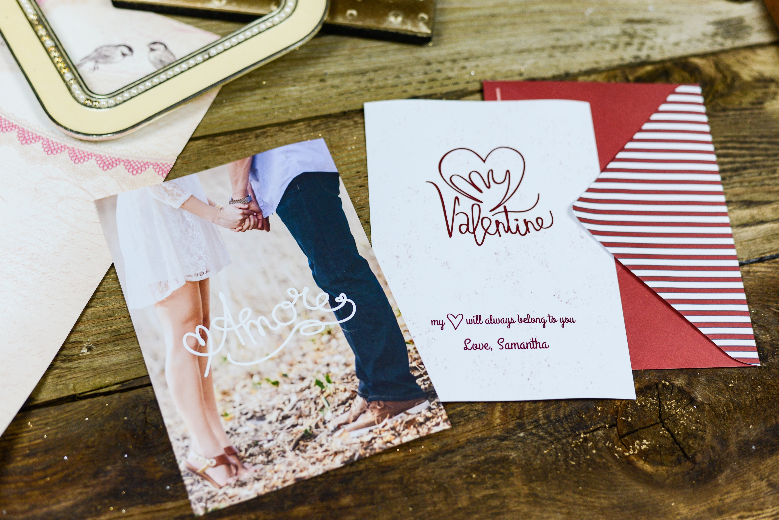
Gifts
Valentine’s Day cards are sent with special messages written inside.

Slide 7
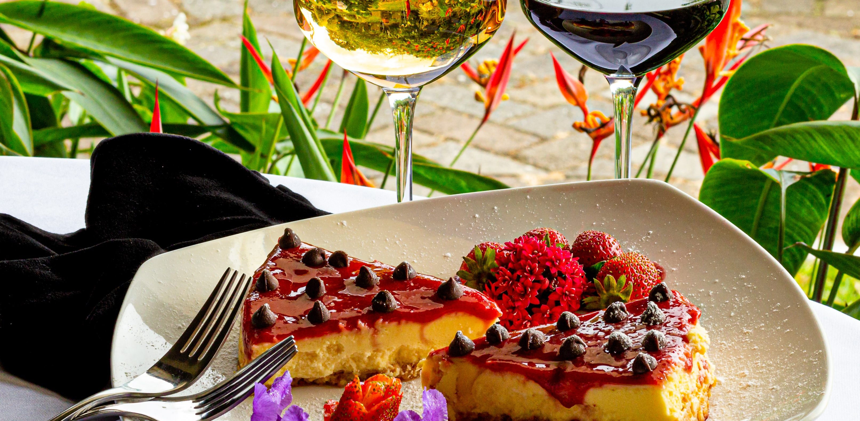
Romantic Celebrations
Some people celebrate Valentine’s Day by going out for a special dinner or to the movie theater.

Slide 8
Symbols of Love
These are some of the symbols of Valentine’s Day:
dove
heart
Cupid

Slide 9
Talk about it…
What does love mean to you? Write a sentence starting with love is.
Love is…when my mummy and daddy give me cuddles.
Love is…cheering my friends up when they feel sad.
Love is…reading my favourite book.
Love is…eating yummy food.

Slide 10
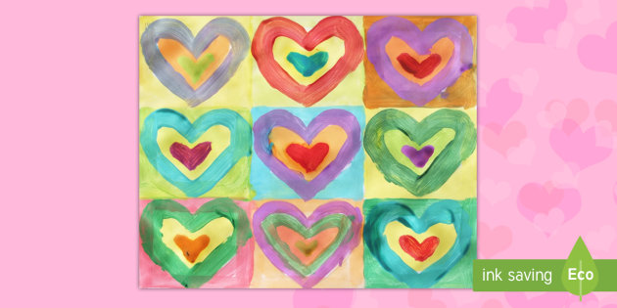
Why not create your own ‘Valentines art’ or make a lovely card for someone you love. Here are a few ideas.

Slide 11
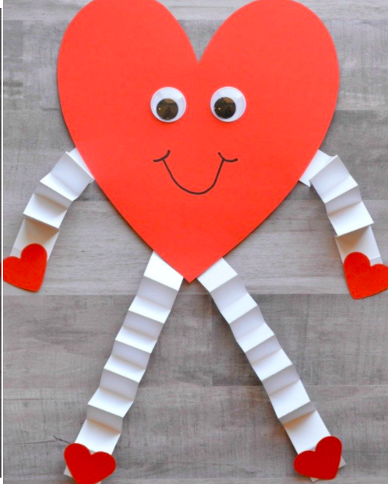

Slide 12
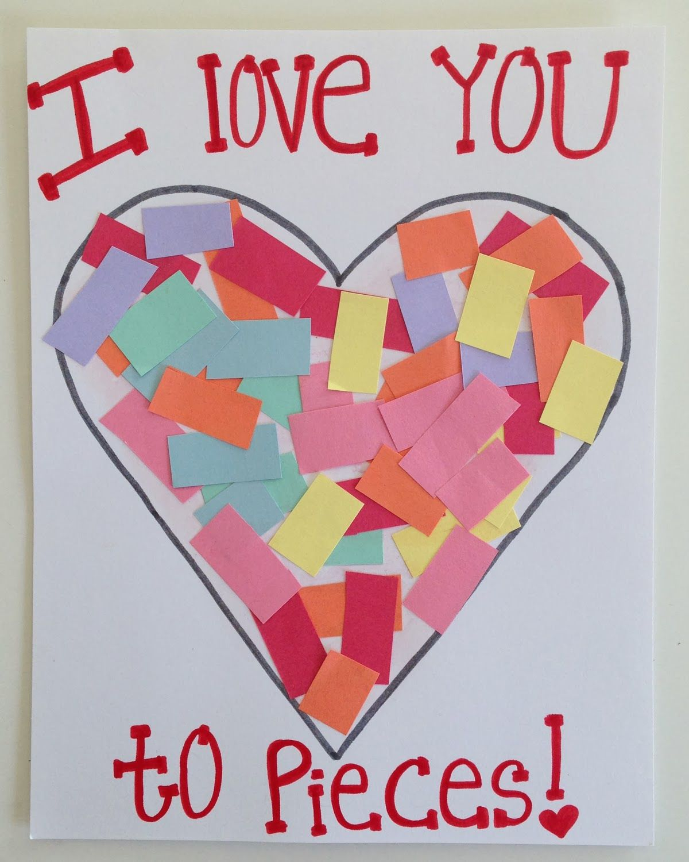

Slide 13
