Slide 1
Phonics Day 2
You will need –
Jotter and pencil.
‘High 5’ hand strategy.
Alphabet letters.
We are learning to make sentences using words with our new phoneme.

Slide 2
Read the phoneme story again, sounding out any tricky words and highlighting words with your new phoneme.

Slide 3
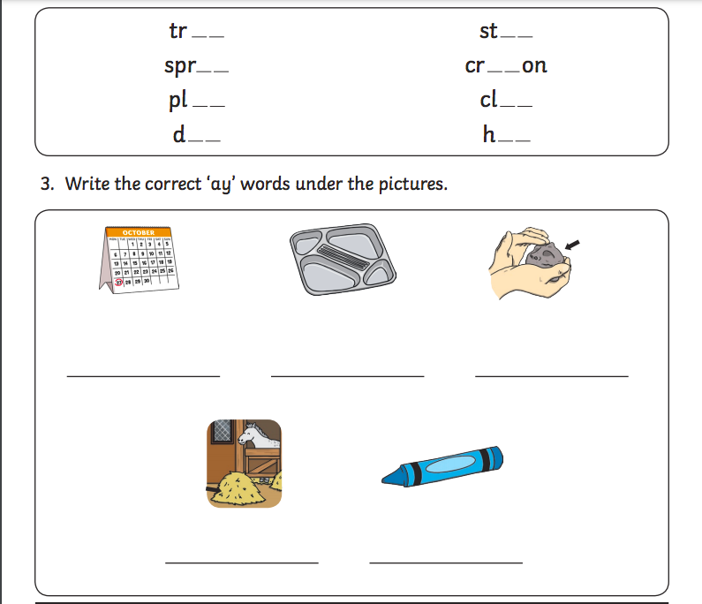
Revision of ‘ay’ phoneme

Slide 4
Making sentences with our new phoneme
You are going to create your own sentences using the words in the lists below.
REMEMBER your core targets when writing your sentences - capital letters, full stops, finger spaces and joining words (and, but).
P2 Words:
day
play
stay
prayer
way
tray
P3 Words:
essay
birthday
holiday
always
layer
Sunday
Challenge – think of your own words with ‘oa’ phoneme and write them in a sentence.

