Slide 1
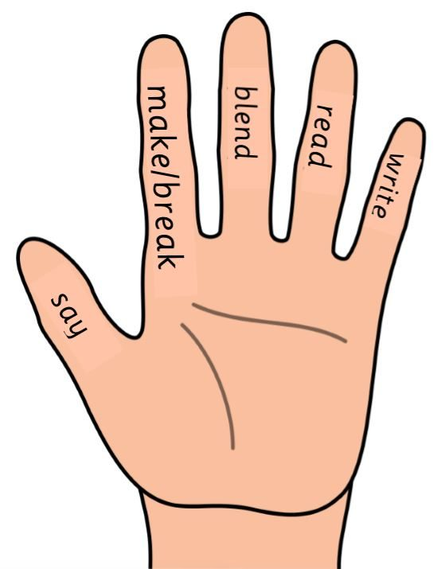
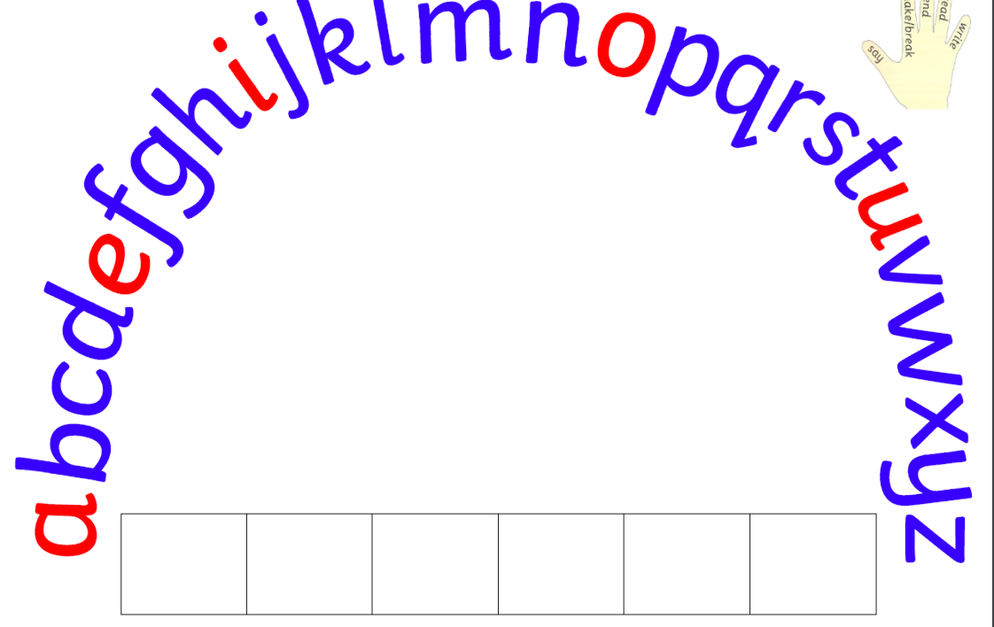

Slide 2
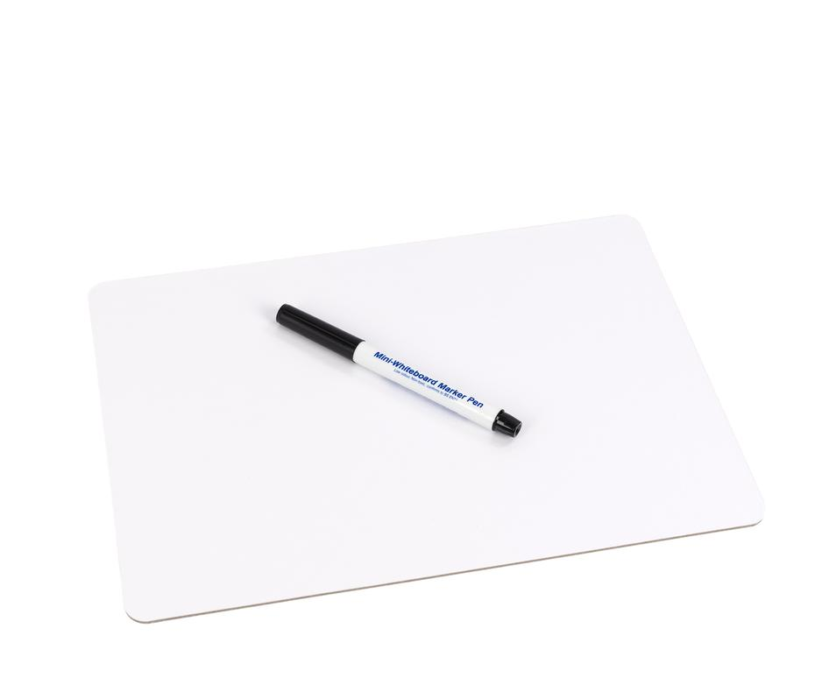
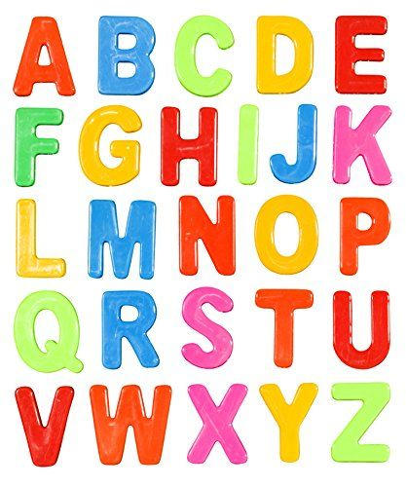
You will need…
White board and pen
Magnetic alphabet letters

Slide 3
Quick revision of phonemes Click on the sound button to hear the phoneme
ck
ai
ee
sh
ch
th
ph
ng
oo
wh
oy
oa

Slide 4
New phoneme:
ay
We are learning to read and say the ‘ay’ phoneme.

Slide 5
Geraldine the Giraffe
Be like Geraldine and see if you can find anything in your house/garden with the ‘ay’ phoneme!

Slide 6
Word building with ‘th’ phoneme
Can you think of any words with our new sound? Write them down on your whiteboard.
Have a look at the words below and use your ‘High 5 hand’ to say it/make it/break it/blend it/read it/write it.
day tray delay pray

Slide 7
Now it’s your turn…
Look at the word lists below and use your ‘high 5’ strategy and alphabet letters to build these words.
P2 Words:
day
play
stay
prayer
way
tray
P3 Words:
essay
birthday
holiday
always
layer
Sunday
Challenge – can you think of your own words with the ‘ay’ phoneme? See how many you can find!

