Slide 1
Phonics Day 2
You will need –
White board and pen
‘High 5’ hand strategy
Alphabet letters
We are learning to use the say it/make it/break it/blend it/read it/write it strategy to make words

Slide 2
Let’s sing our alphabet song!
Can you remember which letters are vowels?

Slide 3
Revision of our new sound – ‘th’

Slide 4
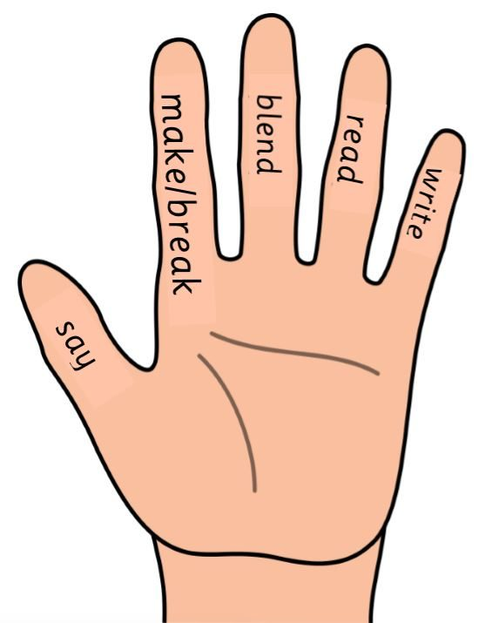
Word building with ‘ch’
Use your ‘high 5’ hand strategy to build the words in the list with your alphabet letters – like we do in class.
Remember to - say it, make it, break it, blend it, read it, write it (in that order).

