Slide 1
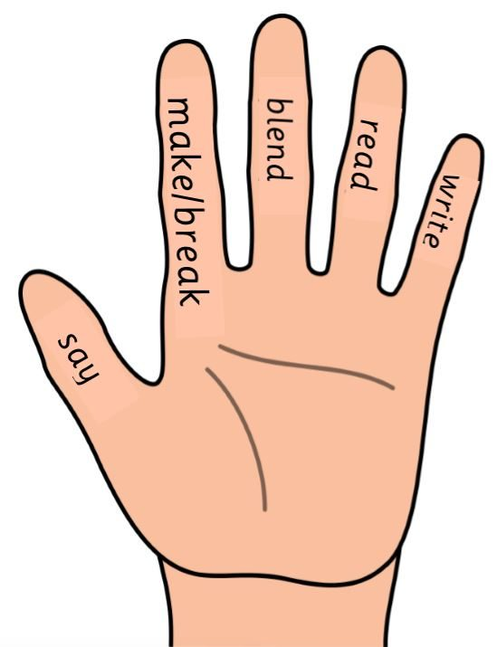
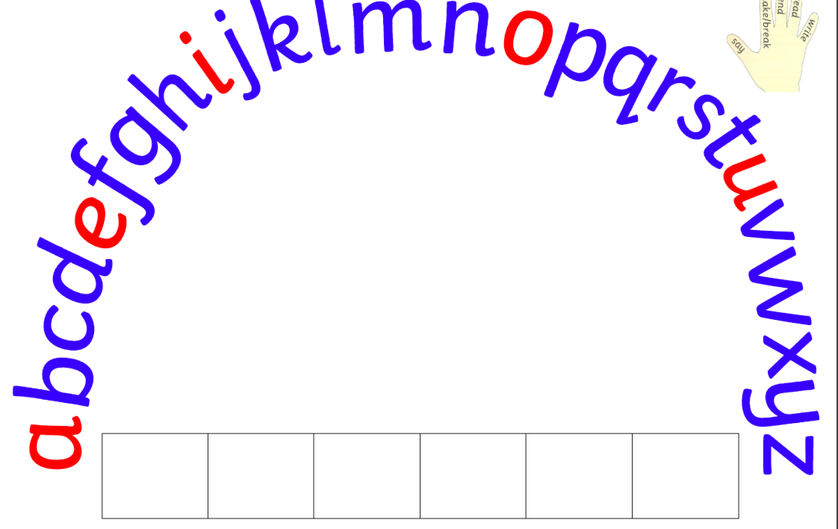

Slide 2
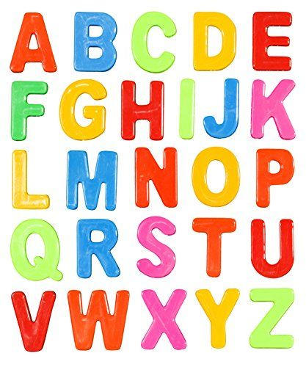
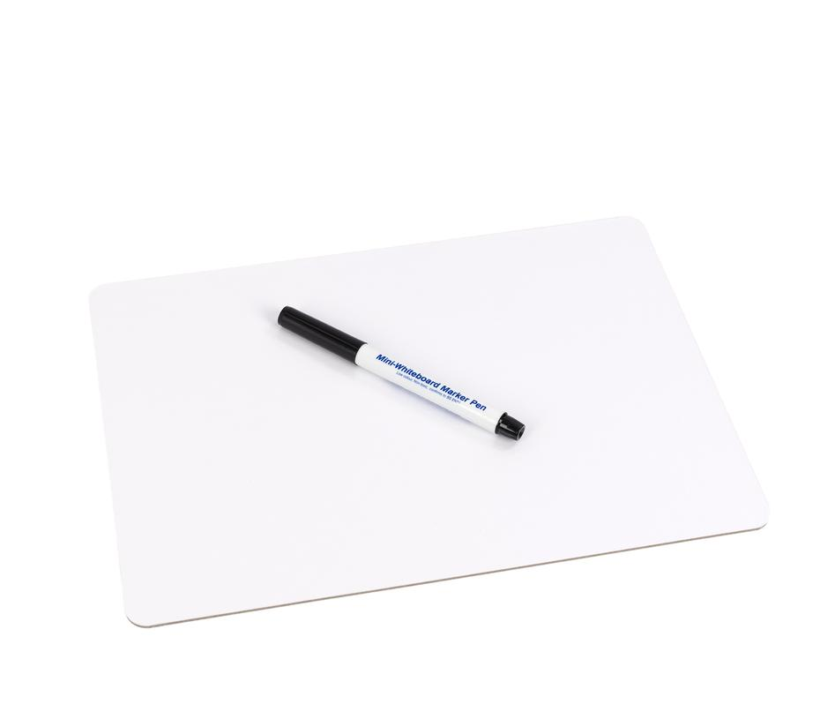
You will need…
White board and pen
Magnetic alphabet letters

Slide 3
Let’s sing our alphabet song!
Can you remember which letters are vowels?

Slide 4
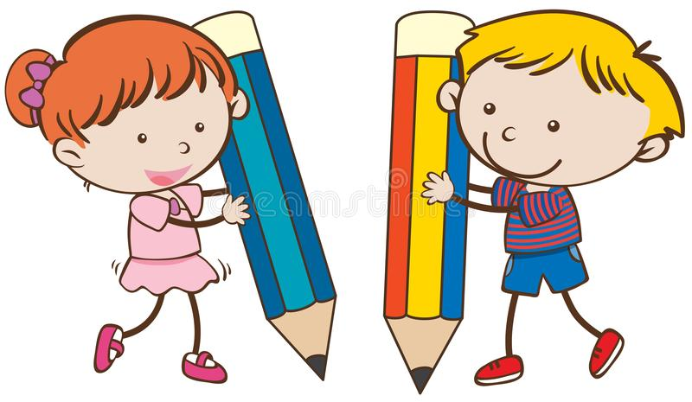
New sound
ch
We are learning to say and read the ‘ch’ phoneme.

Slide 5
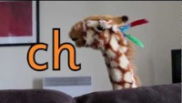
Geraldine the Giraffe

Slide 6
Word Building
Now have a go at building some words on your own.
chat much
Can you think of any words with ‘ch’ phoneme?

