Slide 1
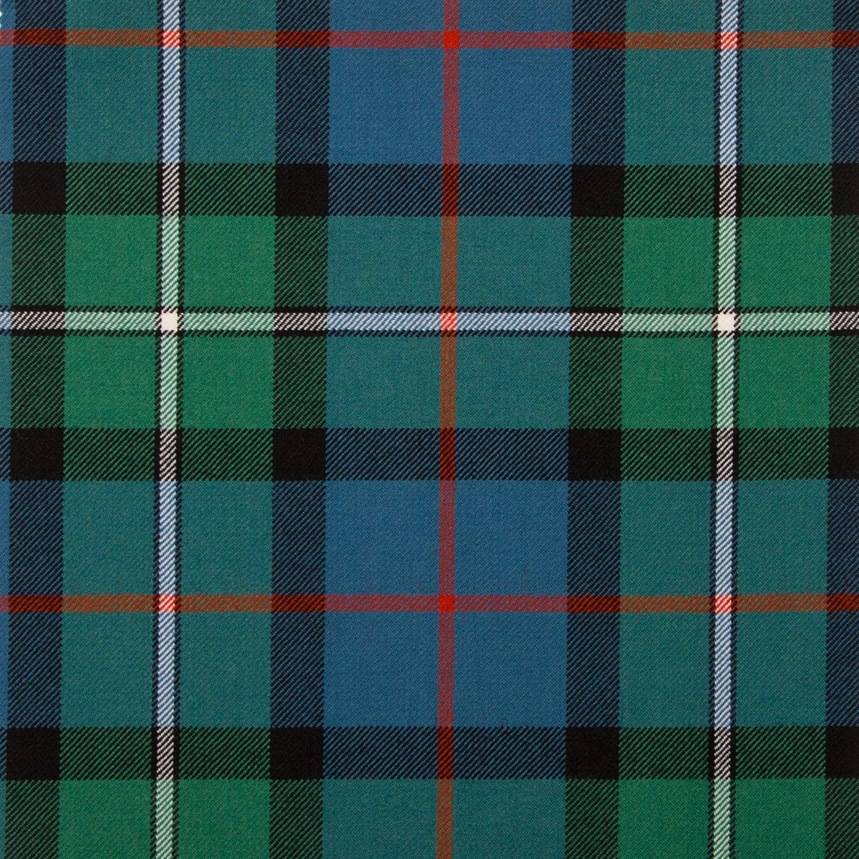
We are learning to make our own Tartan using the ‘weaving’ technique.

Slide 2
You will need…
Coloured paper or card – at least 2 different colours.
Glue stick
Scissors
White paper/card as your backing sheet.

Slide 3
Step 1 – Cut the coloured paper into strips. You can make them all different widths and lengths.

Slide 4
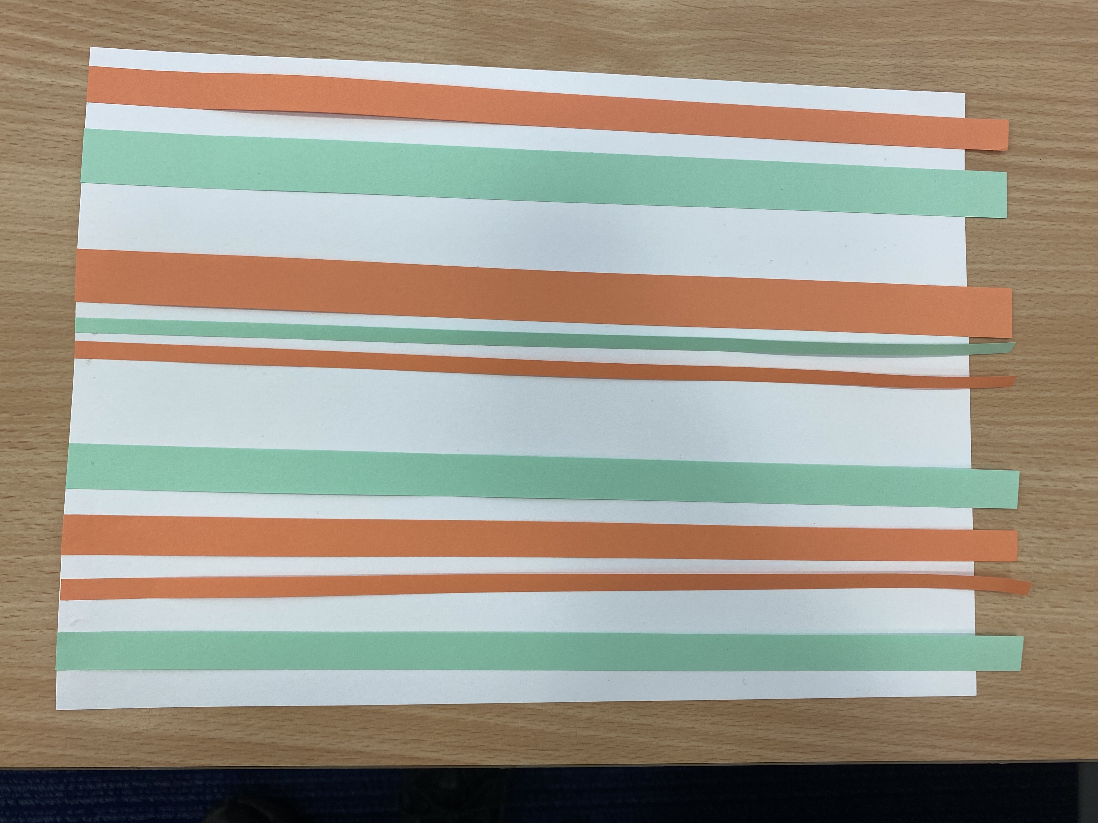
Step 2 – stick one side down onto your paper and leave the other side loose.

Slide 5
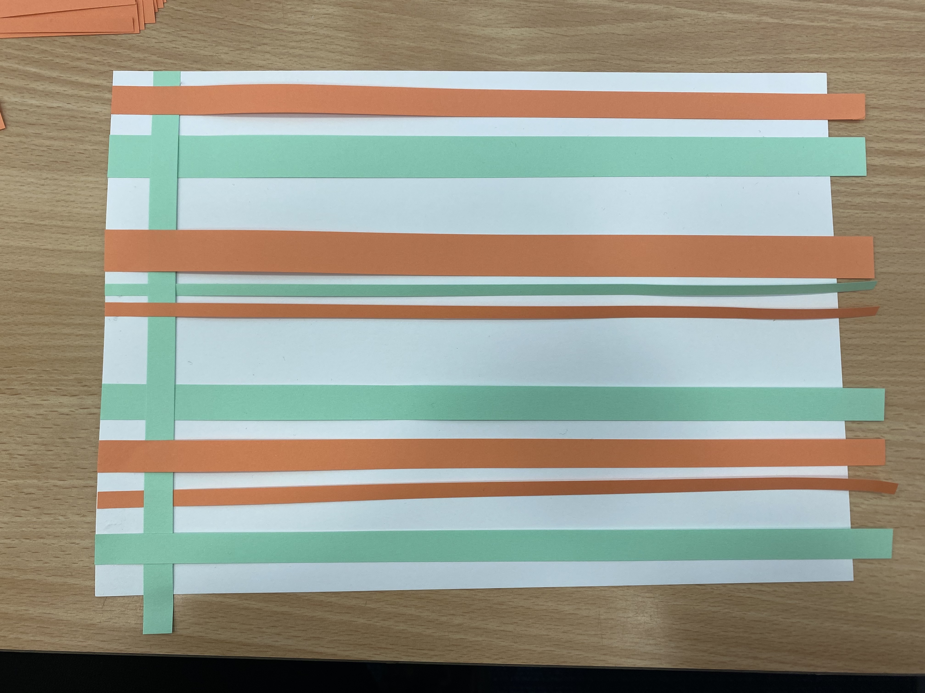
Step 3 – Start to weave your first strip of paper.

Slide 6
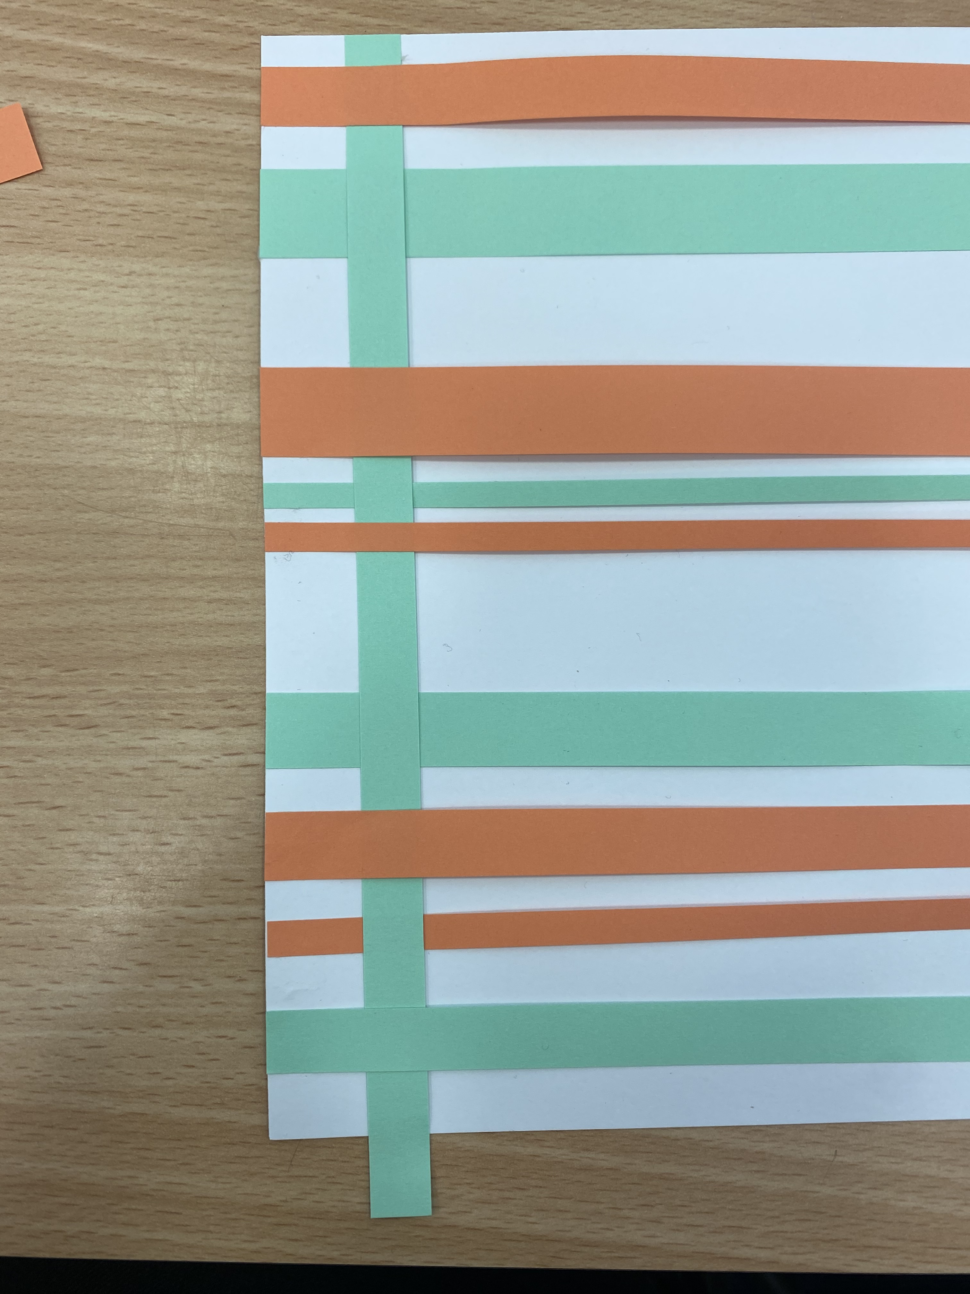
Step 4 – Make sure to go over and under each time you weave.

Slide 7
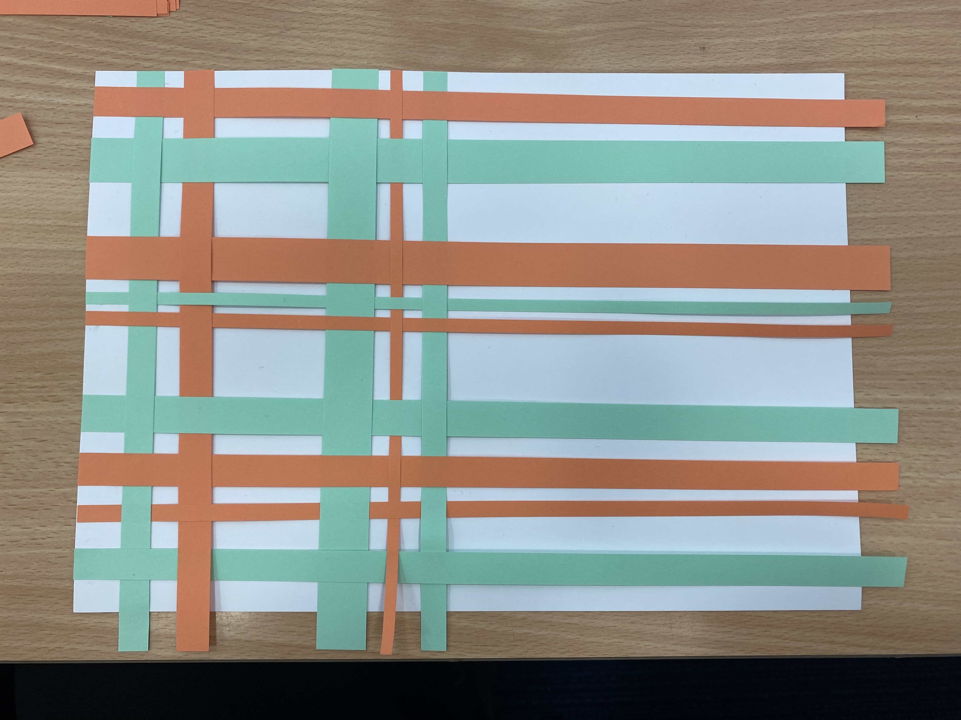
Step 5 – Continue weaving all the way along until you are finished. You can put your strips close together or far apart, it’s up to you!

Slide 8
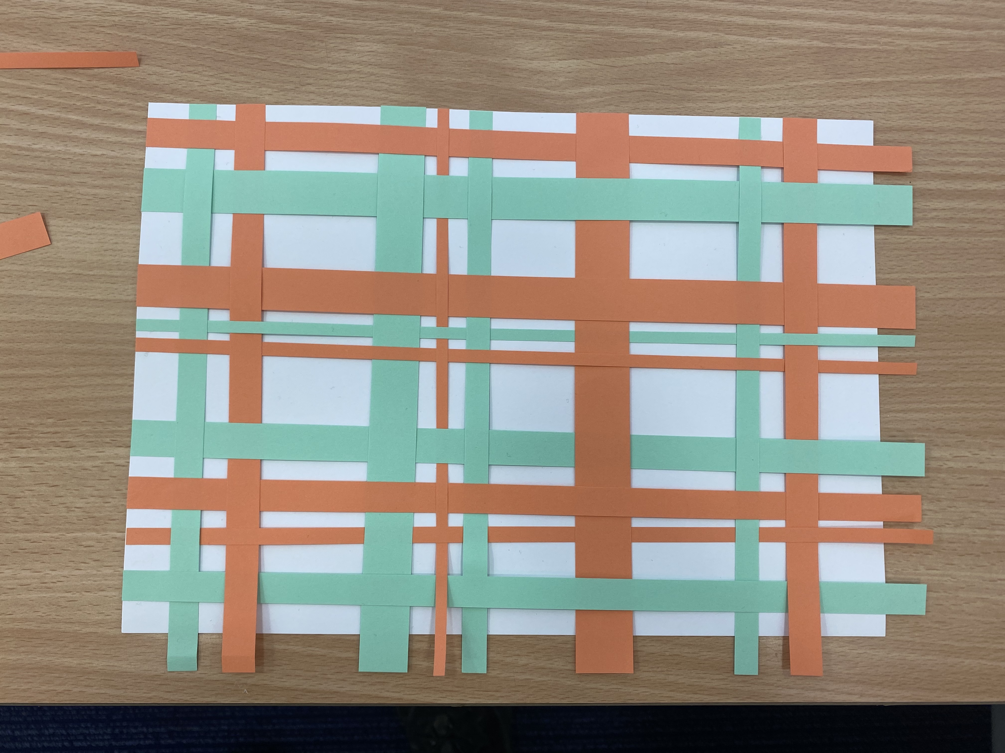
Step 6 – Your finished product should look something like this. If the paper is slightly too long, trim it with the scissors and make sure all ends are stuck down

Slide 9
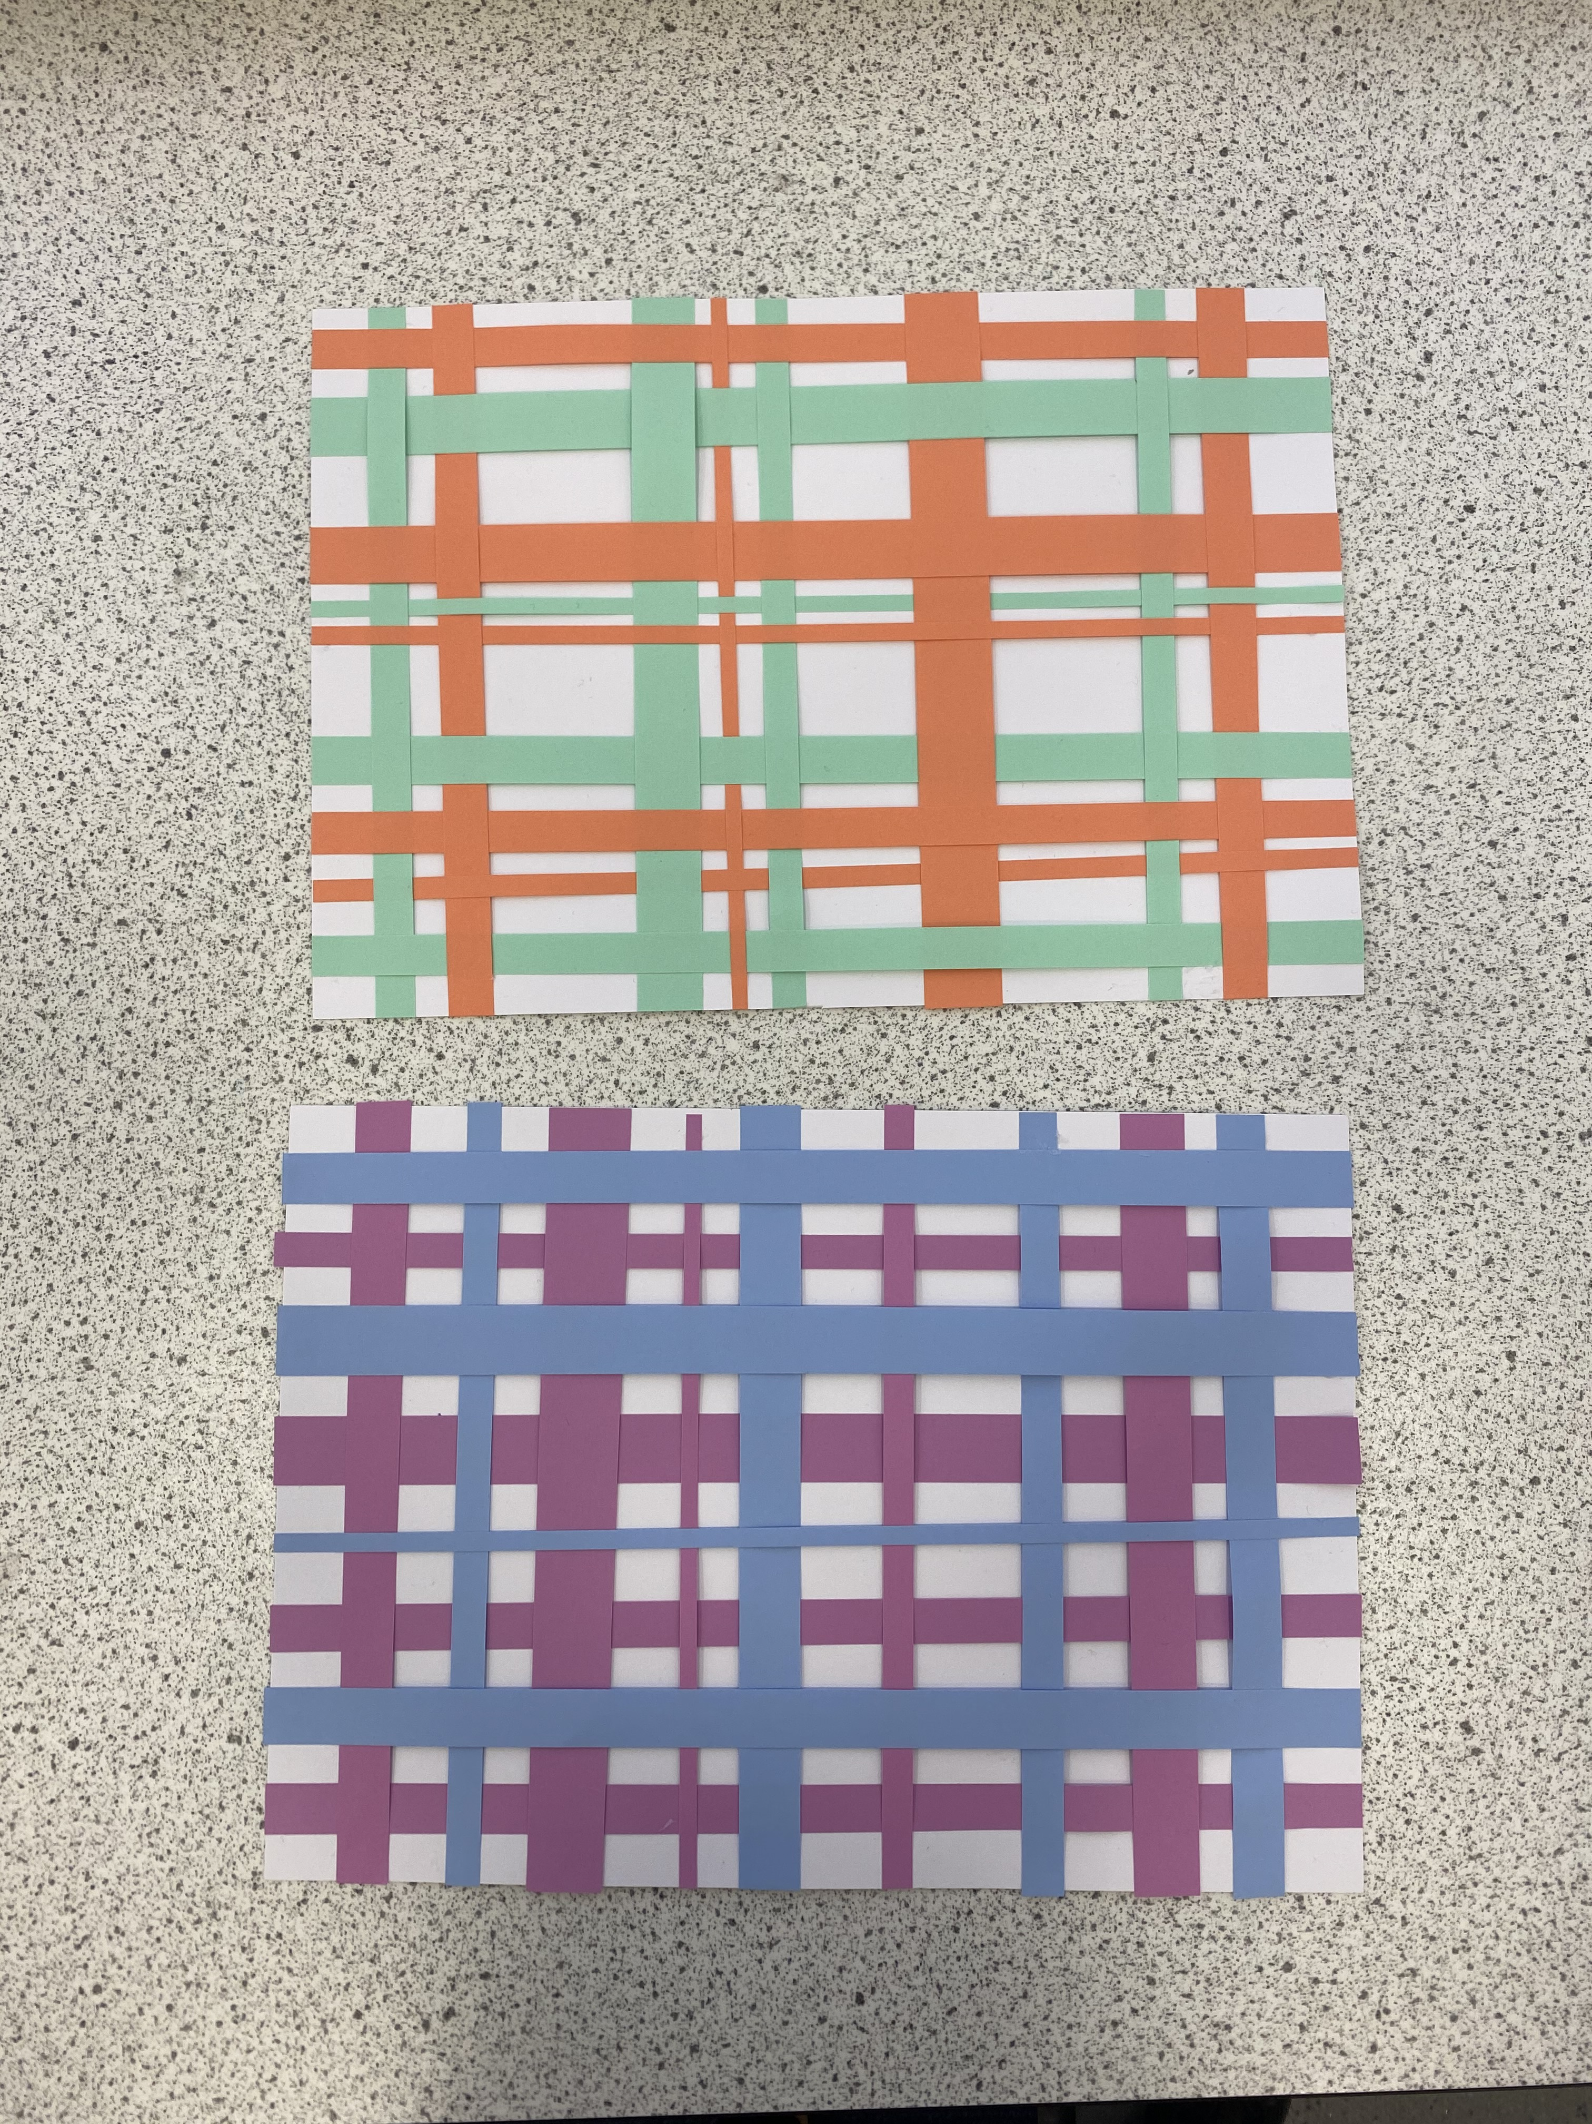
Some examples.. Enjoy!

