Slide 1
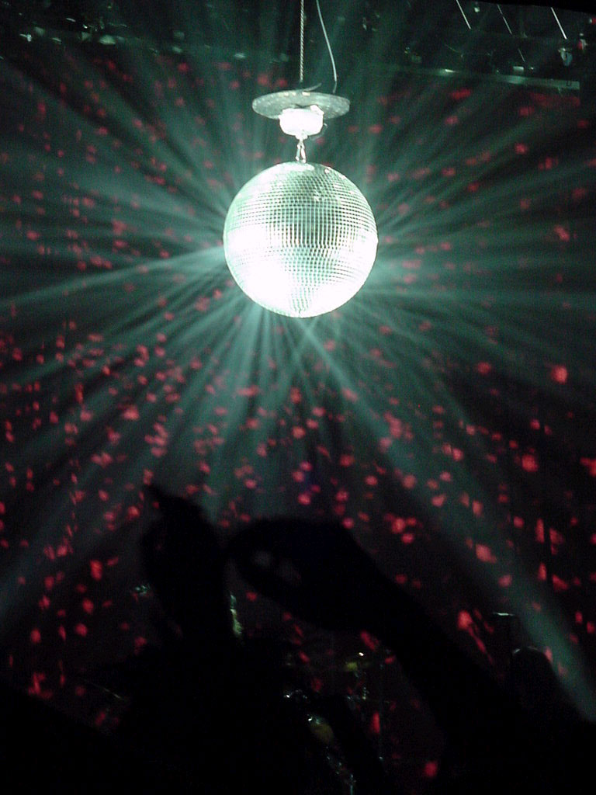
Bee Gees
Funky Phonics

Slide 2
sh

Slide 3
ch

Slide 4
th

Slide 5
ng

Slide 6
wh

Slide 7
ph

Slide 8
ee

Slide 9
oo

Slide 10
ck

Slide 11
ai

Slide 12
oy

Slide 13
oa

Slide 14
qu

Slide 15
ll

Slide 16
ff

Slide 17
ss

Slide 18
