Slide 1
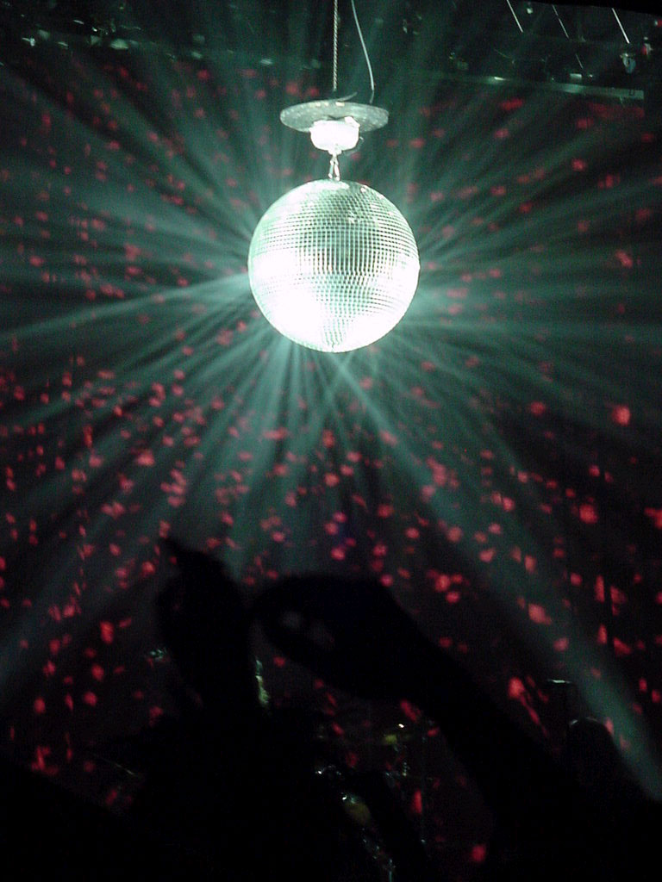
Bee Gees
Funky Phonics

Slide 2
m

Slide 3
e

Slide 4
t

Slide 5
qu

Slide 6
k

Slide 7
n

Slide 8
a

Slide 9
th

Slide 10
u

Slide 11
d

Slide 12
f

Slide 13
j

Slide 14
b

Slide 15
z

Slide 16
x

Slide 17
g

Slide 18
i

Slide 19
h

Slide 20
o

Slide 21
sh

Slide 22
w

Slide 23
l

Slide 24
y

Slide 25
r

Slide 26
v

Slide 27
a

Slide 28
in

Slide 29
I

Slide 30
the

Slide 31
in

Slide 32
at

Slide 33
it

Slide 34
an

Slide 35
is

Slide 36
and

Slide 37
