Slide 2
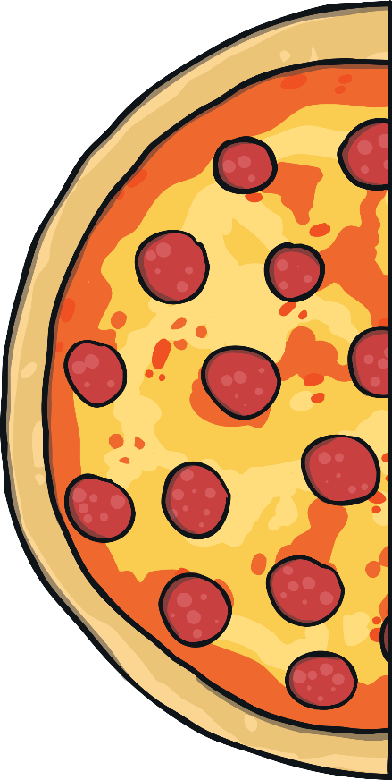
Is it a half?
answer
Yes, it is a half because it is divided into two equal parts.

Slide 3
Is it a half?
answer
No, because it’s a whole shape.

Slide 4
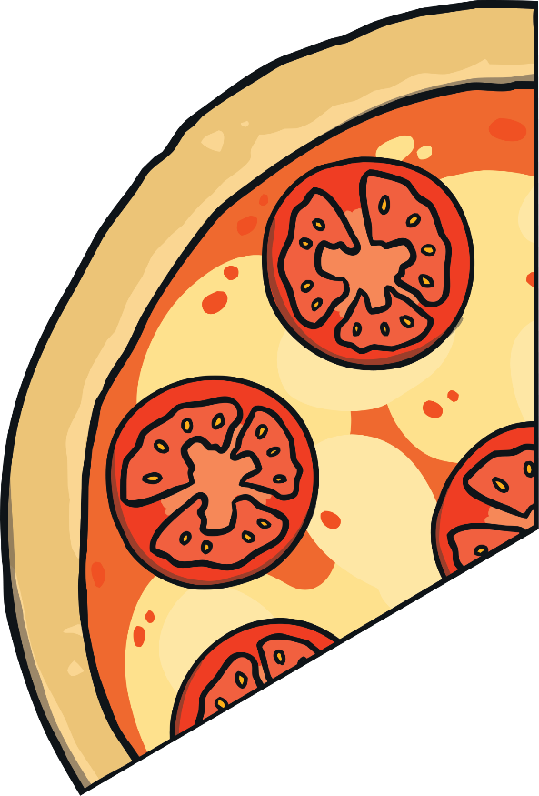
Is it a half?
answer
No, because the parts are not equal.

Slide 5
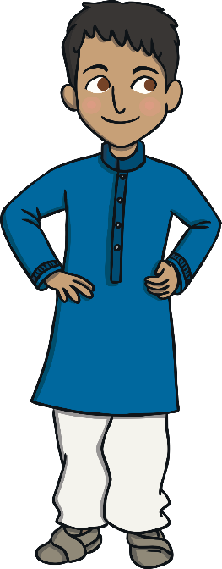
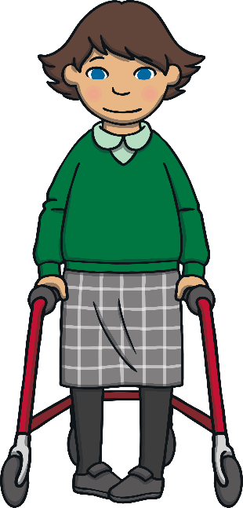
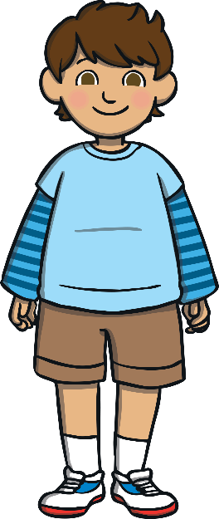
Is it a half?
Half of the class are girls. There are 6 girls. How many children are in the class altogether?
12
answer

Slide 6
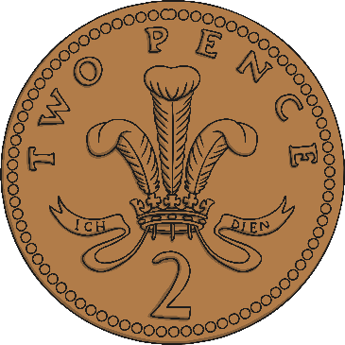
Halve It!
What is half of this amount?
4p
answer

Slide 7
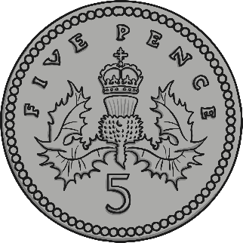
Halve It!
What is half of this amount?
5p
answer

Slide 8
Halve It!
What number is half of 10?
5p
answer

Slide 9
Halve It!
What number is half of 12?
6p
answer

Slide 10
Halve It!
What number is half of 20?
10p
answer

