Slide 1
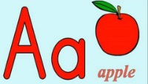
Phonics Alphabet

