Slide 1
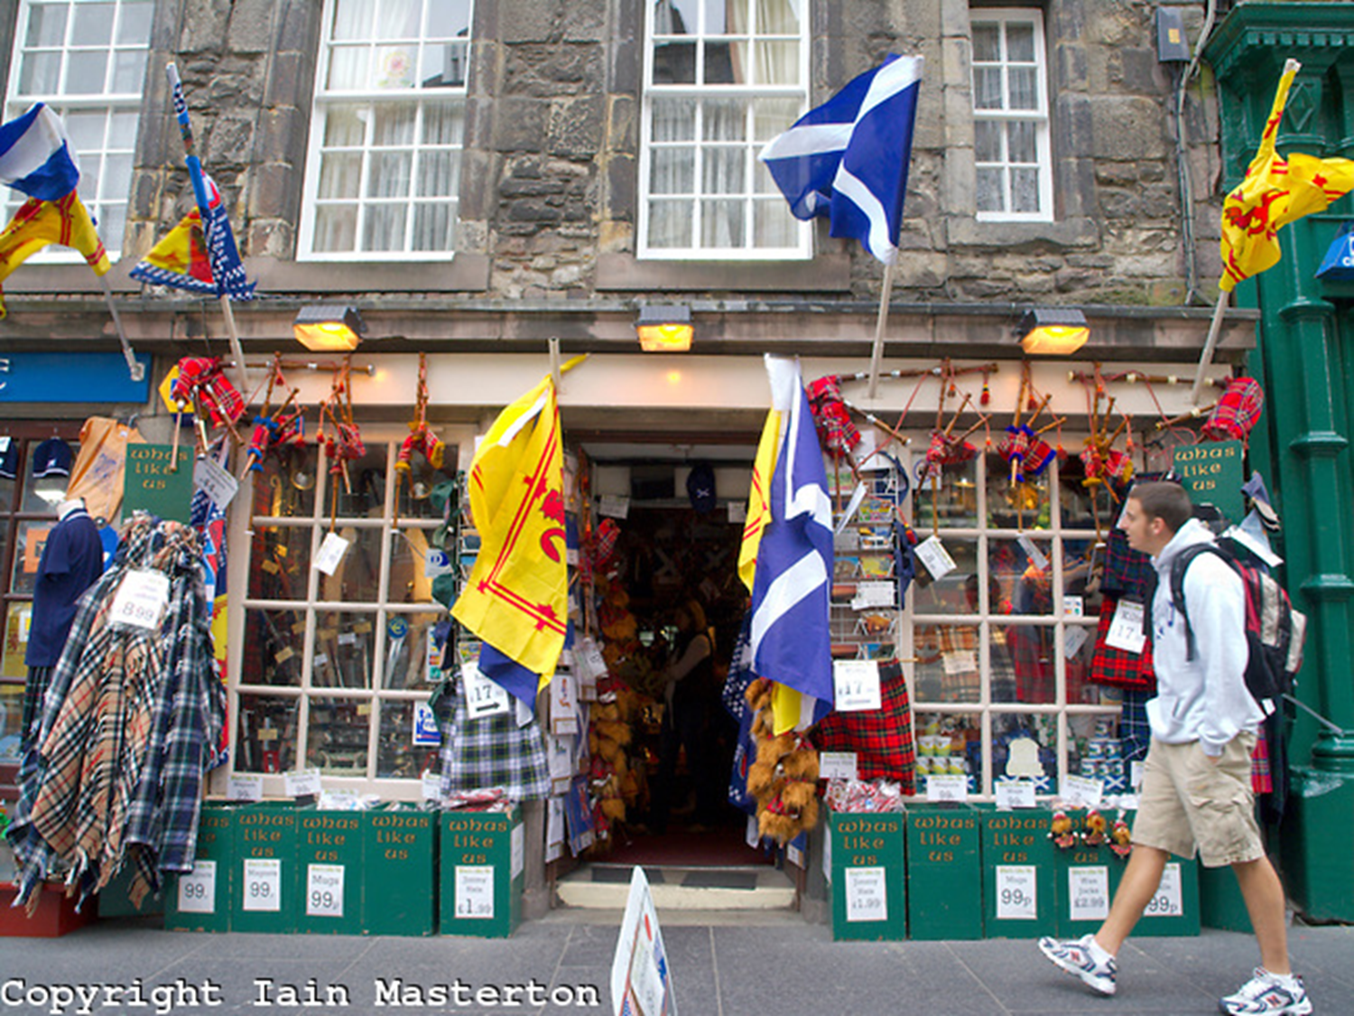
Scotland Unit
Positive Impacts of Tourism

Slide 2
Learning Intentions
To be able to describe the four positive impacts from tourism in Scotland and explain how they are related.
To be able to apply knowledge on positive impacts to a case study.

Slide 3
Success Criteria
I can complete a note on positive impacts
I can write a report on positive impacts brought from sport tourism at the Commonwealth Games.

Slide 4
What are Impacts?
Impacts are those things which tourists do the area they are visiting an area and the changes that occur as a result of tourism.
Nearly all tourist activities have an impact on the destination where tourists are staying.
These can be good impacts or bad impacts…

Slide 5
Tourism in Scotland
Tourism related activities is worth £4.1 billion per year to the Scottish economy.
In 2009 around 15 million tourists took overnight trips in Scotland.
Over 216,000 people are employed in the tourist industry in Scotland.
Tourism is one of Scotland’s largest business sectors.
Many people depend on tourism from rural areas in Scotland to the major cities for jobs and infrastructure…

Slide 6
Impacts
Employment
Infrastructure Development
Cultural Preservation
Environmental Protection
Income

Slide 7
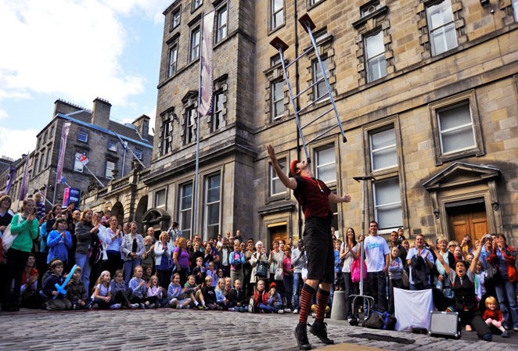
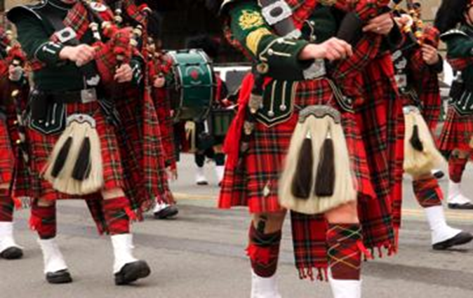
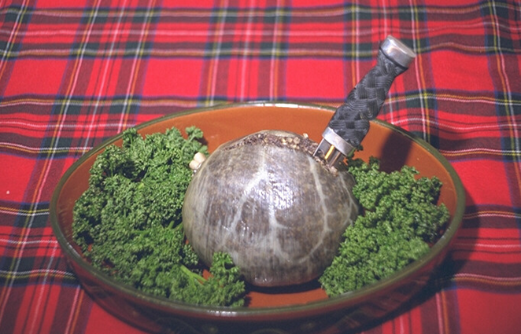
Cultural Preservation
Preserving our culture is important to keep tourists coming to Scotland and creating investment in Scottish tourism…
Haggis
Edinburgh Tattoo
World Pipe Band Championships
August 2014
Whisky

Slide 8
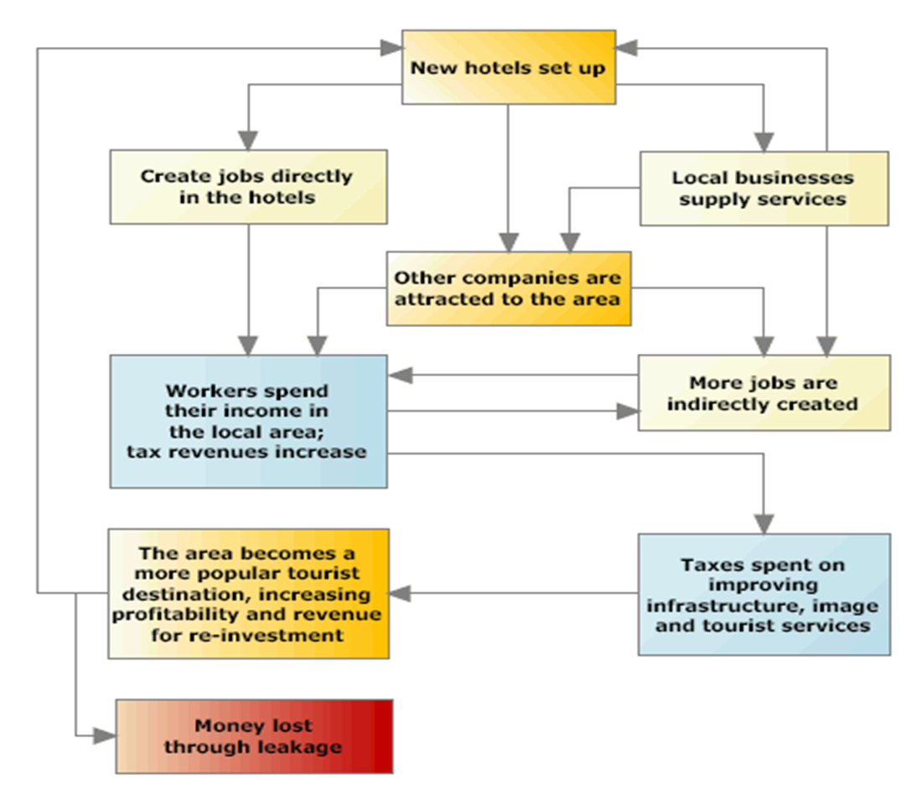
Income
What are the benefits of bringing money into Scotland through tourism?

Slide 9
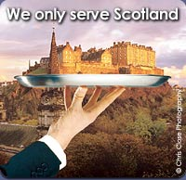
Employment
Scotland is a popular tourist destination so more jobs are being created through new hotels and attractions being built.

Slide 10
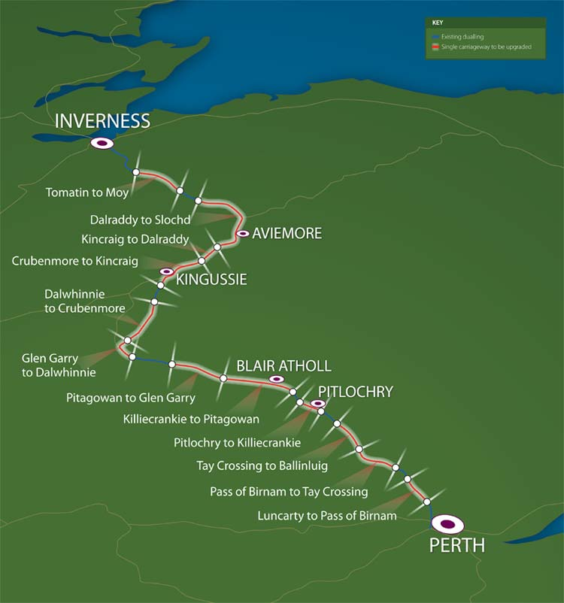
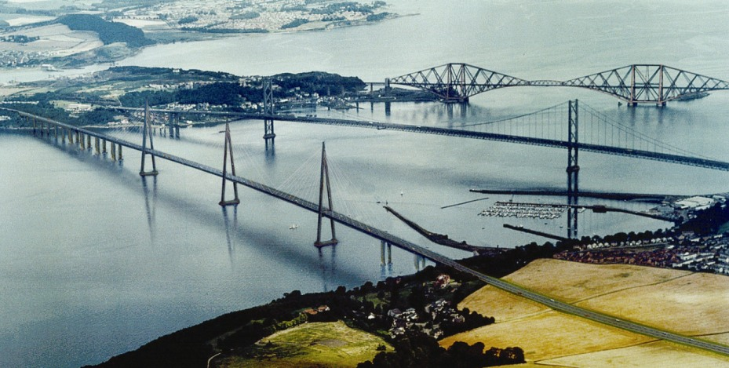
Infrastructure Development
If more money is coming into the country then this money can be spent on improving infrastructure…
Dualling the A9 – benefit tourism in the north of Scotland
New Forth crossing – Queensferry Crossing

Slide 11
Positive Impacts
Multiplier Effect
This is called the Multiplier Effect. This is a cycle – Scotland needs money coming in from tourism to create jobs in hotels and attractions. This creates more money through people being employed and spending money in the country which can be spent on improving infrastructure. We need to preserve our culture to keep attracting tourists!
Think about the questions raised under each of the benefits of tourism in Scotland.
Did you notice they are all related to one another? This is called the multiplier effect.

Slide 12
Glasgow 2014
The Commonwealth Games was a massive event which showcased our history and culture. Over 1 million tickets were sold for the event attracting tourists from around the world to Glasgow…

