Slide 1
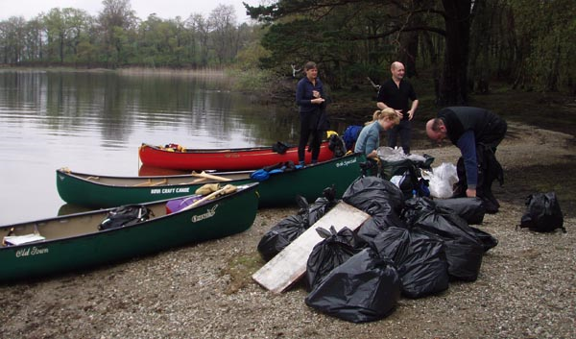
Scotland Unit
Negative Impacts of Tourism

Slide 2
Learning Intentions
To be able to describe the four negative impacts from tourism in Scotland.
To be able to apply knowledge on negative impacts to a case study.

Slide 3
Success Criteria
I can make notes on negative impacts by applying my knowledge to Cairngorm Mountain.

Slide 4
Negative Impacts
Employment
Environmental Destruction
Cultural Destruction
Second Homes

Slide 5
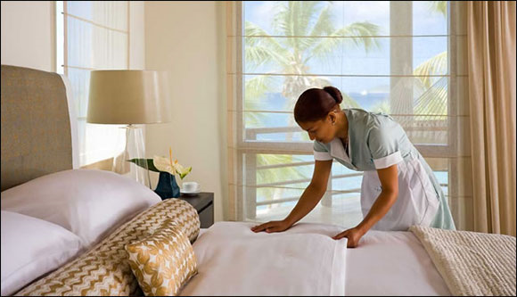
Employment
Although employment was a positive impact it is also a negative impact…
Jobs in the tourism sector can be low skilled…
Jobs in the tourism sector can be seasonal

Slide 6
Second Homes
Tourists can enjoy a destination so much that they buy a holiday home. This has a negative impact on those that live in that area because it pushes the price of houses up. Making it difficult for young locals to get onto the property ladder…

Slide 7
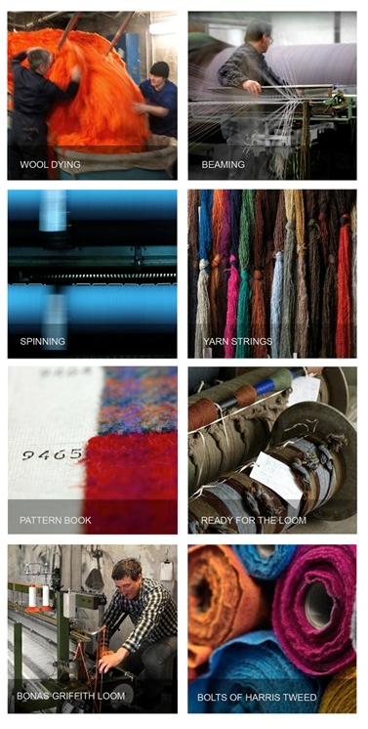

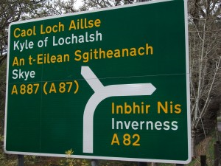
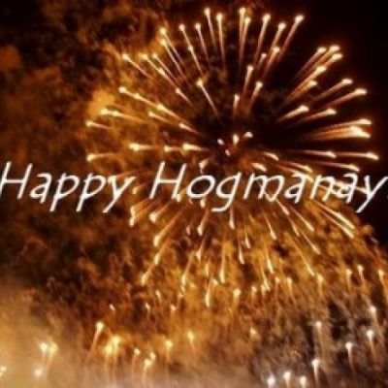

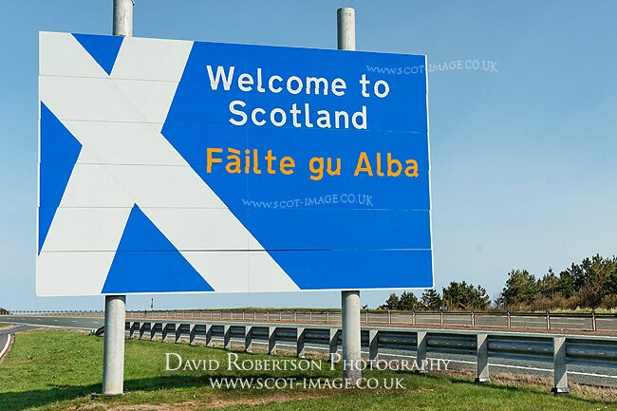
Cultural Destruction
Our culture can be lost in this modern world. Destinations can look and feel the same with brands such as Starbucks and McDonalds on every corner.
Traditional languages can be lost.
Traditional skills can be lost – weaving (Harris Tweed)
Traditions can be lost. E.g. Hogmanay

Slide 8
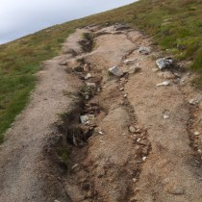
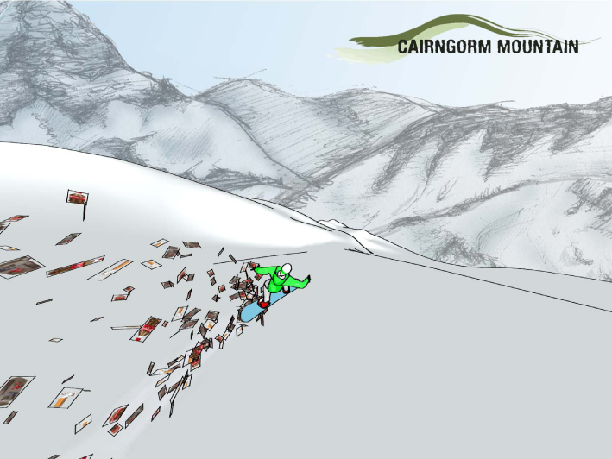
Environmental Destruction
Footpath Erosion from too many walkers.
Litter is a huge problem. Visitors need to be reminded to take their rubbish home with them, especially in rural areas.

Slide 9
Employment
Problems
Salaries for workers are low.
Tourists come to the Cairngorms in the summer and winter months but there are prtiods in between when there is a shortage of jobs. E.g. September to December and April - June. This means jobs are seasonal.
Although employment was a positive impact it is also a negative impact…
Solutions
Attracting more tourists out of season by spreading guided walks and the events in the park throughout the year. E.g. Aviemore Mountain Film Festival - May

Slide 10
Environmental Destruction
Problems
Footpath erosion from walkers.
Traffic congestion from large numbers of tourists in popular areas such as Aviemore.
Litter being dropped by tourists is dangerous to wildlife and causes visual pollution.
Dogs owned by tourists worry sheep.
Solutions
Mending footpaths by planting new grass or laying a new path of quarried stone.
Advertising public transport and developing new routes to encourage visitors to use public transport. Increasing car park charges to help environmental conservation.
Rangers educate visitors on how to protect the animals, wildlife and landscape. Signage to protect areas of the park.
Although employment was a positive impact it is also a negative impact…

Slide 11
Second Homes
Problems
Salaries for workers are low but visitors want to buy a holiday home which has pushed the process of houses up so local people can’t afford them.
Although employment was a positive impact it is also a negative impact…
Solutions
If people want to buy a home in the park they have to have lived or worked in the park for at least 3 years.

Slide 12
Cultural Destruction
Solutions
A mountain railway was built to allow skiers in the winter to ski and in summer allow visitors to reach the Cairngorm plateau in an accessible way and experience the mountains of Scotland. Walkers are not allowed to leave the top station area to protect the mountain environment that is unique to Scotland.
Problems
The ski resort at Cairngorm was difficult to maintain. The chairlifts and tows had to be closed in high winds which prevented skiing.
Although employment was a positive impact it is also a negative impact…

