Slide 1
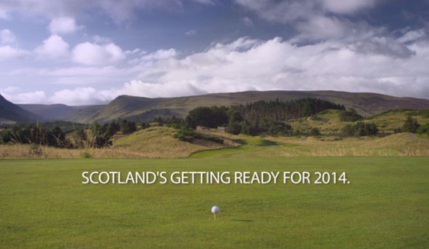
Scotland Unit
Current Trends in Tourism

Slide 2
Current Trends in Tourism
I can name some of the current trends Visit Scotland has identified in their recent trends publication.

Slide 3
Tourism Trends
A trend is an item or idea that becomes extremely popular for a short period of time. Trends are constantly changing and coming in and out of style.
Trends happen in the Travel & Tourism industry and these drive what is offered to customers…

Slide 4
1. Staycation
Due to the recession and other factors such as the threat of terrorist attacks and the change in value of the euro, many people are deciding to stay at home for their holidays…

Slide 5
2. Sustainable Tourism
Visit Scotland Definition
“Sustainable tourism is tourism committed to generating a low impact on the surrounding environment and community by acting responsibly while generating income and employment for the local economy and aiding social cohesion. Sustainable tourism aims to ensure that economic development as a result of tourism is a positive experience for everyone involved; local community, tourism businesses and visitors.”

Slide 6
What is Sustainable Tourism?
Sustainable Tourism is about managing tourist’s impact on the environment.
Sustainable Tourism involves the culture of the people living in areas where tourism takes place.
Sustainable Tourism aims to reduce the amount of the Earth’s resources being used.
Sustainable Tourism is about having a positive impact on the area where tourism takes place.

Slide 7
Green Tourism Award
The award is awarded by the Green Tourism Business Scheme and operates across the UK, Ireland and Canada.
Visit Scotland have embraced an award scheme for businesses who develop sustainable practices.

Slide 8
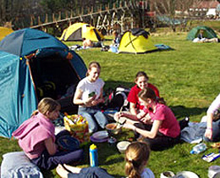
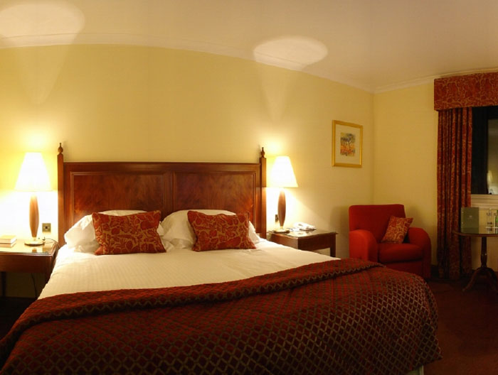
3. Mod-stalgia
From this…
To this…
People visit a favourite holiday destination from their childhood but with modern luxuries e.g. this time stay in a luxury hotel rather than a campsite.

Slide 9
4. Modern Clans
Due to the cost of living being so high the traditional family units going on holiday has changed. Many parents are now paying for their elder children (20-30 year olds) to go on holiday because they cannot afford it. Families are also going on holiday with different generations – grandparents, parents, children and grandchildren.

Slide 10
5.One Foot in the Past
With the monumental year Scotland will have in terms of tourism, this will spark more interest in Scotland’s history and folklore. E.g. More interest in Nessy, film sets for Game of Thrones and World War Z even Brave will attract tourists to investigate…

Slide 11
6. Consumer Feedback Prestige
Social networks makes it easier for customers to make comments on businesses both positive and negative which then influences potential customers who view these sites.

Slide 12
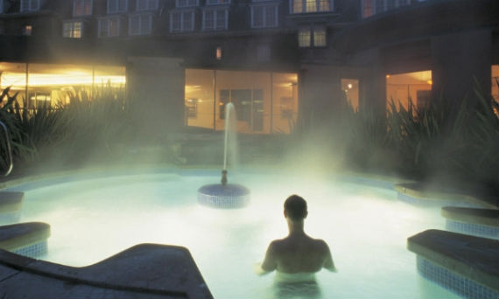
7. Soul Recharge
Stress is now a part of everyday life and tourists are now looking to combine their holiday with fitness and well-being activities. E.g. going to spas or going on walks.
Outdoor spa pool, Gleneagles

Slide 13
8 & 9. Fear of Missing Out (FOMO) and Joy of Missing Out (JOMO)
FOMO holidaymakers can not bare to be without their portable devices – iPhone, iPad, laptop etc. Whereas JOMO holiday makers are the opposite. They want to escape the technological world.

Slide 14
Scotland can cater for both…
FOMO
Using Facebook and other social media to influence people to visit Scotland.
Tourist Providers can also meet the needs of these tourists by providing
Wi-Fi.
JOMO
Scotland is perfectly placed to meet the needs of these clients with the many remote locations on offer. This trend may fit in with wellness tourism.

