Slide 1
Lesson five: Urban and Rural Hydrographs
Learning intensions: We are learning about the hydrosphere.
Success criteria:
I can describe the differences between a rural and urban hydrograph.
I can account for the differences between a rural and urban hydrograph.

Slide 2
Starter – Urban or Rural?
You will be given a number of statements and have to decide if they apply to an urban or rural hydrograph.
Make your thoughts clear by moving to the door for RURAL, and the window for URBAN.

Slide 3
Urban (window) or rural (door)?
Shorter lag time
Steeper rising limb
Gentle falling limb
Overland flow
Precipitation falls onto leaves then drops onto ground
Will take longer for river to return to base level
Notes:
1. Urban 2. Urban 3. Rural 4. Urban 5. Rural 6. Rural

Slide 4
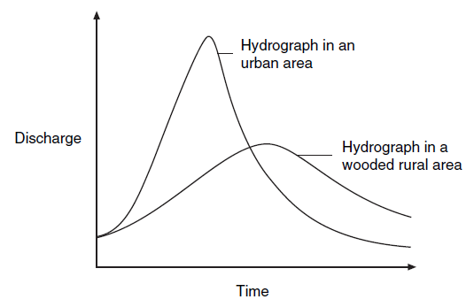
Urban and rural hydrographs
Hydrographs can look very different depending on the environment of the drainage basin. Urban hydrographs have steeper rising and falling limbs, whereas rural hydrographs have more gentle rising and falling limbs.

Slide 5
Urban and rural hydrographs
On page 9 in your booklets you have summaries of the two hydrographs.
You are often asked to compare the two graphs and then provide reasons for the differences.
This means that in your answers you must use phrases such as “compared to”, and “whereas”.

Slide 6
Urban | Rural
Shorter basin lag time = impermeable surfaces e.g. tarmac lead to rapid overland flow resulting in quick transfer of water to the river. | Longer basin lag time = Precipitation falls onto leaves (interception) and then drops to the ground (stem flow). Some will infiltrate and therefore take longer to return to the river.
Steeper rising limb = Water management systems such as gutters and drains allows water to flow into river quicker leading to high peak discharge. | Gentler rising limb = Moisture can also be absorbed and transpired by trees so less water reaches the river.
Steeper falling limb = There is less underground storage of water so the vast majority of the water will have entered the river and the base level will return quicker because there is not any more water to add to it. | Gentler falling limb = Water will return to the river after many hours as it flows through soil and rocks as groundwater flow This further results in the river taking longer to return to base level.

Slide 7
Task 5 – Past Paper Question
Page 12
Account for the differences between the urban and rural hydrographs shown in the diagram following a heavy rainstorm. (8)
“The urban hydrograph has a shorter lag time compared to the rural hydrograph because...”
Remember to use terminology such as ‘infiltration’ etc.

Slide 8
Structure
1. Urban steeper rising limb due to gutter and drains → high peak discharge.
2. Urban shorter basin lag time due to increased overland flow from impermeable surfaces.
3. Rural longer lag time due to interception and stem flow.
4. Rural gentle rising limb (and lower peak discharge) due to absorption and transpiration.
5.Rural gentle falling limb due to throughflow (soil and rocks).

Slide 9
Perfect answer
The urban hydrograph has a steeper rising limb compared to the rural as water enters the river quicker via gutters and drains, leading to a high peak discharge.
The urban hydrograph has a shorter basin lag time as water flows over impermeable surfaces such as tarmac, and therefore enters the river quicker as a result of rapid overland flow.

Slide 10
The rural hydrograph has a longer basin lag time compared to the urban hydrograph because some of the water can be stored through interception when precipitation lands on the leaves of the trees, or can run down the branches and trunks via stem flow, slowing down the time it takes for the water to enter the river.
The rural hydrograph has a more gentle rising limb compared to the urban hydrograph (and therefore a lower peak discharge) as some of the water does not reach the river as it is absorbed by the roots of the plants and then transpired out into the atmosphere.

Slide 11
The rural hydrograph has a more gentle falling limb compared to the urban hydrograph because water will keep returning to the river after many hours as it flows through soil and rocks as groundwater flow. This further results in the river taking longer to return to base level.

Slide 12
Homework
Page 1 of your booklet.
Explain the global hydrological cycle. You may wish to draw an annotated diagram. (8)
Suggest how human activities such as those written below can impact on the hydrological cycle. (6) Deforestation, Irrigation, Dam building, Reservoirs, Urbanisation and Mining.
Account for the differences between the urban and rural hydrographs shown in the diagram following a heavy rainstorm. (5)

Slide 13
Success criteria
I can describe the differences between a rural and urban hydrograph.
I can account for the differences between a rural and urban hydrograph.

Slide 14
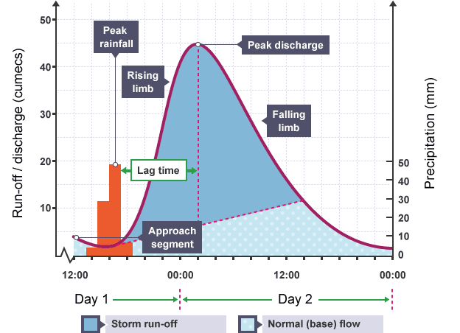
Plenary – Label the hydrograph
3
1
4
2
5

