Slide 1
Starter
Can you name any river features / landforms?

Slide 2
Lesson three b: Landforms
Learning intention:
We are learning about river processes in the hydrosphere.
Success criteria:
I can explain, with the aid of a diagram, the processes involved in erosion of rivers and the transportation of materials with the use of diagrams.

Slide 3
River Processes

Slide 4
What is erosion?
This is the wearing away and removal of the material loosened by weathering.
Weathering and erosion work together!

Slide 5
What are the agents of erosion?
Physical agents:
Rivers - they wear the banks and bed of their channel
Ice - when a glacier (tongue of moving ice) moves down a valley it uses the material it carries with it to wear away the valley bottom and sides
Sea - coastlines are under constant attack by waves
Wind - in the dry deserts the wind picks up tiny particles of sand and blast them against anything that is in the way
Human agents:
Bulldozers and lorries can dig out and move large amounts of soil and loose rocks, so changing the landscape
People also remove trees and vegetation which can allow water, wind and ice to erode land more easily

Slide 7
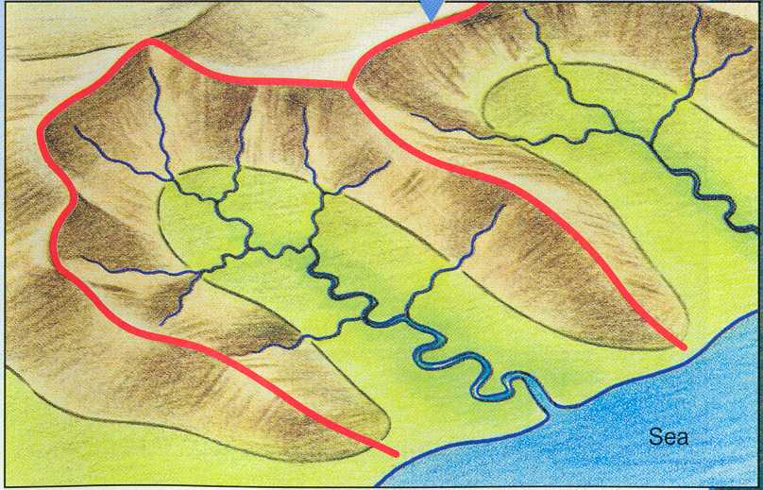
Make a copy on A4 paper of the diagram below:
Tributary
Neighbouring drainage basin
Drainage basin
watershed
Mouth
Source
Confluence

Slide 8
Lesson three b: Landforms
Learning intention:
We are learning about the three courses of a river and the landforms associated with the upper course.
Success criteria:
I can explain, with the aid of a diagram, the formation of features in the upper course of a river..

Slide 9
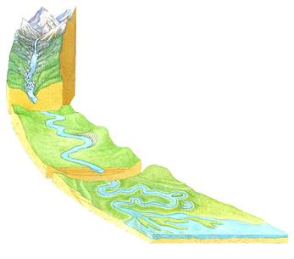
Upper Course: This is the section of the river nearest the source. This is where load is biggest and most erosion is vertical. Most landforms are made by erosion and include; waterfalls, gorges, rapids, v-shaped valleys and interlocking spurs
Middle Course: This is the section when the river leaves the mountains and enters are more hilly environment. The valley floors starts to widen as you get more horizontal erosion. The landforms that you get in the middle course include alluvial fans and meanders.
Lower Course: This is the section closest to the mouth. Here the river is travelling over much flatter land and the load is much smaller and smoother. This is more horizontal erosion here as the river nears its base level. The landforms you find in the lower course include meanders, oxbow lakes, braided rivers, levees and deltas.

Slide 10
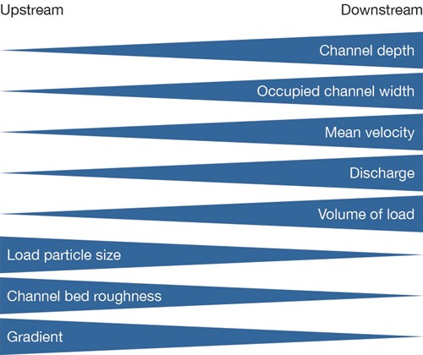

Slide 11
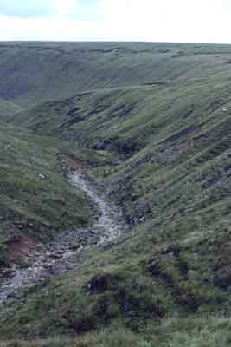
Upper valley characteristics
“V”shaped valley, vertical erosion dominant
Narrow, shallow channel, low velocity and discharge
Interlocking spurs
Slumping and landslides - very active hill slopes
Large bed load derived from upstream and from valley sides

Slide 12
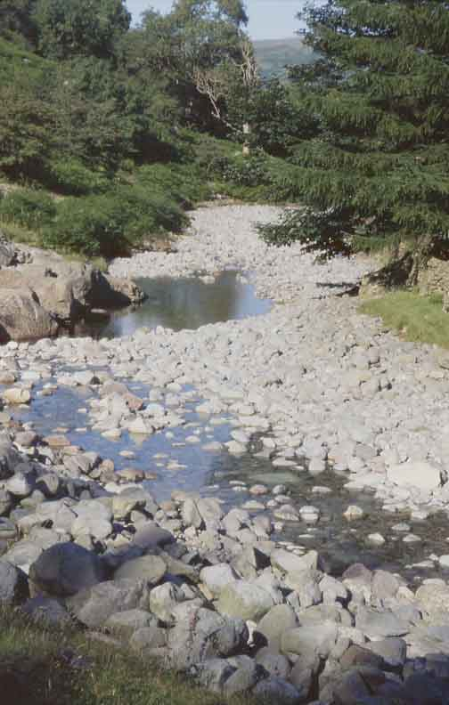
River load in upper course
Boulders are large, angular and/or semi-rounded, due to attrition within the load and abrasion with the stream bed and banks

Slide 13
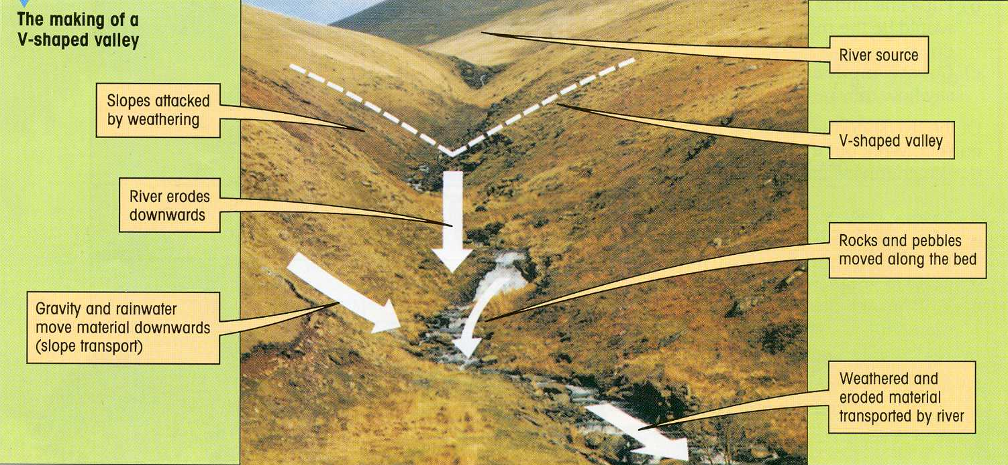
Upper course - V-Shaped valley

Slide 14
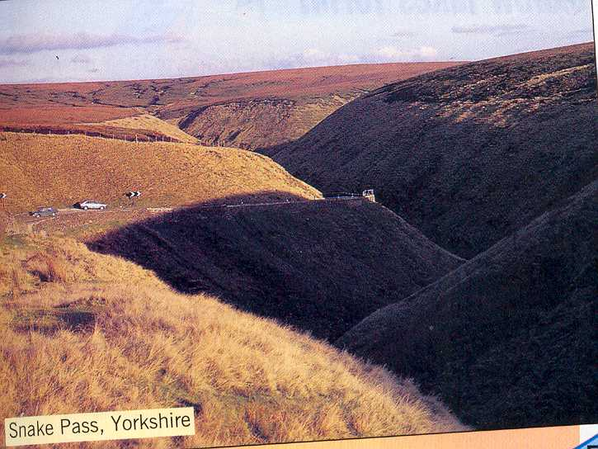
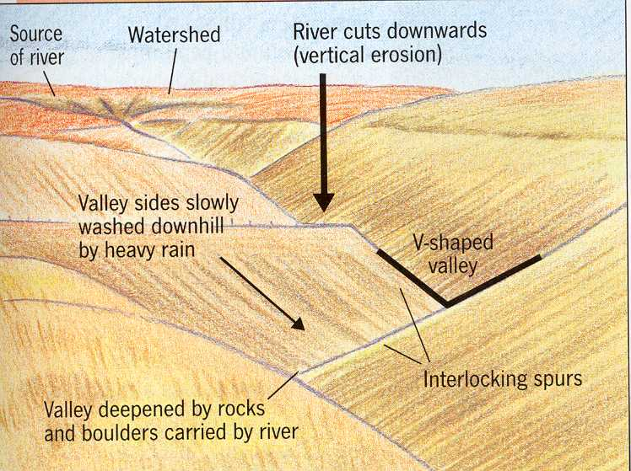

Slide 15
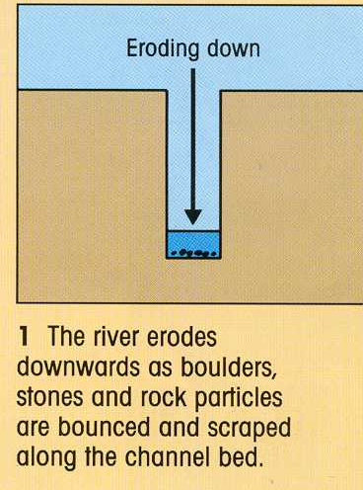
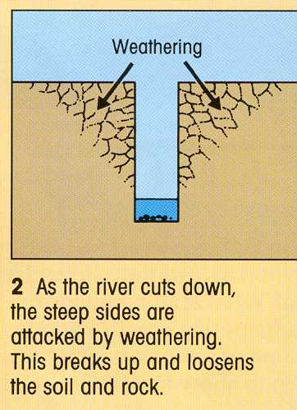

Slide 16
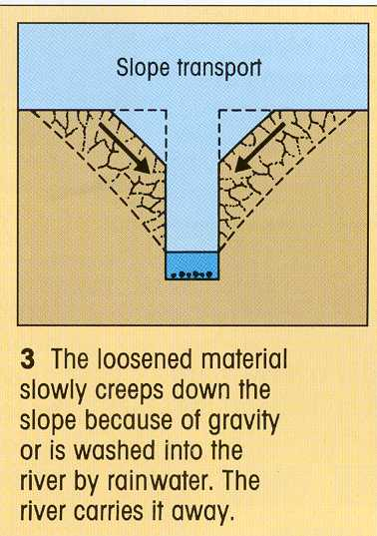
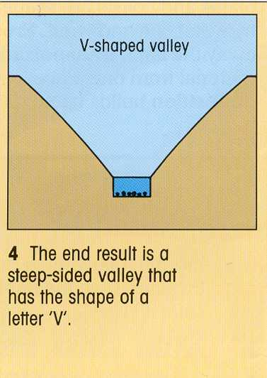

Slide 17
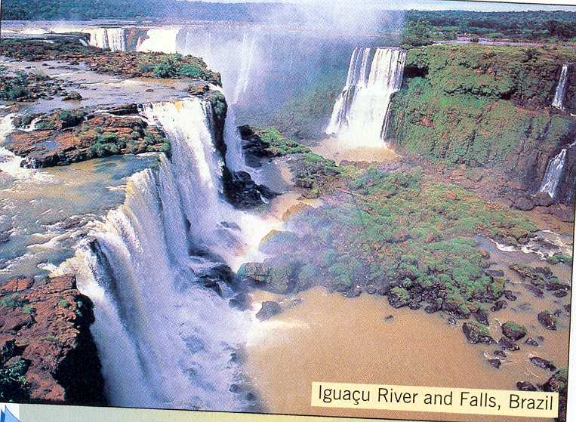
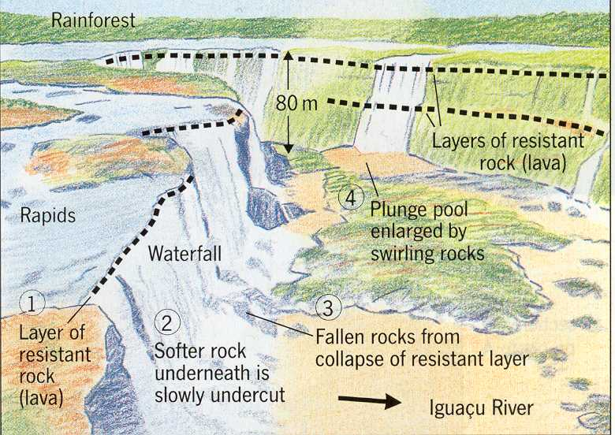
Upper course - Waterfall

Slide 18
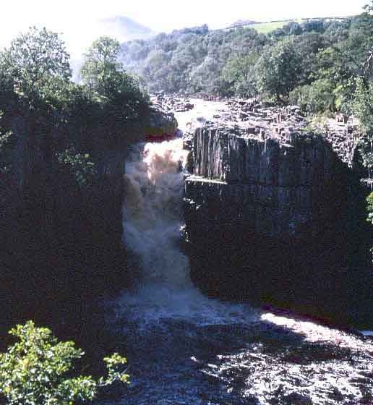
High Force waterfall, R. Tees
Waterfall creates a gorge as it recedes upstream by eroding the base and neck
Plunge pool

Slide 19
Waterfall formation

Slide 20
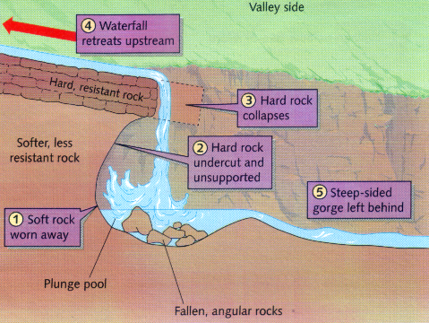
Formation of a waterfall

Slide 21
Task: Past paper question
With the aid of a diagram, explain the formation of a waterfall 8
Hint: give examples of rock types and include processes of erosion

Slide 22
Perfect Answer
Waterfalls are found where hard rock such as limestone overlies softer rock such as mudstone ✓. The water is powerful and erodes the softer rock by hydraulic action ✓ (the sheer force of the water hitting off the rock) ✓ . A plunge pool forms. The softer rock is worn away and the hard rock is undercut ✓. And an overhang of hard rock is left suspended above the plunge pool ✓. This collapses as there is nothing to support it and the rock falls into the plunge pool ✓. Rock fragments swirling around deepen the plunge pool ✓ by the process of abrasion, where rocks carried by the river rub against the rock wearing it away in a sandpaper action ✓. This process is repeated over a long period of time and the waterfall retreats upstream leaving a steep-sided gorge ✓. A good example of this can be found at High Force on the River Tees ✓.

Slide 23
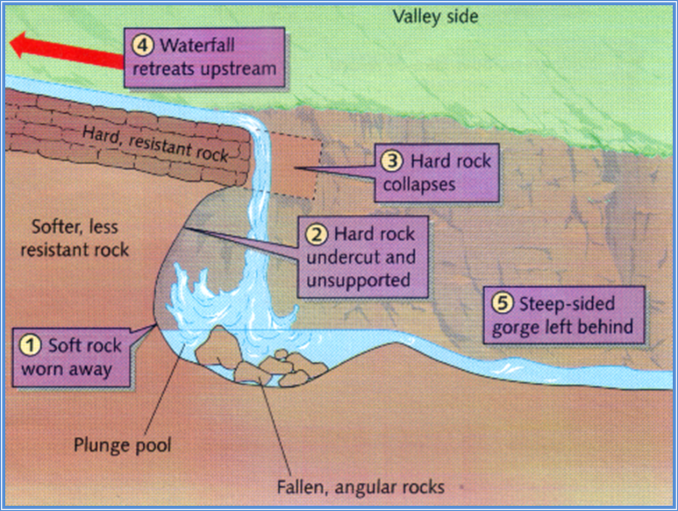
The diagram
With the aid of a diagram, explain the formation of a waterfall 8

Slide 24
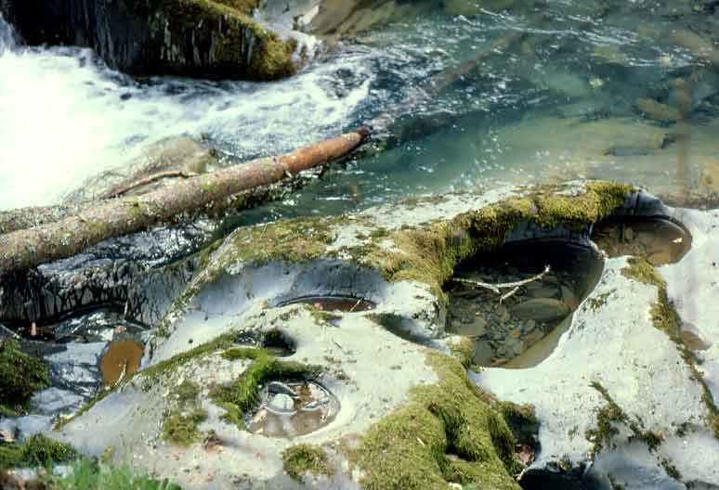
Close-up of potholes

Slide 25
Lesson three b: Landforms
Learning intention:
We are learning about the three courses of a river and the landforms associated with the upper course.
Success criteria:
I can explain, with the aid of a diagram, the formation of features in the middle course of a river..

Slide 26
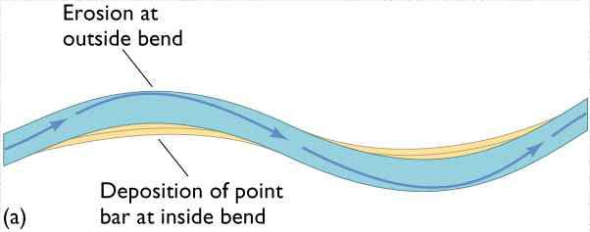
Middle course - Meanders

Slide 27
Formation of Meanders
Line of maximum velocity - the ‘thalweg’

Slide 28
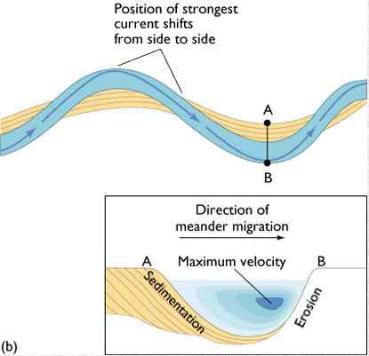
Point bar deposits

Slide 29
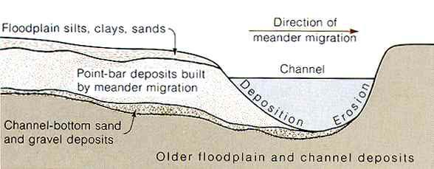
Point Bar Deposits
Point bar deposits grows laterally through time

Slide 30
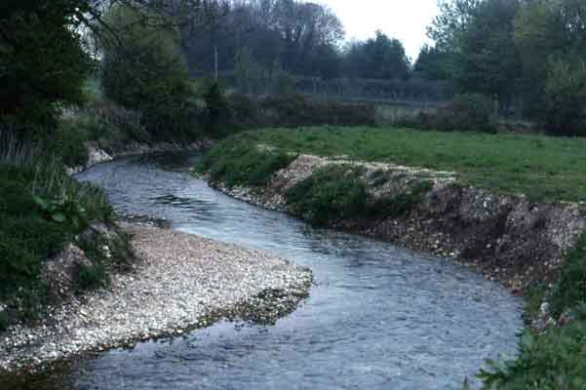
Meander, R. Lavant, Chichester
Floodplain
Thalweg
River Cliff
Slip-off slope or
River beach
Point bar deposits on the inner meander bend where there is low energy

Slide 31
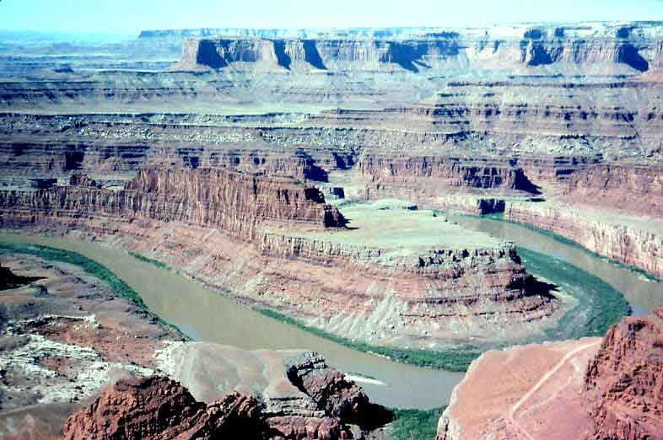
Incised meander on the R. Colorado

Slide 32
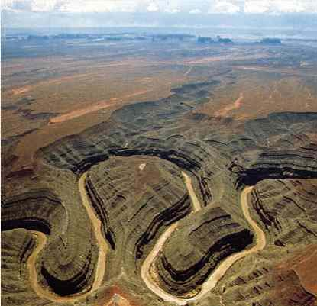
Incised meanders – Colorado plateau

Slide 33
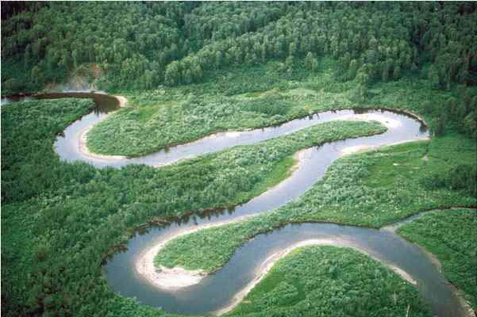
Migrating meanders
What are the signs that the meanders are moving downstream?

Slide 34
Lesson three b: Landforms
Learning intention:
We are learning about the three courses of a river and the landforms associated with the upper course.
Success criteria:
I can explain, with the aid of a diagram, the formation of features in the lower course of a river..

Slide 35
Lower course – Ox-bow lakes

Slide 36
Task – Past Paper Question 10 minutes
Ox-bow lakes are common features in the lower course of a river.
Explain, with the aid of a diagram or diagrams, how an oxbow lake is formed.. (5)

Slide 37
Perfect Answer
The water flows faster on the outside bend of a river meander so erodes the banks by the processes of hydraulic action (the sheer force of the water hitting the banks)✓ ✓ and by abrasion (where fine materials rubbing against the banks act like sandpaper) causing the banks to become steeper ✓ ✓ Deposition takes place on the inside bend of a meander where the water is shallower and moving more slowly✓. It has less energy here. ✓. Over time the neck of the meander becomes more incised and bends back on itself, leaving a very narrow piece of land ✓. During a storm or prolonged period of rain when the river is more powerful, it cuts through the narrow neck and takes a new, straighter route ✓. Deposition takes place, leaving the old meander cut off, and an oxbow lake is formed ✓. This feature can fill up with sediment and dry out, only filling up after heavy rain ✓.

Slide 38
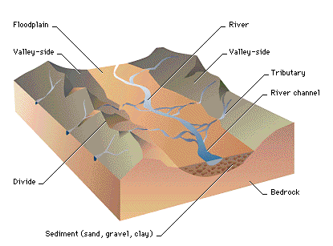
Lower course – flood plains

Slide 39
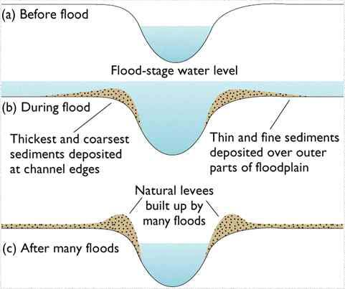
Lower course – levees

Slide 40
Lower course - Delta
A river delta is a landform that forms from deposition of sediment carried by a river as the flow leaves its mouth and enters slower-moving or stagnant water.
This occurs where a river enters an ocean, sea, estuary, lake, reservoir, or (more rarely) another river that cannot carry away the supplied sediment.

Slide 41
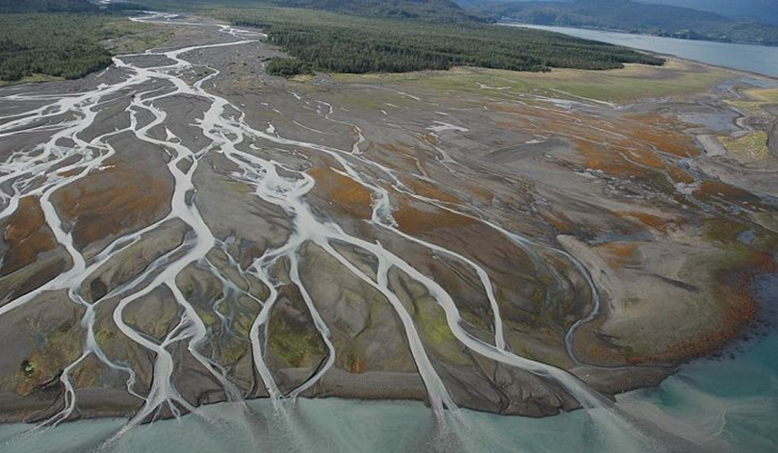
Delta

Slide 42
Lower course - Estuary
An estuary is a partially enclosed coastal body of brackish water with one or more rivers or streams flowing into it, and with a free connection to the open sea. Estuaries form a transition zone between river environments and maritime environments.

Slide 43
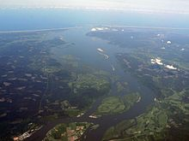
Estuary

Slide 44
Estuary / Delta – the difference
An estuary is a body of water, while a delta is a landmass.
Estuaries are places where the river meets the ocean. Deltas are formed by the accumulation of sediments borne by the river.

Slide 45
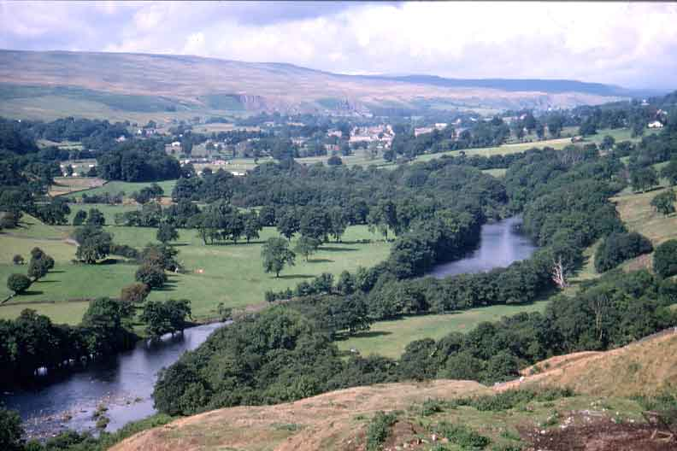
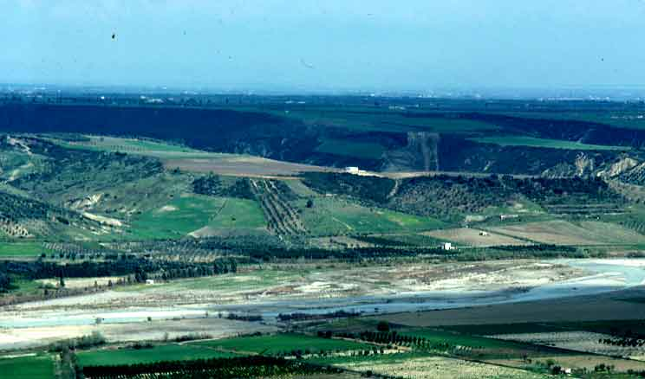
Summary of valley characteristics
Course | Feature
Upper | Interlocking spurs ‘v’ shaped valley Waterfall gorge
Middle | Wider valley Gentler sloping sides meanders
Lower | Widest part of valley Floodplain Levees Ox bow lakes Delta Estuary

Slide 46
Success criteria
I can explain the features of a river in the upper, middle and lower courses with the use of diagrams

Slide 47
Plenary
What processes are involved in the formation of river cliffs and beaches?

