Slide 1
Lesson three: Drainage Basins
Learning intention: We are learning about the hydrosphere.
Success criteria:
I can explain what a drainage basin is.
I can name the components of a drainage basin.
I can account for the movement of water within a drainage basin.

Slide 2
What is a drainage basin?
The drainage basin is an open system, where water is added and lost and constantly moves.
This means it has inputs, outputs, stores and transfers.
The drainage basin is an area of land surrounding a river and its tributaries into which all the water drains.
It will also include water that is stored in the water table and that flows over the surface as runoff.

Slide 3
What is a drainage basin?
All rivers have an imaginary line called a watershed, surrounding the land from which they receive water.
When precipitation falls inside the watershed it will find its way into the river.
If it falls outside of the watershed it will drain into a different river.

Slide 4
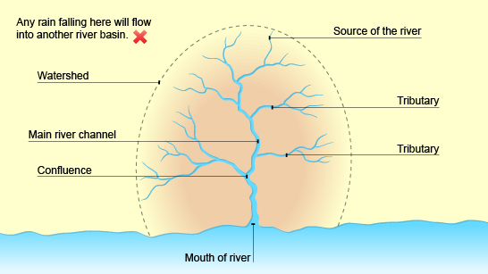

Slide 5
Starter
Copy down this table
Categorise the elements of a drainage basin into one of the columns in your table.
See next slide
Inputs | Outputs | Storage | Transfers

Slide 6
Elements of a drainage basin
Rivers
Overlandflow/runoff
Precipitation
Transpiration
Groundwater
Evaporation
Lakes
Through flow
Soil
Vegetation
Glaciers
Infiltration
Solar energy
Stem flow
Percolation
Flowing into the sea

Slide 7
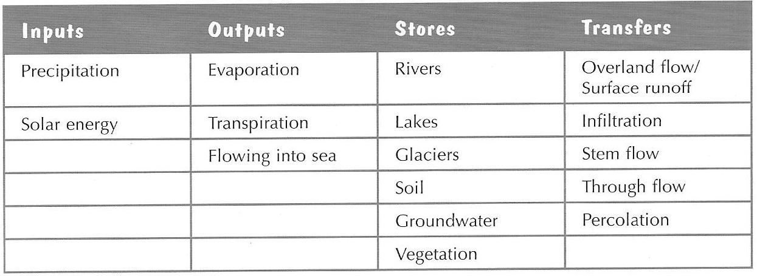
How water moves through a drainage basin
Are you familiar with all of these terms?

Slide 8
Think…
What will affect these things?
Amount of precipitation
How much can be stored

Slide 9
Inputs
The main input is precipitation. This can be in the form of rain, hail, sleet or snow. Clouds gather their content from water which has been evaporated from water sources such as the seas and oceans
The amount of precipitation is determined by how often it rains, as well as how long it rains for and how strong the rain falls.

Slide 10
Storage (below, above)
Water can be stored in the drainage basin on the surface in lakes and rivers. It can also be stored by vegetation when leaves intercept precipitation.
Furthermore, water can be stored below the in groundwater. The amount which can be stored in this zone is determined by the permeability of the soil and rock.

Slide 11
Transfers (below, above)
Water is then transferred through the drainage basin. This can occur in two ways: surface run off where water flows across the surface and via river channels within the drainage basin.
Water is transferred below the ground as it makes it way towards a river. Throughflow and groundwater flow are two examples of this and this movement is generally slow.

Slide 12
Outputs
Outputs are where water exits the drainage basin and it can be lost directly through the river when it enters the sea, or it can be lost through evaporation when it turns from a liquid into a gas again.
Water can also be lost via the trees and vegetation through transpiration which is when water evaporates from the leaves after being intercepted. This combined is called evapotranspiration.

Slide 13
Task 3 – Past Paper Question 10 minutes
A drainage basin is an open system with four elements. Account for the movement of water within a drainage basin with reference to the four elements; Inputs, Outputs, Storage and Transfers. (5)
N.B. Answers should refer to all four elements – start with inputs.
Precipitation is the main input in a drainage basin. Rain clouds are fed by evaporation from water sources including the seas/oceans. ✓

Slide 14
Peer Marking
Swap your answer with someone at your table
Each developed point gains a mark
Give a mark if you think the person has written something similar to what is shown in the perfect answer.
If you are unsure ask your teacher.

Slide 15
Perfect answer
The main input in a drainage basin is precipitation. This can be in the form of rain, hail, sleet or snow. The amount is determined by the intensity, the duration and the type.
One way the water is transferred is above the surface. It can transfer across the land which is called overland flow where it flows over the surface of the land. It can also flow through the rivers, known as channel flow.
It can also transfer below the ground. The water enters through infiltration and then continues to move through the soil through percolation. It then moves through the soil towards the sea or a river via throughflow.

Slide 16
Perfect answer
Water can also be stored in the system above ground through vegetation. Firstly by interception which is when a water droplet lands on a leaf. Secondly, by absorption when the water is stored in the plants and roots.
Additionally, when water is stored underground it is called groundwater. This is determined by the amount of pore spaces and the rock type.
Water from lakes and seas leaves the system (output) by evaporation when water vapour rises into the atmosphere. It also leaves when tress transpire water from leaves. When both of these are put together it is known as evapotranspiration.

Slide 17
Success criteria
I can explain what a drainage basin is.
I can name the components of a drainage basin.
I can account for the movement of water within a drainage basin.

Slide 18
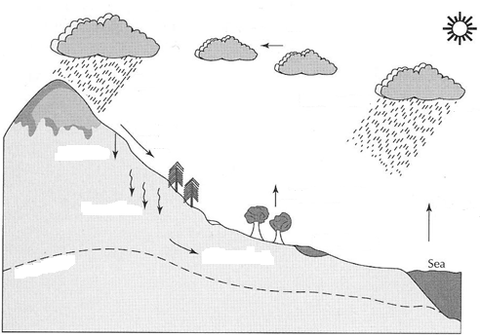
Plenary – Label the hydrological cycle

