Slide 1
Lesson two: Factors affecting the hydrological cycle.
Learning intentions: We are learning about the hydrosphere.
Success criteria:
I can describe the factors which affect the hydrological cycle.
I can explain in detail how these factors affect the hydrological cycle.

Slide 2
Starter
In pairs, describe what these human activities are and then explain why they are carried out.
Forestry
Urbanisation
Deforestation
Reservoirs/Dam building
Irrigation
Mining

Slide 3
Factors affecting the hydrological cycle
The hydrological cycle as we discovered in the last lesson is a closed system which is powered by the sun.
However, it can be affected by both physical and human factors.

Slide 4
Physical factors
Relief – the steeper the slope, the more quickly water will reach the river.
Vegetation (Type and density) – the more vegetation there is, the more will be absorbed/intercepted and then transpired back into the atmosphere.

Slide 5
Physical factors
Size of basin– water comes from a bigger area so more water is in the cycle compared to other areas.
Rock type
Some rocks are more permeable than others (allow water to pass through them).
Some are impermeable.
Some rocks are better at storing water.

Slide 6
Physical factors
Soil type – sandy soils cause less flooding, whereas clay soils cause more flooding.
Climate
Prolonged rainfall results in saturation
Intense storms lead to more surface run off
Snowfall – water is held in storage and when it melts increases run off. If ground is frozen, water cannot infiltrate it.

Slide 7
Human factors
Specifically for this topic, we are more concerned about how humans can affect the hydrological cycle.

Slide 8
Human factors
Forestry
Urbanisation
Mining
Deforestation
Reservoir/dam building
Irrigation
Notes on these in your booklet

Slide 9
Past Paper Question
Study the diagram below.
Explain how human activities, such as those shown on the diagram, can impact on the hydrological cycle.

Slide 10
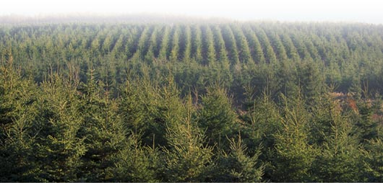
Forestry
The planting of trees, usually for economic purposes e.g. Christmas trees.
Trees are then felled leaving ground exposed.
When the trees are planted, this increases interception as the number of trees has increased, thus increasing the total surface area of leaves which raindrops land on.

Slide 11
Reservoirs/Dam building
By building dams and reservoirs, water will be stored and therefore less water will flow over the surface and through underground stores, back to the river.
This can result in a lowering of the water table. They can also have an impact on where it rain.
Dams and reservoirs increase evaporation, resulting in increased cloud formation in these areas.
Cloud formation would therefore be altered, changing levels of precipitation.

Slide 12
Urbanisation
This is the expansion of towns and cities.
This will reduce the amount of natural vegetation available and replace it with impermeable surfaces and drains.
This will increase surface runoff and also evaporation, leading to higher river levels.
It will also reduce the water table as less water is being returned to underground stores.

Slide 13
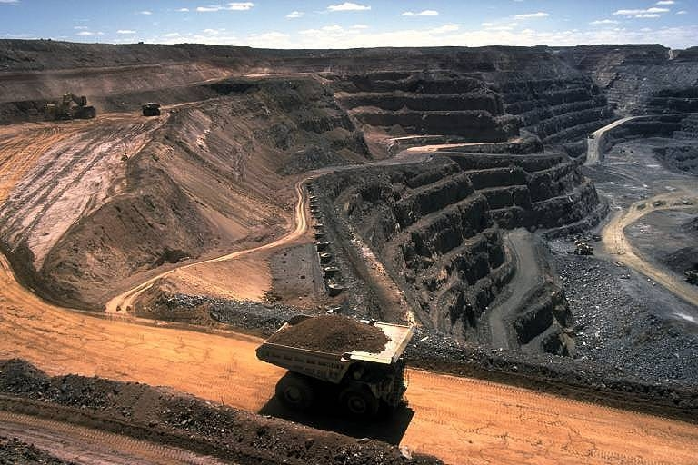
Mining
The extraction of ores and minerals. This involves removing vegetation, then digging or blowing large holes in the ground.
Will cause the silting up of lakes, reservoirs and rivers reducing the amount of storage in these areas.
It may also result in a reduced vegetation cover, leading to increased runoff and decreased evapotranspiration.

Slide 14
Deforestation
The cutting down or burning of trees.
Increases the amount of runoff water and it decreases evapotranspiration, therefore decreasing cloud formation.
As there are no longer tree roots to take up ground water or leaves to intercept precipitation, this leads to more extreme river flows.

Slide 15
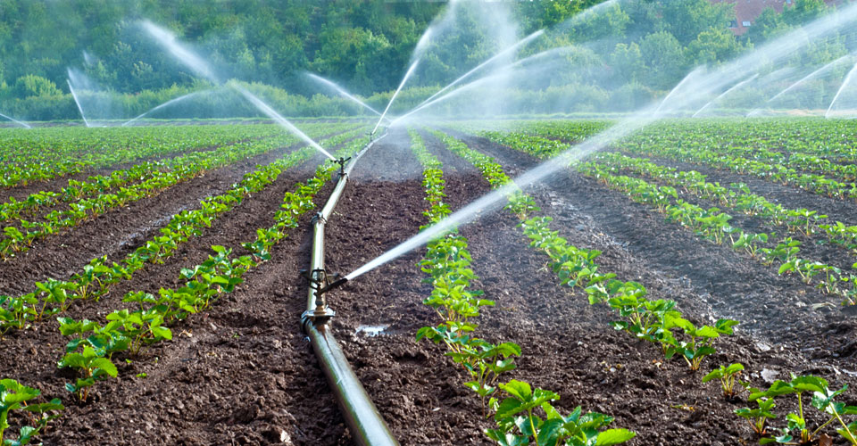
Irrigation
This takes water from underground water stores therefore lowering the water table.
It also places more water in surface stores i.e. canals/ditches, which will increase evaporation and transpiration.
Furthermore, given irrigation improves plant growth, water will be removed from the hydrological cycle as crops grow.

Slide 16
Task 2
Suggest how human activities such as those written below can impact on the hydrological cycle. (6) Deforestation, Forestry, Irrigation, Dam building, Reservoirs, Urbanisation and Mining.
You must refer to at least two human activities.
Try not to repeat yourself i.e. You can only get a mark for explaining how something affects the water table once.

Slide 17
Irrigation
Taking water from a river or ground water reduces river flows
Lowers water table
Increases evaporation due to water being stored in ditches and canals
Deforestation
Cutting down trees increases run off
Decreases transpiration
Changes cloud formation impacting on local rainfall patterns
Less absorption
Less interception
More extreme river flows
Urbanisation
Removal of vegetation and replace with impermeable surfaces such as tarmac
Higher river levels
Due to overland flow being sped up and less water infiltrates the soil
Evaporation increases
Percolation decreases
Less water in ground water so lowers water table.
Mining
Silting up of lakes and reservoirs leads to reduced storage
Less vegetation cover so more run off
Altered cloud formation due to higher rates of evaporation.

Slide 19
Success criteria
I can describe the factors which affect the hydrological cycle.
I can explain in detail how these factors affect the hydrological cycle.

Slide 20
Plenary
Explain each of these components of the hydrological cycle:
Infiltration
Percolation
Advection

