Slide 1
Hydrosphere
Higher Geography

Slide 2
Assessment
What you must know
  Explain hydrological cycle
  Explain how factors can affect the hydrological cycle
  Account for water movement within a drainage basin
  Explain and compare urban and rural hydrographs

Slide 3
Homework
Page 1 of booklet.
All homework must be handed in on lined paper.
Remember to put your name on it.

Slide 4
Lesson one: The Hydrological Cycle
Learning intentions: We are learning about the hydrological cycle.
Success criteria:
I can draw an annotated diagram of the hydrological cycle.
I can explain the hydrological cycle.

Slide 5
What is hydrology?
Hydrology is the study of water within the Earth, whether it is in the atmosphere, on the surface or underground.
The movement of that water, the impact of it on the land and how movement may be interrupted are also important aspects of this particular topic.

Slide 6
Starter – Group task
What powers the hydrological cycle?
What processes take place there?
Where does water go when it rains?
How does it return back into the atmosphere?

Slide 7
The hydrological cycle
The intricate process of movement of water back and forth between land, oceans and the atmosphere is called the hydrological cycle.
The hydrological cycle works as a closed system, in that there is a finite amount of water in the atmosphere, lithosphere and hydrosphere (land and water areas). This amount remains constant.
The system is powered by energy from the Sun. Within the system the amount of water in the various components can and does vary, especially when the system is interrupted.

Slide 8
What you need to know
You should be able to draw a diagram to show the hydrological cycle and explain the main elements within the diagram.
In your exam, you may be given a diagram of the hydrological cycle or asked to draw this yourself.
See page 3 of your booklet now.

Slide 9
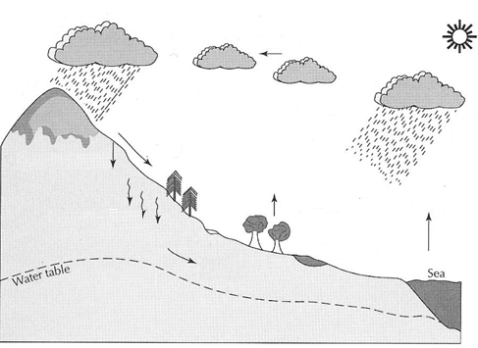
The hydrological cycle
The hydrological cycle is powered by the sun. When the sun shines, water in the sea is evaporated – this means the water is heated and rises into the atmosphere. As it does, it turns from a liquid into a gas in the form of water vapour.

Slide 10
The hydrological cycle
As this water vapour is rising, it cools and condenses to form clouds. The wind then blows these clouds over land or sea which is called advection which is a form of transportation.

Slide 11
The hydrological cycle
When the clouds become saturated with water vapour, the clouds release the water vapour in the form of a liquid (or solid). This is known as precipitation and can be in the form of rain, hail, sleet or snow.

Slide 12
The hydrological cycle
Where does this precipitation go? Firstly it can go straight into soil. It enters the soil vertically through infiltration. It then percolates downwards through the soil through the pore spaces in the rocks.

Slide 13
The hydrological cycle
Ground water
It then moves through the soil with gravity towards a river or the sea. This is called throughflow. It can however be stored in the pore spaces in the rocks called ground water. The pore spaces can become totally saturated with water. The level at which they do this is called the water table.

Slide 14
The hydrological cycle
Absorption
Ground water
Secondly, the water can be stored in plants. Plant leaves can draw the water upwards through absorption and can then return the water to the atmosphere by transpiration where water is lost through the pores on the leaves.

Slide 15
The hydrological cycle
Interception
Absorption
Ground water
Stem flow
Precipitation can fall directly on the plant leaves before reaching the ground (interception) but it can make its way to the soil by stem flow where water runs drips from the leaves or runs down the trunk where it can then infiltrate the soil.

Slide 16

The hydrological cycle
Channel flow
Interception
Absorption
Ground water
Stem flow
Lastly, precipitation can fall directly into lakes or the sea and be stored there, or it can flow over the surface of the land (overland flow/surface run off ), and can then collect in river and flow to the ocean as channel flow.

Slide 17
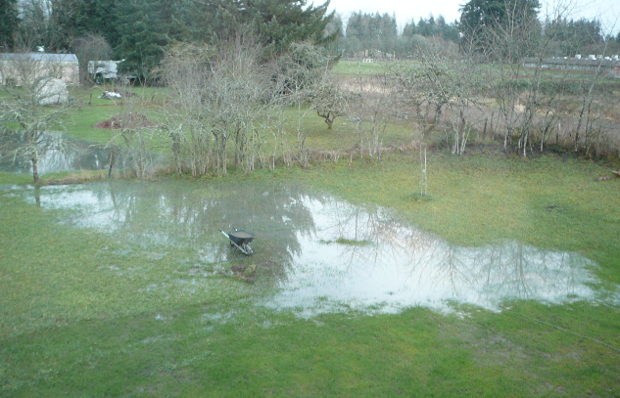
The water table
The water table marks the level where the ground is saturated.
After heavy rainfall, you can sometimes see the water table come to the surface.

Slide 18
Task
Watch how water moves through the hydrological cycle.
The Hydrological Cycle
Task 1
Explain the global hydrological cycle. You may wish to draw an annotated diagram. (6)

Slide 20
Perfect answer
Water is heated by the sun and turns to a vapour. This evaporates into the atmosphere. ✓
When the vapour gets high into the atmosphere it cools and condenses, forming clouds. ✓
Clouds are moved, overland, by the process of advection. When clouds become saturated with moisture it pulled to earth by gravity. This is called precipitation and can be rain, hail, sleet or snow. ✓
The precipitation may be stored or transferred back to the river/ocean in a number of ways.

Slide 21
Perfect answer
The water may be stored in a lake or as ice or snow on an area of high land. ✓
Precipitation may fall directly onto the soil. It can infiltrate the soil and make its way back to the river by the process of throughflow. ✓
It may percolate through the soil until it reaches an area of impermeable rock. The water will fill up groundwater stores. This is called the watertable. ✓
Water is then transferred back to the river or ocean by the process of groundwater flow. ✓

Slide 22
Perfect answer
Precipitation may fall onto vegetation. It can be transpired off of leaves back into the atmosphere, this is evapotranspiration✓
It may trickle down the stems of plants into the soil, this is called stem flow. Water may be absorbed from the soil by plants and then evaporated off of their leaves, back into the atmosphere. ✓
Some precipitation will flow directly overland, back to the river, by the process of surface run-off. Some will fall directly into the river and flow back to the ocean as channel flow ✓

Slide 23
Success criteria
I can draw an annotated diagram of the hydrological cycle.
I can explain the hydrological cycle.

Slide 24
Plenary
Water cycle rap

