Slide 1
Lesson four: Gley
Learning intentions: We are learning about soil.
Success criteria:
I can draw an annotated diagram of a gley soil.
I can explain the formation of a gley soil.

Slide 2
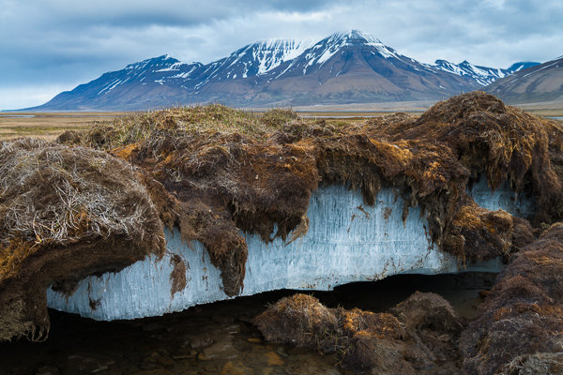
Starter
Permafrost is defined as permanently frozen ground.
It is found in Tundra regions, and in areas where the climate is cold.
What do you think the characteristics of a gley soil are?

Slide 3
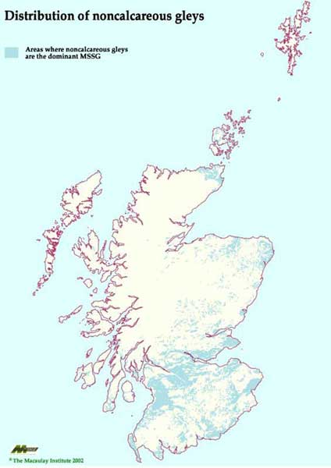
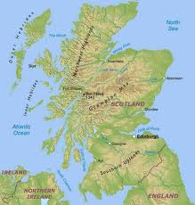
Gley - found where water does not drain away e.g. flat land

Slide 4
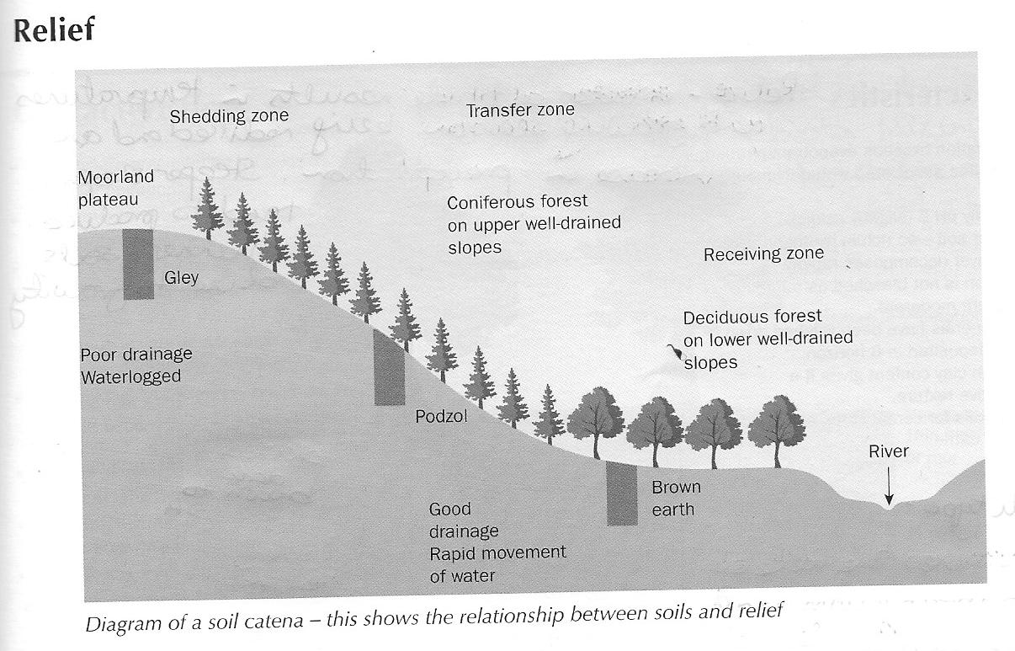
Found on flat land e.g. plateau

Slide 5
Processes - Gleying
Gley soils are found in sites which are permanently or temporarily waterlogged.
When soil gets waterlogged for a long time, its pore spaces lose oxygen.
This is called anaerobic and means that any decay of bacterial is slowed down.
Iron compounds in the soil are reduced chemically from their red-brown colour to a blue-grey colour.
This process can be reversed because of any seasonal drying out of the soil.
As a result, a gley soil develops a mottled appearance with orange-brown mottles set in a blue-grey matrix.

Slide 6
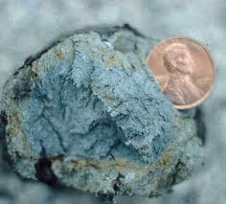
As a result of wetting then drying, gley soils develops a mottled appearance with orange-brown mottles set in a blue-grey matrix

Slide 7
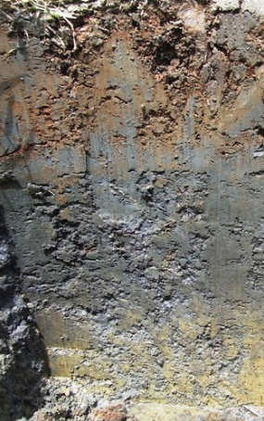
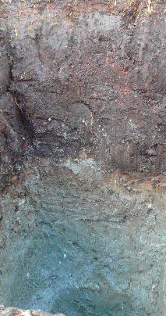

Slide 8
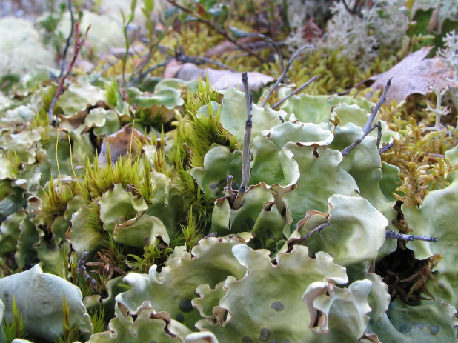
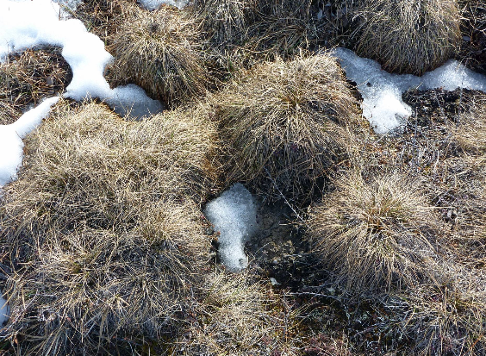
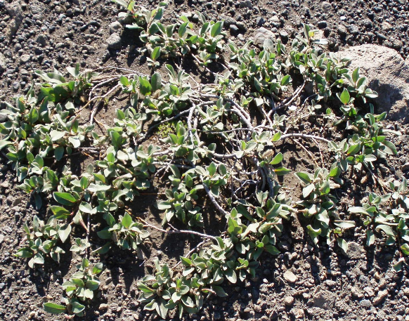
Vegetation

Slide 9
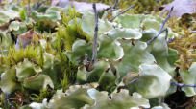
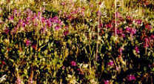
Gleys are found in cold regions such as the Tundra. These conditions mean natural vegetation is limited, providing little nutrients and litter, reducing the development of gley soils.
Vegetation which is made up of shrubs and lichens, breaks down very slowly in the cold climate, resulting in an acidic mor humus.
AO
Gley soils can be peaty and are characterised by waterlogging, which denies the oxygen that supports the presence of soil organisms.
A
Soil organisms extract limited oxygen supplies from the soil, decolouring the soil and leading to a grey/blue appearance.
B
Parent material is often found in the B horizon of the soil due to frost shattering of the parent material.
Gley soils tend to be found in flat landscapes, resulting in limited surface run-off and further adding to the problem of poor drainage and waterlogging.
C
Soil heave brings this weathered material up through the soil. At times this material may breach the surface.

Slide 10
Task 4
Using the previous slide, complete your diagram of the gley using coloured pencils.
Using the information on pages 5 and 6, Explain how the factors such as the ones stated affect the formation of a gley soil. (6) Natural vegetation, Climate, Relief, Soil organisms, Drainage, and Rock type.

Slide 11
Marking scheme
Possible answers might include:
Climate – Gleys are found in cool regions such as the Tundra. These conditions mean natural vegetation is limited, providing little nutrients and litter, reducing the developing of gley soils. (1 mark)
Vegetation breaks down very slowly in the cold climate, resulting in an acidic mor humus. (1 mark).

Slide 12
Marking scheme
Drainage – Gley soils can be peaty and are characterised by waterlogging, which denies the oxygen that supports the presence of soil organisms. (1 mark)
Relief – Gley soils tend to be found in flat landscapes, resulting in limited surface run-off and further adding to the problem of poor drainage and waterlogging. (1 mark)

Slide 13
Marking scheme
Soil organisms extract limited oxygen supplies from the soil, decolouring the soil and leading to a grey/blue appearance. (1 mark)
Parent material is often found in the B horizon of the soil due to frost shattering of the parent material. (1 mark).
Soil heave brings this weathered material up through the soil. At times this material may breach the surface. (1 mark)
OR ANY OTHER VALID POINT.

Slide 14
Success criteria
I can draw an annotated diagram of a gley soil.
I can explain the formation of a gley soil.

Slide 15
Plenary
Describe the climate and vegetation for each soil.

