Slide 1
Lesson three: Brown Earth
Learning intentions: We are learning about soil.
Success criteria:
I can draw an annotated diagram of a brown earth soil.
I can explain the formation of a brown earth soil.

Slide 2
Starter
Look at page 4 of your booklets.
What soil forming processes do you think will be found in a brown earth soil with the following characteristics.
Precip > evap in winter. Precip < evap in summer.
Found in woodland areas where the leaves fall off the trees seasonally.
Notes:
Leaching in winter, causing slight iron pan. Capillary action in summer.
Mull humus.

Slide 3
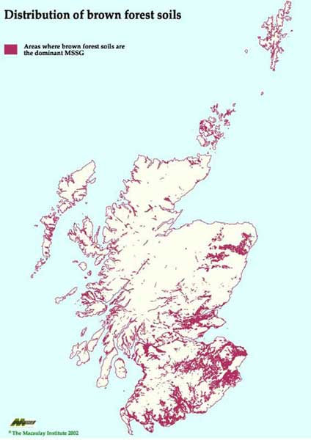
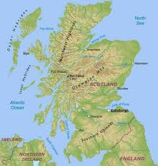
Found on lower slopes/lower relief

Slide 4
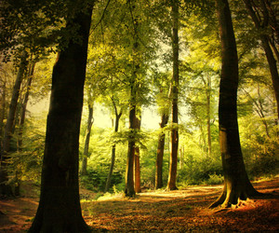
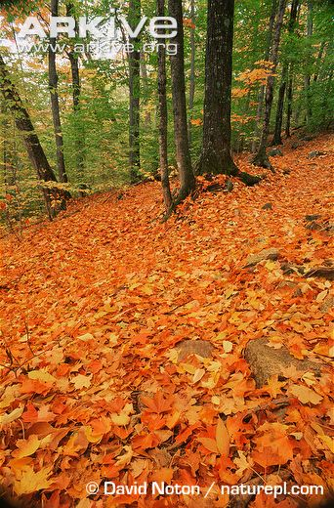
Brown Earth
Brown Earth soils develop beneath temperate broadleaved deciduous forests of Western Europe, Russia and North America.

Slide 5
KEY
Red: soil organisms
Green: vegetation
Blue: climate
Pink: parent material (rock type)
Black: drainage/relief (these are very closely linked)

Slide 6
Deciduous trees and grasses provide abundant and deep leaf litter which is broken down rapidly by the mild climate.
There is a presence of soil organisms which break down leaf litter producing a mildly acidic (pH5-6.5) mull. They also ensuring the mixing of soil, aerating it and preventing the formation of distinct horizons.
AO
A
Tree roots penetrate deep into the soil ensuring that materials are recycled back to the vegetation. This is why B is lighter brown in colour compared to A.
P slightly exceeds E, causing downward leaching of the most soluble minerals and the possibility of an iron pan forming.
B
When E > P in the summer, capillary action can take which brings up the minerals from the B to the A horizon, further helping to mix the soil.
C

Slide 7
Greater altitude results in temperatures and the growing season being reduced and an increase in precipitation.
Rock type determines the rate of weathering. Hard rocks e.g. schist take longer to weather producing thinner soils, than soft rocks e.g. shale that weather quickly
AO
A
Steeper slopes tend to produce thinner soils due to gravity.
There is a range of parent materials with limestone producing lighter coloured alkaline soils.
B
South facing slopes with a greater amount of sunshine and higher temperatures increase the rate of humus production.
C

Slide 8
Brown Earth
Deciduous trees provide a thick leaf litter which is broken down quickly due to the mild climate. This produces a mull humus (pH5-6.5)
Brown Earth soils have many soil organisms found in them. The organisms help to mix the soil and prevent distinct horizons.
When precipitation is higher than evaporation during the winter leaching occurs. Iron minerals are washed down and an iron pan may form in the B horizon.

Slide 9
Brown Earth
Steeper slopes tend to produce thinner soils due to gravity
Hard rocks e.g. schist weather slower producing thin soils, whereas soft rocks e.g. shale weather more quickly
South facing slopes receive more sunshine and higher temperatures therefore speeding up humus production.

Slide 10
Task 3
Using the previous slide, draw a diagram of brown earth using coloured pencils.
Explain how the factors such as the ones stated affect the formation of a brown earth soil. (6) Natural vegetation, Climate, Relief, Soil organisms, Drainage, and Rock type.

Slide 11
Developed Point
Brown Earth soils have many soil organisms found in them. The organisms help to mix the soil, aerating it and preventing distinct horizons.
Make the point, give detail/explain, give more detail (or an example)

Slide 12
How it’s marked

Slide 13
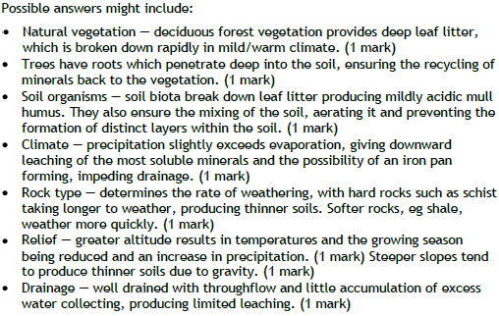
How it’s marked

Slide 14
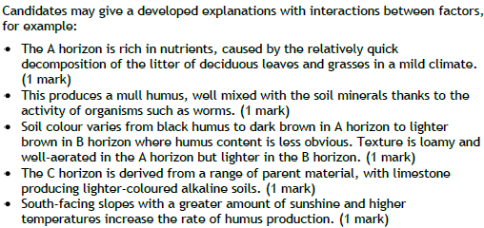
How it’s marked

Slide 15
Homework
Explain how the factors such as the ones stated affect the formation of a podzol soil. (6) Natural vegetation, Climate, Relief, Soil organisms, Drainage, and Rock type.
Explain how the factors such as the ones stated affect the formation of a brown earth soil. (6) Natural vegetation, Climate, Relief, Soil organisms, Drainage, and Rock type.
Explain how the factors such as the ones stated affect the formation of a gley soil. (6) Natural vegetation, Climate, Relief, Soil organisms, Drainage, and Rock type.

Slide 16
Success criteria
I can draw an annotated diagram of a brown earth soil.
I can explain the formation of a brown earth soil.

Slide 17
Plenary
Under what conditions does capillary action happen?
What is the opposite of it?
What does this cause?
Notes:
Evap > precip, usually in summer
Leaching and waterlogging when precip>evap
Iron pan

