Slide 1
Higher Geography
Physical Environments - Biosphere

Slide 2
Biosphere
The biosphere is the sum of all the living ecosystems on Earth.
It is the zone of all life on earth.
It is self regulating
We will study soil within the biosphere, specifically looking at how soils are made and the processes which take place there.

Slide 3
Homework
Page 1 of Biosphere booklet.
Explain how the factors such as the ones stated affect the formation of a podzol soil. (6) Natural vegetation, Climate, Relief, Soil organisms, Drainage, and Rock type.
Explain how the factors such as the ones stated affect the formation of a brown earth soil. (6) Natural vegetation, Climate, Relief, Soil organisms, Drainage, and Rock type.
Explain how the factors such as the ones stated affect the formation of a gley soil. (6) Natural vegetation, Climate, Relief, Soil organisms, Drainage, and Rock type.
Homework should be submitted on A4 lined paper.

Slide 4
Lesson one: What is soil made of?
Learning intentions: We are learning about the Biosphere (soil).
Success criteria:
I can explain what soil is made from.
I can explain the main soil forming factors.
I can explain the main soil forming processes.

Slide 5
Starter – Group discussion
What do you think soil is made from?
How long do you think it takes to make a soil?
Who do you think soil is important for?
It takes around 200-400 years to make 1cm of soil.
It takes 3000 years to make soil fertile enough to support life.

Slide 6
What is soil made of?
45% mineral matter: this comes from the weathering or breakdown of the underlying parent material. It consists of a range of particles sizes from small clay (<0.002mm diameter) to course sand (>2mm diameter). The texture of the soil is determined by the particle mix.
5% organic matter: this comes from the decaying vegetable matter than is broken down by decomposers, e.g. fungi, earthworms.
25% air
25% water
What is soil made from?

Slide 7
Soil formation
What determines the type of soil found in a location?
1. Climate
Temperature: determines the length of the growing season, the supply of organic material (amounts of humus) and the speed of decomposition, which will be faster in warmer climates.
Precipitation: where rainfall totals and intensity are high there will be more leaching (downward washing by rainwater) and in areas of less rainfall more evaporation will lead to capillary action (upwards transfer of minerals).

Slide 8
Soil formation
2. Organisms and vegetation
Active micro-organisms will increase the amount of nitrogen fixation and the decomposition of dead vegetation, leading to an increased depth of humus.
The type of vegetation determines the type of organic matter and therefore the pH. Most British soils are slightly acidic, particularly as heavy rainfall leaches out the calcium which is alkali.

Slide 9
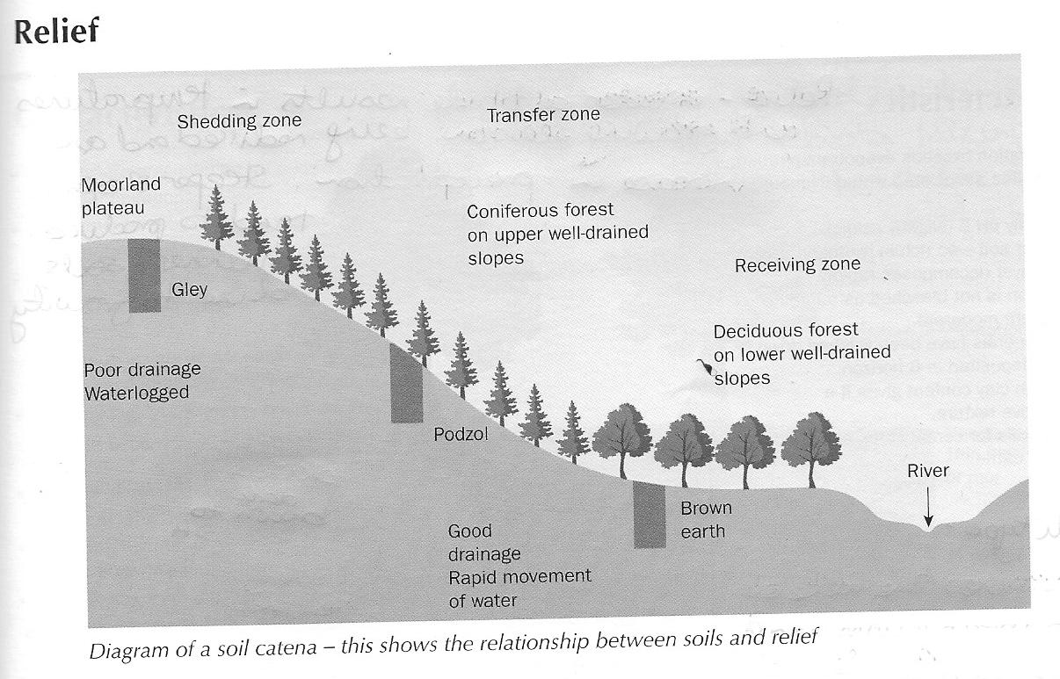
Soil formation
Soils found on flat ground or plateaus (hills with a flat top) are poorly drained and therefore waterlogged (e.g. Gley)
Those found on slopes drain much more freely due to gravity so are less likely to become waterlogged (e.g. Podzol and brown earth).

Slide 10
Soil formation
4. Parent material
This is a major factor determining soil type.
It provides a supply of minerals and controls soil depth, texture, drainage (permeability) and soil quality.
Fluvioglacial – deposited by a river from a melting glacial
Weathered – broken up by physical, chemical or biological processes such as tree roots

Slide 11
Soil forming processes
Processes | Definition
Acidity | A measure of the hydrogen icon concentration in the soil. Values greater than 7.0 are alkaline and values less than 7.0 are acidic.
Capillary action | Transfer upwards of minerals through the soil horizons caused by evaporation loss at the surface.
Leaching | Downward washing by rainwater of soluble ions in solution.
Eluviation | The leaching of small suspended soil particles in infiltrating water from the A horizon.
Illuviation | The deposition of leached or eluvial particles into the B horizon.
Mor humus | Acid humus formed by the decaying of pine needles.
Mull humus | Soft, blackish organic matter formed by the decaying of deciduous leaves. (slightly acidic)
Gleying | Occurs in waterlogged, anaerobic conditions (lack of oxygen) when iron compounds are reduced and either removed from the soil, or segregated out as mottles or concretions in the soil.

Slide 12
Task 1
Heading: Introduction to Soils
Answer the questions on the next slide.
Extension: Highlight the names of four properties of soil formation, and the soil forming processes.

Slide 13
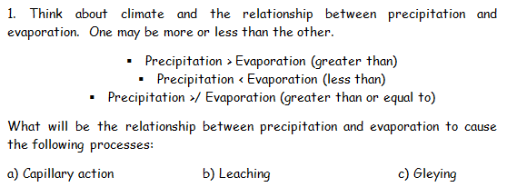
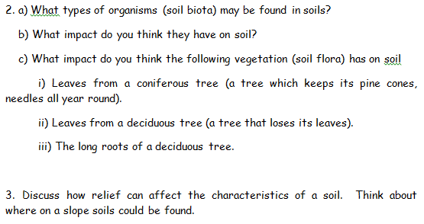

Slide 14
Success criteria
I can explain what soil is made from.
I can explain the main soil forming factors.
I can explain the main soil forming processes.

Slide 15
Plenary
What role do you think the following play in soil formation?
Organisms such as worms.
Trees.
Rain.

