Slide 1
Lesson 5: Need for traffic management schemes - Glasgow
Learning Intentions
We are learning the reasons for traffic congestion in Glasgow
Success Criteria
I can give at least 5 reasons for traffic congestion in Glasgow

Slide 2
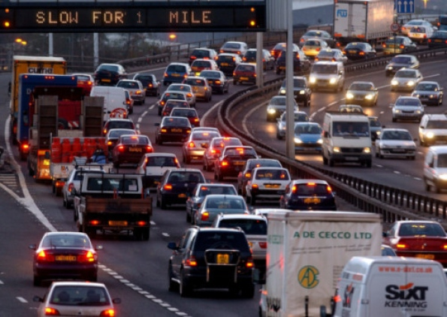
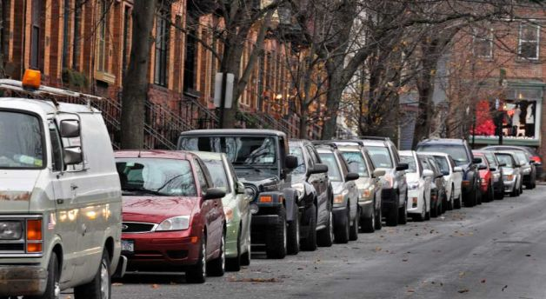
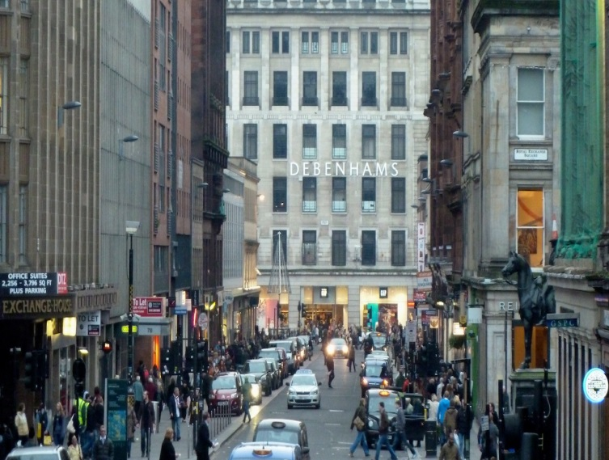
Starter
Why do you think there is traffic congestion in Glasgow?

Slide 3
Population Growth
As world population continues to grow traffic congestion becomes more of a problem
More people = more people on the roads

Slide 4
1. More cars on the road
Cars are now more affordable & many families own more than one car
This means there are more cars on the road, adding to congestion.
Also, as population grows more cars are added to the road and more people are now completing the school run by car.
This extends the rush hour.

Slide 5
Developed point???
Cars are now more affordable and many families own more than one car.
Cars are now more affordable and many families own more than one car. This increases traffic congestion as there are more cars on the road.

Slide 7
2. Cars > public transport
Some people see public transport as being too costly and therefore prefer to use their own car
Also, for some public transport is not suitable. For people who work shifts or live in areas with a poor public transport network it is difficult to find public transport which suits them.
e.g. living in a small village and working nightshift

Slide 9
Developed point????
Some people have to use their car to get to work as public transport is not suitable to them. For example, they may work in a small village and there is no bus to take them into work, or an infrequent bus service. Therefore they must take the car, adding to congestion.

Slide 10
3. Commuters from suburbs
Many people now live in the suburbs of Glasgow e.g. Newton Mearns
25% of people who work in the city live outwith
They use their cars to commute into the city centre and use only a few roads to do this e.g. M8, M77 and M74.
These roads then suffer from traffic congestion as large numbers of people are using them to travel in the same direction.

Slide 11
3. Commuters converging
Many of the commuters use roads which converge (meet) on a few main arteries e.g. Great Western Road
This means there is a large number of cars heading in the same direction on only a few main roads.

Slide 12
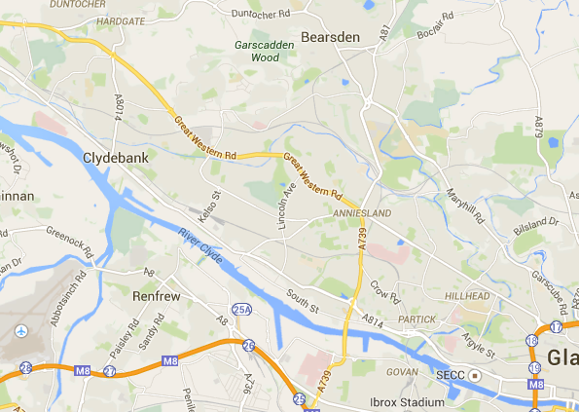
Commuters coming from lots of different areas on either sides of GWR, all heading to the CBD or the M8.

Slide 13
4. Few bridging points
There are only a few bridging points across the River Clyde in Glasgow.
This means many people need to cross the river at only a few places, leading to congestion.
The Kingston Bridge deals with over 170,000 cars per day!
Example of a developed point
Some detail
More detail
Example

Slide 14
5. Old, narrow roads
Many roads in Glasgow’s city centre were built before the age of the car e.g. Medieval times
The roads are narrow and not built to allow cars to manoeuvre
As cars exit new & large motorways they meet and need to squeeze into narrow roads e.g. Bath St.
This causes bottleneck and congestion

Slide 15
6. More delivery vehicles
An increase in online shopping e.g. Amazon means there are increased delivery vehicles on the road
These vehicles are heavy and cause damage to roads.
As roads require resurfacing, many are closed causing major delays and congestion

Slide 16
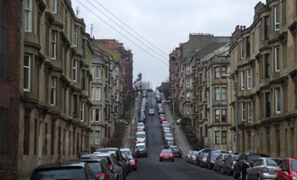
7. Lack of parking
In the CBD there is often a lack of affordable parking
This means many cars are parked along the sides of the road, narrowing the road width
This makes it difficult for traffic to flow due to the restricted space e.g. St. Vincent street

Slide 17
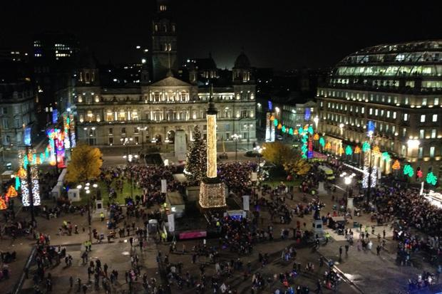
8. Increased tourists
Glasgow is a popular destination for tourists & shoppers
At particular times of the year e.g. Christmas Glasgow becomes very busy as people visit the attractions e.g. Christmas lights and market at George Sq.

Slide 18
Past Paper Question
For Glasgow or a named city you have studied in the Developed World, explain why it suffers from traffic congestion.
7 marks

Slide 19
Marking scheme
A developed world city I have studied is Glasgow. There are several causes of traffic congestion.
Firstly, there is an increased number of cars on the road as a result of people not wanting to take public transport because they think it is too expensive or they live in an area with insufficient public transport e.g. they live in a rural area and work nights. ✓
In addition to this there are also more cars on the road due to increased car ownership. This coupled with an increasing population means there are more cars used for the school run, extending the rush hour. ✓
Another cause of traffic congestion is commuting from suburbs. 25% of people who work in Glasgow live outside the city in area such as Newton Mearns and travel into work via the newer, larger roads or motorways such as the M77, M74 and M8, causing traffic congestion. ✓

Slide 20
Marking scheme
A further cause of traffic congestion is an increase in online shopping (e.g. Amazon). There are more delivery vehicles on the roads and therefore an increased need for road maintenance which causes congestion when they are shut for resurfacing. ✓
Lastly, Glasgow has few bridging points across the River Clyde meaning many are converging on only a few roads causing congestion. The Kingston bridge has 170,000 cars crossing it every day. ✓

Slide 21
Plenary
Pick 2 reasons why Glasgow suffers from traffic congestion
Think of ways these problems can be managed
Share with your shoulder partner

Slide 22
Lesson 6: Solutions to traffic management - Glasgow
Learning Intentions
We are learning about the management strategies employed to reduce traffic congestion in Glasgow
Success Criteria
1. I can explain the solutions put in place to manage Glasgow’s congestion problem

Slide 23
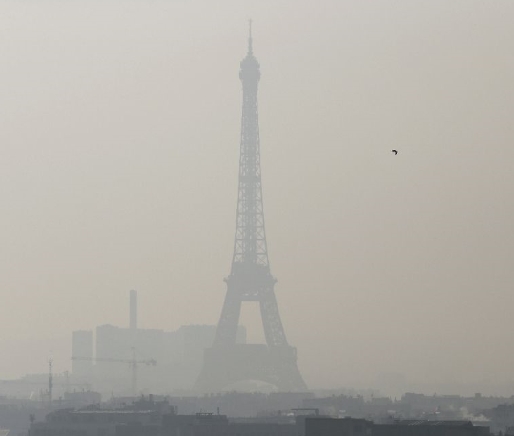
Starter
In Paris they had 5 days of very bad smog.
They introduced a one off, one day ban on cars entering the city whose number plate ended in an even number.
“Hundreds of police manned checkpoints around Paris from dawn, to stop any car whose number plate ended with an even number from entering the city.
Drivers who defied the alternate-day ban faced on-the-spot fines of €22 (£18.50) or €35 if they paid within three days.”

Slide 24
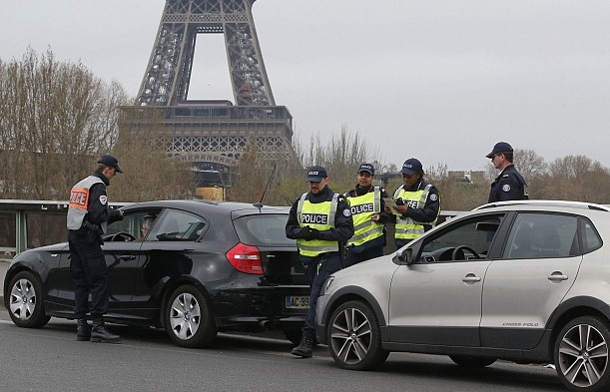
Starter
“By midday on Sunday, Paris police said they had handed out nearly 4,000 fines to drivers not respecting the restriction, aimed at reducing the “dangerously” high levels of harmful particles that have blighted the atmosphere for five straight days.
There was half the usual number of traffic jams.”

Slide 25
Video
Watch the video on how Stockholm has reduced traffic congestion.
Did it work?
What do you think of the idea?
Would it work here in Glasgow?
Stockholm traffic congestion

Slide 26
China’s futuristic traffic congestion solution
China's futuristic bus
'Transit Elevated Bus' allows cars to pass underneath it, alleviating traffic
Scale model was demonstrated at a technology expo in Beijing last week
It is designed to carry 1,200 passengers but will be cheaper than a subway
The futuristic buses could be running by the end of the year

Slide 27
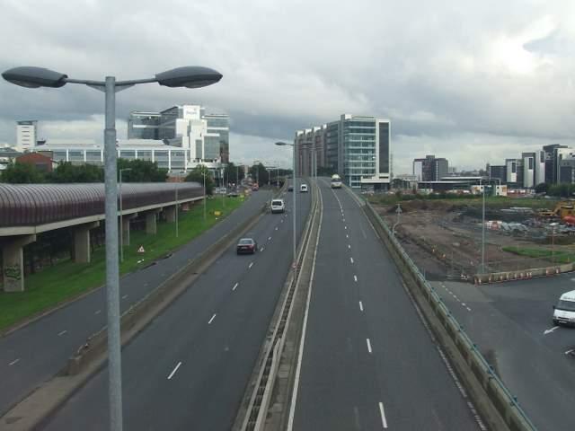
1. Construction of new roads (1)
New dual carriageways have been built to improve access to the city centre e.g. Springburn Expressway & Clydeside Expressway
The M80 (North) and M77 (South) have also improved access into Glasgow for commuters from Stepps (M80) and Newton Mearns (M77) ✓

Slide 28
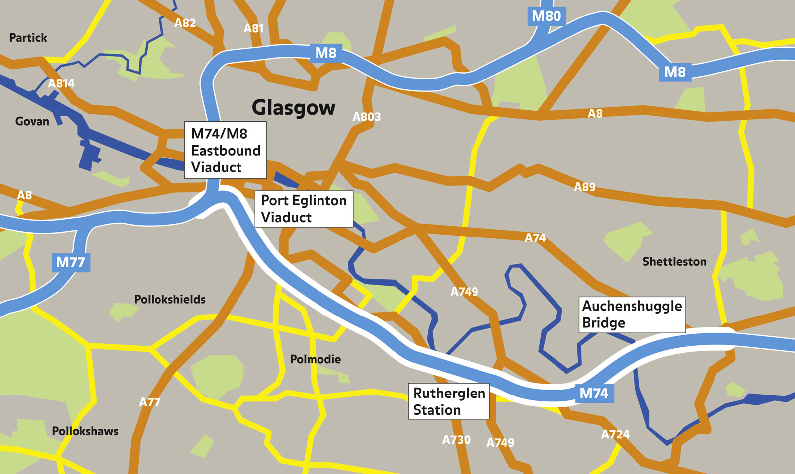
1. Construction of new roads (2)
The M74 has been extended in order to relieve congestion on the M8, one of Britain's busiest motorways. The extension cost £500million and homes and businesses were demolished to make way for the new road ✓
DEVELOPED POINT

Slide 29
2. Improvements to public transport
Glasgow City Council and FirstBus worked together to introduce revised bus routes and timetables called Simplicity. The aim is to make journeys across the city quicker ✓
Park and ride schemes have been introduced across the city. This is when commuters can travel to a nearby train station and park their car and then continue their journey to the CBD by train. An example is Shield’s Road in the south of the city. ✓
DEVELOPED POINT

Slide 30
3. Improvements to traffic flow
One way systems have been introduced to help improve traffic flow in the CBD e.g. Bath st. This stops cars being held up as cars wait to turn right ✓
Bus lanes have been introduced in busy areas such as West George St. around George square. This makes bus travel faster and therefore more appealing to people reducing the number of cars on the road ✓
Parking restrictions have been put in place e.g. parking metres in Bothwell St. and increased traffic wardens. This reduces the number of cars parked along the roadside, allowing traffic more space to flow freely ✓

Slide 31
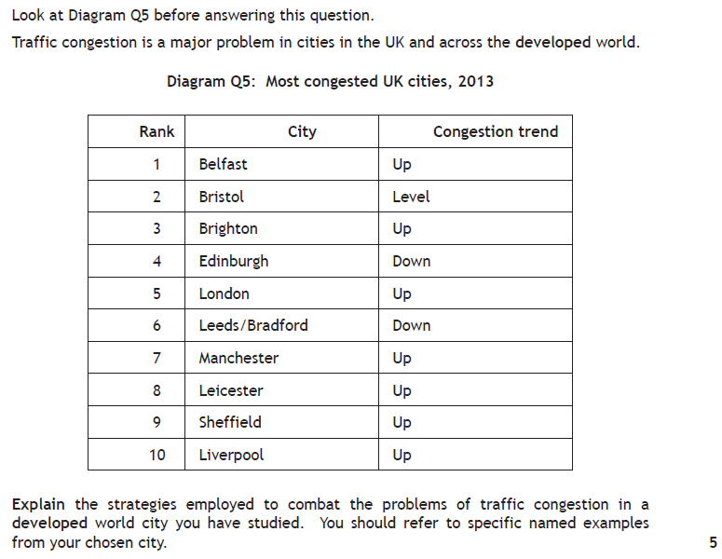
Past Paper Question
For a developed world city you have studied, explain the strategies put in place to manage traffic congestion. (5)
2015 exam.

Slide 32
Peer Assessment
You should mark your shoulder partners answer using the marking scheme on the next slide
Only award a mark for a DEVELOPED point (3 pieces of info/2 pieces and an example)
You should give your partner a RED BOX
You need to add 2 points for full marks

Slide 33
Perfect answer
A developed world city I have studied is Glasgow. There are many solutions to traffic congestion. Firstly,

Slide 35
Plenary
Complete your RED BOX to ensure you get full marks for the question

Slide 36
Lesson 7: Effectiveness of solutions to traffic management - Glasgow
Learning Intentions
We are learning about the effectiveness of traffic management strategies in Glasgow
Success Criteria
1. I can evaluate the effectiveness of traffic management strategies in Glasgow

Slide 37
Starter
Update your “POP QUIZ” checklist

Slide 38
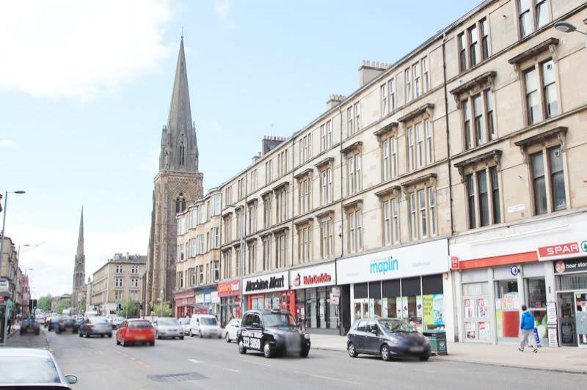
1. Construction of new roads (1)
Large motorways such as the M80 and M77 reduce the number of cars on smaller roads such as Great Western Road. This helps reduce congestion in built up areas making it safer for pedestrians. ✓

Slide 39
1. Construction of new roads (2)
The M74 extension was controversial when it was first proposed. Many people had to leave their homes and businesses had to close to make way for the new road. People were also concerned about noise and air pollution. ✓
However, the extension has been successful in reducing congestion on the M8. Around 20,000 vehicles have been removed from the M8 between Baillieston and Charing Cross. Journey times are also around 15 minutes faster. ✓

Slide 40
2. Improvements to public transport
There has been a significant increase in passenger numbers on trains between Edinburgh and Glasgow. Stations such as Carntyne and Shettleston connect passengers to the city centre in both Edinburgh and Glasgow with trains every 15 minutes between the hours of 0700hours and 1800hours. ✓
First Bus has made some improvements such as adding new buses, some which contain wifi. However, some have complained that services have been amalgamated and some popular routes cancelled or experiencing reduced services. Also, there are two buses which use the number 60 but have different routes and this may be confusing for passengers. ✓

Slide 41
3. Improvements to traffic flow
In recent years there has been public outcry as there has been a significant increase in the number of bus lanes in Glasgow’s city centre. The newly introduced bus lane at Nelson Madela Place earned the council at least £800,000 in its first two months. Drivers are fined £30, increasing to £60 after 14 days for driving in the bus lane. ✓

Slide 42
Task
Name the case study.
Firstly….
Name a solution.
This is effective because / This is not effective because…
Secondly….
This is effective because / This is not effective because.

Slide 43
Perfect answer
A developed world city I have studied is Glasgow. The solutions to traffic congestion have had varying degrees of success.
Firstly, building new roads such as the M77 and M80 has reduced the number of cars on Great Western Road ✓, thus reducing congestion and making it safer for pedestrians ✓.
Secondly, the M74 motorway was not effective because many people complained when their houses and businesses were destroyed ✓, and now local residents are worried about noise and air pollution leading to bad health ✓.

Slide 44
In addition to this, Simiplicity is effective because buses are now more convenient due to additional services and routes, and new additions such as wifi ✓. This means people are less likely to take the car so there are less cars on the road, thus reducing congestion ✓.
Furthermore, improving the traffic flow has been effective, particularly on roads such as Nelson Mandela Place where the government has introduced a bus gate ✓. This has removed the number of cars going through that area of the CBD and has reduced congestion ✓.

Slide 45
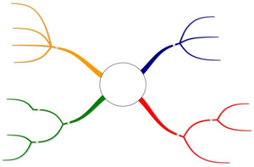
SOLUTIONS
REASONS
TRAFFIC MANAGEMENT GLASGOW
EFFECTIVENESS

Slide 46
Plenary

