Slide 1
Higher Urban
Glasgow & Mumbai Case Studies

Slide 2
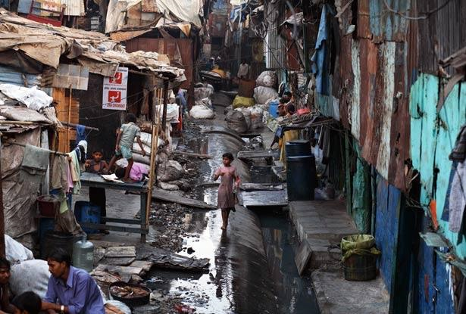
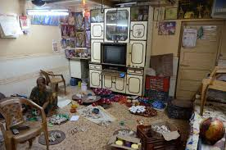
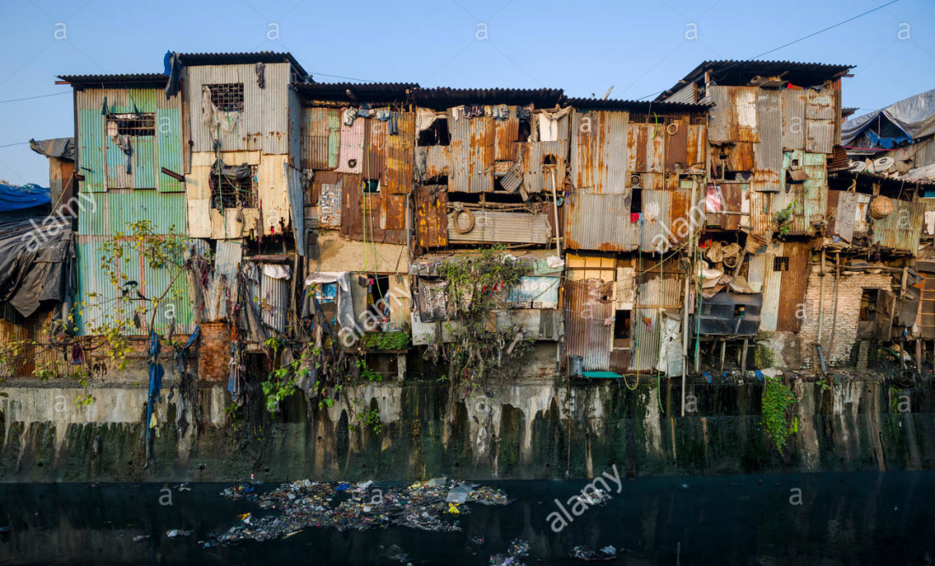
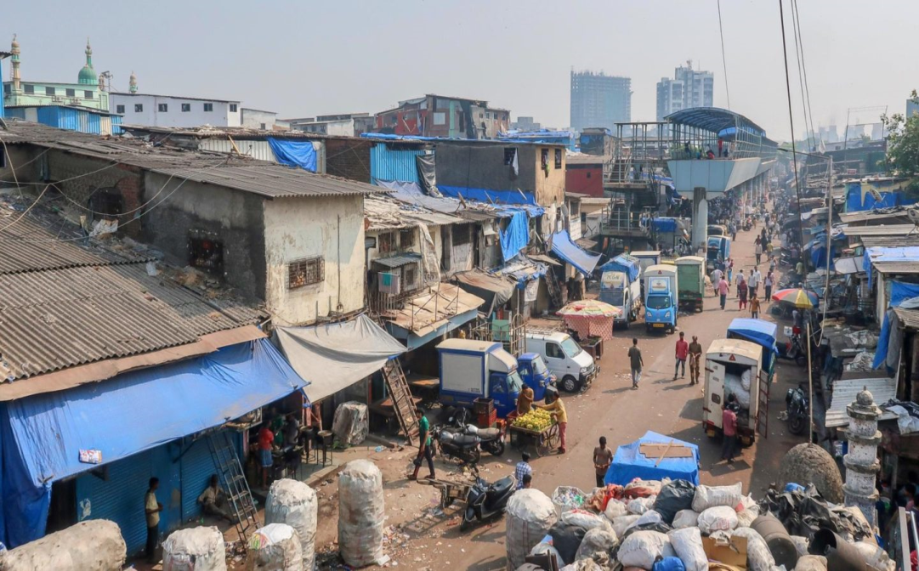
Starter - Describe the conditions of the homes shown in the photographs

Slide 3
Lesson 1: A shanty - Dharavi
Learning Intentions
We are learning what a shanty is and the conditions of the shanty in Dharavi
Success Criteria
I will be able to explain the conditions of Dharavi’s shanty

Slide 4
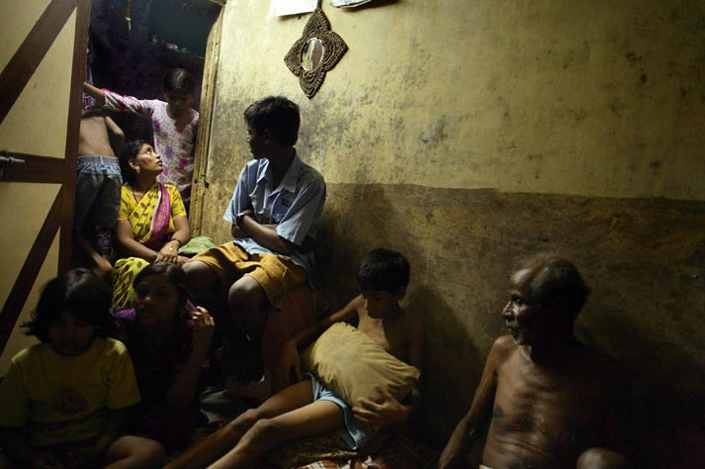
Large families sharing a small area

Slide 5
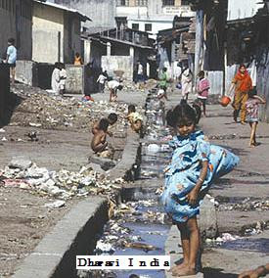
Poor sanitation

Slide 6
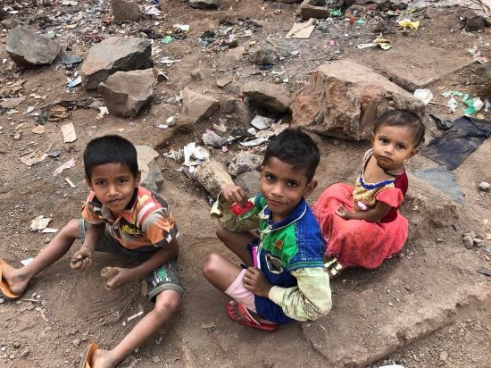
No green space/places to play

Slide 7
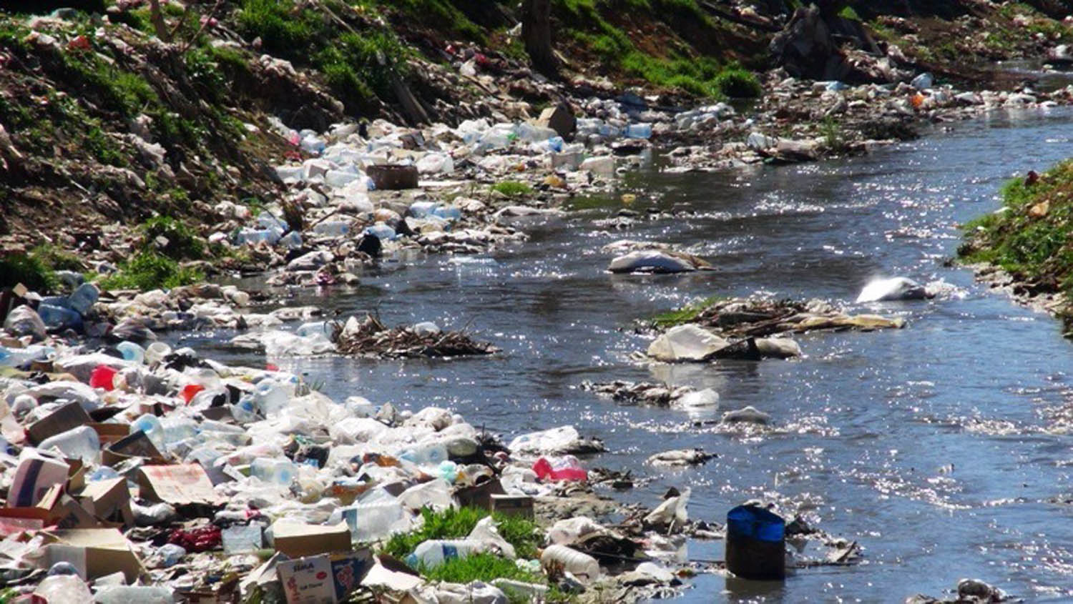
Rubbish & rats spread disease

Slide 8
Shanty town in Mumbai - Dharavi
There are literally hundreds of shanty towns in Mumbai but probably the most famous is Dharavi, because it featured in Slumdog Millionaire and also in some British TV programmes and Bollywood films.
It is near the centre of Mumbai, next to the financial district, and occupies a small area of 175 hectares (less than one square mile) between two railway lines.
In this very small area it is estimated that up to one million people live in extremely crowded conditions.

Slide 9
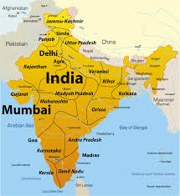

Slide 10
The Conditions in Dharavi
Dharavi is home for 1 million people, 15,000 one room factories and huge recycling industry. There are also small shops and eating places for the local residents.
Local residents are squatters as they do not pay rent to the government who own the land. They do however pay rent to a local landlord who looks after the land.
Most houses have electricity but it is tapped from the city’s power line so is dangerous and illegal.

Slide 11
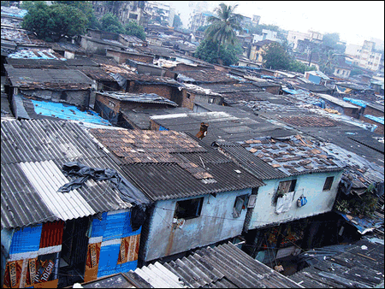
The Conditions in Dharavi
Recent arrivals build their houses with flimsy material such as wood, corrugated iron and cloth.
The oldest buildings are made of brick and concrete as they have been improved over the years.
There is a maze of alleyways to get to them.

Slide 12
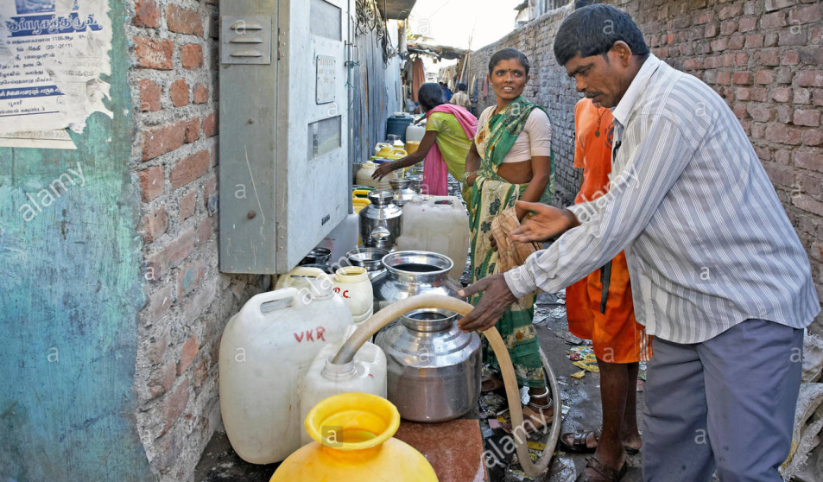
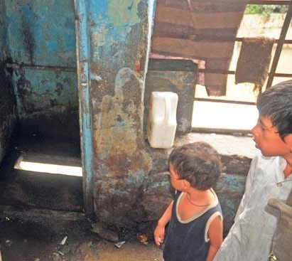
The Conditions in Dharavi
Water comes from standpipes but is only available for 2 hours a day.
There is only 1 toilet per 500 people which is usually blocked.
Most people use the shallow river as a toilet.

Slide 13
Benefits of living in Dharavi
It provides cheap, affordable housing. Mumbai cannot build enough houses for its entire people. Renting accommodation elsewhere in the city is expensive. Rents in Dharavi can be as little as £3 per month, so even the poorest can live here.
It provided a lot of employment. There are thousands of small factories and workshops here which pay low wages but which together give employment to most of the residents. Many skilled people work here and pass on their skills to others, for example metal smiths, garment workers and potters. Now there is even a small tourist industry, with guided tours of the shanty town.

Slide 14
Benefits of living in Dharavi
It brings the city a lot of money. Some of Dharavi’s goods are exported all over the world – the total value of everything made here in a year is over £300 million. Much of this money is spent in Mumbai. The recycling industry here is vast, and 80% of all Mumbai’s waste is recycled (compare this to 23% in the UK).
Very low crime rate. Conditions are overcrowded, most houses do not even have doors and certainly no locks, but crime rates are lower here than in the rest of the city.
It is very sociable. There are communal open areas where people can sit and chat, and many of the daily chores, such as washing and repairing clothes, are done together. The feeling of belonging to a community is very strong.

Slide 15
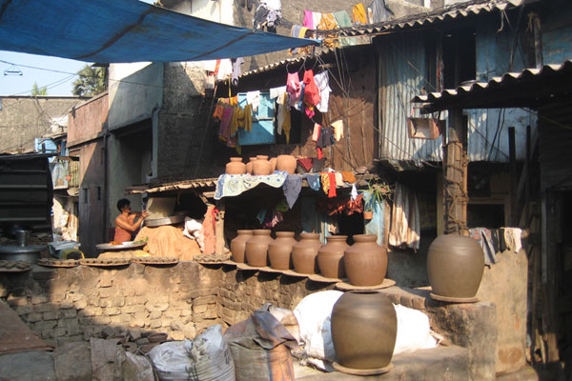
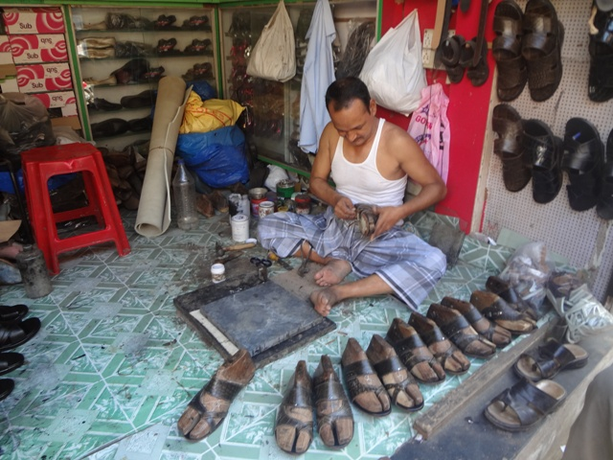
Benefits of living in Dharavi
People work, very hard and are very enterprising- they pass on these attitudes to the next generation, which must benefit the city.

Slide 16
Lesson 1: A shanty - Dharavi
Learning Intentions
We are learning about housing management strategies in Dharavi
Success Criteria
I will be able to explain and give examples of housing management strategies in dharavi

Slide 17
1. Large scale redevelopment – Dharavi Redevelopment Project (DRP)
$2billion development project, as proposed by the cities Slum Rehabilitation Authority, threatens the recycling district and part of Dharavi.
The land upon which Dharavi is built is next to Mumbai’s financial district. This makes it a prime target for redevelopment.
Many people, including the Mumbai authorities, think the problems in Dharavi outweigh the benefits and that the area should be redeveloped.

Slide 18
1. Large scale redevelopment – Dharavi Redevelopment Project (DRP)

Slide 19
2. Local Based Improvements –Slum Rehabilitation Scheme (SRS)/Local projects
There is an alternative to large scale redevelopment and that is to allow local people to design the improvements to the slum.
Self-improvement schemes involve the following:
The residents form separate self-help groups in different areas of Dharavi.
One group of residents persuades the authorities to give them ownership of their land.

Slide 20
2. Local Based Improvements –Slum Rehabilitation Scheme (SRS)/Local projects
Then they design their own improvements. These include: building many more properly maintained toilets, improving the water supply, building another floor onto the houses, making stronger walls.
The people of Dharavi have a huge range of skills and can form self-help groups to carry out many of these improvements.
Some self-help groups will negotiate small loans from banks. Others will negotiate with the authorities to provide them with some basic services, such as electricity and piped water.

Slide 21
2. Local Based Improvements –Slum Rehabilitation Scheme (SRS)/Local projects
The Society for the Promotion of Area Resource Centres, better known as SPARC, is an NGO (Non-governmental organisation) that supports the efforts of local people to get better housing for their many members.
Ideas generated from local people supported by this charity include adding an extra floor to buildings so that all family members can be accommodated in the same building.
These flats also had 14-foot high ceilings and a single tall window so are well ventilated, bright, and less dependent on electric fans for cooling.
Their loft spaces add extra room without seeming crowded, and include small spaces for bathing.
But toilets are placed at the end of each of the building’s four floors, and kept clean by the two or three families who use each one.

Slide 22
Past Paper Question
Explain why there was a need for housing management in a developed world city you have studied.
8 marks
A developed world city I have studied is…

