Slide 1
Higher Urban
Glasgow & Mumbai Case Studies

Slide 2
Lesson 1: Introduction to Urban
Learning Intentions
We are learning about land use zones and characteristics in a developed world city
Success Criteria
I will be able to describe each land use zone in a developed world city and give key characteristics

Slide 3
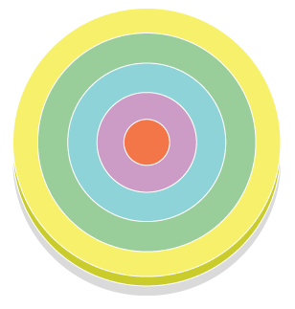
Burgess Model
CBD
INNER CITY
SUBURBS (OLD)
SUBURBS (NEW)
URBAN/RURAL FRINGE

Slide 4
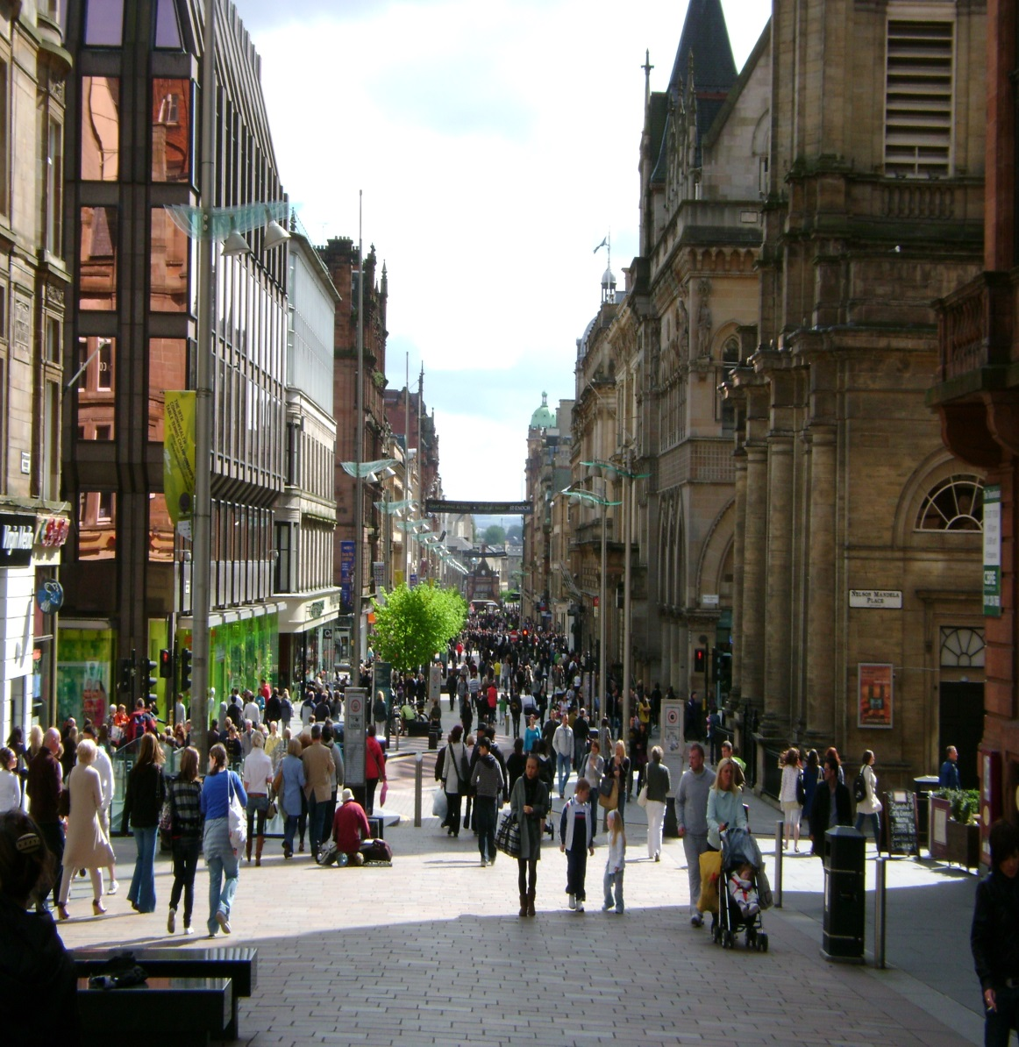
Characteristics of the CBD
The Central Business District is the oldest and busiest part of the city
It is the centre of shopping and entertainment

Slide 5
National 5 Re-cap
Give map evidence to show that the area below is Glasgow’s CBD

Slide 6
Characteristics of the CBD
Old, historical buildings such as Glasgow Cathedral and many churches ✓
Glasgow’s town hall – The City Chambers – is found in the CBD ✓
There are many transport hubs such as Central station and Buchanan bus station ✓
Many main roads lead into the area such as the M8 motorway ✓
The buildings are tightly packed with very little open space shown by the grid iron street pattern ✓

Slide 7
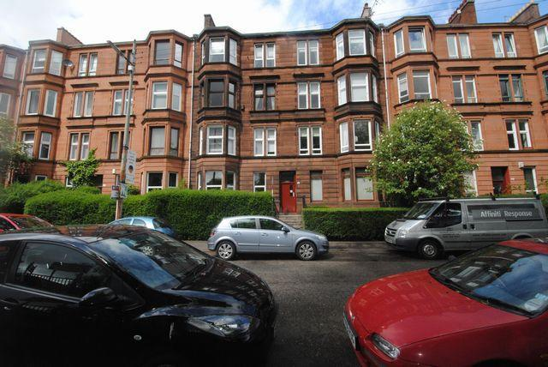
Characteristics of the Inner City
The Inner City is the 2nd oldest part of the city
It surrounds the CBD and usually has high density buildings e.g. tenement flats
Many areas have recently undergone regeneration

Slide 8
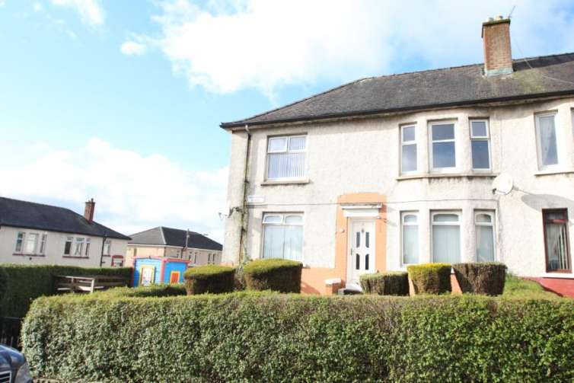
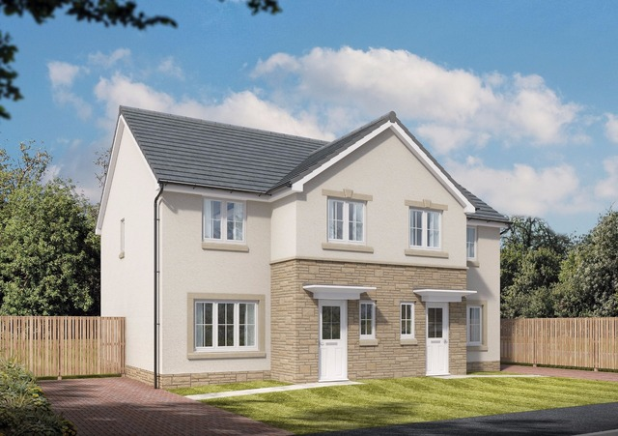
Characteristics of the Suburbs
The Suburbs are new, more modern areas of the city
Some suburb areas date back to just after WW2
Some areas are newly built

Slide 9
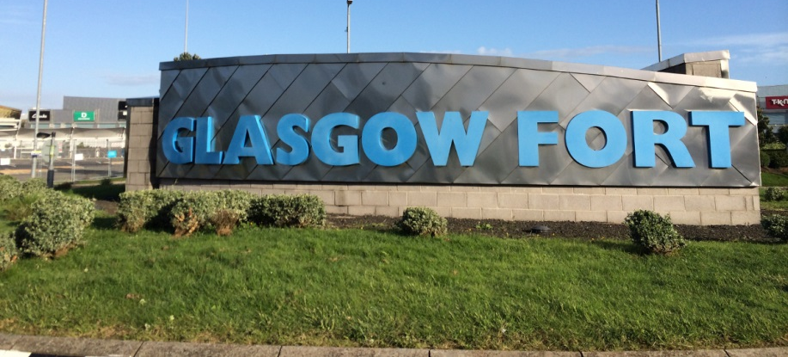
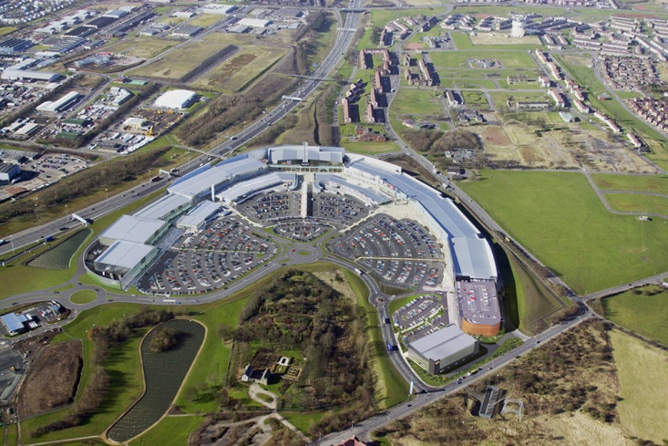
Characteristics of the New business zone
The New Business Zone is an area where new shopping and business parks are being built
These are close to residential areas
They have large car parks and space to expand

Slide 10
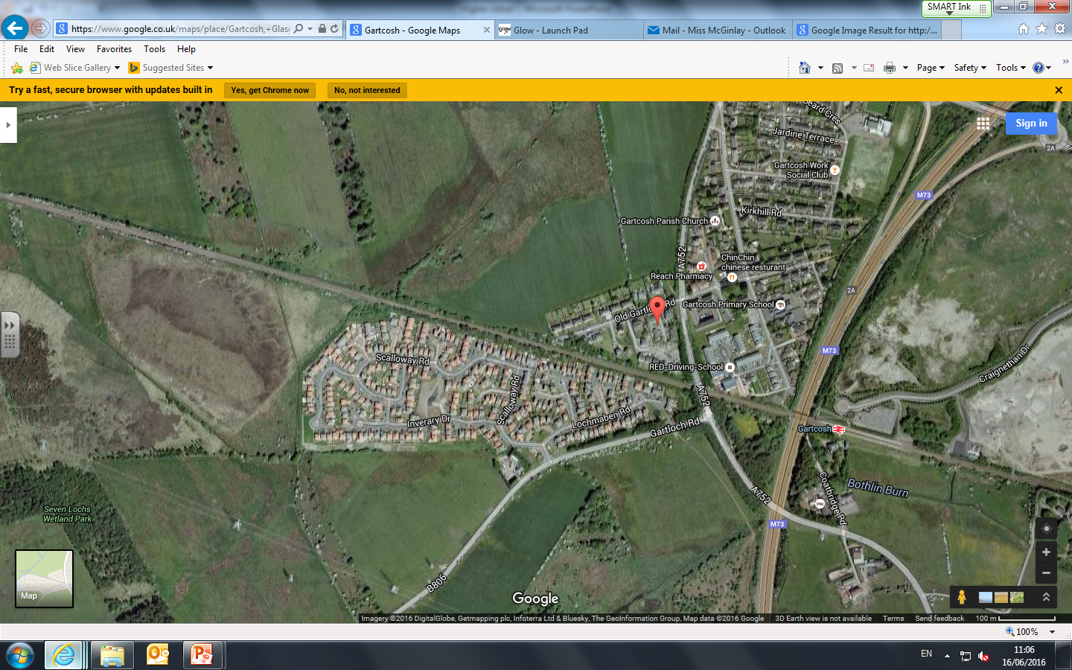
Characteristics of the Urban/Rural fringe
The Urban/Rural fringe is the boundary area between the city and countryside
Many of these areas are new developments
Some areas are farm houses/farms

Slide 11
Urban Transect
CBD
INNER CITY
SUBURBS
NEW BUSINESS ZONE
URBAN/RURAL FRINGE
Draw an Urban Transect showing
the main zones in Glasgow

Slide 12
Plenary
Which land use zone do you live in? Give 3 pieces of evidence to support your answer.

Slide 13
Lesson 2: Need for housing management - Glasgow
Learning Intentions
We are learning about why there is a need for housing management in Glasgow
Success Criteria
I will be able to explain the conditions of Glasgow’s slum areas
I will be able to explain why there is a need for housing management in the city

Slide 14
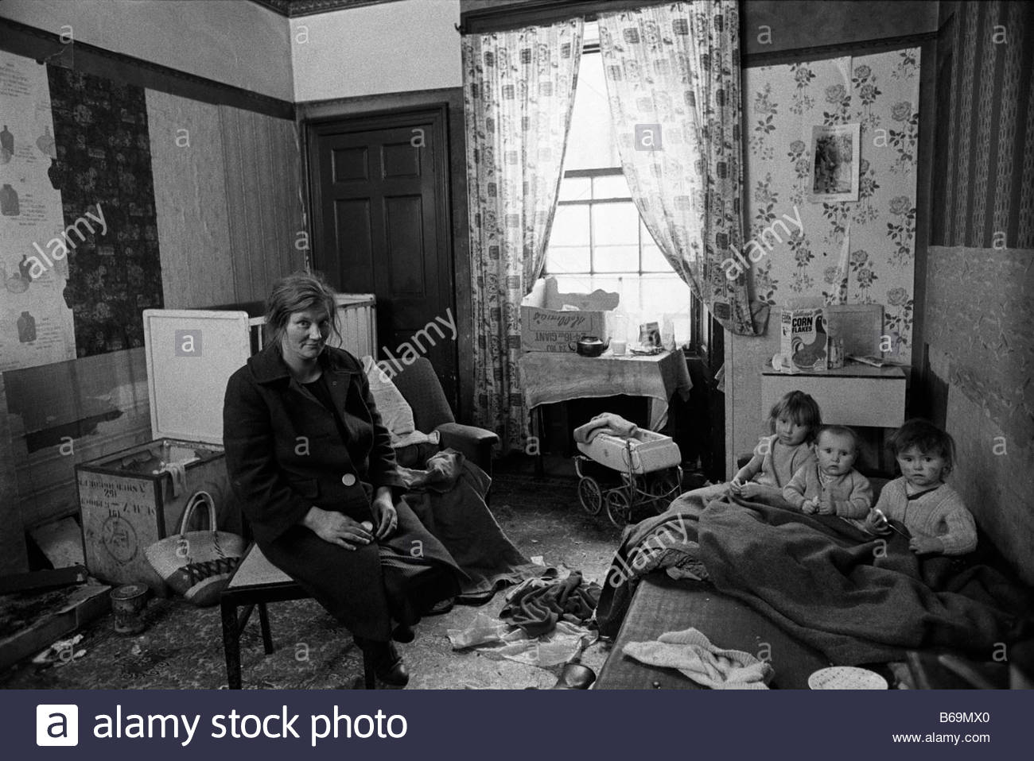
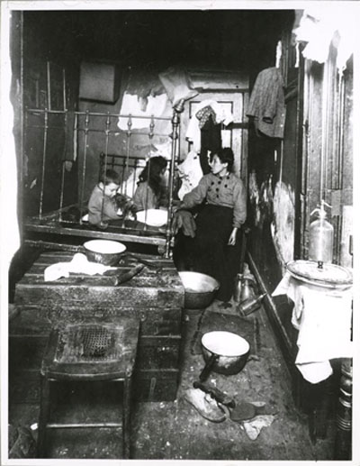
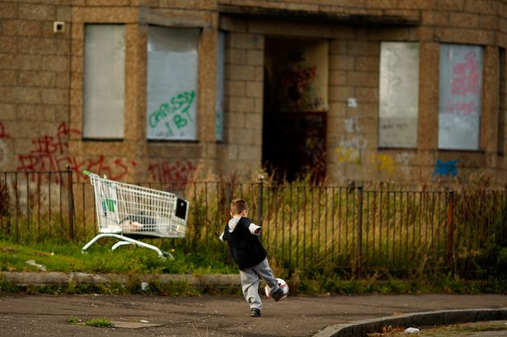
Starter
Describe the conditions of the homes shown in the photographs

Slide 15
The “single end” “Room & kitchen”

Slide 16
Large families sharing 1 room

Slide 17
No electricity – dark & damp

Slide 18
No green space/places to play

Slide 19
Rubbish & rats spread disease

Slide 20
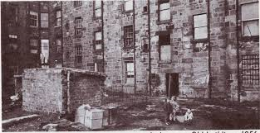
Why was there a need for housing management in Glasgow?
Tenements
Tenement flats in areas such as the Gorbals did not have basic amenities such as running water, central heating or indoor toilets. Each ‘close’ shared an outdoors toilet outside at the back of the building ✓
The tenements usually only had 1 bedroom and this was shared by large families. These cramped conditions mean that illnesses spread easily which lowered life expectancy ✓

Slide 21
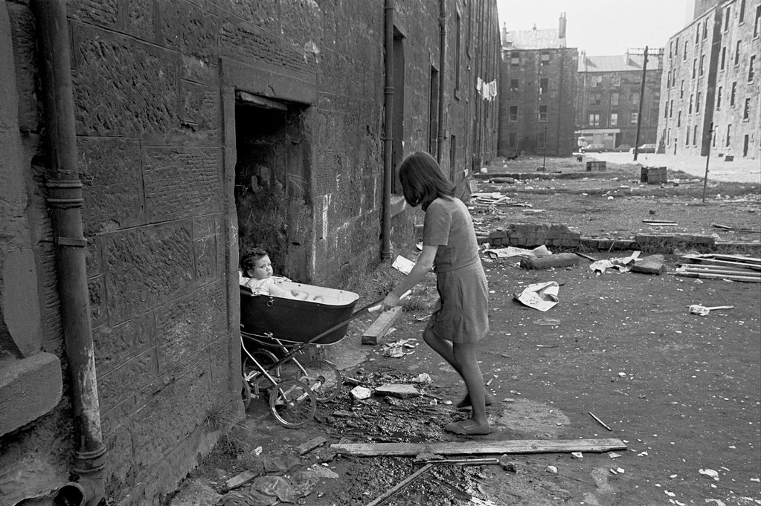
Why was there a need for housing management in Glasgow?
Due to the filth and lack of refuse collection, disease carrying rats were often found in closes. The air was thick with smoke from the factories, exacerbating breathing conditions such as asthma ✓
The tenements were dark and damp. The dampness caused diseases such as bronchitis and tuberculosis. ✓

Slide 22
Why was there a need for housing management in Glasgow?
High rise flats
The high rise flats in Glasgow (e.g Red Road flats) were built cheaply with poor quality materials. The roofs were flat and so water collected easily, leading to problems with damp and mould. ✓
As people moved from tenements to high rise flats, there was a break up of community spirit so people felt isolated and many moved out. These empty flats allowed squatters and drug dealers to use the abandoned premises fuelling drug crime & violence✓

Slide 23
Jeely Piece song
Ahm a skyscrapper wean, a live oan the eighteenth flair
But am no gawn oot tae play onymair
Cause since ah moved tae castlemilk I’m waistin away
Cause am getting wan meal less every day
Oh ye cannae fling pieces oot a twenty storey flat, Seven hundred hungry weans'll testify, to that. If it's butter, cheese or jeely, if the breid be plain or pan, The odds against it reaching earth are ninety-nine tae wan

Slide 24
Why was there a need for housing management?
Council Houses
Council estates on the edge of Glasgow such as Easterhouse were built without amenities such as shops, leisure centres, post offices and there were very poor bus links to the city centre. People felt isolated and unhappy ✓
There was high unemployment amongst the residents and crime rates began to rise. Those who could move away left, leaving the area to fall into disrepair ✓

Slide 25
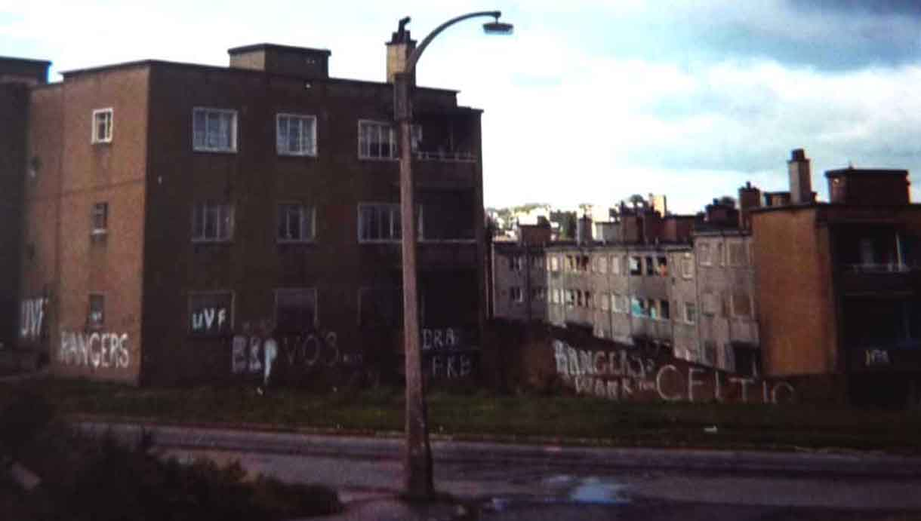
Notes:
Easterhouse/Pollock

Slide 26
Past Paper Question
Explain why there was a need for housing management in a developed world city you have studied.
8 marks
A developed world city I have studied is…

Slide 27
Peer Assessment
You should mark your shoulder partners answer using the marking scheme on the next slide
One mark should be awarded for each point made.
You should give your partner a RED BOX
You could have added…

Slide 28
Perfect Answer
There was a need for housing management in Glasgow for many reasons. Firstly, the tenements were in close proximity to the factories where most of the residents worked and were therefore exposed to smoke and chemicals. ✓ This resulted in diseases like asthma. ✓
In addition to this overcrowding and poor conditions caused further diseases and lowered life expectancy. ✓ Diseases such as bronchitis and TB spread quickly due to large families living in small flats. ✓
People who moved from tenements to high rise flats were annoyed that communities were destroyed. ✓ These residents ended up moving which resulted in these areas becoming empty and filled with crime. ✓
In addition to this, people were isolated in council estates such as Easterhouse as there was no community ✓ so the area became rundown and derelict. ✓
Lastly, in council estates there were no local amenities like shops, pubs and cinemas, as well as bus service which only came once an hour. ✓ This meant that those without a car found it difficult to travel outside the area for amenities. ✓

Slide 29
Human AS 2.1
Explain the reasons there is a need for housing management in Glasgow.
SC – I can give at least two developed explanations about a process/interaction in the context of an urban environment.

Slide 30
Plenary
Write down one area in Glasgow which has:
High rise flats
Tenement flats
Council estates

Slide 31
Lesson 3: Strategies to improve housing in Glasgow
Learning Intentions
We are learning the strategies put in place to improve the living conditions in Glasgow
Success Criteria
I can explain the strategies which were introduced to improve the living conditions of Glasgow residents

Slide 32
Starter
Name 2 areas in Glasgow which has recently experienced regeneration (been ‘done-up’)

Slide 33
Housing strategies
To deal with the tenements:
Comprehensive redevelopment
Tenement redevelopment
Other solutions to housing problems
New Towns
Gorbals regeneration
Athletes village

Slide 34
What housing management strategies were put in place?
Comprehensive Redevelopment
Glasgow City council designated 29 'slum' areas as 'Comprehensive Development Areas' e.g. Springburn and the Gorbals. The tenement buildings were knocked down and were replaced with high rise flats ✓

Slide 36
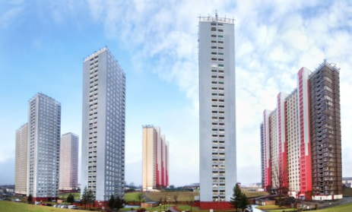
The Red Road Flats, Springburn

Slide 37
What housing management strategies were put in place and how effective were they?
Tenement renovation
In CDA areas such as Partick, some tenements were regenerated. The exterior of the flats were sandblasted to remove the soot and interior walls were knocked down to increase flat sizes ✓
Electricity, running water, double glazing and internal bathrooms were added and streets including Woodlands Drive had bollards installed to reduce traffic flow and make them safer for families. ✓

Slide 39
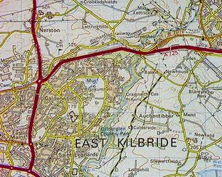
What housing management strategies were put in place?
New Towns
In the 1950's and 1960's, new towns such as East Kilbride were built from scratch to accommodate the 'Glasgow overspill'. ✓
These were well planned settlements designed to incorporate many services for example high quality housing, workplaces, schools, shops and leisure activities. ✓

Slide 40
What housing management strategies were put in place?
The Gorbals regeneration
In the 1990's, the Crown Street regeneration project saw high quality, expensive and largely owner occupied new 'tenement style' properties built in the Gorbals. ✓
Crown street was well planned and had plentiful private parking as well as numerous green spaces, including Gorbals New park. The flats also incorporated private gardens for residents ✓

Slide 41
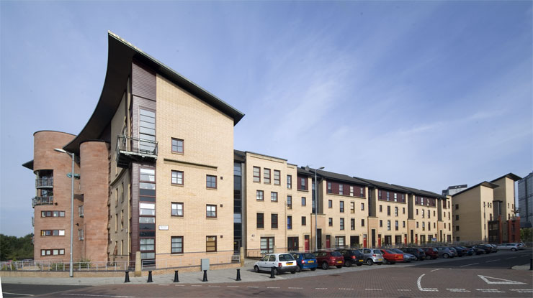

Slide 42
What housing management strategies were put in place?
The Athlete’s Village
As part of the Commonwealth Games regeneration, a 33 acre site in Dalmarnock was developed as the ‘Athlete's Village'. A total of 700 high quality two, three and four bedroom houses were built, 300 were sold to private owners and 400 for social housing. ✓
All homes were provided with front and back gardens as well as areas of private parking. The homes were sustainably built and give out 60% less carbon emissions. ✓

Slide 45
COPY & COMPLETE THE TABLE, USING PAGES – IN YOUR BOOKLET
Management strategy | Explanation
Athletes Village e.g.
New Towns e.g.
Tenement Regeneration e.g.
Gorbals redevelopment e.g.

Slide 46
Plenary
Where are each of these photo’s taken?
Notes:
1st = Parkhead/Gallogate whitevale flats being taken down, 2nd: Wardie Road, Easterhouse, 3rd: Red Road flats, barmulloch

Slide 47
Lesson 4: Effectiveness of strategies to improve housing in Glasgow
Learning Intentions
We are learning about how effective the strategies to improve Glasgow’s housing were
Success Criteria
I can evaluate how effective each strategy was at improving living conditions for people in Glasgow

Slide 48
Effectiveness of management strategies
Comprehensive Redevelopment
This was not successful as many high rise flats fell into disrepair. The flats suffered social problems as residents felt isolated and crime was rife. Over 100 high rise flats in Glasgow have been demolished, including the Red Road flats. ✓

Slide 49
“The skyline of Glasgow is set to be radically transformed, as swatches of high-rise tower blocks make way for thousands of new homes across the city. Glasgow is enjoying a real renaissance. We’re delivering on better housing and we have regained our sense of ambition. This is an announcement that looks to the future and we are determined we will not repeat the mistakes of the past”
– Glasgow City Council (2006)

Slide 50
Demolition of the Red Road Flats - Video

Slide 51
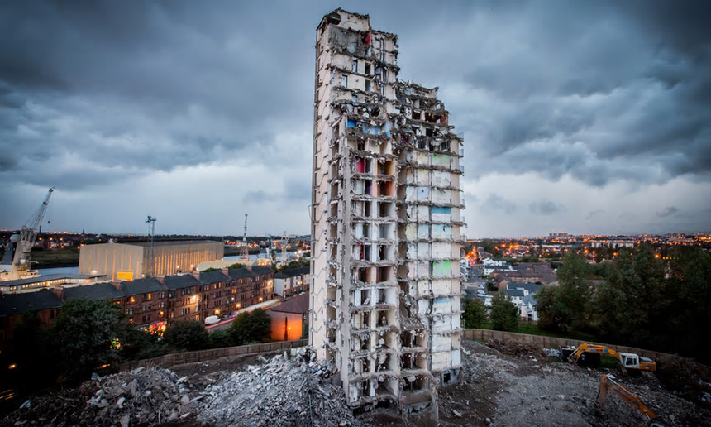
Plean St, Yoker “Towers of Terror”
“You were embarrassed to say you came from Plean Street – we were all classed as junkies”

Slide 52
Whitevale & Bluevale The highest flats in Scotland
On construction in 1969 they were dubbed “Mansions in the sky” however this soon changed. Billy who lived on the 20th floor states “As soon as one dealer moved in that was the start of the end. With no concierge, people were free to come and go as they pleased. They were shooting up on the stairs, the families living here all wanted out and when other dealers moved in, it was beyond anyone’s control”
Notes:
View from the red road

Slide 53
Effectiveness of management strategies
New Towns
New towns such as East Kilbride have grown since the 1960’s as it offers quieter, less hectic environment but is also an excellent location for commuters as its 25 minutes from Glasgow’s CBD. ✓
Due to the greenbelt land around the town and the financial incentives given, many foreign companies set up in business parks on the outskirts, which provided well paid employment for residents. ✓

Slide 55
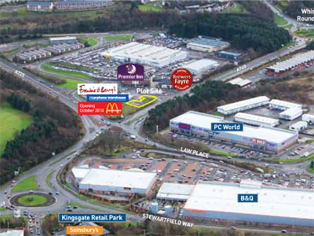

Slide 56
Effectiveness of management strategies
Tenement Renovations
This strategy was successful as communities were kept together increasing community spirit. Tenement areas in Partick and Denniston are now popular with students and young professionals and are seen as desirable places to live. ✓
However, some areas such as The Oatlands and Dalmarnock failed after refurbishment. The areas were rife with drugs and crime. Some tenements were demolished and the land was sold to private house builders in 2005 for £1. ✓
Notes:
Oatlands - 1978

Slide 57
Notes:
Partick today

Slide 59
Notes:
Oatlands empty/derelict

Slide 60
Notes:
Now owned by private builder

Slide 61
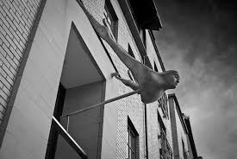
Effectiveness of management strategies
Crown St. Regeneration (Gorbals)
Crown Street was seen as a success as the council and developers worked with the local people which gave them a sense of ownership of the area. Murals and artwork on buildings depicting local history were by local artists. ✓

Slide 62
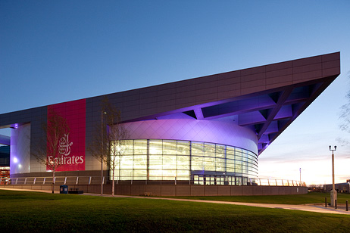
Effectiveness of management strategies
Athlete’s Village
It is anticipated that the quality of life of residents will improve as houses are modern and have outdoor space. Also, leisure facilities such as the Emirates Arena are close-by, encouraging people to live a healthy lifestyle ✓

Slide 63
Past Paper Question
For a developed world city you have studied, evaluate the effectiveness of recent housing management strategies
5 marks

Slide 64
Plenary
Without looking at your notes write a developed point, evaluating the effectiveness of either:
The Athlete’s Village
Tenement renovations

Slide 65
Videos/Documentaries
Commonwealth City: Episode 1
Episode 2
Episode 3
Jaconelli Eviction
The Jaconelli’s 18 months later
Memories of the Oatlands: A Short film

