Slide 1
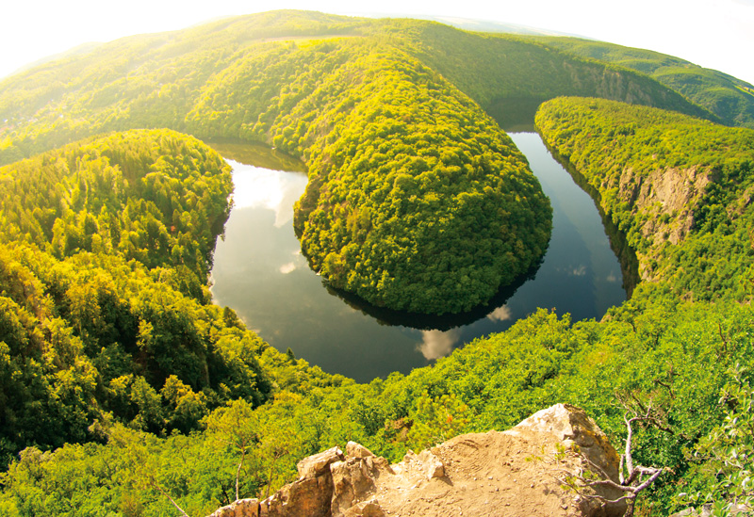
River Basin Management
Higher Geography

Slide 2
Structure of unit:
Characteristics of the Colorado River Basin
Need for water management
Dam site selection
Consequences of water control projects

Slide 3
Consequences of water control projects
Learning intentions:
We are learning to explain the consequences of water control projects.
Success Criteria:
I can categorise the positive and negative impacts of water control projects
I can formulate an answer to an exam question on the social, economic and environmental consequences of water control projects.

Slide 4
Starter
In groups, come up with a possible consequence of water control projects under each of the following:
Social
Economic
Environmental.

Slide 5
Social Consequences - Positive
Large cities such as LA, LV and Phoenix are provided with a fresh water supply. Phoenix is supplied water from the Central Arizona Project
People in the basin area enjoy a better standard of living as they are able to use air conditioning due to cheap HEP. Also, many people have swimming pools can landscape their gardens.
Areas such as Lake Mead provide opportunities for tourism, water sports & fishing. There are 6 marinas found on Lake Mead alone.

Slide 6
Social Consequences - Positive
The Imperial Valley is the largest area of irrigated land in the USA, often referred to as the ‘Salad Bowl’. Irrigation allows the possibility of food surpluses, double cropping, growing cash crops and increasing yields.
The risk of flooding has reduced in areas which are downstream due to the possibility of flood control. Peoples’ homes are no longer at risk of flood damage.

Slide 7
Social Consequences – Negative
Disagreements arise between US states and Mexico due to the allocation of water. Mexico is often disadvantaged as large volumes of water are removed from the river before it reaches the Mexican border.
Many people and farmers have been moved off of their land so valleys can be flooded. Also, there has been a loss of ancient burial sites and other Native American sacred areas.

Slide 8
Economic Consequences – Positive
Many high tech industries have been attracted to areas such as Phoenix, Arizona, in turn bringing well-paid jobs
Industries such as aluminium mining in California rely on the water and the cheap power available from water control projects
Farmers are able to grow high value citrus crops due to the cheap availability of water for irrigation, therefore they are making a greater profit

Slide 9
Economic Consequences – Positive
Tourism is a huge earner. Desert cities such as Las Vegas attract people from all over the USA and the world bringing money to the area
Millions of people are attracted to water sports on the reservoirs and 700,000 people visit the Hoover Dam every year

Slide 10
Economic Consequences – Negative
Silting of the reservoirs greatly reduces their capacity. It costs huge amounts of money to dredge the reservoirs so that capacity can be maintained.
Loss of silt downstream means that farmers now need to apply expensive fertilisers to land that was previously supplied with river deposits to keep it fertile.

Slide 11
Economic Consequences – Negative
High evaporation rates lead to increased salinity. This means that the HEP turbines have a shortened lifespan. The yield of crops decreases as the salinity of the land increases with evaporation bringing salts to the surface. The total cost of salination is estimated at $113 million a year.

Slide 12
Environmental Consequences – Positive
New habitats for wildlife have been created - 250 species of birds have been spotted in Lake Mead National Park. Species such as the egret and blue heron have thrived on the new lakes.
Flood control means that the areas downstream now do not live under constant flood danger. HEP is clean electricity from a renewable source and does not contribute to the greenhouse effect.

Slide 13
Environmental Consequences – Negative
Rainbow Bridge, an important geological site is being slowly destroyed. Many plants and animals were lost as the lakes flooded. Beavers for example disappeared from Tucson as the rivers dried up.
Increased evaporation rates means that lots of water is lost every year, Lake Powell loses 0.74 km³ annually. Seepage is a major problem with Lake Powell losing 300 km³ annually.

Slide 14
Exam question – answer the following question:
Referring to a water control project you have studied, discuss the positive and negative environmental impacts created by the construction of a major dam and its associated reservoir.
(4 marks)

Slide 15
The perfect answer

Slide 16
Plenary
Without using your notes
Write

