Slide 1
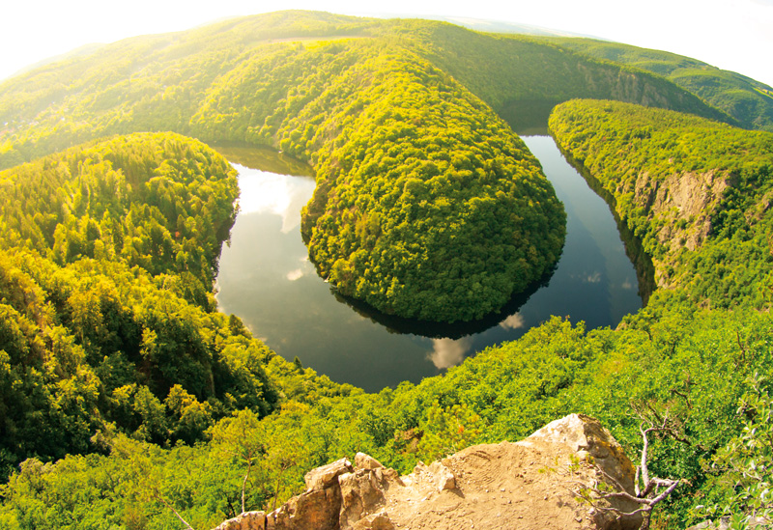
River Basin Management
Higher Geography

Slide 2
Structure of unit:
Characteristics of the Colorado River Basin
Need for water management
Dam site selection
Consequences of water control projects

Slide 3
Dam Site selection
Learning intentions:
We are learning about the factors that need to be considered when selecting a suitable site for the construction of a dam.
Success Criteria:
I can explain the human and physical factors that need to be considered when constructing a dam.

Slide 4
Starter
Write down two factors that you think may need to be considered when constructing a dam.

Slide 5
Considerations when constructing a dam
Many factors are considered when selecting a suitable site for dam construction.
In geography we split these factors into 2 categories: human factors and physical factors.

Slide 6
Human Factors
A site which is close to construction materials would help to reduce the cost of transporting these materials to the construction site.
A site close to areas of farmland or urban areas would help to reduce water/electrical loss during transportation

Slide 7
Human Factors
The costs involved in moving people who live in the area to be flooded, to reduce costs for compensation and re-housing.
The land which is to be flooded should not be valuable, for example high quality farmland or of historic/environmental importance.

Slide 8
Physical Factors
Narrow cross section of the valley is required in order to reduce construction costs of the dam.
A deep valley is required behind the dam as this will result in a smaller surface area for the reservoir, thereby reduce loss from evaporation.

Slide 9
Physical Factors
A site which has impermeable rock would be advantageous as this would reduce loss from the reservoir by percolation.
An area free from earthquakes or subsidence is needed as the area needs to be able to support the weight of a large dam.
An area with plentiful supply of snowmelt/rainfall/river water is required to ensure a consistently high volume of water in the reservoir.

Slide 10
Exam question – answer the following question: Explain the human and physical factors which need to be considered when selecting a site for a major dam and its associated reservoir. (10 marks)

Slide 11
The perfect answer
Narrow cross section of the valley is required in order to reduce construction costs of the dam (1 mark).
A deep valley is required behind the dam as this will result in a smaller surface area for the reservoir, thereby reduce loss from evaporation (1 mark).
A site which has impermeable rock would be advantageous as this would reduce loss from the reservoir by percolation (1 mark).
A site which is close to construction materials would help to reduce the cost of transporting these materials to the construction site (1 mark).

Slide 12
The perfect answer
An area free from earthquakes or subsidence is needed as the area needs to be able to support the weight of a large dam (1 mark).
A site close to areas of farmland or urban areas would help to reduce water/electrical loss during transportation (1 mark).
The costs involved in moving people who live in the area to be flooded, to reduce costs for compensation and re-housing (1 mark).

Slide 13
The perfect answer
The land which is to be flooded should not be valuable, for example high quality farmland or of historic/environmental importance (1 mark).
An area with plentiful supply of snowmelt/rainfall/river water is required to ensure a consistently high volume of water in the reservoir (1 mark)

Slide 14
Plenary
Without using your notes
Write down 2 human and 2 physical factors to consider when building a dam

