Slide 1
River Basin Management
Higher Geography

Slide 2
Structure of unit:
Characteristics of the Colorado River Basin
Need for water management
Dam site selection
Consequences of water control projects

Slide 3
Need for water management
Learning intentions:
We are learning about the need for water management.
Success Criteria:
I can explain the need for water management in an area I have not studied by making use of maps, diagrams etc.

Slide 4
Starter
Discuss with a partner possible reasons for the need for water management in the Colorado basin

Slide 5
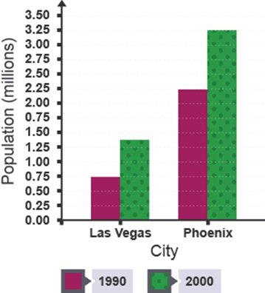
The need for water management in the Colorado river basin
There is more demand for water for use in homes as population is rapidly increasing in major cities such as Los Angeles, Las Vegas and Phoenix.
Phoenix population increased by 1 million in between 1990 and 2000.

Slide 6
The need for water management in the Colorado river basin
There is a low annual rainfall and rainfall is often unreliable.
Water management allows the transfer of water from water surplus areas to water deficit areas by means of aquaducts, canals and rivers.
Sudden increases river flow from seasonal precipitation or snow melt can lead to flooding in urban and agricultural areas.
Dams can be used to regulate river flows.

Slide 7
The need for water management in the Colorado river basin
Provides irrigation for farmland within the basin e.g. Arizona allowing economic growth and providing many jobs
The energy produced in the Hydro-Electric power stations within the basin can be used to power large cities in the area such as Las Vegas.
Energy could also be exported to other countries for profit.

Slide 8
The need for water management developing countries e.g. India
Can help to improve sanitation as people are provided with clean water resulting in less people being affected by cholera.
Textile industries, which are popular in India/Bangladesh use large amounts of water to produce goods, dye fabric and power machines therefore they need access to a reliable water source to produce goods.

Slide 9
The need for water management developing countries e.g. India
Many people living in developing countries don’t have access to electricity therefore Hydroelectric Power generated from water management schemes can help to provide this at an affordable price.
Rice is a major source of food in developing countries e.g. China and is always exported all across the world for profit.
Rice farming requires irrigation as rice grows in flooded padi fields.
Water management schemes allow irrigation of fields and increase employment & boost the economy.

Slide 10
Regulates flow
Rapid population growth
Increased demand for water
Improves navigation potential
Hydroelectric power
Concentration of water demand
Urbanisation
Access to electricity
Need for water management
Need for irrigation schemes
Reliance on agriculture
Generate power for industry, farms and urban communities
Unreliable rainfall
Dams used to contain/regulate flow
Higher consumption
High rainfall
Low rainfall
Change in food habits toward ‘richer’ diets
Risk of floods
Drought/famine

Slide 11
Task – Refer to the additional sheet.
Study Map Q5A, Map Q5B, Diagram Q5A, Diagram Q5B, and Diagram Q5C.
Explain why there is a need for water management in the Karnafuli River Basin.

Slide 12
Perfect Answer:
Population increase of almost 50 million for country in last 20 years would require additional water for domestic use (1 mark).
Irrigation is required for rice production to feed the population or for export (1 mark).
Textile industries use large volumes of water therefore a reliable year round supply is required (1 mark).
Due to the monsoon climate a lack of rainfall in Nov – March increases the need for water to be stored to allow use during the dry period (1 mark).
The heavy monsoon rainfall of up to 800mm of rain in the month of July means there is a requirement to prevent flooding (1 mark).
The city of Chittagong has a population of 7·5 million and is situated on the banks of the river; this increases the need for flood prevention (1 mark).
Only 62% of the country has access to electricity, HEP from the dam could be used to improve this (1 mark).
Excess energy produced could be exported to neighbouring countries such as India (1 mark).
Improved sanitation means that far less of the population will be at risk from diseases such as cholera (1 mark).

Slide 13
Plenary
Without using your notes
Write down 5 Reasons for the need for water management

