Slide 1
Starter
In your groups, come up with a solution to land degradation in the Sahel.
How would it help?
What would it cost?
Why may it not work?

Slide 2
Lesson 4-5: Solutions to land degradation and their effectiveness
Learning intention: We are learning about the solutions to land degradation on a semi-arid area.
Success criteria
I can suggest solutions to land degradation in the Sahel.
I can evaluate the solutions to land degradation in the Sahel.

Slide 3
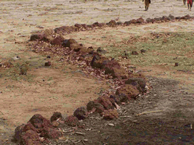
Solution 1 - Diguettes
Diguettes are lines of stones laid along the contours of gently sloping farmland to catch rain water and reduce soil erosion.
They allow water to seep into the soil rather than run off the land through overland flow.
This prevents soil from being washed away and can double to yield of crops such as groundnuts.

Slide 4
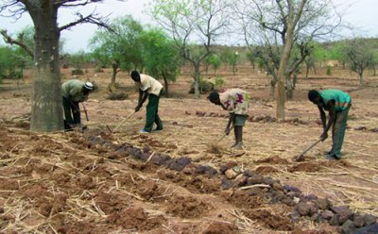
Solution 1 - Diguettes
Effectiveness:
It can be completed as part of a community project at very little cost.
Charities such as Oxfam have used this method very effectively.
Communities in Mali and Burkina Faso have seen crop yields increase by as much as 50%.

Slide 5
Solution 2 – Managing grazing areas
Research and tests have shown that grasses are able to re-establish themselves very quickly given an undisturbed fallow period in which to recover (1-2 years).
Therefore if areas are fenced off from grazing animals such as sheep and goats on a rotational basis it is possible to sustain the herds without long term damage to the soil.
One area is fenced off in order for it to recover.
This reduces over grazing and trampling to the soil.

Slide 6
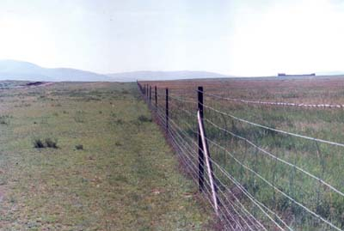
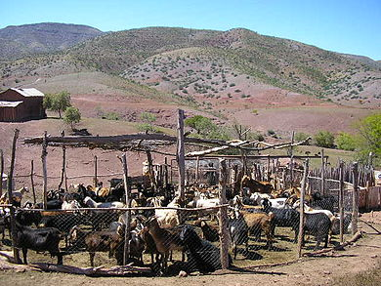

Slide 7
Solution 2 – Managing grazing areas
Effectiveness:
The main disadvantage of this method is the cost of fencing and the management of the grazing areas e.g. in Korr, northern Kenya.
Herders harvest woody thorn materials mainly for construction of livestock enclosures to secure their livestock.
But this process has led to destruction of whole woodlands within the vicinity of settlement areas and along the routes of livestock movement, leaving some herders with no food supply for their animals.

Slide 8
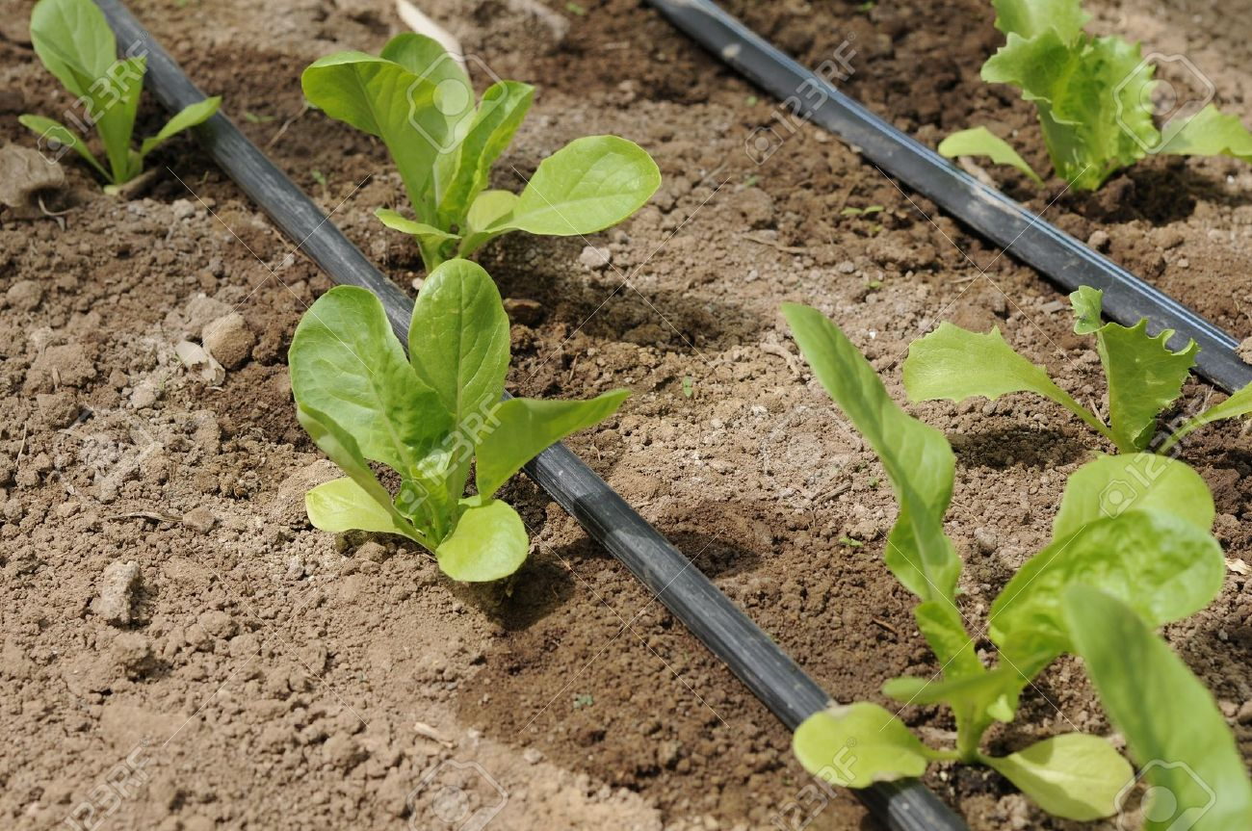
Solution 3 - Education
Farmers are educated to use more appropriate techniques such as terracing, strip cropping and drip irrigation.
This helps avoid draining the soil of its nutrients and avoiding salinisation.
Drip irrigation, is an irrigation method that saves water and fertilizer by allowing water to drip slowly to the roots of plants, either onto the soil surface or directly onto the root zone, through a network of valves, pipes, tubing, and emitters.

Slide 9
Solution 3 - Education
Effectiveness:
This can be expensive unless funded by charities, and are often more difficult to implement and manage, resulting in few farmers willing to change their practice.
However, if successful, farmers can pass on their new knowledge to their children which does not cost anything and prevents them from using degrading practices.

Slide 10
Solution 4 – Fuel efficient stoves
The development of stoves like the Jiko, which is cheap and uses approximately half the quantity of fuelwood required by an open fire, can play a part in reducing rural land degradation.
If these stoves are used, the demand for fuelwood is reduced and trees will be retained for longer.

Slide 11
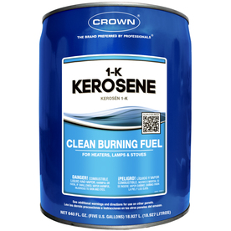
Solution 4 – Fuel efficient stoves
Effectiveness:
This technique can be particularly effective in areas where the cost of alternative fuels such as Kerosene, are beyond the means of local people.

Slide 12
Solution 5 – Reducing herd size
Reducing the number of cattle, sheep and goats and focusing on the quality rather than the quantity of the herds, decreases grazing pressure on the land.
It also reduces the impact of soil compaction which causes increased overland flow and reduced infiltration.
Effectiveness:
This is a very culturally sensitive issue as traditionally the size of the herd is often a measure of an individual’s status within his tribe and therefore herders may be resistant to change.

Slide 13
Solution 6 - Afforestation
Planting new trees helps prevent soil erosion as the roots will bind the soil together and will also act as a windbreak, reducing wind erosion.
In parts of West Africa, the Kad tree, a variety of Acacia has been used in an attempt to restore the soil fertility and productivity.
Kad is good because it retains its leaves in the dry seasons so providing shade, and it fixes nitrogen in the soil, thus raising fertility and productivity.

Slide 14
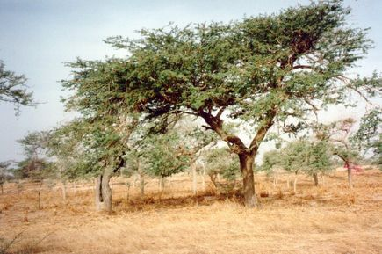
Solution 6 - Afforestation
This scheme has other benefits - depending on the species planted trees may also provide nuts and fruit for humans and animals.
The Kad tree’s decaying leaf litter provides an addition source of nutrients.

Slide 15
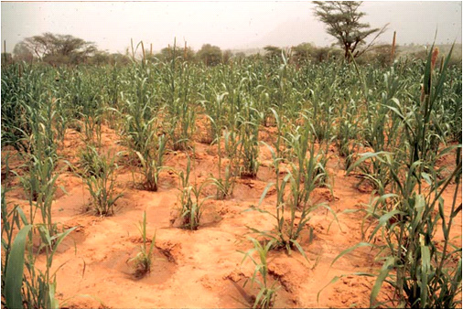
Solution 7 – Planting pits / Zai
Farmers dig a grid of planting pits.
Run-off water is trapped in the hole, then manure or compost is added to the hole.
Termites are attracted and they dig galleries that make the infiltration of rainwater, run-off and the retention of moisture easier.

Slide 16
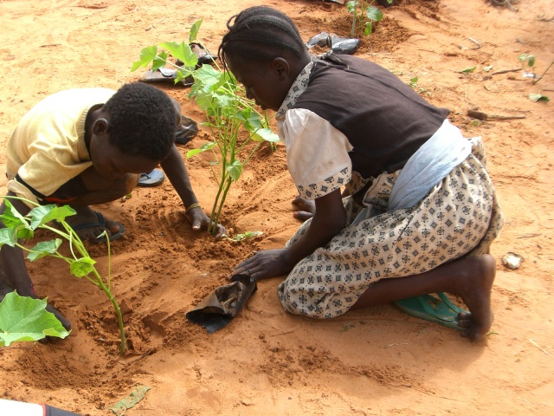
Solution 7 – Planting pits / Zai
Effectiveness:
Zai is a simple technique which needs no equipment other than what is available on the land.
Zai are usually constructed on abandoned or unused ground, so crop yields resulting from this practice bring a benefit of 100%.
https://www.youtube.com/watch?v=x28NpUZjmN8

Slide 17
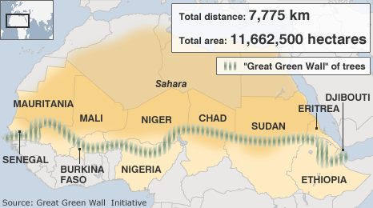
Solution 8 – Great Green Wall
The Great Green Wall is an initiative in the Sahel where a wall of trees is planted across Africa on the edge of the Sahara desert in order to prevent desertification.
It is nearly 8000km long and stretches from the west to the east coast.

Slide 18
Solution 8 – Great Green Wall
Effectiveness
Other than stopping desertification and erosion, the wall would protect water sources, such as Lake Chad, which has been drying up for decades, and restore or create habitats for biodiversity.
The wall would provide energy resources; fruit, vegetables and other foodstuffs; support local economic development; and even political stability in the whole region.
It is simply growing trees, but growing solutions and opportunities, resilience to climate change, green jobs that provide a suitable income for African women and youth food security among others.
Some people claim there are ownership issues with the Green Wall, and since it is run from the top down and depends on external management and external funds, it may not be possible to run it smoothly.
The cost has been criticised and is therefore out the reach of many developing nations.

Slide 19
Videos
Great Green Wall 1
Great Green Wall 2
You may wish to take notes.
Notes:
Video 1 – 4.24mins
Video 2 – 5.59mins

Slide 20
Task
Suggest the techniques used to combat rural land degradation in a named rainforest or semi-arid area you have studied. (10)
Evaluate the methods used to conserve soils in a semi-arid area, commenting on their effectiveness. (10)
Write these as a mind map or as perfect answers.

Slide 21
Homework
1. Explain how human activities such as inappropriate farming techniques have caused land degradation in a rainforest or a semi-arid area. (5)
2. a) Suggest the techniques used to combat rural land degradation in a named rainforest or semi-arid area you have studied. (5)
b) Evaluate the methods used to conserve soils in a rainforest or a semi-arid area, commenting on their effectiveness. (5)

Slide 22
Success criteria
I can suggest solutions to land degradation in the Sahel.
I can evaluate the solutions to land degradation in the Sahel.

Slide 23
Plenary
What must you do in an “Evaluate” question?

