Slide 1
Starter
Write down 3 things YOU can do to help reduce climate change.

Slide 2
Solutions to Climate Change
Learning Intention
We are learning about the solutions to manage and reduce climate change
Success criteria
I can give examples of ways the effects of climate change can be managed
I can give examples of the ways climate change can be reduced
I can evaluate the effectiveness of solutions to manage and reduce climate change

Slide 3
Exam Question
1. Suggest ways to:
(i) reduce the emissions of greenhouse gases;
(ii) manage the local effects of climate change.
6 marks
2. Evaluate the effectiveness of the strategies used to:
(i) reduce the emissions of greenhouse gases;
(ii) manage the local effects of climate change.
6 marks

Slide 4
Table – page
KEY:
WAYS TO MANAGE
WAYS TO REDUCE

Slide 5
Solution 1: Renewable Energy
Explanation:
Wind, solar, hydroelectric power and geothermal energy reduces the reliance on and usage of fossil fuels. These greener sources of energy do not produce harmful emissions and therefore reduces the levels of C02 in the atmosphere.
Evaluate:
Alternative energies are expensive to develop and operate and are therefore not a practical solution for large, debt stricken countries such as India. As technology develops, and the price decreases, their effectiveness and use around the world will increase.
Scotland is making progress towards green energy targets. At the end of 2014 it was reported that renewable sources of energy were providing 30% more power and meeting almost 50% of the demand in the country, thus reducing greenhouse emissions.

Slide 6
Example
Iceland uses 100% renewable energy – 25% of that energy comes from geothermal energy and 74% comes from Hydro electric power.

Slide 7
Solution 2: Reduce reliance on cars
Explanation:
Use public transport, car pooling or cycling. Schemes such as ‘cycle to work scheme’ have been launched by local councils e.g. Glasgow City Council, to encourage people to use greener methods of transport
Evaluate:
Many people are unwilling to reduce the use of their car because it is more convenient for them and may not be able to car pool if no one is going in the same direction as them so will continue to use their own car.

Slide 8
NextBike scheme
Glasgow has introduced 435 bikes at 35 stations across Glasgow. The scheme encourages people to use the alternative method of transport instead of the car which reduces the amount of fossil fuels being used. It also encourages a healthy lifestyle.
The scheme has been incredibly successful and is used by both locals and visitors. It is now the third biggest cycle scheme in the UK. The scheme now has 700 bike and 70 stations, and is available in more areas throughout the city.

Slide 9
Solution 3: Consume less
Explanation:
Consumers are encouraged to consume less to conserve resources and energy. Pollution is produced at each stage of the consumerist process and by consuming less greenhouse gas emissions are reduced. Re-using plastic bags is one such example.
Evaluate:
The carrier bag charge has been extremely successful – retailers report that plastic bag usage has dropped between 80 – 90%, has raised thousands of pounds for charities, and less are being deposited in landfill reducing methane.

Slide 10
Solution 4: Insulate your home
Explanation:
Insulation helps reduce the amount of energy which is used keeping the house warm which results in less fossil fuels being used. Insulation can reduce bills by £300 per year. Governments have introduced schemes to allow people to get insulation for free.
Evaluate:

Slide 11
Solution 5: Flood Prevention
Explanation:
The Thames Barrier in London was built in 1984 to manage the effects of extreme weather events. It provides protection from a ‘1 in 1000 year’ flood event.
Evaluate:
Has successfully protected London from many flood events but a second barrier is needed to cope with the flooding, and advance warning systems may need to be put in place to advice people on potential flooding.

Slide 12
Solution 6: Desalinisation
Explanation:
The London Desalinisation plant takes in sea water, evaporates the salt and produces fresh water in times when there is a shortage of fresh, drinking water.
Evaluate:
This is very expensive to operate and as a result is only used in periods of extreme drought. However, as drought is increasing it may need be used more often.

Slide 13
Solution 7: Hosepipe Bans
Explanation:
Drought is becoming more of a threat as a result of increasing temperatures bringing long spells of weather. This has been managed with the implementation of hosepipe bans in many parts of England meaning water is conserved rather than wasted.
Evaluate:
These bans are very unpopular and are difficult to enforce so many people continue to use their hosepipes & water when they want.

Slide 14
Solution 8: Kyoto Protocol
Explanation:
The Kyoto Protocol is an international treaty that sets binding obligations on industrialised countries to reduce emissions of greenhouse gases by 5% between 2008 and 2012. 191 countries agreed to the treaty in 1997.
Evaluate:
Although the USA signed, they did not endorse the policy. Canada withdrew in 2011. Overall the treaty has been unsuccessful as many industrialised countries have refused to cut their greenhouse gas emissions.

Slide 15
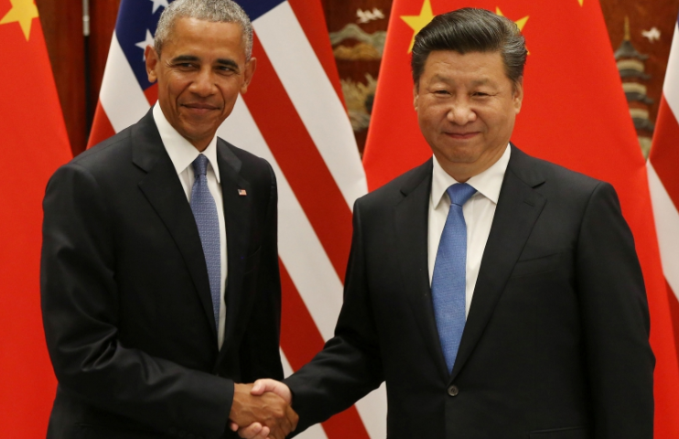
2016/17 update
In September 2016 more than 170 countries agreed to drastically reduce carbon emissions in the Paris Agreement, in order to reduce temperature increases. China promised to invest $361bn in renewable energy.

Slide 16
“Where there is a will and there is a vision and where countries like China and the United States are prepared to show leadership and to lead by example, it is possible for us to create a world that is more secure, more prosperous and more free than the one that was left for us” – Obama.
The EU has promised to cut emissions by 40% by 2030 on 1990 levels, and the US by up to 28% by 2025 compared with 2005.

Slide 17
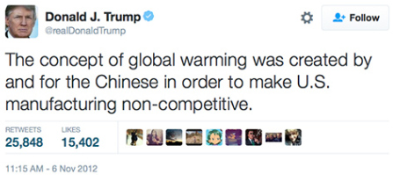
However President Trump has threatened to pull out of the agreement, saying that Climate change is a Chinese hoax.
He also wants to revive the coal industry and roll back federal environmental regulations.
If Trump follows through, scientists say it could have a profound long-term effect on the planet.

Slide 18
The History of Climate Change Negotiations in 83 seconds
Plenary
This video is an effective way of summarising the way nations interact when trying to agree on reducing their greenhouse gas emissions.

Slide 19
Solutions and evaluations
There are many solutions to climate change and these have varying degrees of success.
A first solution to climate change is….
This is effective/not effective because…

