Slide 1
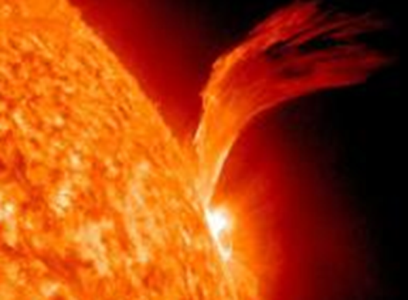
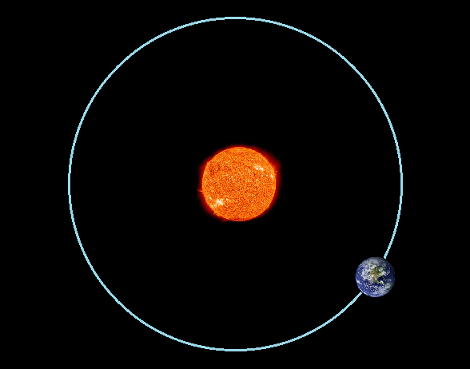
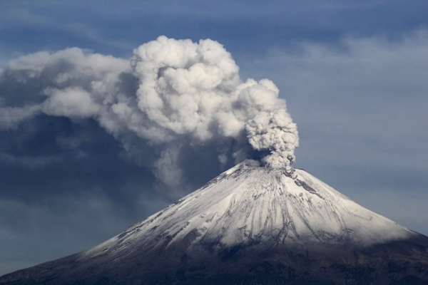
Starter
How do you think the things in the photographs lead to changes in the climate?

Slide 2
Physical Causes of Climate Change
Learning Intention
We are learning about the physical causes of climate change
Success criteria
I can explain the physical causes of climate change
I can work well as part of a group

Slide 3
1. Variations in solar activity
We do not always receive the same amount of heat from the sun.
At times, the sun has ‘sun spots’ these are hotter points than usual.
Scientists at Cardiff University have shown that low sun spot activity corresponds with colder ocean currents.

Slide 4
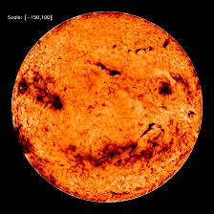

Slide 5
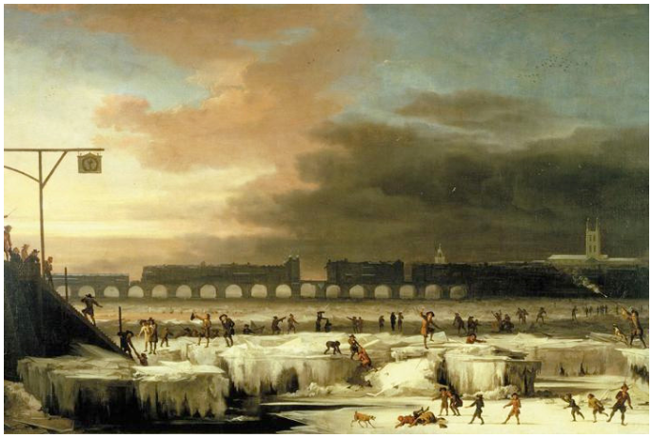
Reduction in sun spots
Between 16745-1700 there was a reduction in sunspots. There were only 50 sunspots instead of 40-50,000. A similar ice age is expected in 2030-2040.

Slide 6
2. Croll-Milankovitch theory (stretch, wobble and roll)
The earth is tilted as it spins around the sun
The Earth also orbits the sun in different ways.
This affects how much of the suns rays reach the earth.
The orbital shape changes from being a near perfect circle, to an elliptical shape.
When the orbit is most elliptical, the Earth is further away from the Sun during winter, so winters are longer and colder.
Video

Slide 8
3. Volcanic eruptions
When volcanoes erupt they release sulphur gas, this in the long term heats up the earth.
However, in the short term the ash/smoke block out the suns rays and temporarily cool the earth.
There have been many eruptions over the years that have decreased global temperatures, including Mt St Helens (1980), Mount Hekla (1980) and Mt Pinatubo (1991).
Video

Slide 10
4. Plate tectonics
As the continents move, they affect the world’s climate.
Many continents near poles – ice sheets form – earth cools quickly
When there are many continents near the Equator the opposite is true.
Plate tectonics are also responsible for folding the land from sea beds, up to mountain ranges.
With this increase in altitude, comes a lower temperature.

Slide 11
5. Ocean currents
The ocean helps to transfer heat energy around the world.
The ocean currents flowing from the tropics to the poles transfer warm water and vice versa; this affects the climate of countries all over the world.
Ocean currents change direction and they can also become stronger or weaker.
When they do this they change the climates of the places they flow past.

Slide 12
North Atlantic drift – (Jet stream)

Slide 13
North Atlantic Drift
Brings warm water from the tropics to the UK
Affects the west coast of the UK most, makes our winters 5˚C warmer.
11,000 years ago the current stopped causing an ice age
There is evidence it has been slowing down in the last 50 years…

Slide 14
What would the effect on the UK be if the North Atlantic Drift stopped completely?
https://www.youtube.com/watch?v=hzCvY0ENrhk

Slide 15
6. Ice sheets melting
More fresh water entering oceans affects ocean currents.
Albedo effect is reduced – as there are less reflective surfaces (less white ice, more dark land) the suns rays are absorbed more, increasing the temperature.

Slide 16
7. Melting permafrost
Permafrost = permanently frozen ground
When permafrost melts, decaying organic matter (plants, animals) release methane and carbon dioxide.
This increases global temperatures. https://www.youtube.com/watch?v=FLCgybStZ4g

Slide 17
How many physical causes of climate change can you name?

Slide 18
Past Paper Question
In groups, create a ‘perfect answer’ to:
Explain the physical factors affecting climate change.
8 marks
You must be prepared to share with the class!

Slide 19
Explain the physical factors affecting climate change.
8 marks

Slide 20
Perfect answer
Dust and ash released after major volcanic eruptions can block incoming solar radiation leading to a global cooling. ✓ After the 1991 eruption of Mount Pinatubo temperatures were reduced by 0.5ºC ✓
Increase in sunspot activity leads to above-average solar radiation reaching Earth, leading to periods of above-average temperatures. ✓ Scientists at Cardiff University have shown that low sun spot activity corresponds with colder ocean currents. ✓
Changes in the Earth’s orbit, linked to Milankovitch cycles, lead to variations in Earth’s distance from the sun and the tilt of the axis. These factors occur on regular cycles and are linked to periods of change in average temperatures. ✓ When the earth is closest to the sun it increases global temperatures. ✓

Slide 21
Perfect answer
Diminishing ice cap coverage lowers global albedo rates and therefore loss of solar radiation, ✓ increasing global temperatures. ✓
In Tundra regions, rotting vegetation and/or a thawing of the permafrost has led to the release of methane into the atmosphere. ✓ Methane is a powerful greenhouse gas and traps solar radiation in the atmosphere, warming the planet. ✓

Slide 22
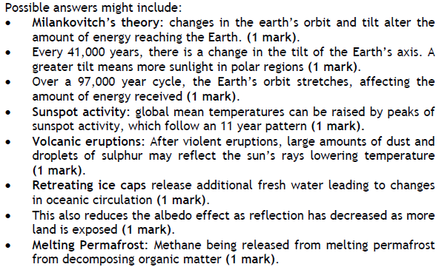

Slide 23
Success Criteria
I can suggest the physical causes of climate change.
I can explain the physical causes of climate change.

Slide 24
Plenary - What’s wrong with this answer?
Lots of things cause climate change. When volcanoes go off they put lots of ash into the sky and this stops the heating coming in so temperature goes down.
Ocean currents can stop warm water moving.
Milankovitch theory says that the earth can change its orbit every 100,000 – 413,000 years so when it is further away from the sun, the earth gets colder.
The sun gives off extra heat and then makes us warmer.
The albedo effect and permafrost melting also cause climate change.

