Slide 1
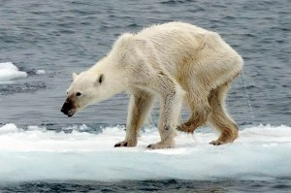
Climate change
Higher Geography

Slide 2
Structure of unit:
Evidence of Climate Change
Causes of Climate
Effects of Climate Change
Solutions to Climate Change

Slide 3
Introduction to Climate Change
Learning intentions:
We are learning about climate change.
Success Criteria:
I can give evidence that the climate is changing.

Slide 4
Starter
Work in pairs – write down everything you know about the following under these headings
Evidence of climate change
Causes of climate change
Effects of climate change
Solutions to reduce/manage climate change

Slide 5
Major World Issue
Climate change is not a new phenomenon..
However, the speed of change in recent years is alarming!
This is ultimately down to human activity & the impact it has on the earth’s climate.

Slide 6
Copy the definitions:
GLOBAL WARMING: the name given to the trend that average global temperature is increasing.
CLIMATE CHANGE: the name given to significant changes in weather patterns over a long period of time.

Slide 7
BBC Report
“highlights major impacts across all continents and oceans”

Slide 8
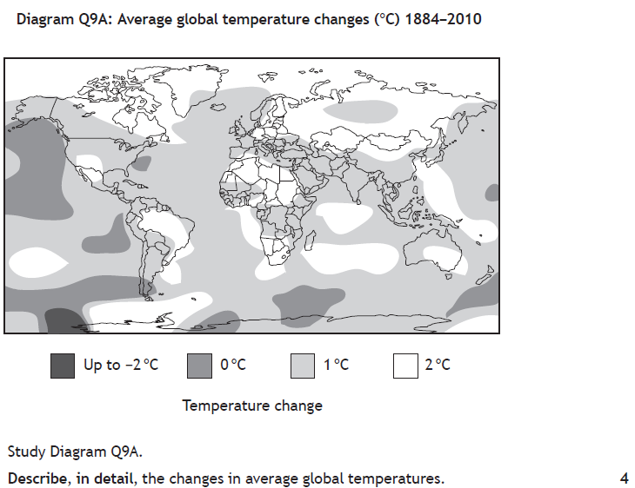

Slide 9
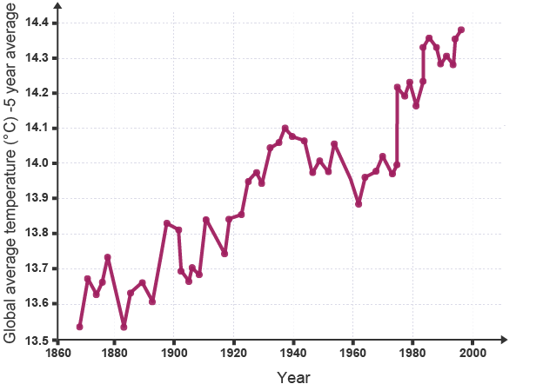
Is the Climate Changing?
For the last 10,000 years average global temperatures have been around 14˚C.
However in the last 100 years our climate has started to change, as the graph shows.
Increases in temperatures have been recorded on land and in the oceans.

Slide 10
Is the Climate changing?
Land and ocean temperatures have increased by 0.85°C between 1880-2012
Each of the last 3 decades has been warmer than the last.
Sea levels have increased across the globe
Snow and ice on mountain tops have diminished.
1983-2012 was the warmest 30 year period of the last 1400 years!

Slide 11
Evidence showing the climate has changed
INFO
INFO
GEOLOGY
Notes:
NOTES SHOULD BE MINIMAL/NO LONG SENTENCES

Slide 12
1. Geology
The presence of certain rock deposits indicate the environment which the rock was formed in.
Therefore, if sandstone is found in the UK it shows the climate here used to be very different than it is now.
Type of rock | Environment suitable
Coal | Tropical rainforest with lots of rain
Limestone | Tropical waters
Glacial till | Cold environment
Sandstone | Very hot desert

Slide 13
Red sandstone cliffs, Landram Bay, Sidmouth (near Devon)

Slide 14
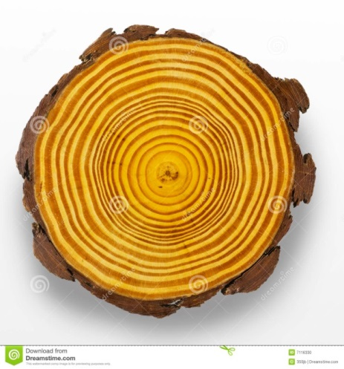
2. Dendrochronology
This is the study of growth rings of trees
Each ring represents one year’s growth.
Thick rings show a warmer climate as the tree had a longer growing period.
Thin rings show colder periods as the tree did not grow much that year.

Slide 15
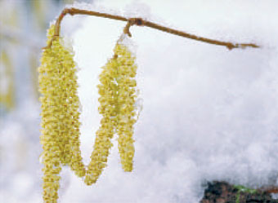
3. Pollen Analysis
Most plant species have distinctive shaped pollen grains.
If these collect in an oxygen free environment such as a peat bog, they do not decay and analysis will provide an idea of the type and extent of vegetation that once grew in an area.
This in turn provides information about the climate.

Slide 16
4. Glacial retreat
Photographs, satellite images and staking the changing position of the terminus, or snout, at the end of a glacier show that many mountain glaciers have retreated in the last 50 years.
However, this could partly be due to a lack of snowfall as well as glacial melting.
Example: Boulder Glacier, Montana, USA

Slide 18
5. Ice core analysis
Air trapped inside ice can show what the atmospheric conditions were like millions of years ago.
Scientists dig deep into ice in the Arctic/Antarctic & can analyse the layers of the ice to find out what gases and chemicals were in the air years ago.
This gives long-term evidence of climate change
Video

Slide 20
6. Sea coral
Coral reefs can only grow and survive when they have adequate sunlight & are underwater.
In recent years some coral reefs have been found under deep water where there is not enough sunlight showing the water used to be shallower.
Some coral is bleached by increased ocean temperatures and pollutants.

Slide 23
Past Paper Question - Pairs
Give evidence to show that the climate is changing.
6 marks
Person 1
Coral
Dendrochronology
Historical Records
Person 2
Ice core analysis
Pollen analysis
Geology

Slide 24
Perfect Answer
There are many indications that the climate is changing.
Firstly, rock deposits give information about the climate it was formed in. ✓ Sandstone is usually found in very hot desert areas however there is evidence of sandstone in the UK e.g. Cliffs in Sidmouth, England. ✓ This shows the climate was once hot and dry. ✓
Also, tree ring analysis shows changes in climate. ✓ Thicker rings indicate warmer periods as they show the tree had a longer growing season whereas thin rings show colder periods and shorter growing seasons. ✓
Pollen grains can become trapped in peat bog under anaerobic conditions. ✓ Scientists can analyse these and understand the extent and type of vegetation that was once present in an area. ✓

Slide 25
Perfect Answer
Historical records such as photographs and sketches of glaciers can indicate that the climate is changing ✓. Photographs of glaciers from decades ago can be compared to more recent photographs showing glacial retreat e.g. Boulder glacier, Montana ✓
Sea coral also indicates changes in the climate. ✓ Coral grows in shallow waters which are exposed to direct sunlight. However, recently coral has been found in much deeper waters where little sunlight can reach, indicating sea level rises due to melting ice. ✓
Lastly, air trapped inside ice can show what the atmospheric conditions were like millions of years ago. ✓ Scientists dig deep into ice in the Arctic/Antarctic & analyse the layers of the ice to find out what gases and chemicals were in the air years ago as these can give an idea of what the climate was like. ✓

Slide 26
Plenary
Without using your notes
Write down 1 developed point giving evidence the climate has changed

