Slide 1
Increased Temperature leads to…
5. Water stress
In areas such as California and Nevada a lack of rainfall is resulting in water stress. Residents can be fined $100 for using water irresponsibly during dry periods for watering their plants and washing their car.

Slide 3
Website

Slide 4
Increased Temperature leads to…
6. Drought
Droughts will become more common. Rainfall in Ethiopia where droughts are already common, could decline by 10 per cent over the next 50 years. This could lead to increased desertification as well as malnutrition and starvation due to lack of crops.
Video

Slide 5
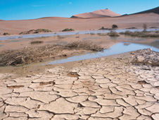
Desertification – when land turns to desert
Ethiopa pics and video

Slide 7
Increased Temperature leads to…
7. More extreme weather conditions
Increased temperatures means sea temperatures are higher. Hurricanes form over seas where the temperatures are 26.5ºC or higher. Hurricanes increase death and destruction, particularly in poorer areas such as the Philippines.

Slide 8
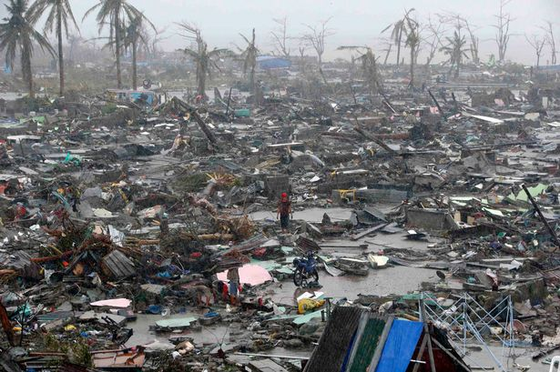
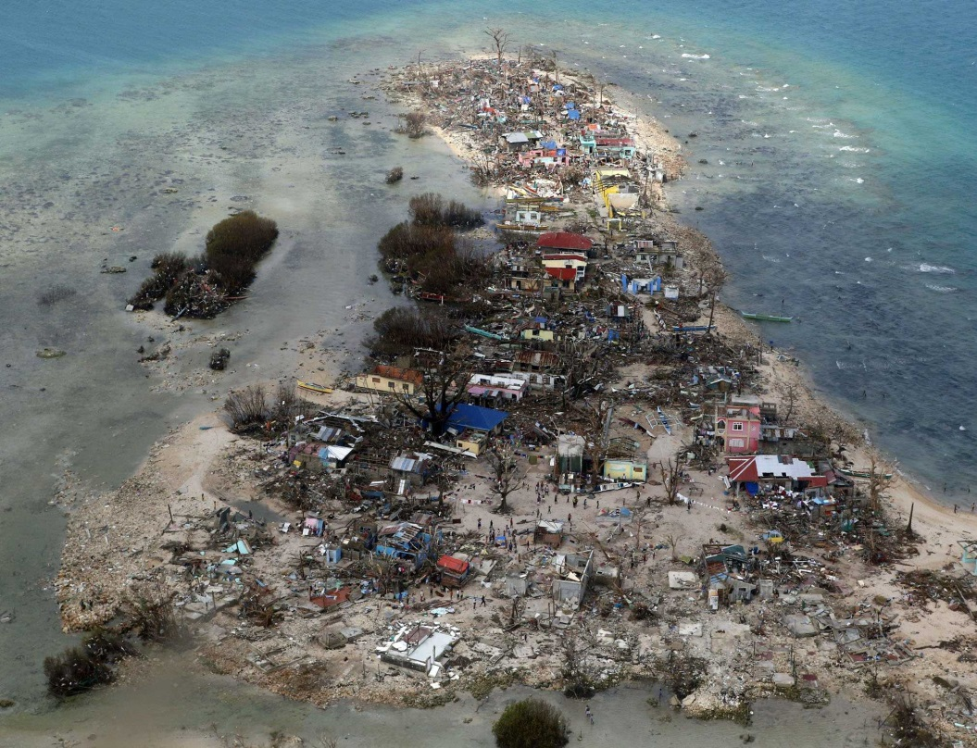
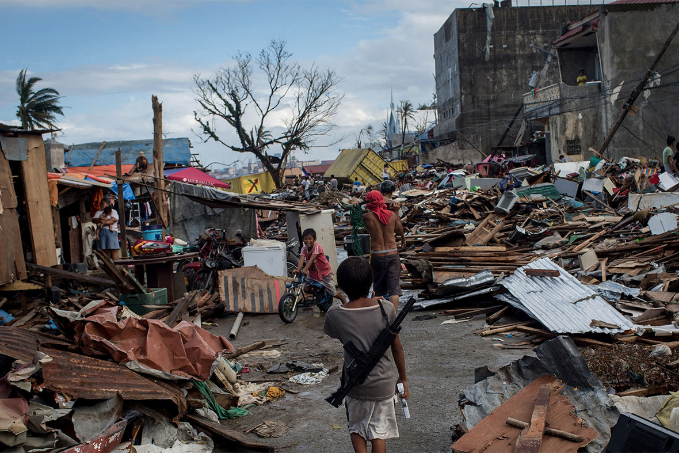

Slide 9
Increased Temperature leads to…
8. Health issues
Increased temperatures in countries such as France and Spain have lead to heat stroke and dehydration. In 2003 more than 20,000 people died across Europe due to a heatwave.

Slide 10
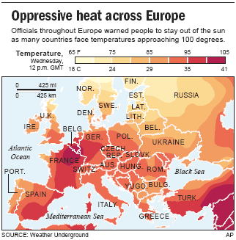
Europe heat map

Slide 11
Exam Question
Discuss the possible effects of climate change. Refer to named examples in your answer.
6 marks
“There are many effects of climate change. Firstly, melting ice caps…”

Slide 12
Effects of Climate Change

Slide 13
Positive Effects
Some effects of climate change are positive.
Can you think of any?
Less sea ice will mean sea transportation will be easier and more efficient for coastal areas such as Alaska.
Increased crop yields – as temperatures increase more crops and different varieties of crops can be grown in more favourable climates e.g. Norway.
Farming will be possible at higher latitudes as temperature increases in areas such as northern Scandinavia in the Arctic circle.
Increased tourism in Canada and Antarctica because it will be warmer. This will bring jobs and increased revenue to economies which can be used to improve the infrastructure and therefore increase the development of a country.

Slide 14
Plenary
Who will be worst affected by climate change:
Those living in developed countries
Those living in developing countries
Give one reason to support your answer

