Slide 1
Starter
Write down 2 ways which YOU will be affected by climate change.

Slide 2
Effects of Climate Change
Learning Intention
We are learning about the global effects of climate change.
Success criteria
I can explain the effects of climate change, referring to specific named examples.

Slide 3
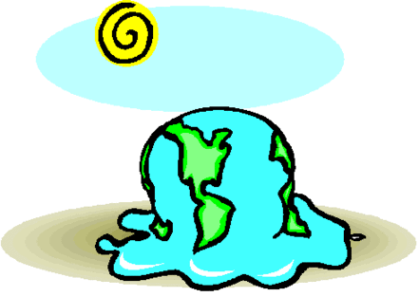
Global Warming leads to…
Increased greenhouse gases traps heat in the atmosphere increasing global temperatures.
The increasing temperatures cause many problems across the globe.

Slide 5
Increased Temperature leads to…
Melting Ice Caps
Every two years, ice the size of Mount Everest drops into the ocean from the continent of Antarctica. The ice sheet of Antarctica is enough to raise sea levels up to 5 metres.
The North American Arctic currently has the lowest levels of winter sea ice ever recorded.

Slide 7
Leading to…
2. Loss of habitat for wildlife
Melting sea ice is making it difficult for polar bears to reach their food sources e.g. seals. Scientists predict that as the Arctic continues to warm, two-thirds of the world's polar bears could disappear within this century

Slide 8
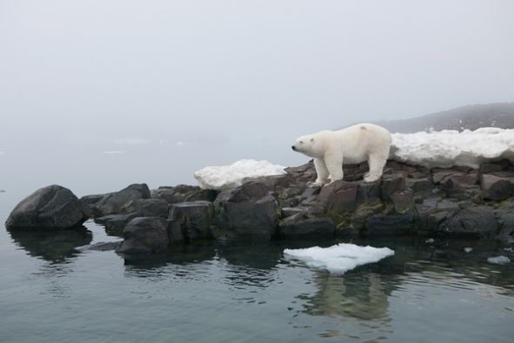
Polar bears
Penguins
VIDEO

Slide 9
Increased Temperature leads to…
3. Rising Sea levels
Due to rising sea levels low-lying areas are at risk of flooding e.g. Bangladesh. In some areas such as the Kiribati Islands people are having to relocate as the islands will be underwater by 2050.
Before & After photographs

Slide 10
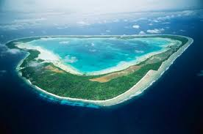
33 small islands in the middle of the Pacific Ocean
Kiribati islands
Maldives
http://www.bbc.co.uk/news/world-asia-35024046

Slide 11
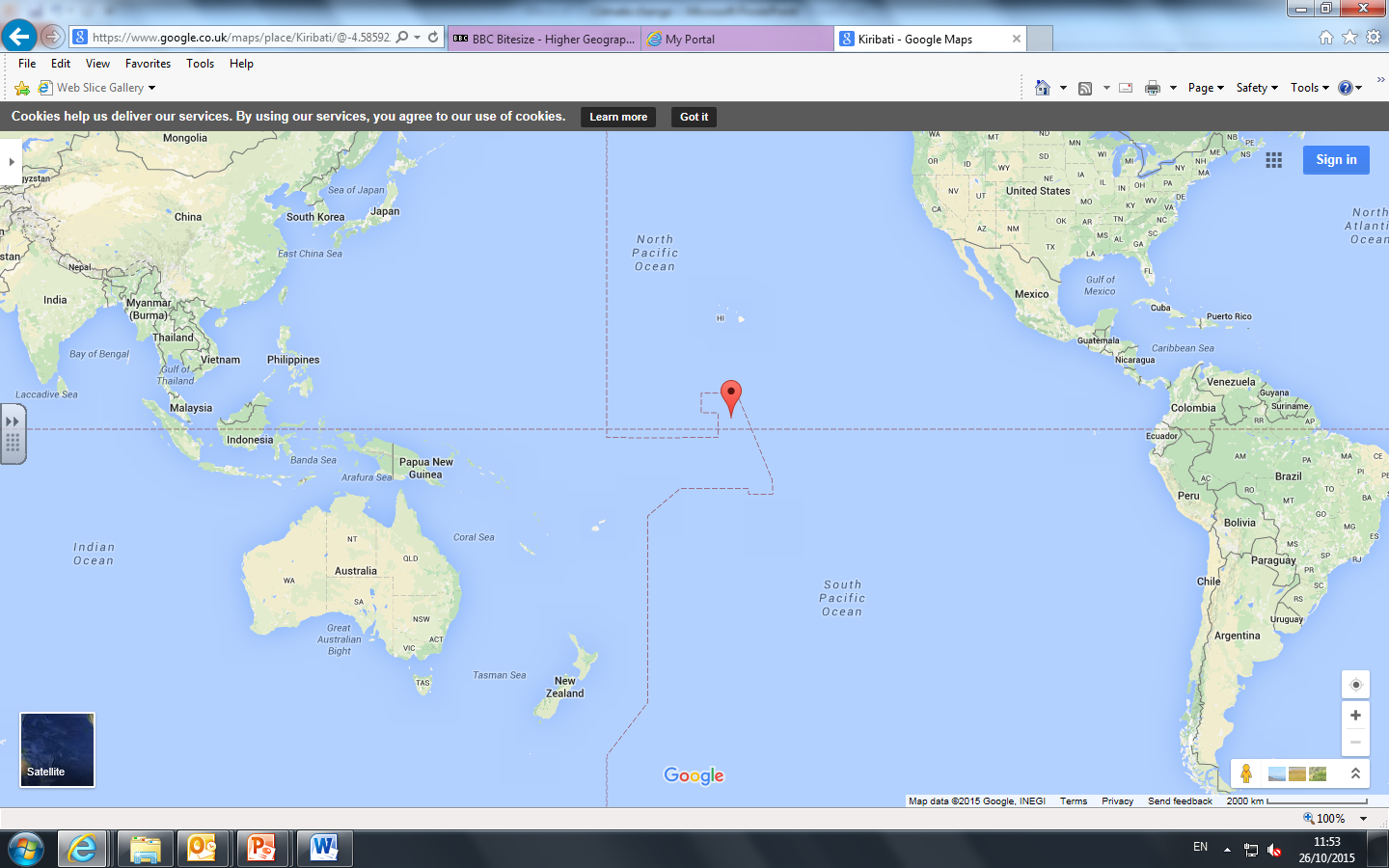

Slide 12
Leading to…
4. Stress of sea defences
Sea defences will be under more stress e.g. Thames Barrier, London. More money will have to be spent protecting coastal areas and there will be more economic damage caused by flooding.
The Thames Barrier cost £500million to build in 1983 (£1.6billion in todays money)
It costs £5,000 each time its closed.
https://www.youtube.com/watch?v=x7mt2gJx5b0 Above: danger of a storm surge

Slide 13
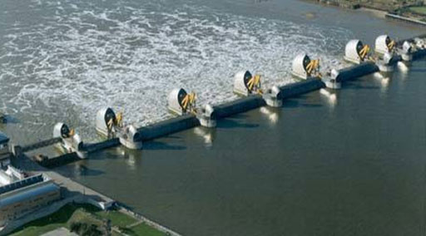
Thames barrier picture

Slide 15
Buckingham Palace
London Bridge
London Eye
Canary Wharf
The O2
Boleyen Ground

